Slide 1
Discussion of Bounded Rationality, Reinforcement Learning, and Market Efficiency

Slide 2
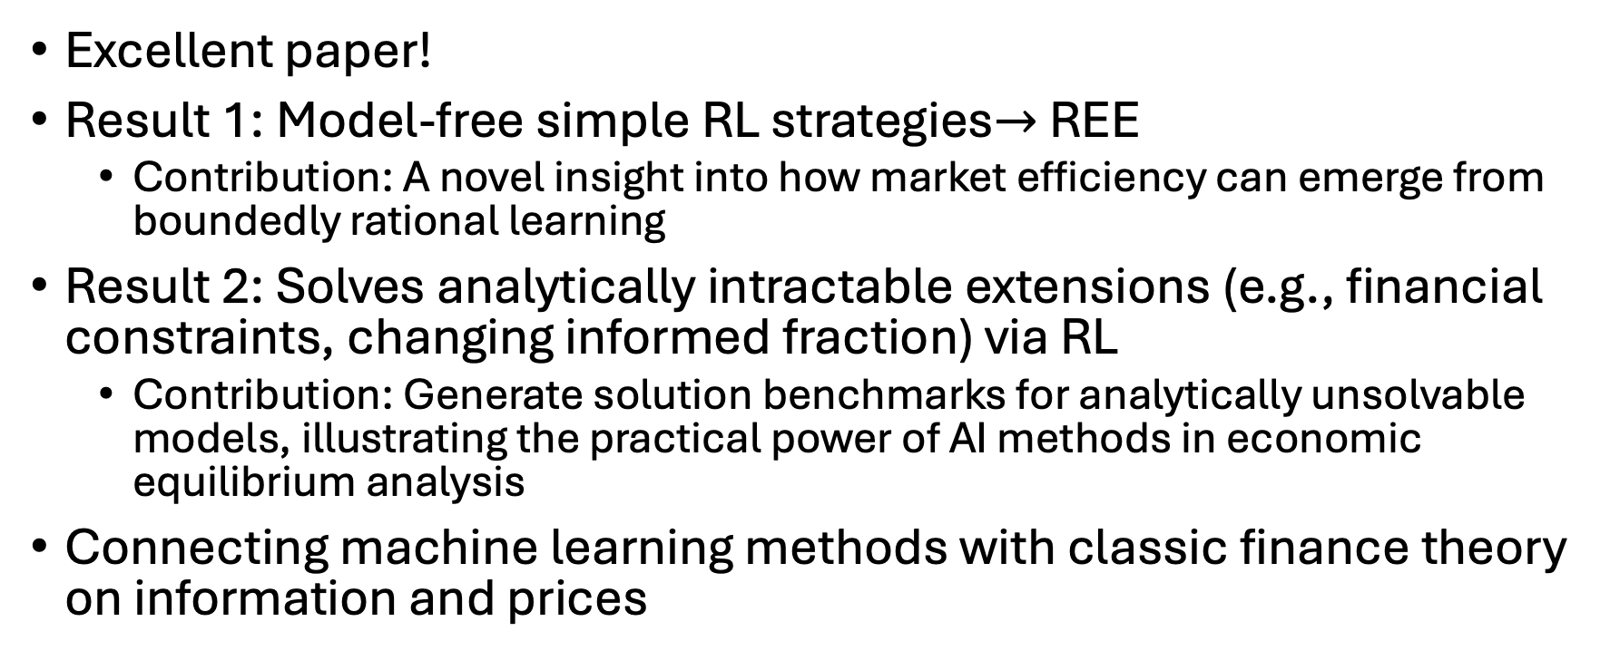
Overview
Excellent paper!
Result 1: Model-free simple RL strategies$→$ REE
Contribution: A novel insight into how market efficiency can emerge from boundedly rational learning
Result 2: Solves analytically intractable extensions (e.g., financial constraints, changing informed fraction) via RL
Contribution: Generate solution benchmarks for analytically unsolvable models, illustrating the practical power of AI methods in economic equilibrium analysis
Connecting machine learning methods with classic finance theory on information and prices

Slide 3
Are uninformed investors genuinely behaving like RL algorithms?
Add explicit justification for RL as a model of bounded rationality?
RL-like adaptive behavior supported by recent behavioral research (Barberis & Jin, 2023)
Empirical evidence from field studies confirming RL patterns in investor decisions (Sun, 2023)

Slide 4
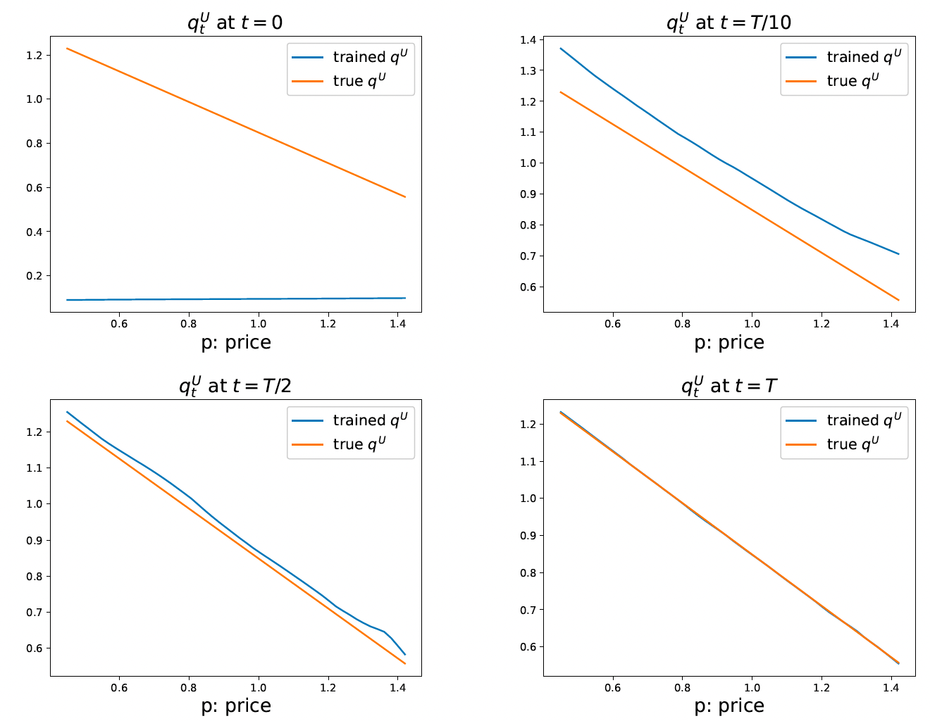
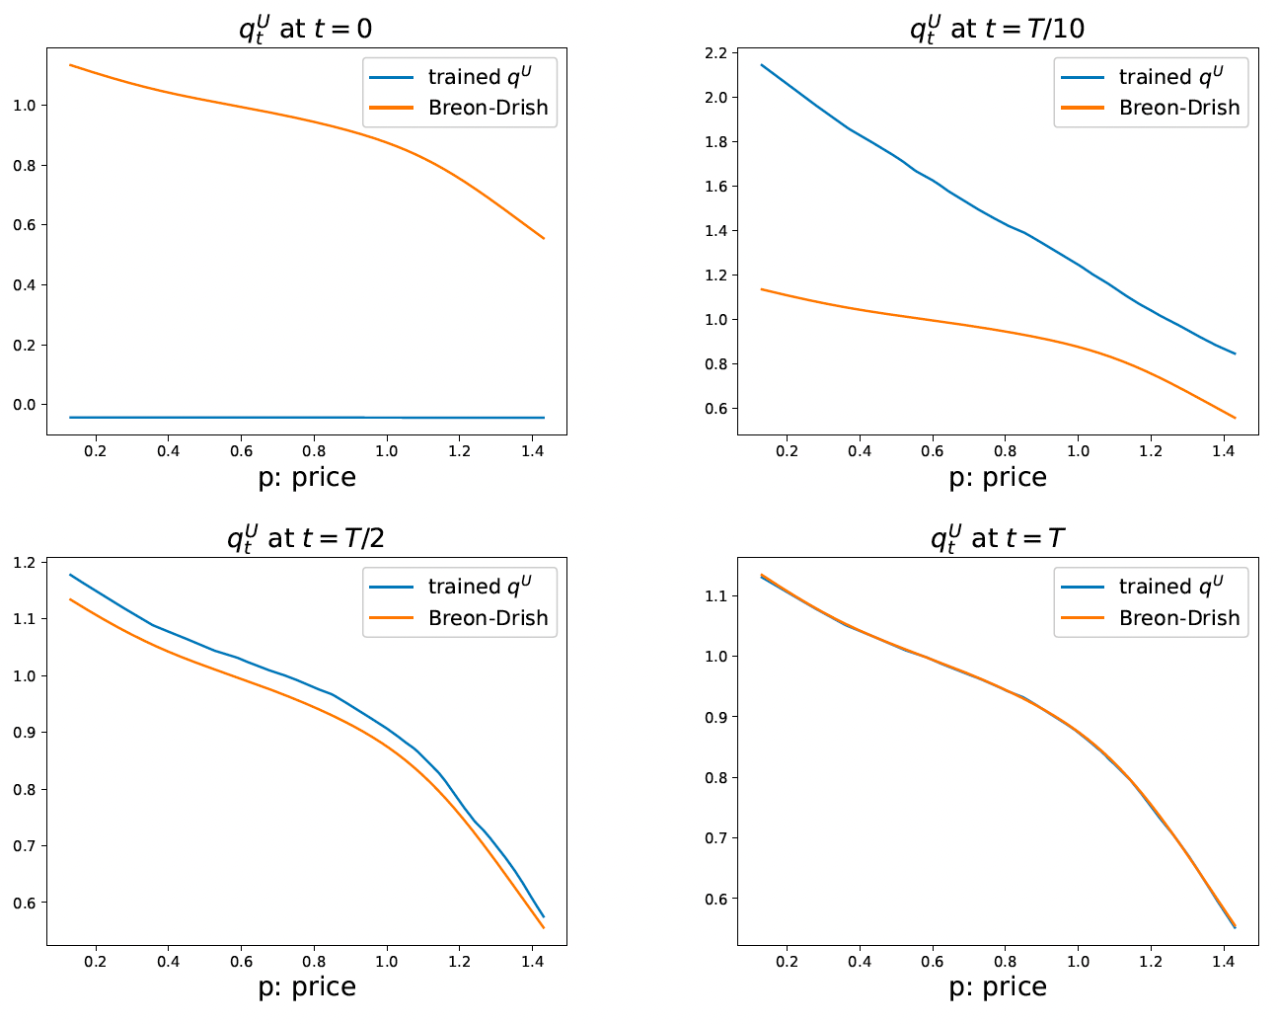
Interesting Learning Pattern

Slide 5
Interesting Learning Pattern
Learned RL demand consistently overshoots theoretical demand despite zero initialization
Are these biases potentially model-specific or more general?
Vary NN architectures, and hyper parameters
Use alternative RL methods (e.g., Q-learning or actor-critic) to examine if similar overshooting patterns emerge
Could laboratory experiments or field data confirm similar patterns in real investor behavior?

Slide 6
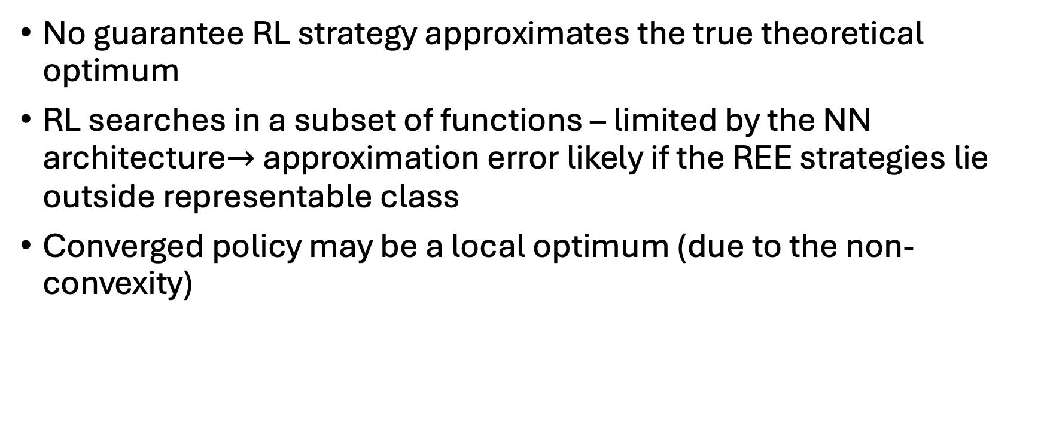
RL vs. intractable REE (if it exists)
No guarantee RL strategy approximates the true theoretical optimum
RL searches in a subset of functions – limited by the NN architecture$→$ approximation error likely if the REE strategies lie outside representable class
Converged policy may be a local optimum (due to the non-convexity)

Slide 7
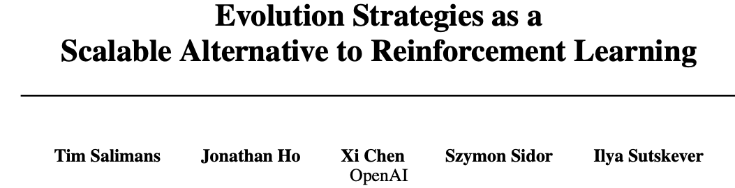
RL vs. intractable REE (if it exists)
Robustness check 1: Vary NN architecture and RL method (e.g., actor-critic)
Robustness check 2:
Consider establishing theoretical bounds on the difference between RL-derived solutions and REE, if the REE exists

Slide 8
Conclusion
Excellent paper!
Remarkably clear, well-executed
RL offers a powerful and flexible approach to studying bounded rationality in financial markets
The framework opens new directions for analyzing market efficiency in complex environments

Slide 9
References
Barberis, N.C. and Jin, L.J., 2023. Model-free and model-based learning as joint drivers of investor behavior (No. w31081). National Bureau of Economic Research.
Salimans, T., Ho, J., Chen, X., Sidor, S. and Sutskever, I., 2017. Evolution strategies as a scalable alternative to reinforcement learning. arXiv preprint arXiv:1703.03864.
Sun, C., 2023. Personal experience effects across markets: Evidence from NFT and cryptocurrency investing. Available at SSRN 4589481.

