Slide 1
Order Delivery [Delivery Module ] through Mobile Apps.
User Requirement Specification (URS)

Slide 2
Use Case Description
Use Case Name: TBL- Mobile Delivery Management Date:05-10-2015
Version: 2.0
Primary Actor (s) : PSR Secondary Actor (s) : DBH Operator
PSR will Delivery confirm Previous days outlet wise order. they can confirm Delivery Last 3 days Order.
PSR can order Confirm outlet wise or all at a time.
Firstly, PSR will enter in Delivery Module , After entering in Delivery Module they will get Date of order, route and sub route .
Secondly, PSR select order Date, route, Sub route and click search button . After search button its show all previous order.
PSR can Confirm all order at time on click all checkbox and click Delivery.
PSR can Confirm order one by one.
For Confirm order one by one ,PSR will click on outlet code, it will go to order summary.
PSR can change order by click edit and click new Qty, and click change. Afterward click change PSR will click Refresh. To show changes Qty.
PSR can ADD new SKU by clicking “ADD” button and add order by select brand and SKU. PSR will input case & PCs as SKU quantities and then, system will automatically the total value. Afterward, PSR will add these quantity, and click Refresh
Finally, PSR will view final order summary and click Delivery to confirm.

Slide 3
Start
Delivery Module Workflow
Log in
Delivery Module
Select Date
Select
Route
Change Order
Save and Send To DBH
End

Slide 4
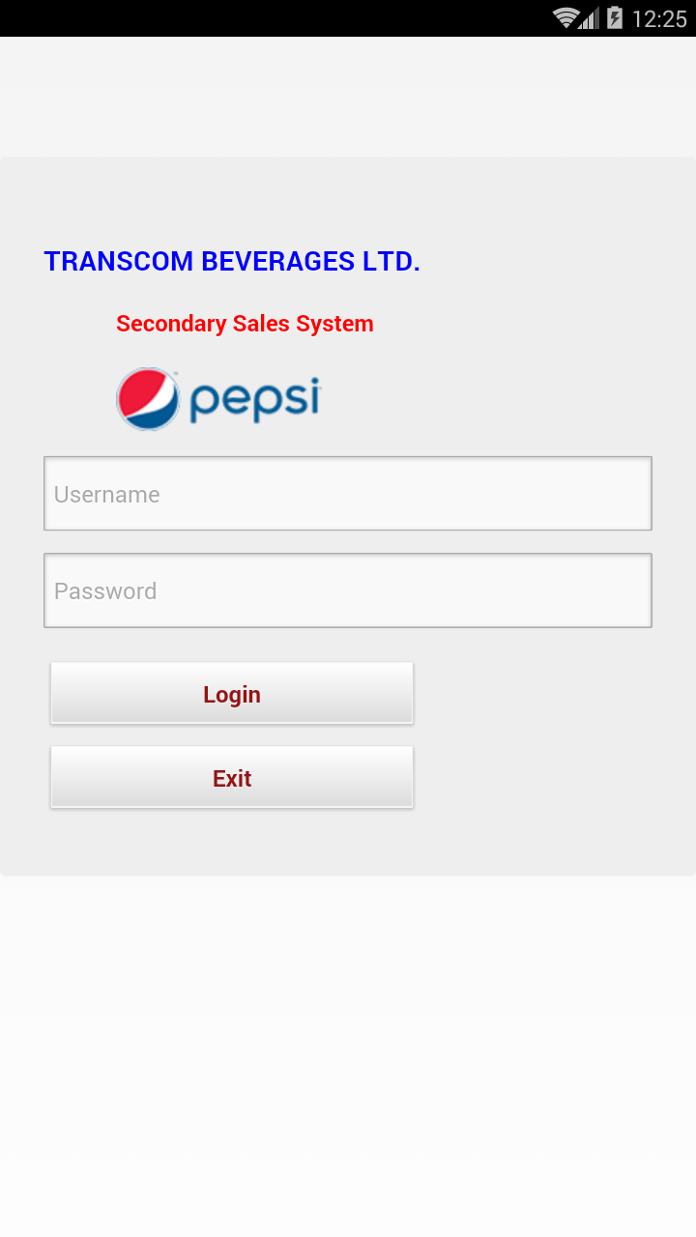
Login User Interface
To login into the system Internet connection must be there.
User need to give their individual User Name & Password to login into the APK system.

Slide 5
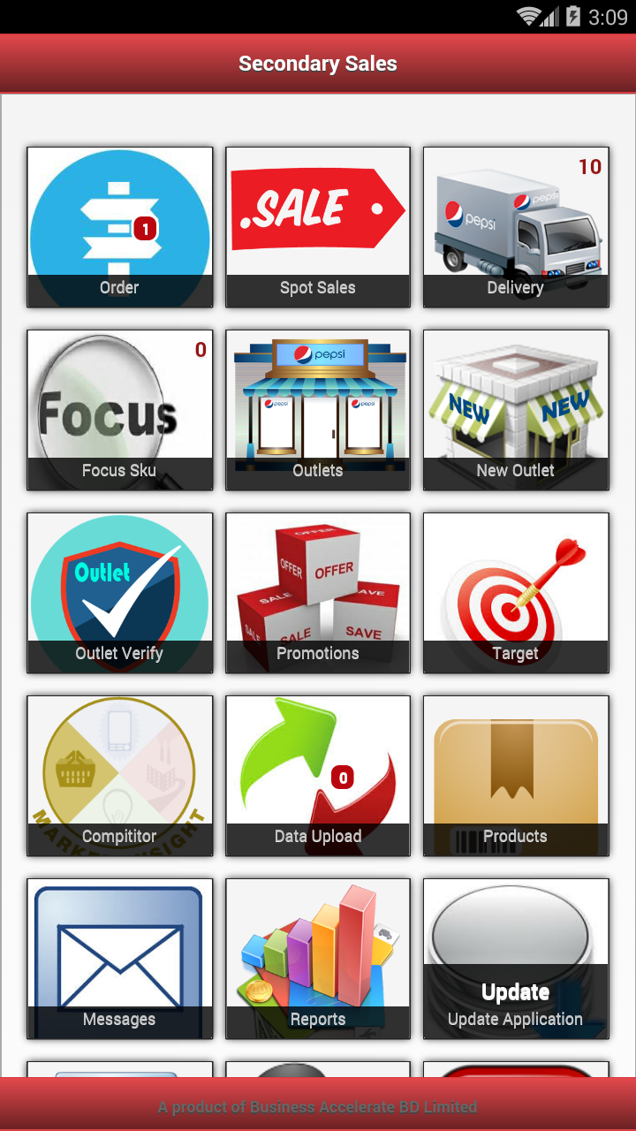
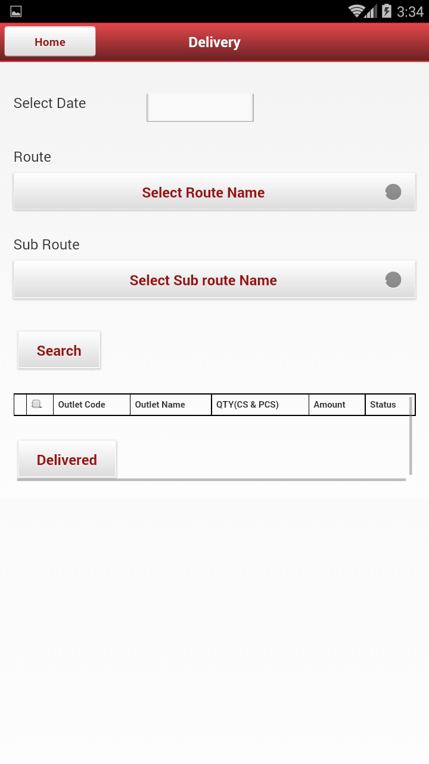
User View after Login
User need to click the “Delivery option” to know about the pre-defined route – Figure 1
After clicking the “Delivery” user can see the Date, Route, Subroute list – Figure 2
Figure 1
Figure 2

Slide 6
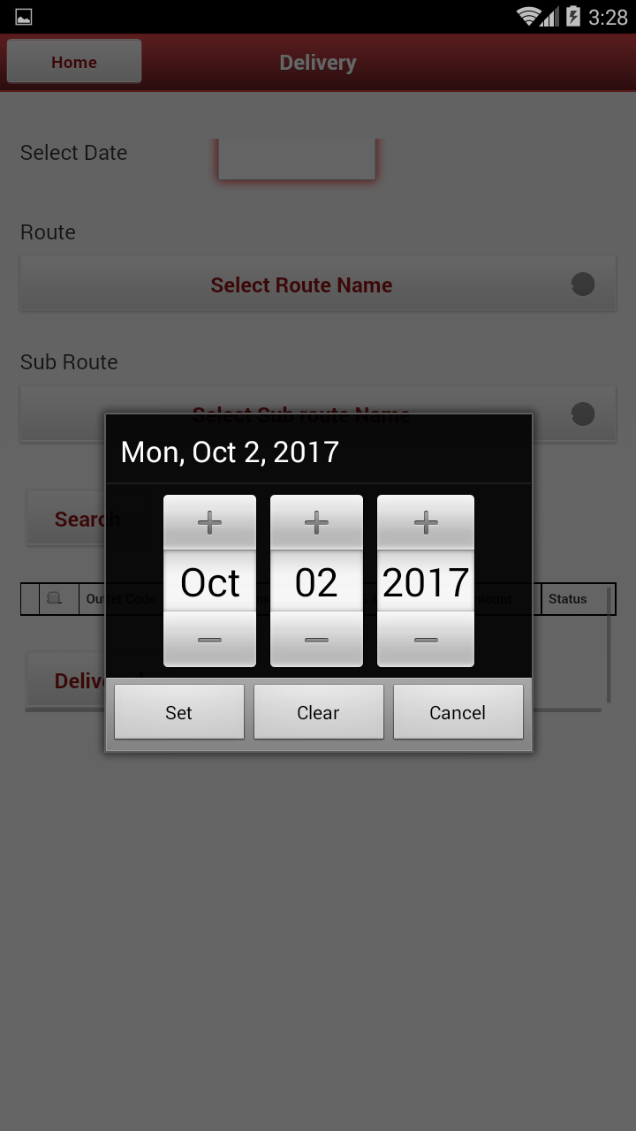
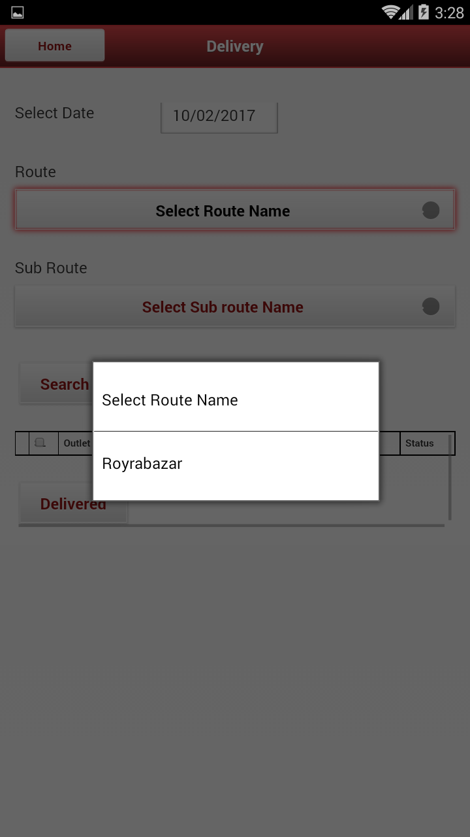
Sub route Selection & Order Creation
Selecting the Data ,route name ,sub route and click search user will see List of order

Slide 7
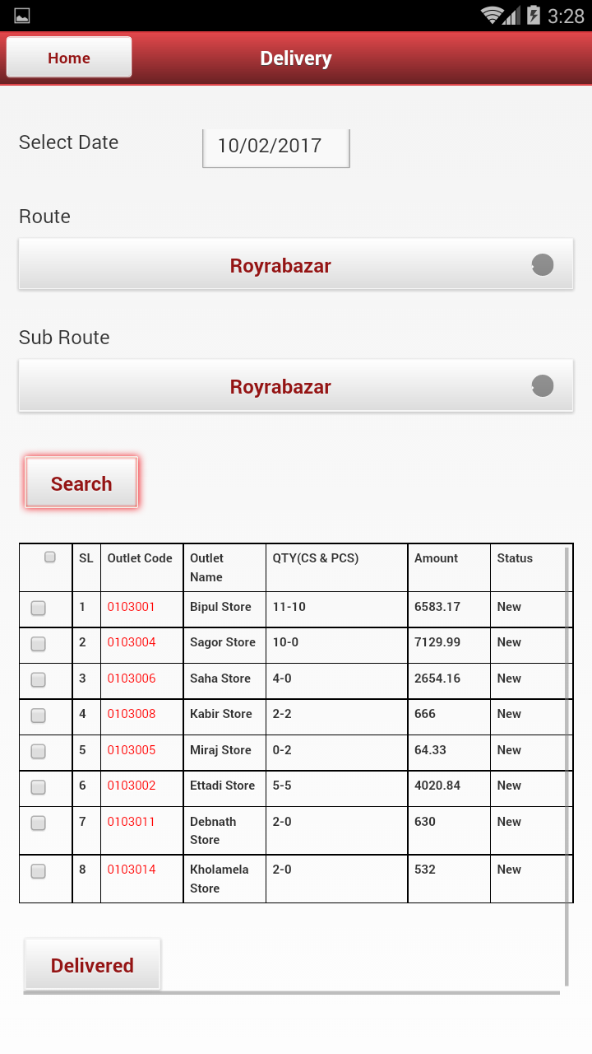
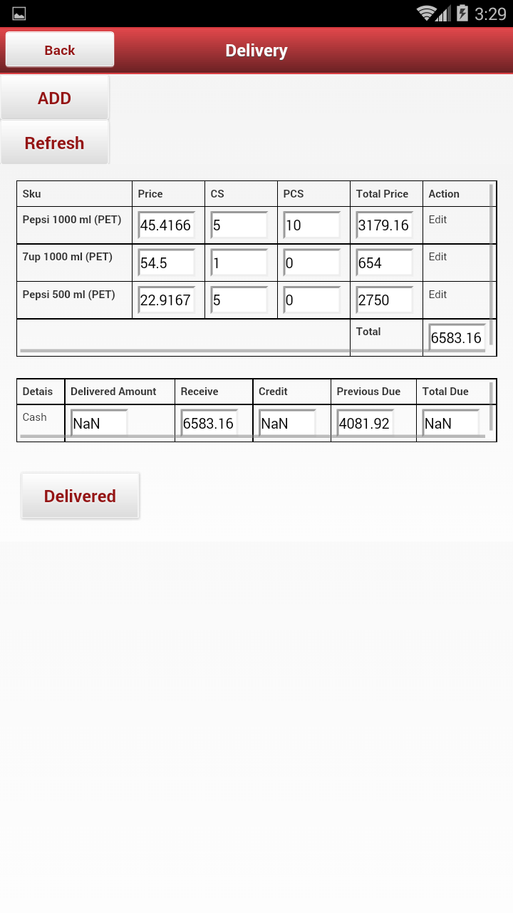
Single Order Confirmation
clicking the outlet code , PSR will see Order summary.

Slide 8
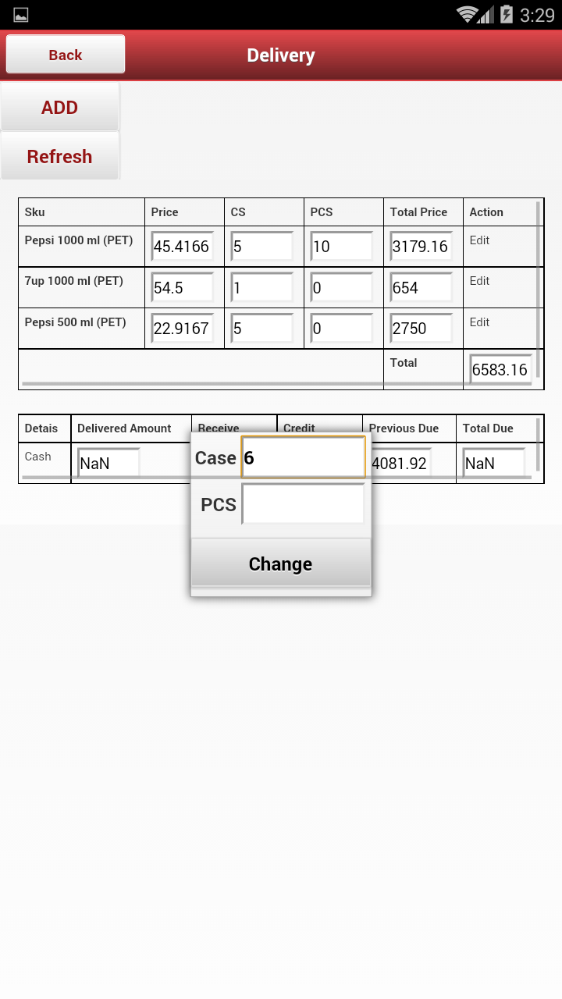
Edit Order
To make an order change PSR need to click on the Edit .
After click A POPUP show current Order Qty on CS and PCS. Edit Order QTY and click change button.
After Click Change Button PSR need to click Refresh Button to show Changes Qty.

Slide 9

Add New SKU
On ADD button PSR will Add new SKU to Delivery

Slide 10
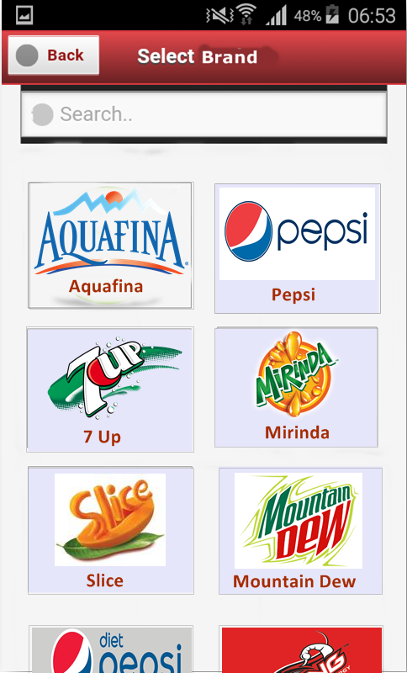
Select Brand
To make an order PSR need to click on the Brand that is ordered by Outlet.
After clicking on the Brand, PSR will see the product list.

Slide 11
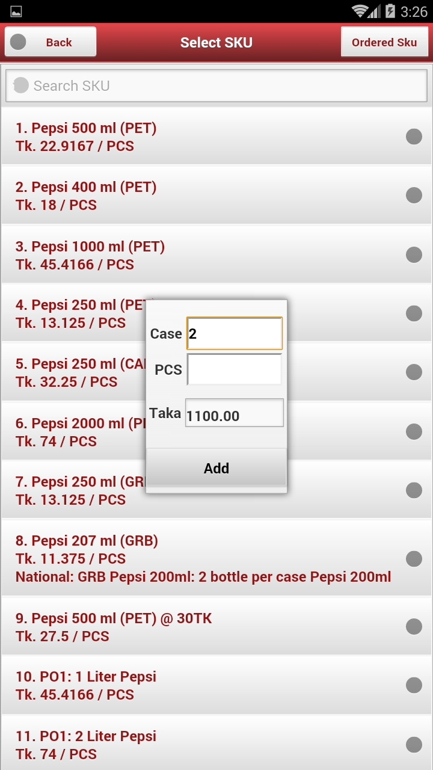
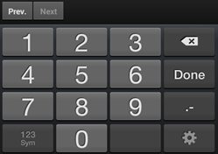
Selection of Product & Qty.
When the PSR will press the Add option the list of SKU’s will be shown. The PSR can also search any SKU from the search option.
The promotion offer will be shown under the individual product in color.
While PSR will select any individual SKU, the Add option will be viewed & in the add option, S/he will only input quantity as Case & Piece wise. After providing quantity input, total value will automatically calculate and show.

Slide 12
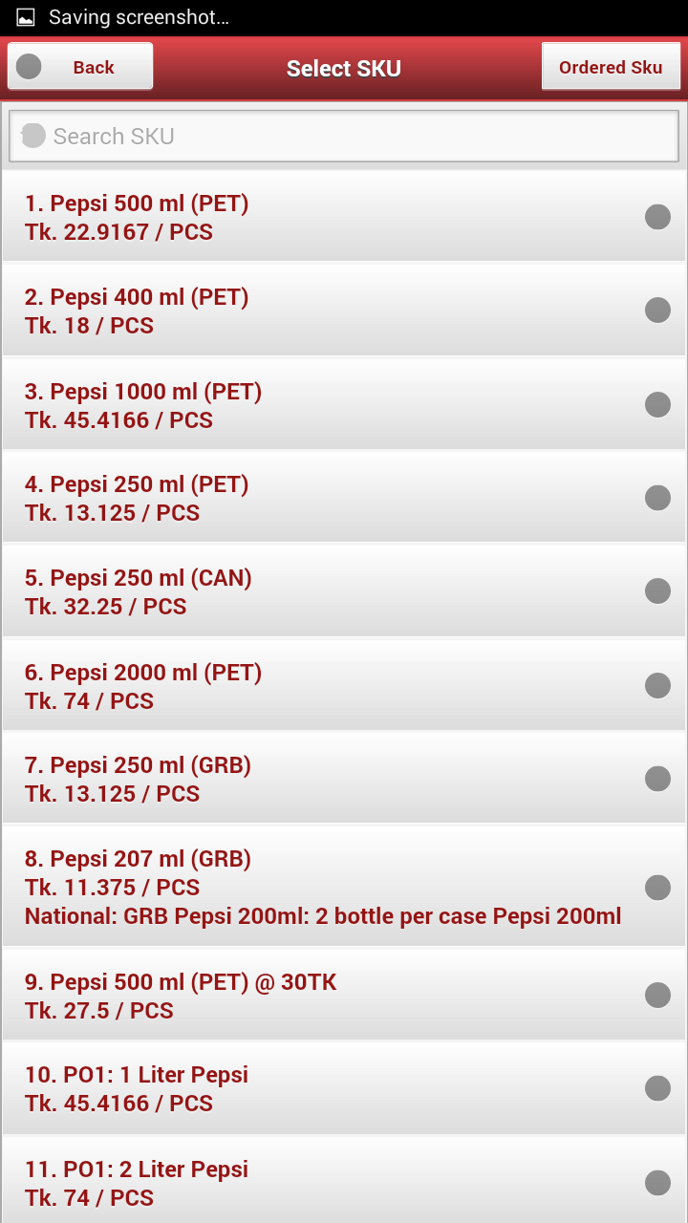
View after Order Confirmation
The selected product will turn into a Specific color.
PSR can select multiple product by clicking on Brand.
To see the ordered product details, PSR need to press the “Back” Button

Slide 13
Order Summary
This is the Summary Interface.
The SKU name, Sku Qty , Total Ordered amount shown in this Interface .

Slide 14
Order Save
After click “Delivery” an alert box show to confirm a Delivery.
If click “Yes” it will save ,if click ”No” order will not save.

Slide 15
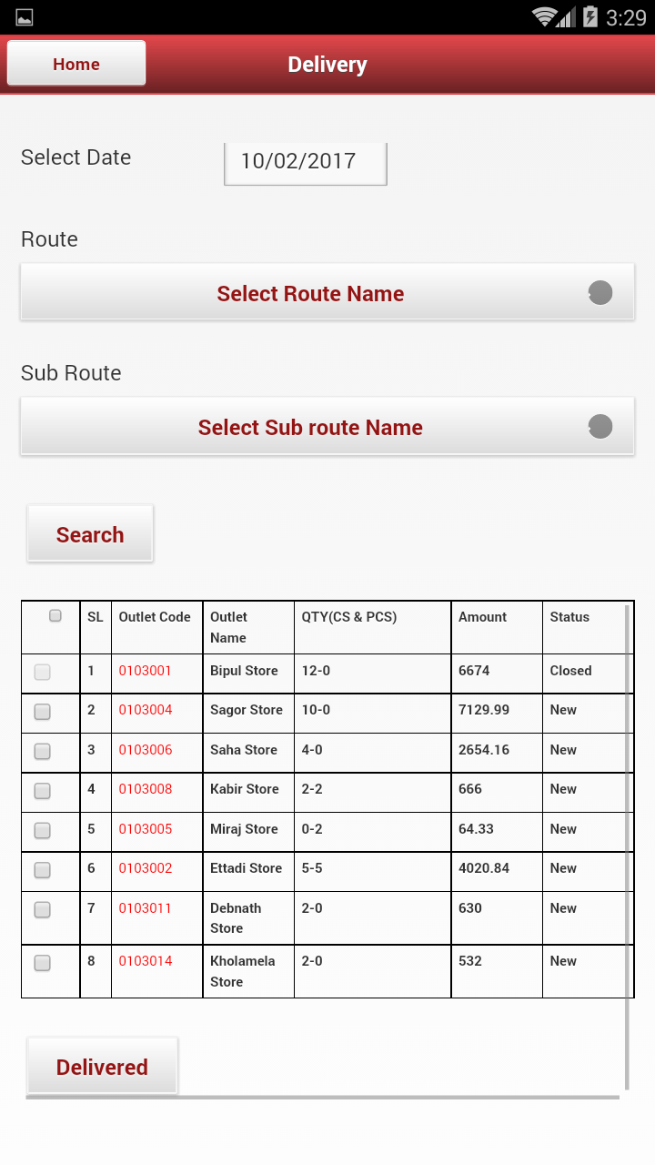
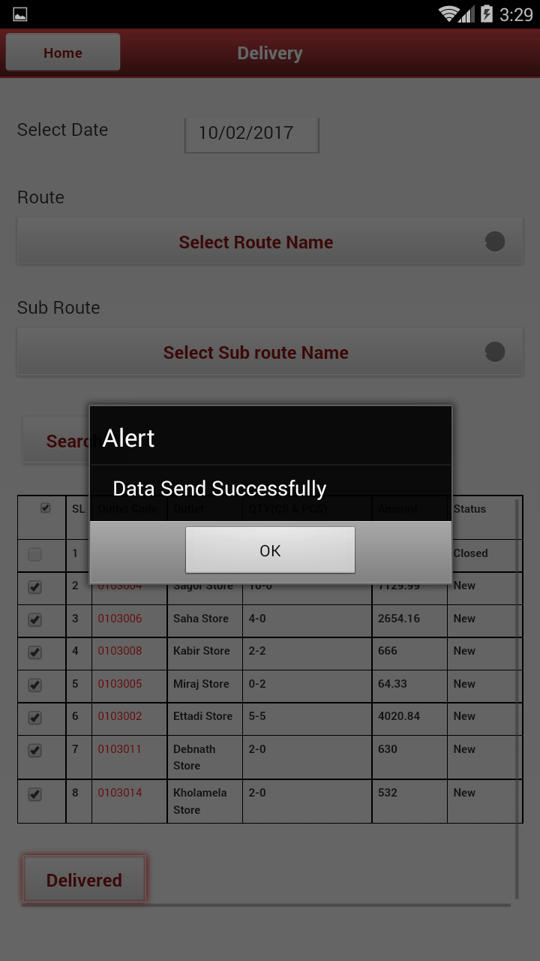
All order confirm
This is the Summary Interface.
On click all chick box , and Click Delivery button order will confirm all order at a time..

Slide 16
End
Thank You

