Slide 1


Goods Receive & Inventory Adjustment
TBL-GRIA | Version 0.2
Mockup User Requirement Specification (URS)

Slide 2

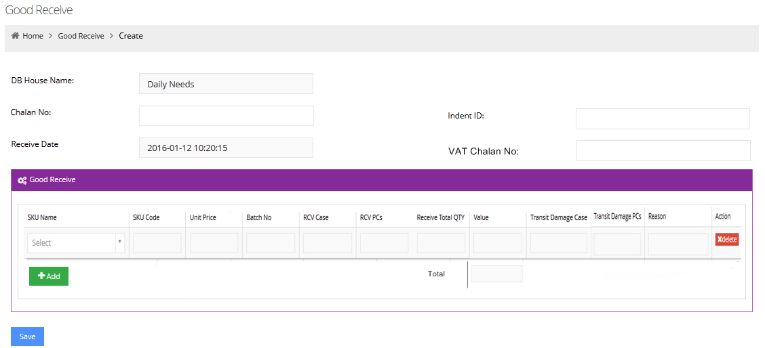

Good Receive Manually
TBL-GRIA | Version 0.2
Actor
DB Operator
Responsible user of DB (e.i. DB Operator) input Chalan No, Indent ID, VAT Chalan No, SKU name, Rcv case & piece, Transit damage qty & damage reason . Thenafter, user will click on save button.

Slide 3
TBL-GRIA | Version 0.2
Good Receive Manually – Field Level Specification
No | Field Name | Specification
1 | DB House Name | Automatically comes, when user create Good Receive manually
2 | Chalan No | Input manually.
3 | Receive Date | System automatically takes receive date & time at the time of creation.
4 | Indent ID | Input manually.
5 | Vat Chalan No | Input manually.
6 | SKU Name | Select from drop down menu.
7 | SKU Code | SKU Code will automatically come when SKU select.
8 | Unit Price | Unit price will automatically come when SKU select. It will be “Invoice/Primary price” for DB.
9 | Batch No. | For the first time, system will automatically create a unique Batch No. It will be same for the next successive times, when unit price will same but when unit price will not same, then system will create additional Batch no. [Ref. 1st Batch No = 00000001, when price change, then Batch No = 00000001 (1)]
10 | Case | Input manually.
11 | PCs | Input manually.
12 | Receive Total Qty | System will automatically calculate total Qty in PCs after providing case & PCs input.
13 | Value | System will automatically calculate total value. (Ref: Value = Receive Total Qty * Unit Price)
14 | Transit Damage Case | Input manually.
15 | Transit Damage PCs | Input manually.
16 | Reason | Manual free text input
17 | Total | System will automatically sum of all SKU value.

Slide 4

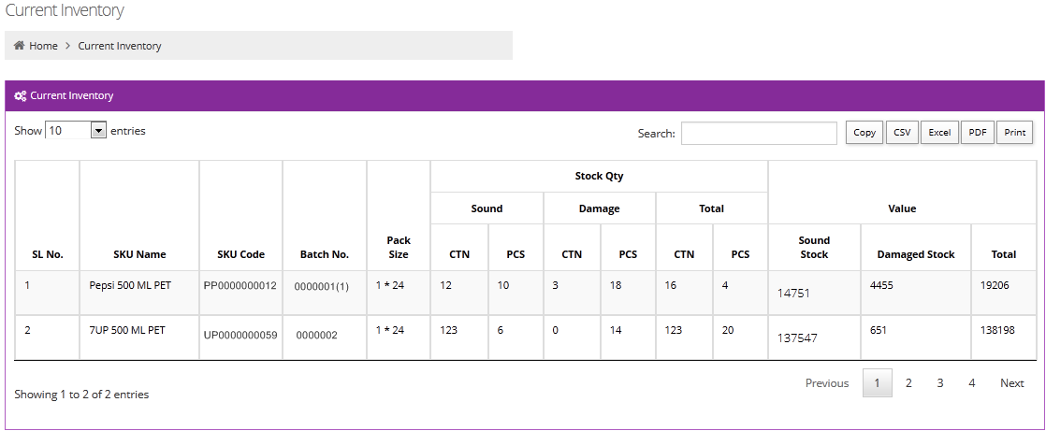
Current Inventory
TBL-GRIA | Version 0.2
Actor
DB Operator
After good receive, physical stock will show in current inventory.

Slide 5
TBL-GRIA | Version 0.2
Current Inventory– Field Level Specification
No | Field Name | Specification
1 | SL No. | System will automatically create
2 | SKU Name | Automatically comes from Good Receive and replace with existing batch (if available, batch is same )
3 | SKU Code | Automatically comes from Good Receive and replace with existing batch (if available, batch is same )
4 | Batch | Automatically comes from Good Receive and replace with existing batch (if available, batch is same )
5 | Pack Size | Automatically comes from SKU/Product info
6 | Sound Qty – Case | Automatically comes from Good Receive and add with existing case (if available, batch is same )
7 | Sound Qty-PCs | Automatically comes from Good Receive and add with existing PCs (if available, batch is same )
8 | Damage Qty-Case | Automatically comes from Good Receive and add with existing case (if available, batch is same )
9 | Damage Qty-PCs | Automatically comes from Good Receive and add with existing PCs (if available, batch is same )
10 | Total Qty (Case) | Automatically comes from Good Receive and add with existing Case (if available, batch is same )
11 | Total Qty (PCs) | Automatically comes from Good Receive and add with existing PCs (if available, batch is same )
12 | Total Value (Sound + Damage + Total) | Automatically comes from Good Receive and add with existing value (if available, batch is same )

Slide 6

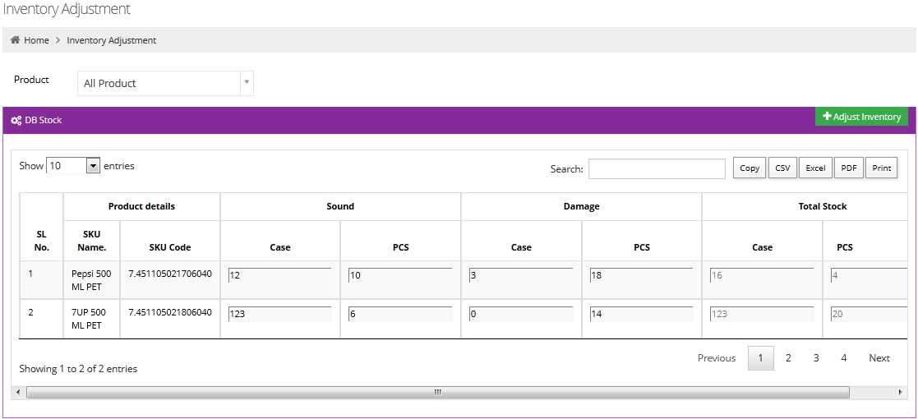
Inventory Adjustment
TBL-GRIA | Version 0.2
Actor
DB Operator
/ CE
Responsible person of DB (e.i. DB Operator/CE ) will
click on adjust inventory for inventory adjustment.

Slide 7

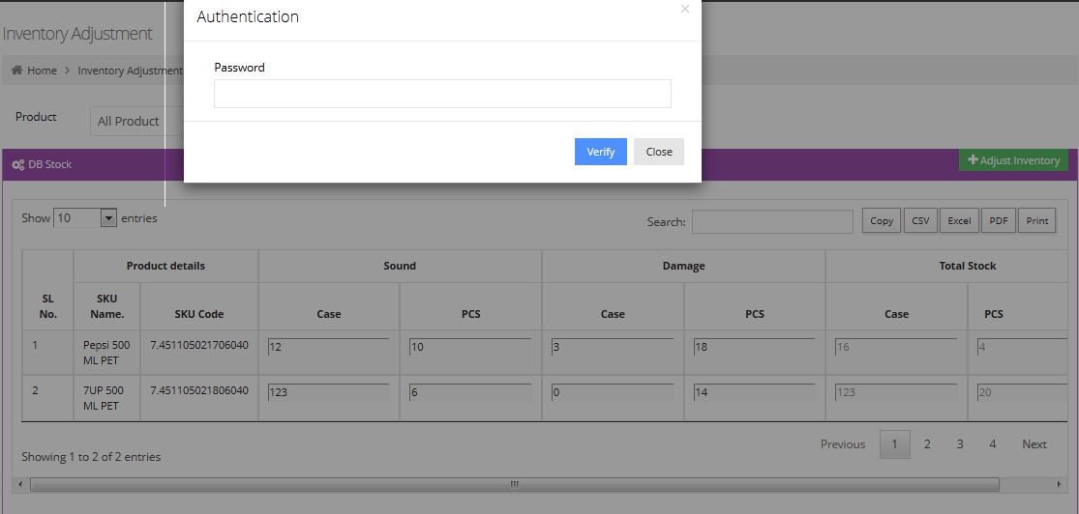
Password Authentication for Inventory Adjustment
TBL-GRIA | Version 0.2
Actor
DB Operator
Responsible person of DB (e.i. DB Operator) will provide authentication password and verify for inventory adjustment.

Slide 8

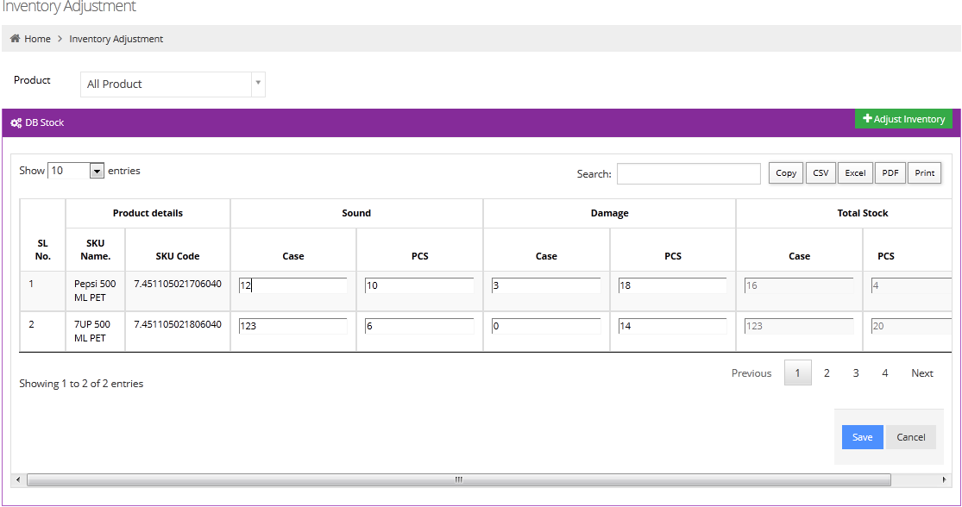
Final Adjustment
TBL-GRIA | Version 0.2
Actor
DB Operator
After verification, sound & damage stock field will be editable. User can increase or decrease quantity which will show in total stock. Finally, user will click on save button.

Slide 9

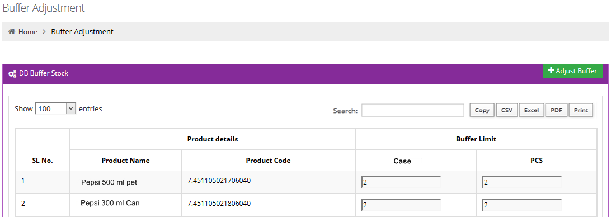
TBL-GRIA | Version 0.2
Buffer Stock
Actor
HO
HO user can set buffer
limit for particular SKU

Slide 10

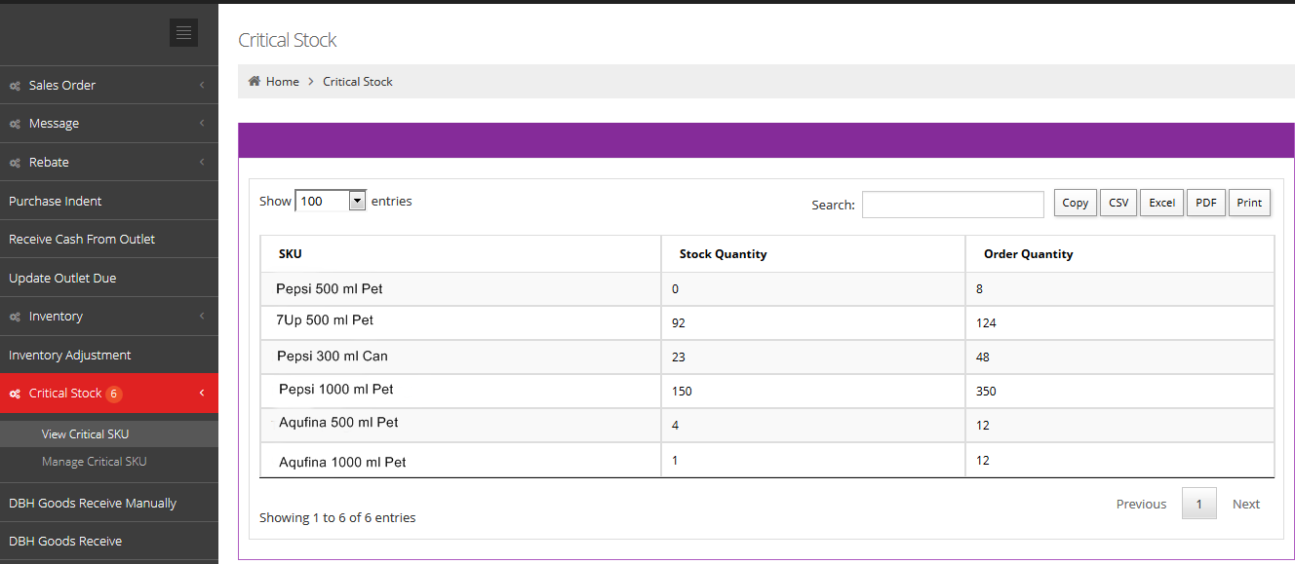
Critical Stock
TBL-GRIA | Version 0.2
Actor
DB
When order
quantity
cross buffer limit then system will show a “Bubble’ Notification.

Slide 11
Thank You
TBL-GRIA | Version 0.2

