Slide 1
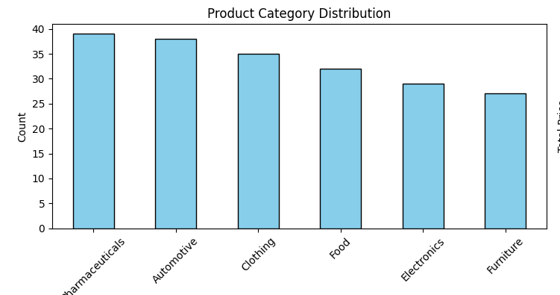
Product Category Distribution

Slide 2
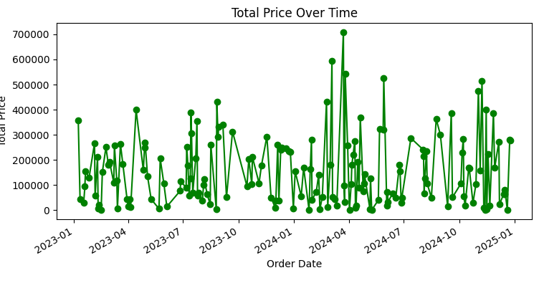
Total Price Over Time

Slide 3
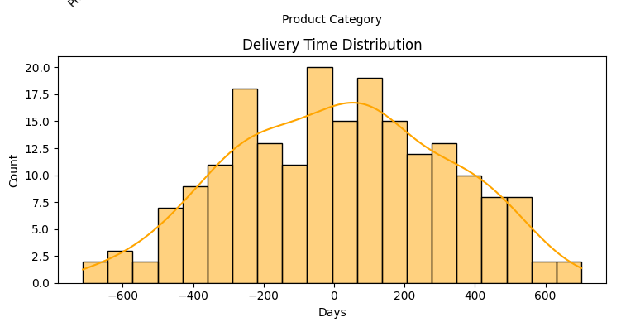
Delivery Time Distribution

Slide 4
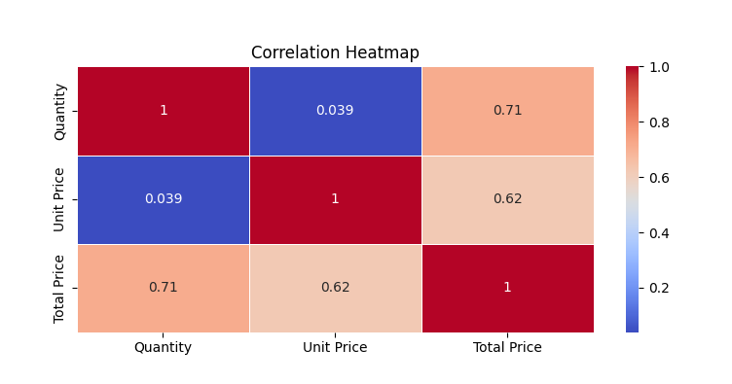
Correlation Heatmap

