Slide 1

Distributed and standalone processing in databend

Slide 2

1
Quickly understand by easy cases
2
Weaknesses in design
3
How to better processing one query #3380
⚠️ The query optimizer is not considered in this.

Slide 3

Quickly understand by easy cases
W W W . D A T A B E N D . COM

Slide 4

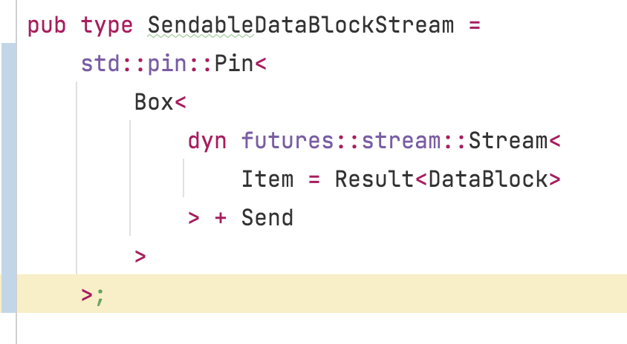
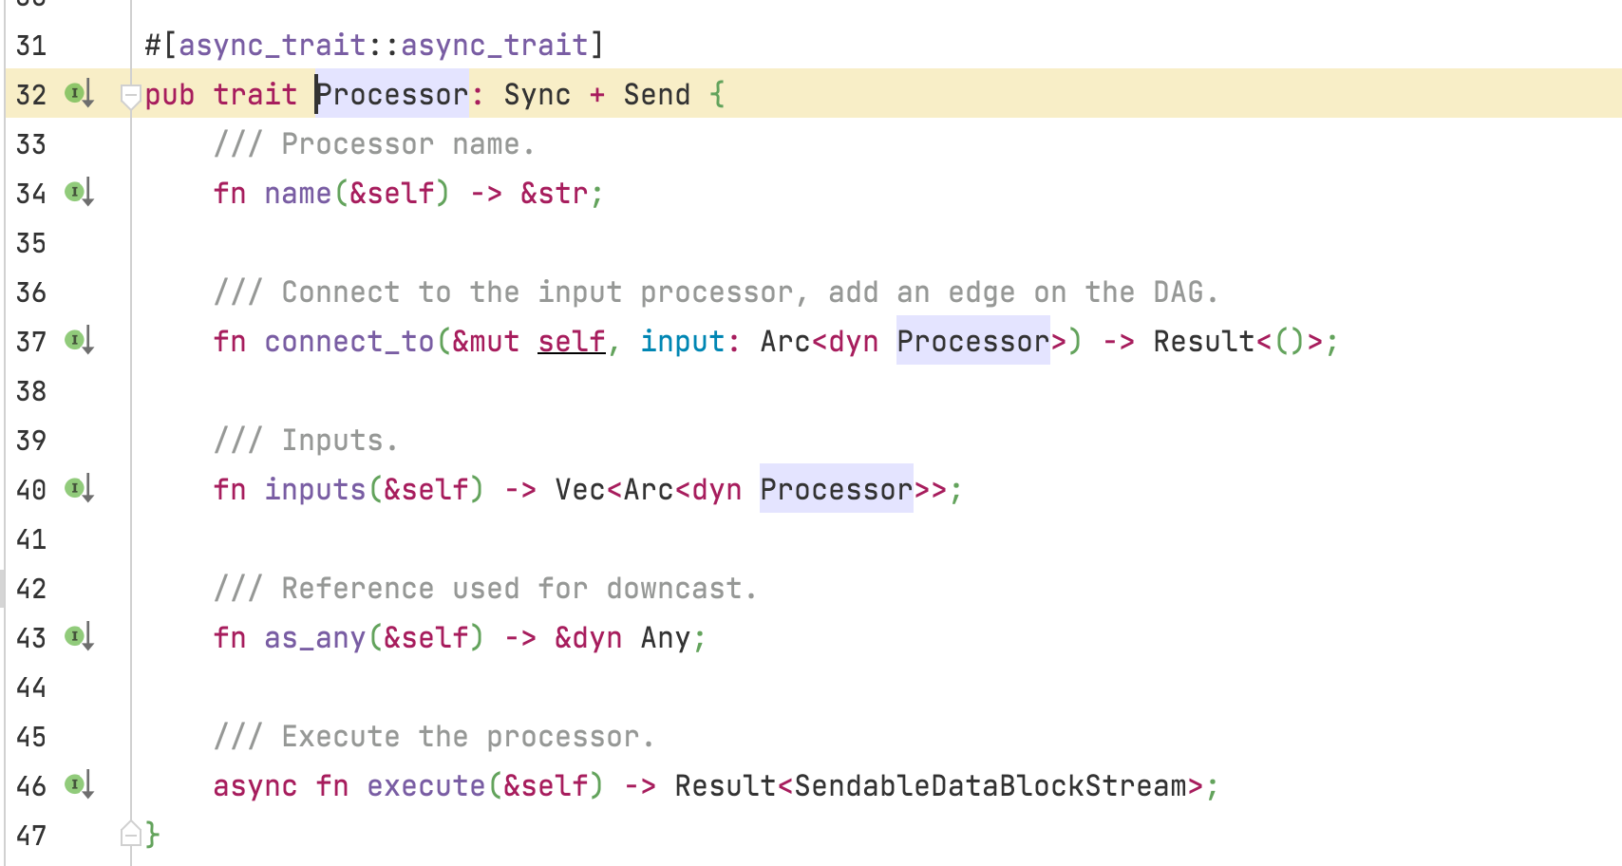
Weaknesses in design
W W W . D A T A B E N D . COM
Talk is cheap. Show me the code

Slide 5

Quickly understand by easy cases
W W W . D A T A B E N D . COM
— Standalone mode
SET max_threads = 1;
SELECT * FROM numbers_mt(1000);
0 - 999

Slide 6

Quickly understand by easy cases
W W W . D A T A B E N D . COM
— Standalone mode
SET max_threads = 2;
SELECT * FROM numbers_mt(1000);
0 - 499
499 - 999

Slide 7

Quickly understand by easy cases
W W W . D A T A B E N D . COM
— Cluster mode(2 nodes)
SET max_threads = 2;
SELECT * FROM numbers_mt(1000);
0 - 249
250 - 499
500 - 749
750 - 999

Slide 8
Weaknesses in design
W W W . D A T A B E N D . COM

Slide 9
Weaknesses in design
W W W . D A T A B E N D . COM
Functional weakness

Slide 10
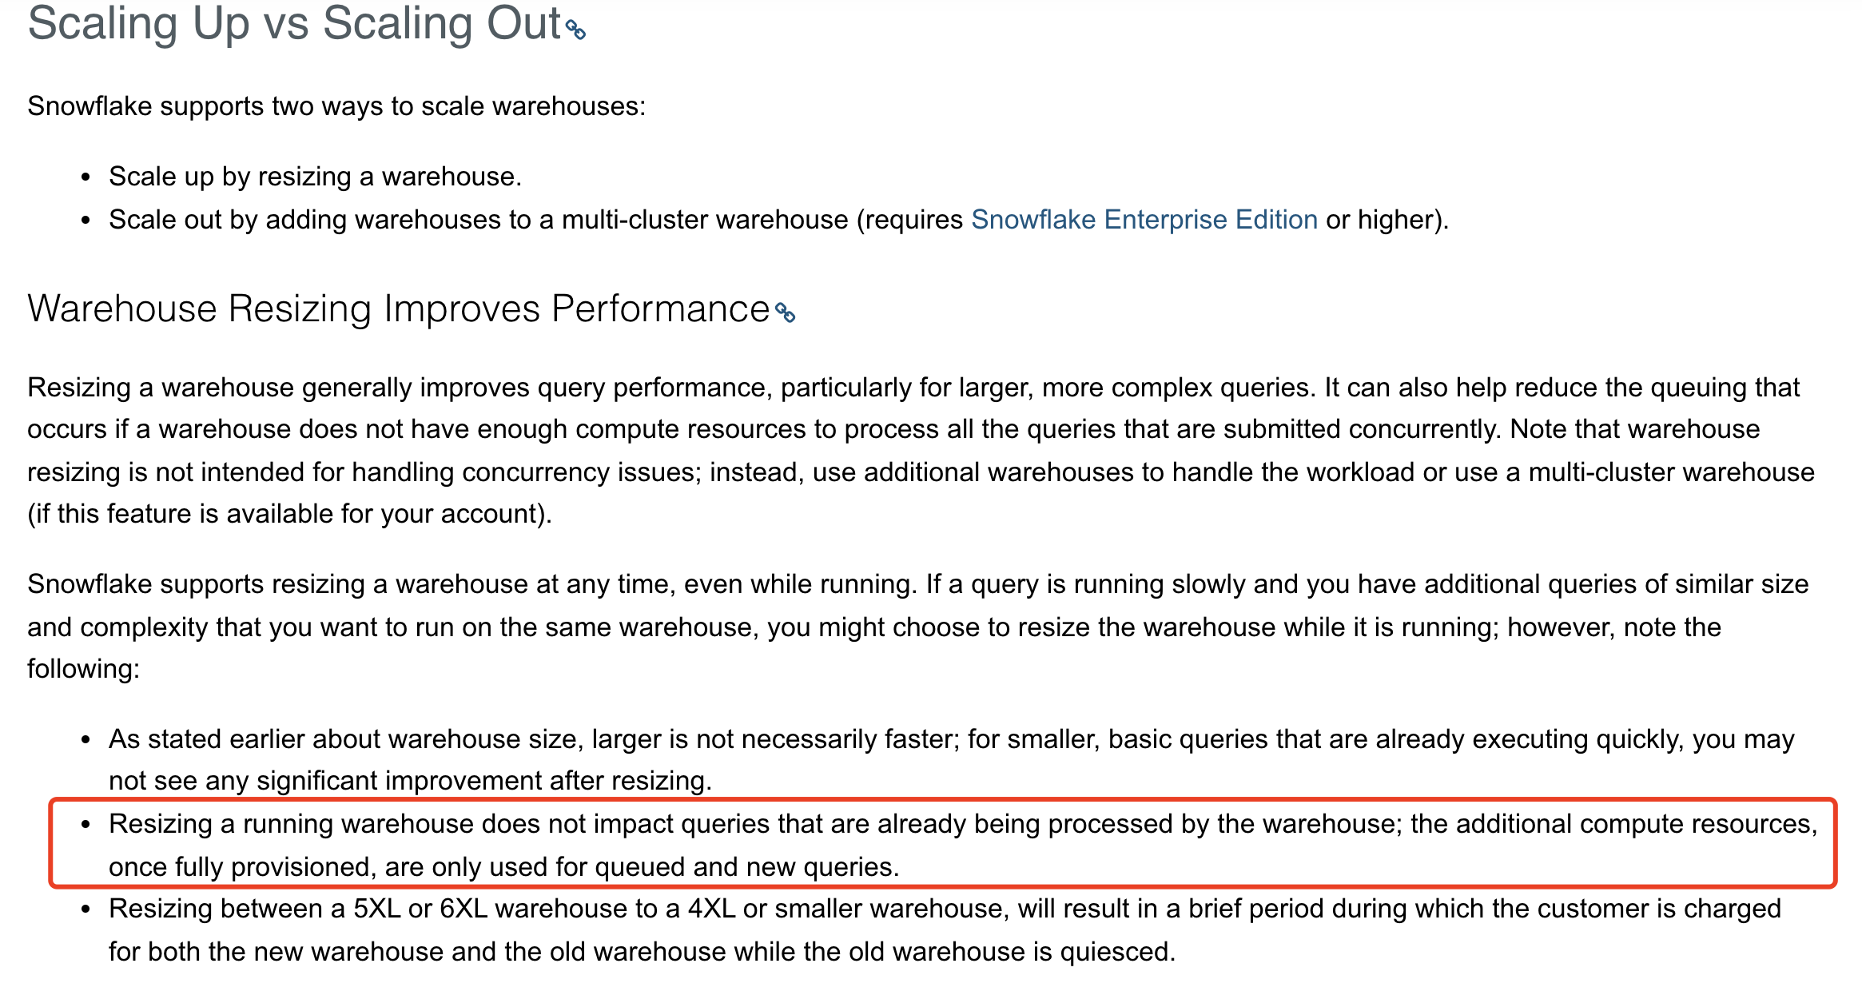
Weaknesses in design
W W W . D A T A B E N D . COM
Scale in/out only to new queries
https://docs.snowflake.com/en/user-guide/warehouses-considerations.html#scaling-up-vs-scaling-out

Slide 11
Weaknesses in design
W W W . D A T A B E N D . COM
Performance weakness

Slide 12
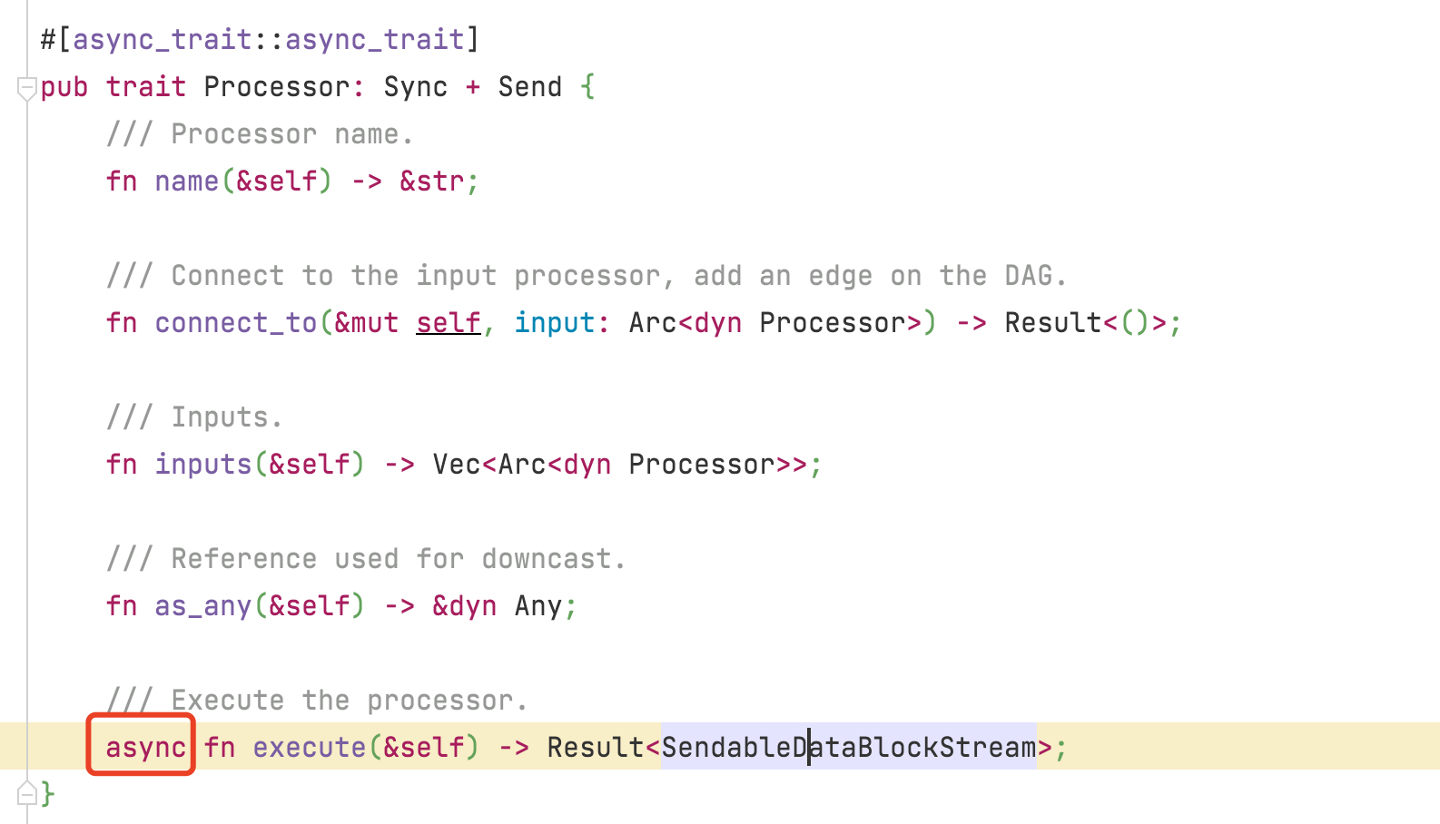
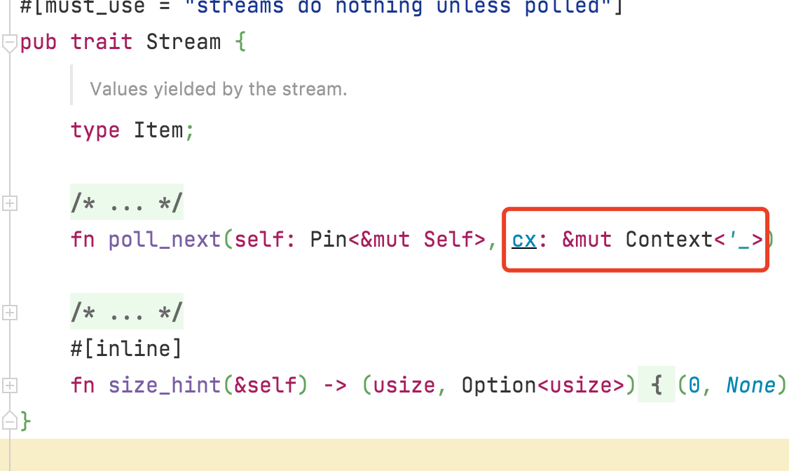
Weaknesses in design
W W W . D A T A B E N D . COM
Sync tasks also bear asynchronous costs
https://github.com/datafuselabs/databend/blob/main/query/src/pipelines/processors/processor.rs

Slide 13
Weaknesses in design
W W W . D A T A B E N D . COM
Asynchronous tasks are not parallel
actual

Slide 14
Weaknesses in design
W W W . D A T A B E N D . COM
Asynchronous tasks are not parallel
expect

Slide 15
Weaknesses in design
W W W . D A T A B E N D . COM
Not steal tasks between threads
actual

Slide 16
Weaknesses in design
W W W . D A T A B E N D . COM
Not steal tasks between threads
expect

Slide 17
Weaknesses in design
W W W . D A T A B E N D . COM
Not steal tasks between threads
actual

Slide 18
Weaknesses in design
W W W . D A T A B E N D . COM
Not steal tasks between threads
expect

Slide 19
How to better processing one query
W W W . D A T A B E N D . COM
https://github.com/datafuselabs/databend/pull/3380

Slide 20
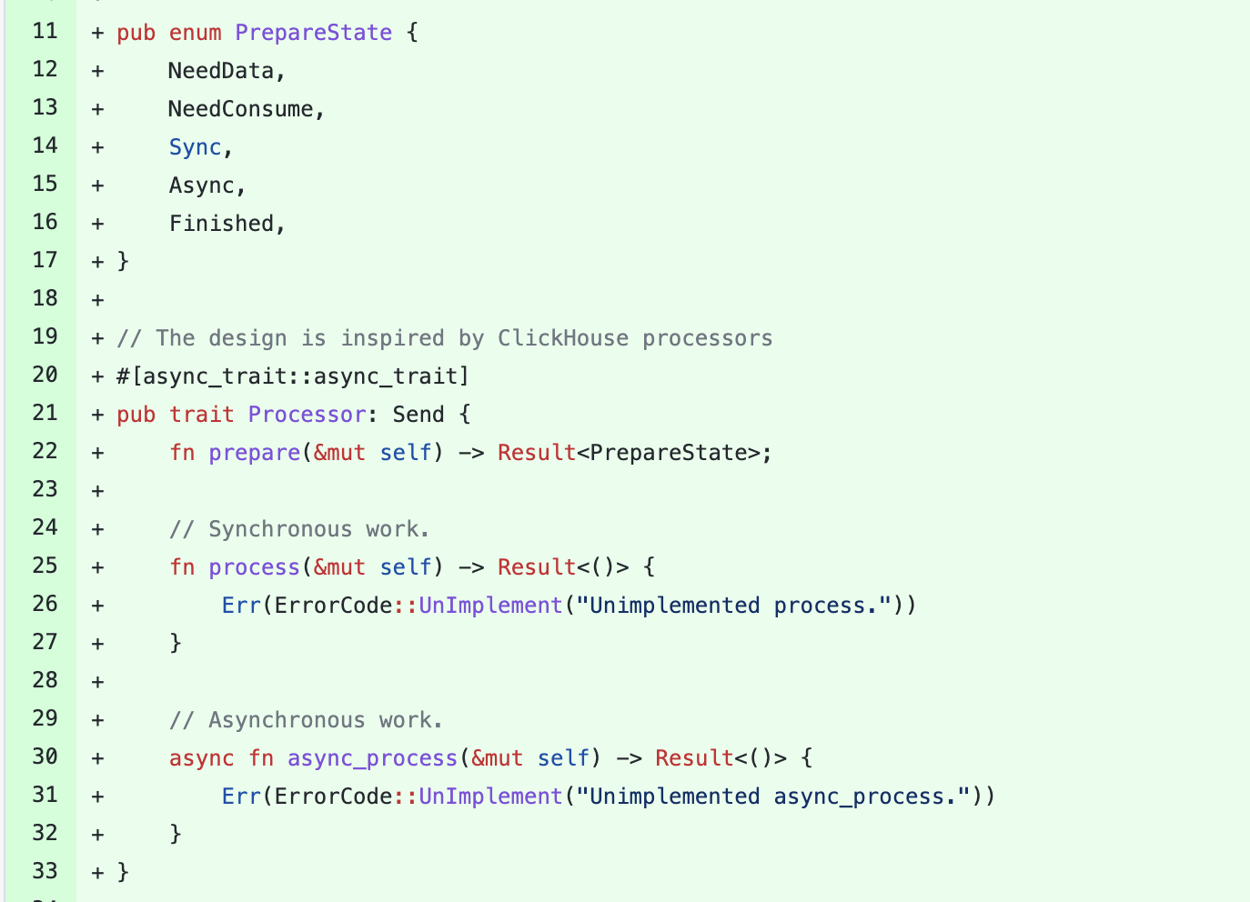
How to better processing one query
W W W . D A T A B E N D . COM
New Processor trait
Each processor is a state machine
Which method is executed by state
Difference methods between sync and async

Slide 21
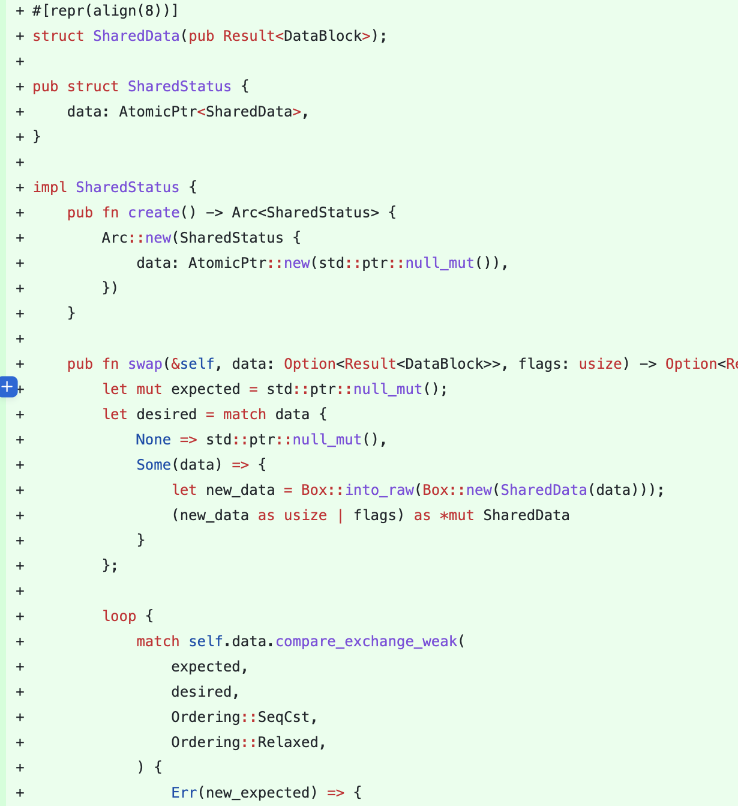
How to better processing one query
W W W . D A T A B E N D . COM
Atomic Port
State and data in CAS
Support pull and push data
Each processor has inputs and outputs

Slide 22
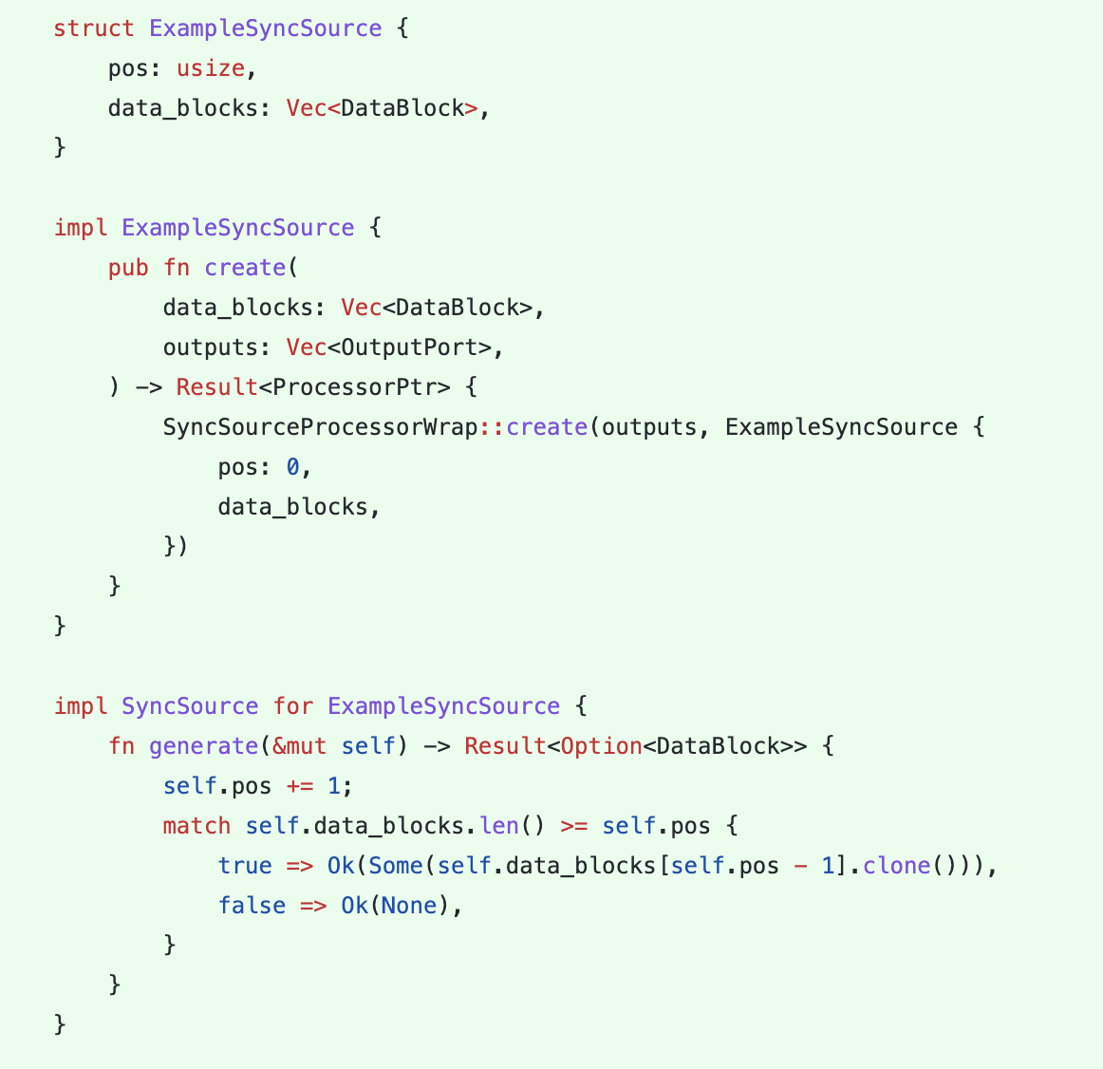
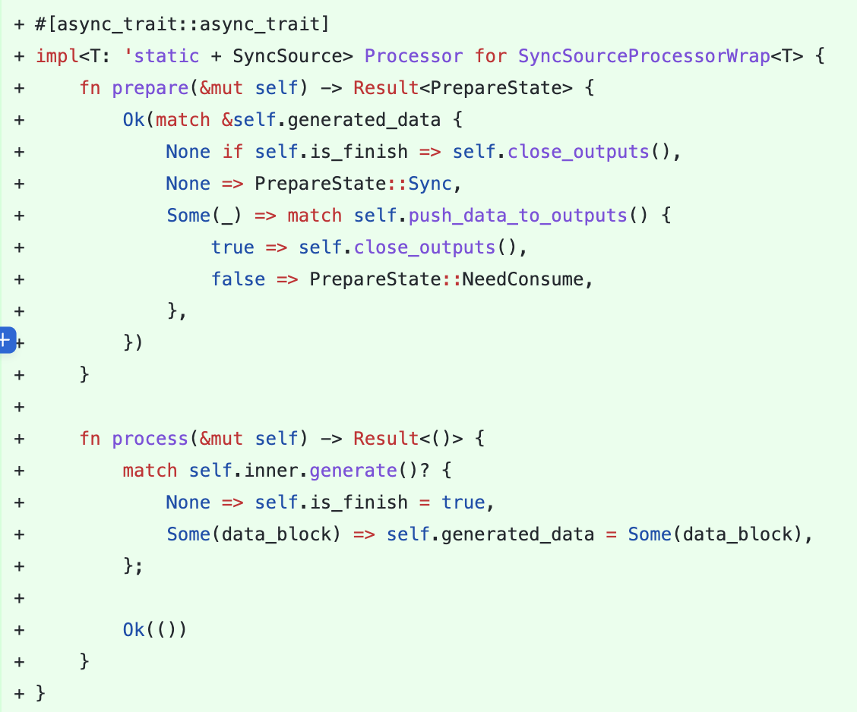
How to better processing one query
W W W . D A T A B E N D . COM
Example SyncSource

Slide 23
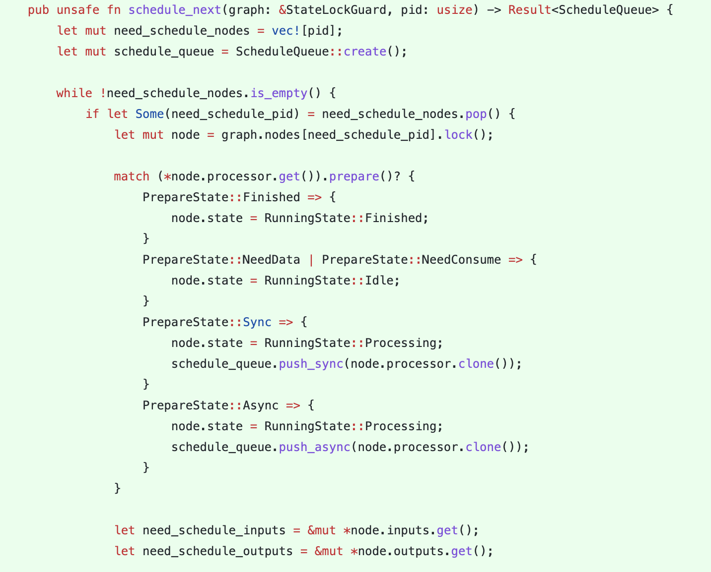
How to better processing one query
W W W . D A T A B E N D . COM
Execute one processor in executor
Lock and call Processor::prepare
Which method is executed by state
Add self to schedule queue if ready state
Add neighbor processor to schedule queue

Slide 24
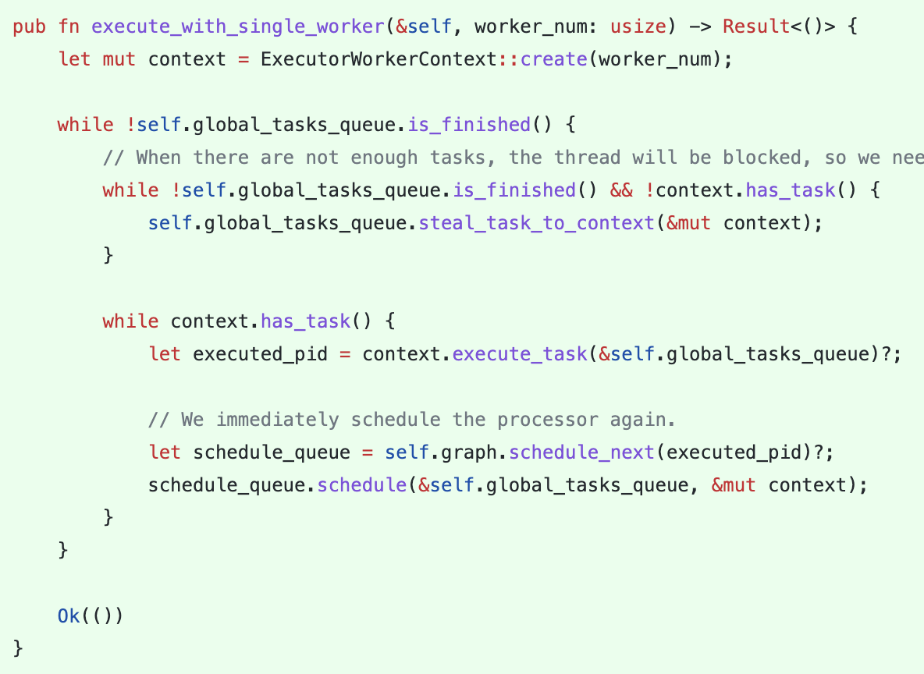
How to better processing one query
W W W . D A T A B E N D . COM
Execute schedule queue in executor
All workers share a global queue
Each worker has a local task queue
First task is put to local queue without lock
Other tasks put to global queue with lock

Slide 25
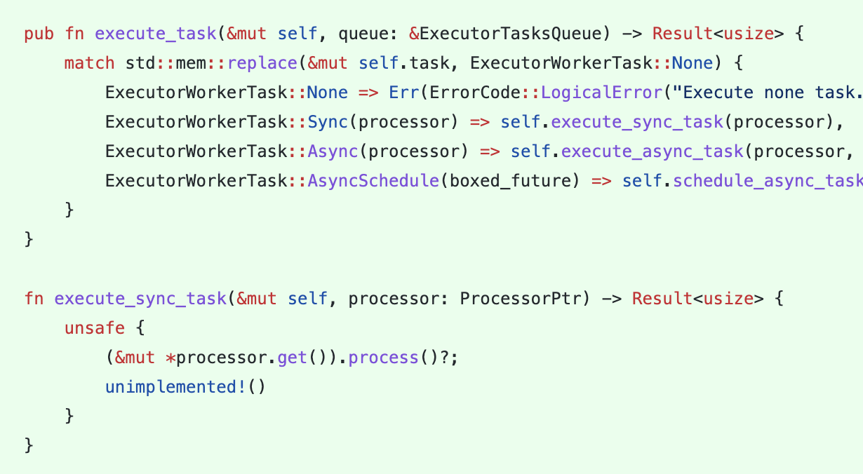
How to better processing one query
W W W . D A T A B E N D . COM
Execute schedule queue in executor
Call Processor::process if sync state

Slide 26
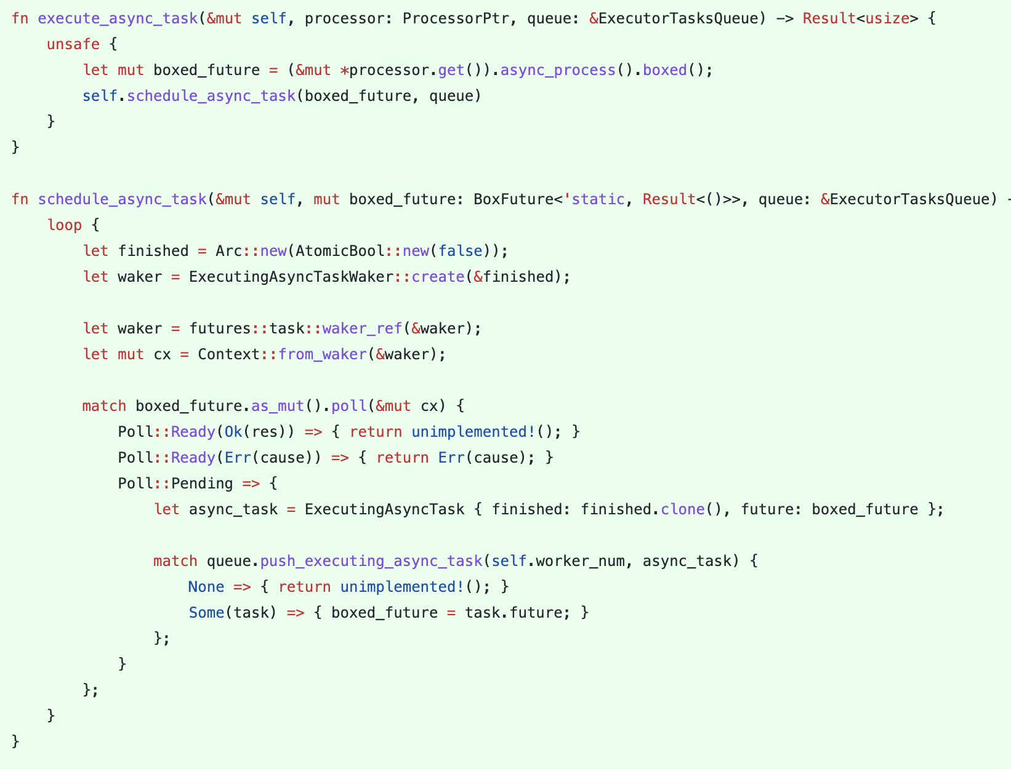
How to better processing one query
W W W . D A T A B E N D . COM
Execute schedule queue in executor
Call Processor::async_process if async state
Mock waker with atomic_bool flags
Push to global queue if async not ready

Slide 27
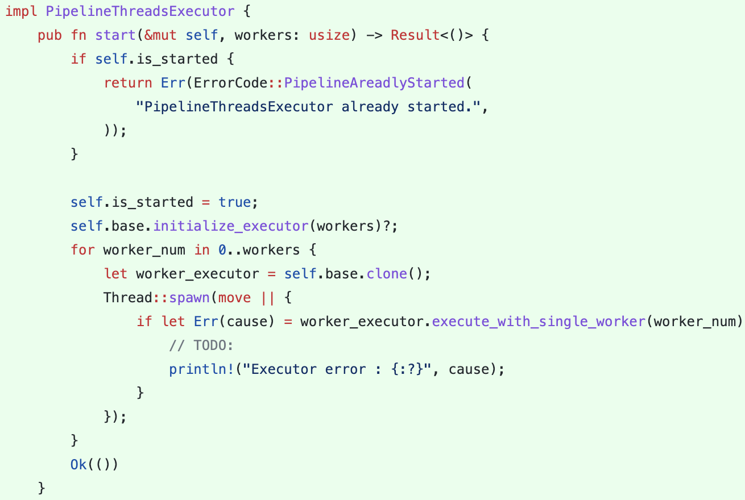
How to better processing one query
W W W . D A T A B E N D . COM
Execute worker in executor
Start workers with thread pool
Wait all processor is finished

Slide 28
感谢您的观看
THANK YOU FOR WATCHING

