Slide 1

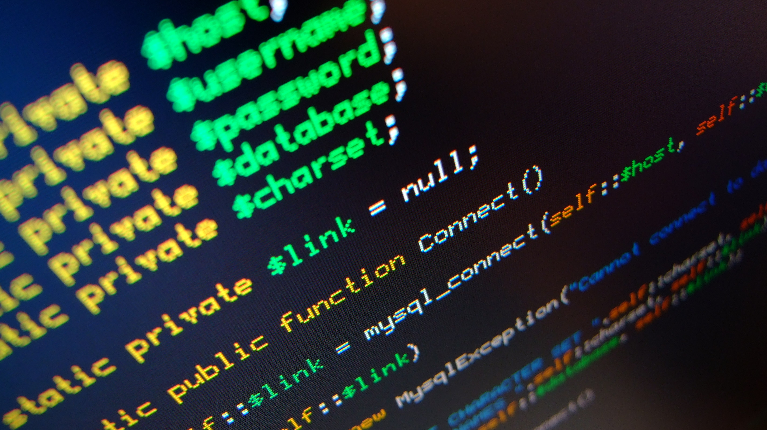
FAST-IOT
Javier Benitez Trinidad
Genesis Rivera Rios

Slide 2
Introduction
On September 20, many families went through needs, were without communication and spent days without food or water. Many of these people were older in most cases. This is one of the reasons why I came up with the idea of ​​the fast-iot project. Which is to try to detect this type of people who are isolated from the majority of the population or who simply live in fields that are far from people.
My project consists of a device that pretends to be in the houses collecting information from both the person and the environment. And another device that will be placed in a drone in charge of gathering the information of the people and determining the damages of the property.

Slide 3
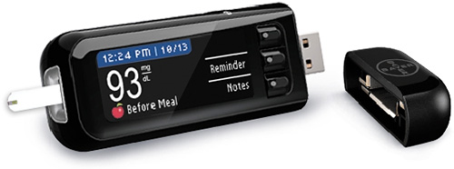
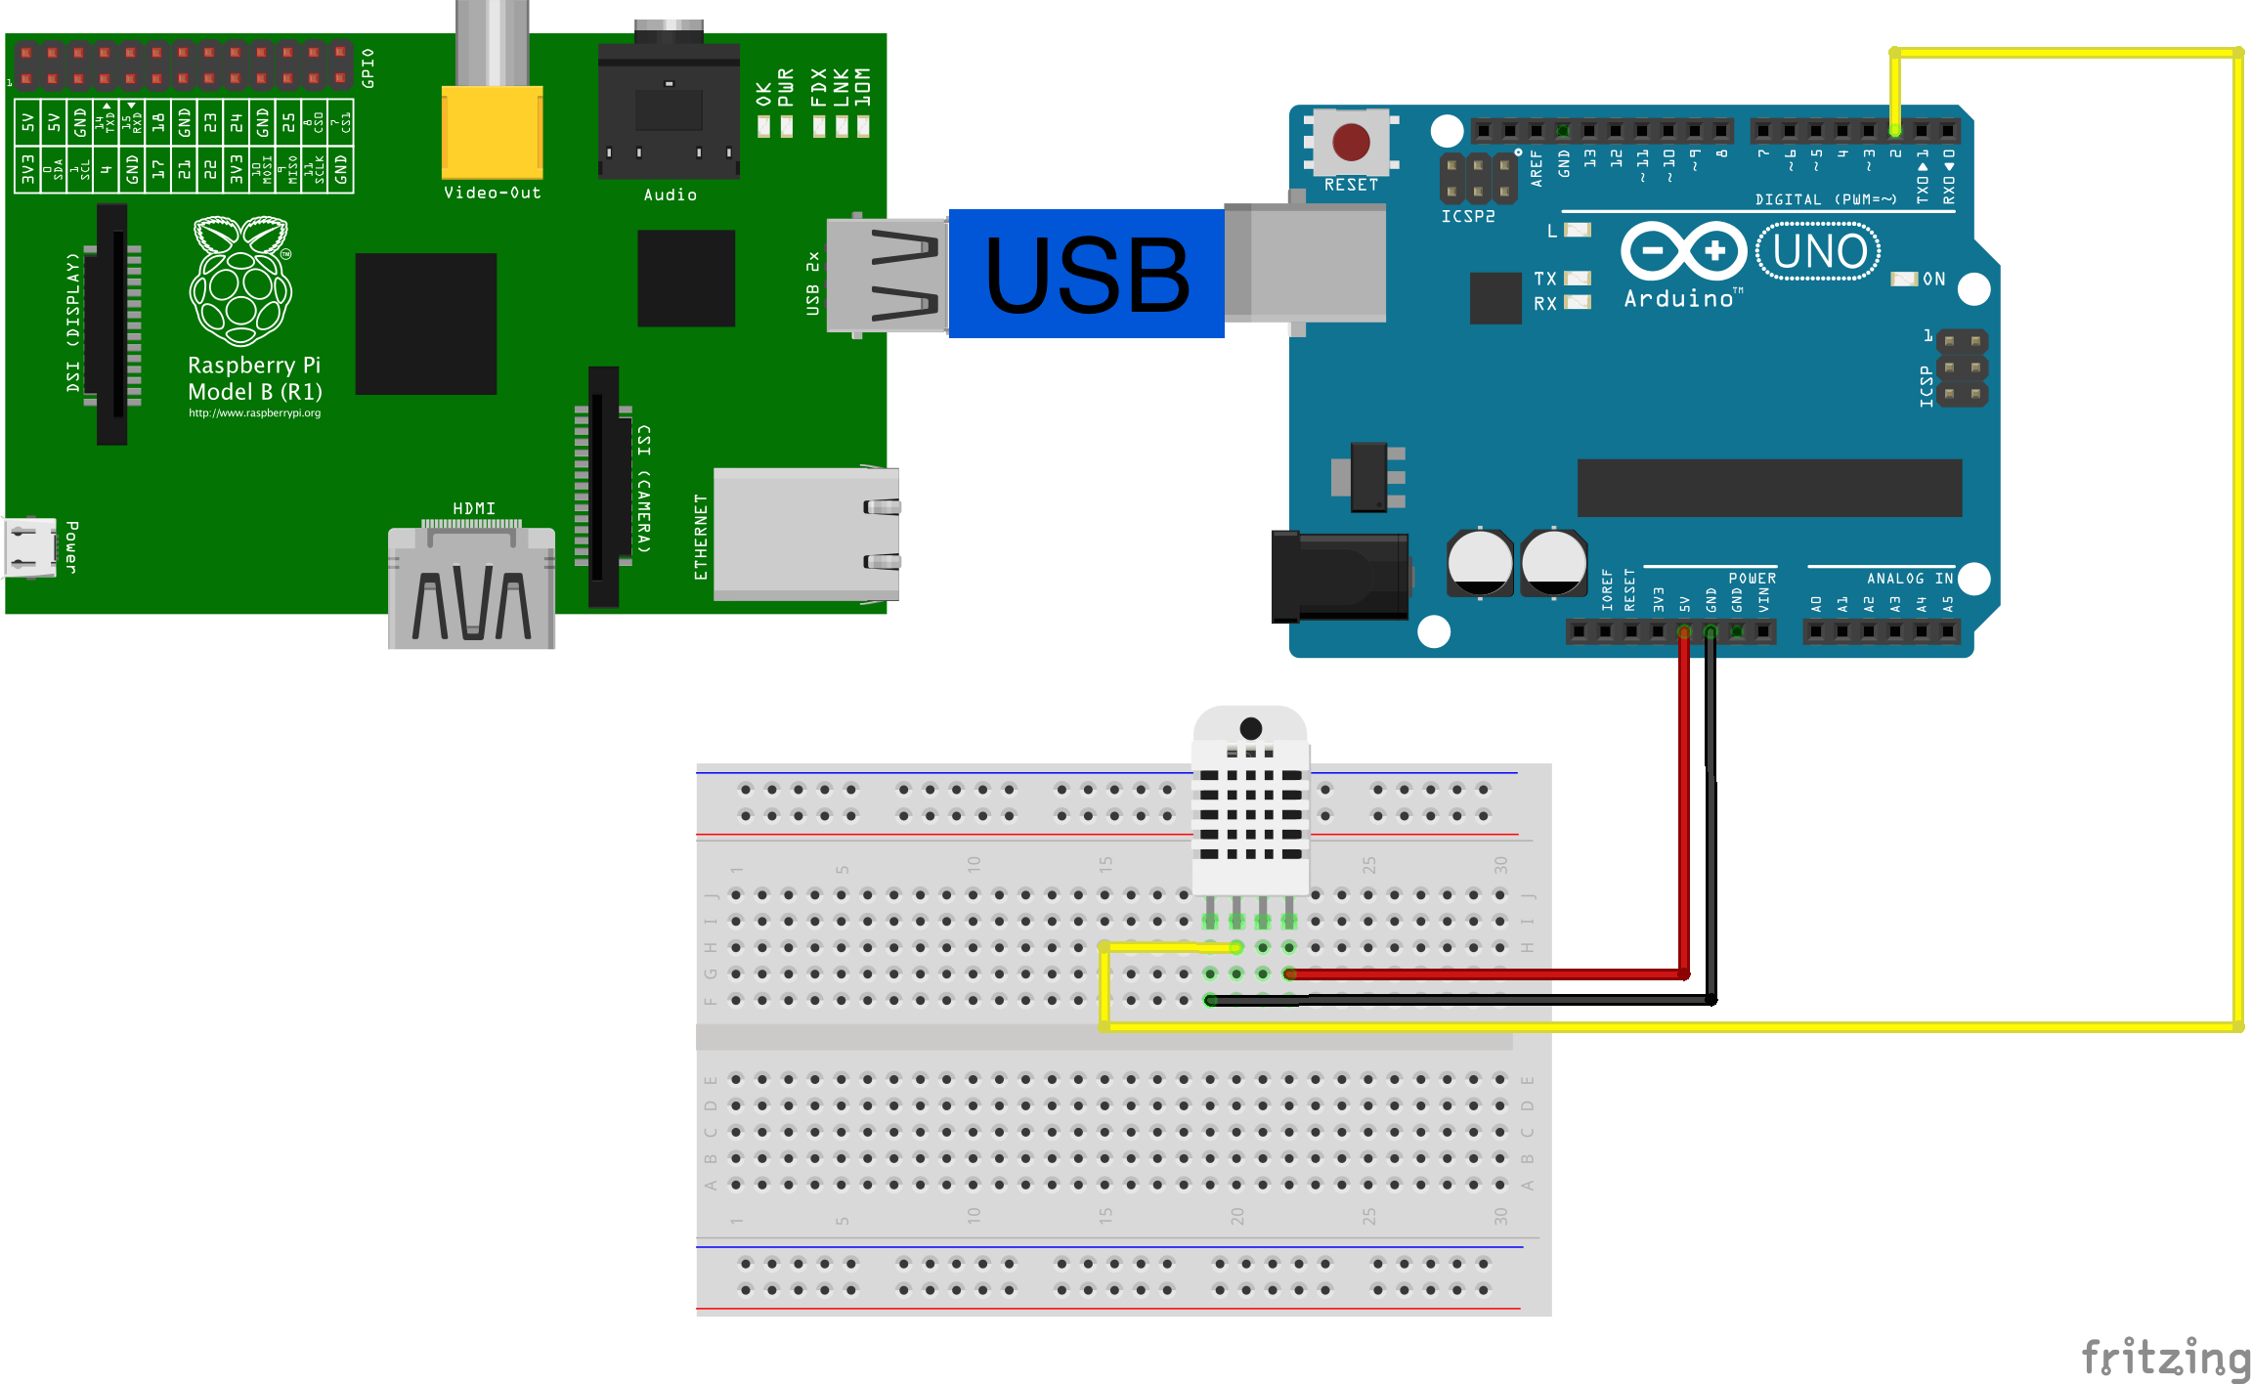
Home device
This project is based on a device that will be in the homes (Especially in the case of elderly people) collecting information on both the person and the environment. The information of the person who will be storing will be the following: blood sugar, time at which the test was taken and the last time he ate. This will help us determine if that person needs insulin or food urgently. While environmental sensors will be keeping data on temperature and humidity because many older people often suffer from asthma and other types of diseases.
The device will have 2 portable batteries and a solar charger that will be responsible for recharging the batteries.

Slide 4
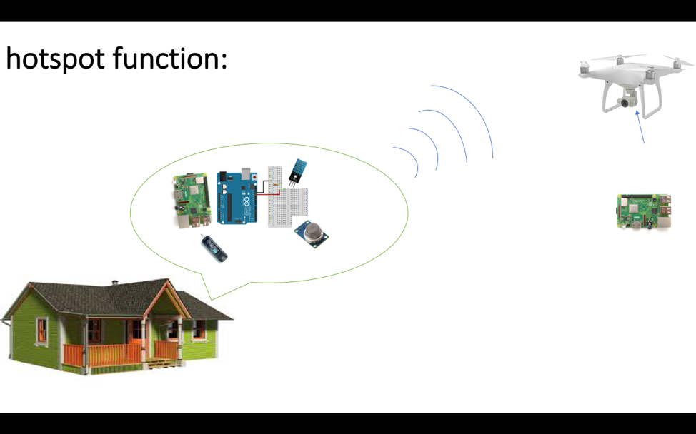
This data will be saved in a csv file which will have an id to identify the person or place where the data was obtained from. The file will remain in the raspberry pi (which will act as a hotspot) waiting for the help drone to pass and collect this data. Once the drone detects the signal the device will automatically connect and it will receive the csv file of the device with the data of the person. Once this receives the data, the drone will take at least 3 photos of the place where it received this data. And keep the photos and the csv in a folder unique to that place or person.

Slide 5
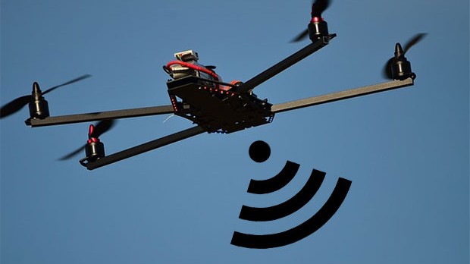
Drone-device
The device of the drone will have a camera which will take the photos once it detects having received the data, It will also have a gps to save the location from which it obtained that data and to be able to determine where the person is to provide the help.
Once the drone ends the determined route it returns to its base to move to the processing phase of the data.

Slide 6
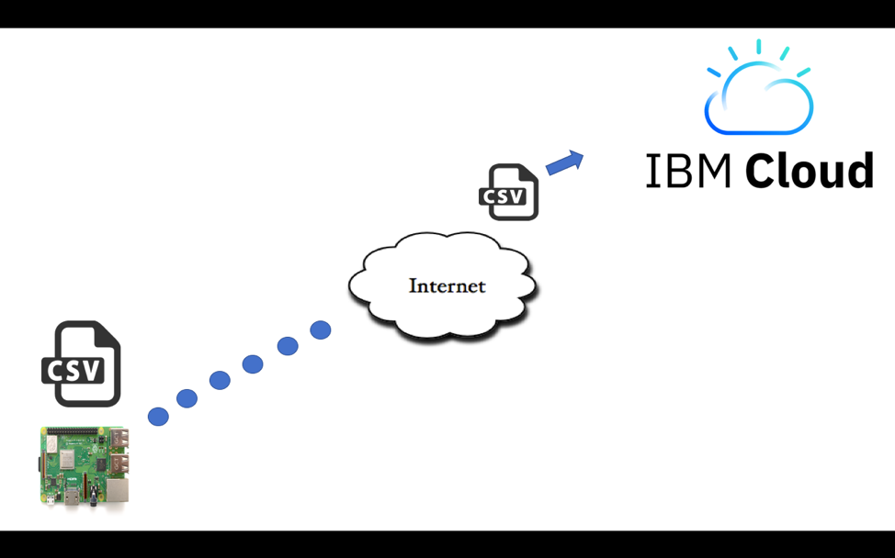
data processing
Once the drone finished the route that was returned to its base where possibly access to the internet. When they connect to the Internet, the first thing they do is that the images of each folder (people or place) and through a program that uses IBM WATSON services looks for what kind of disaster is detected.
If this detects some type of disaster, it will notify you, this in order to finish the areas that were most affected. Once all the images have been processed, the folders with the information of each person will be sent to the IBM cloud for more information about the people who need help most urgently and the most affected places in which it will be necessary to send Several teams to open roads or see if people need supplies, water, roofing thrush, medicines, etc.

Slide 7
Resume
Summing up my project and seeing it from another point of view, the main idea is that the most needy people, such as elderly people, can have these devices in order to be able to monitor them or in other cases detect them. In this way we can collect information that helps us to know what kind of needs the person is going through. With this type of information more elaborate plans could be made to determine which specific areas need help with greater urgency and in this way be able to provide a balanced aid.
This device will not only help us, but also we will be able to make more exact statistics regarding the number of affected people, people who died, places that suffered greater damages, etc.

Slide 8
Conclusion
As part of my conclusion I think that with these devices many lives could be saved as well as better help plans could be developed in case these disasters happen again in the future. As it would be a device that could be improved and adding improvements to be able to collect other types of needs in people.

