Slide 1

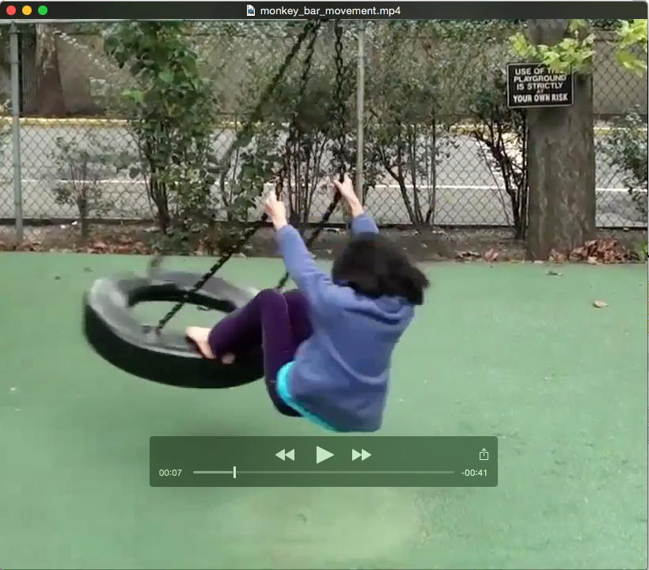
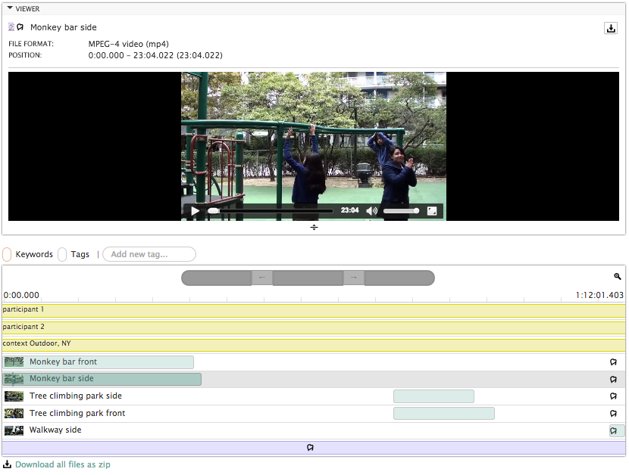
Databrary:
Sharing and
Reusing Video Data

Slide 2
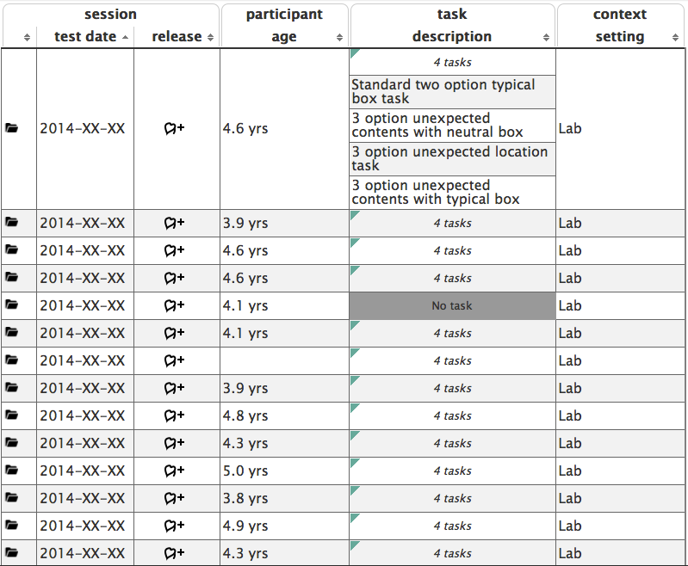

Databrary:
Upload As You Go
Active workspace for researchers
Tools map to existing practices
Enforces standardized metadata

