Slide 1
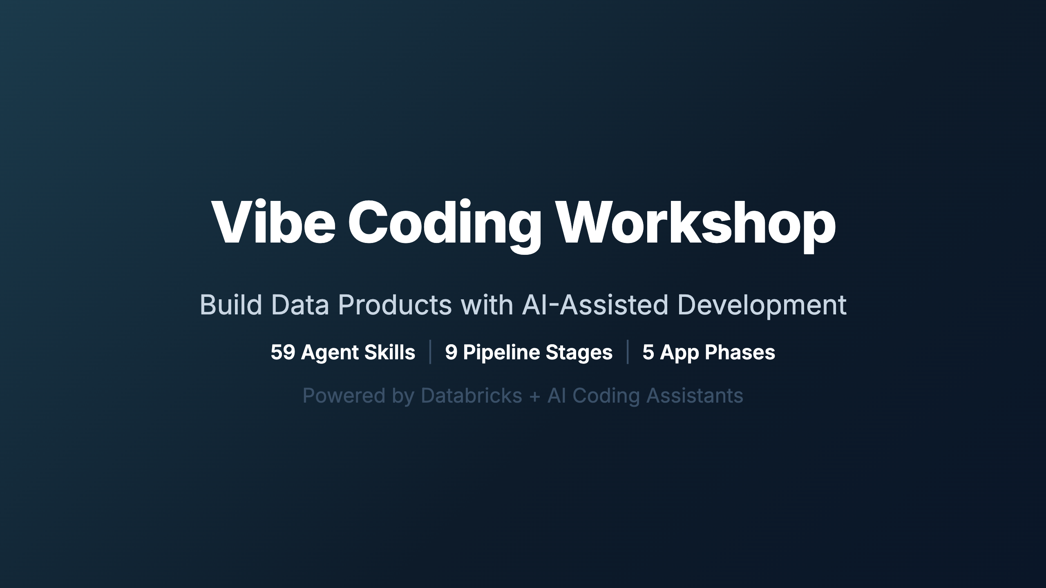
Notes:
_transition: cover
Speaker: Welcome everyone to the Vibe Coding Workshop. Over the next session, we'll take
an animated journey through the entire framework — from raw schema CSVs to production data
products, Databricks Apps, and AI agents. Everything is driven by agent skills that encode
best practices into reusable, AI-readable instructions.
Timing: ~2 min for introductions and orientation.

Slide 2
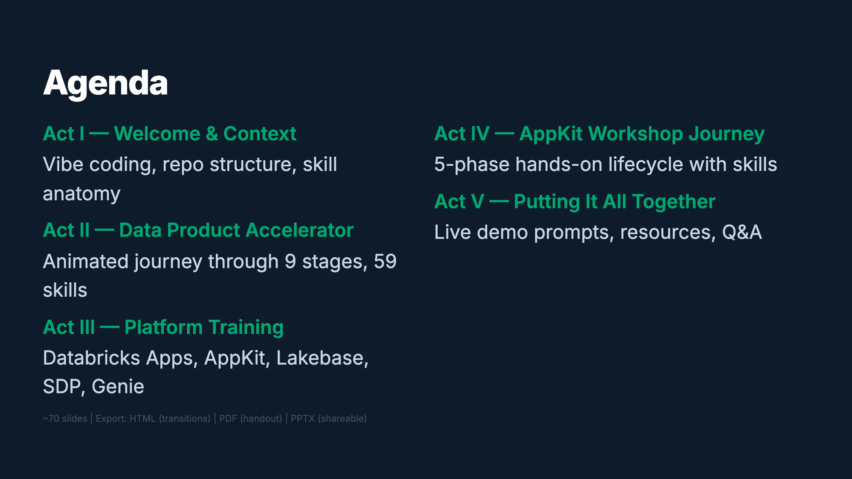
Notes:
Speaker: Here's the roadmap. We start with concepts, then dive into the 9-stage data pipeline
animated as a journey through skill trees. Next, platform training on the building blocks.
Then hands-on with AppKit. Finally, you'll get copy-paste prompts to try it yourself.
Timing: ~1 min

Slide 3
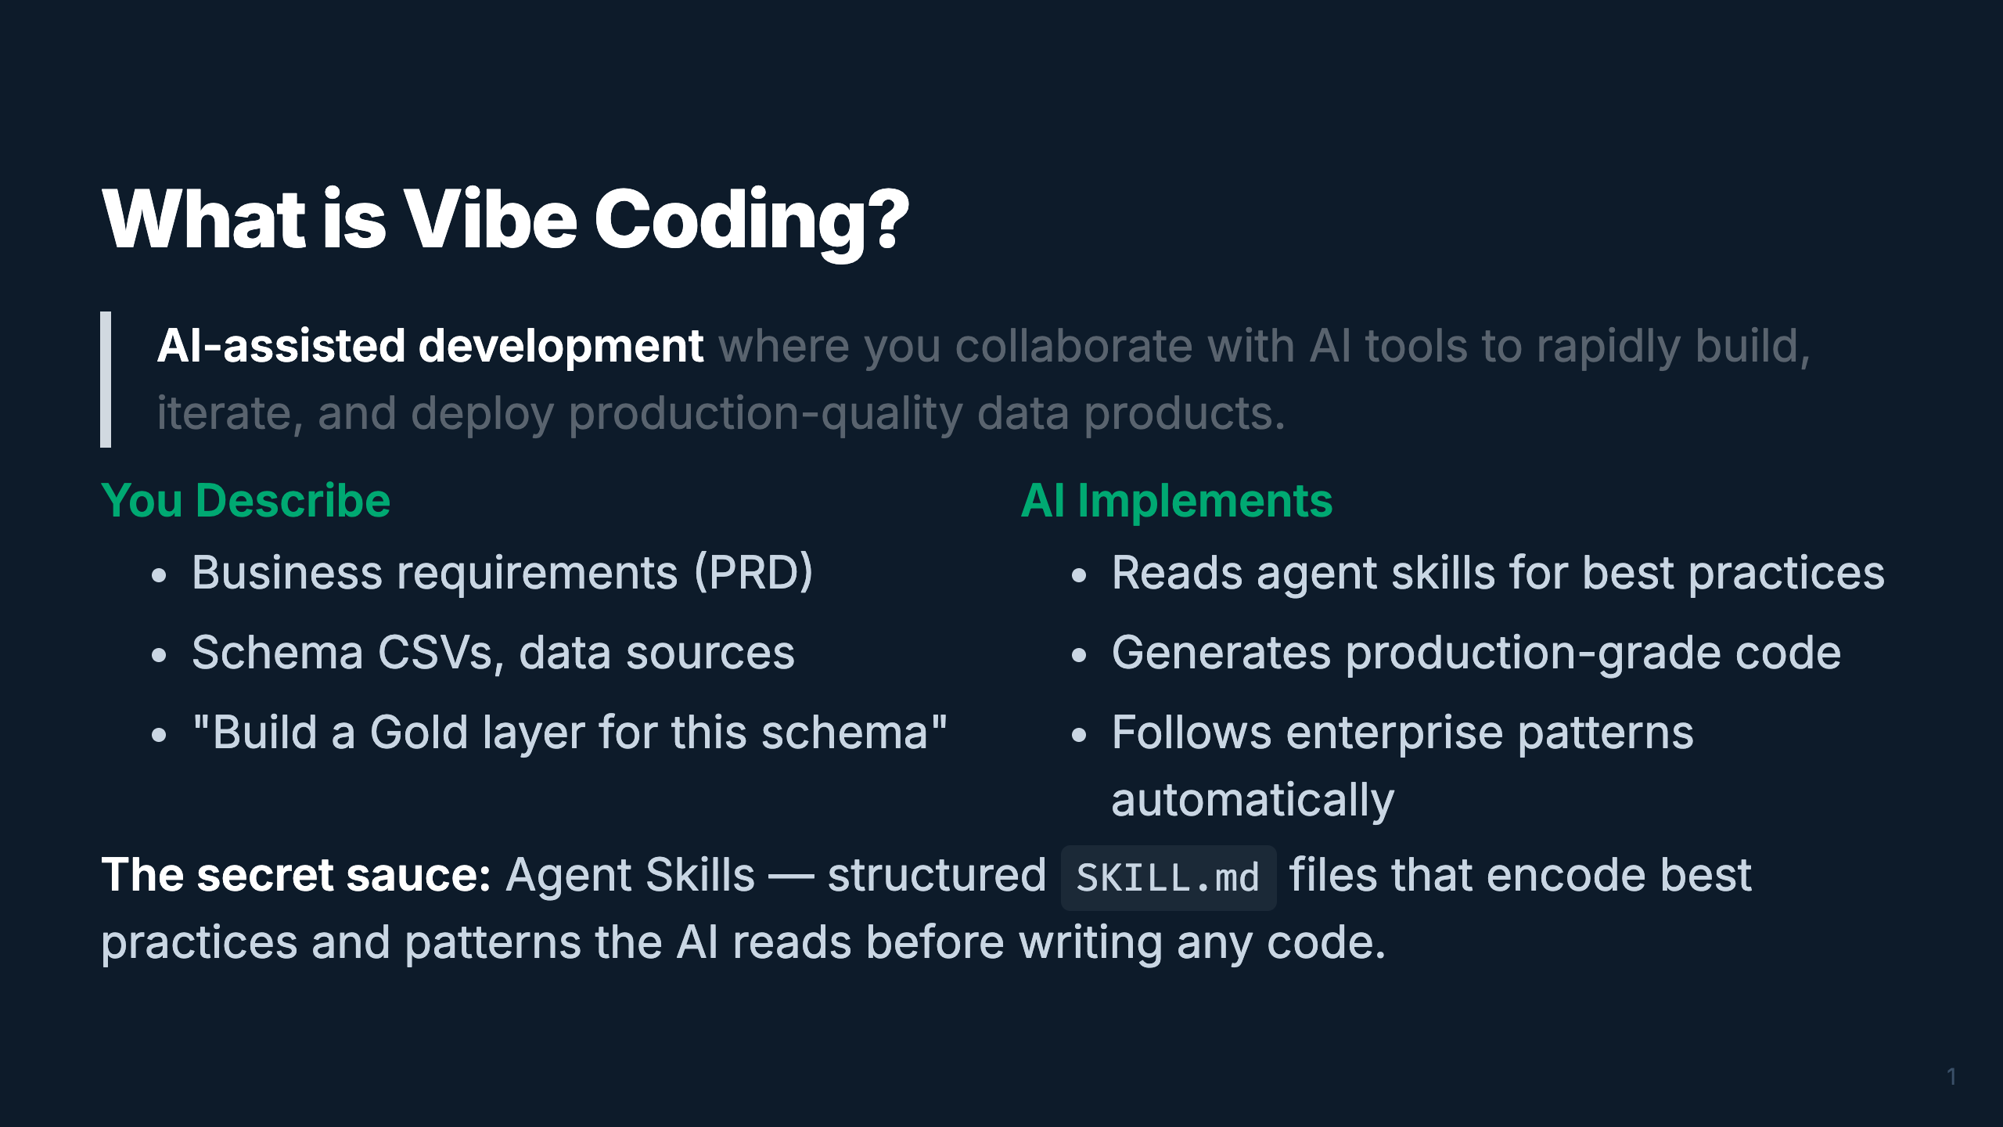
Notes:
_transition: cover
Speaker: Vibe coding flips the ratio — you spend more time describing WHAT you want and less
time writing HOW. The AI handles implementation, guided by 59 agent skills that encode
Databricks best practices. You're the architect; the AI is the builder.
Timing: ~2 min

Slide 4
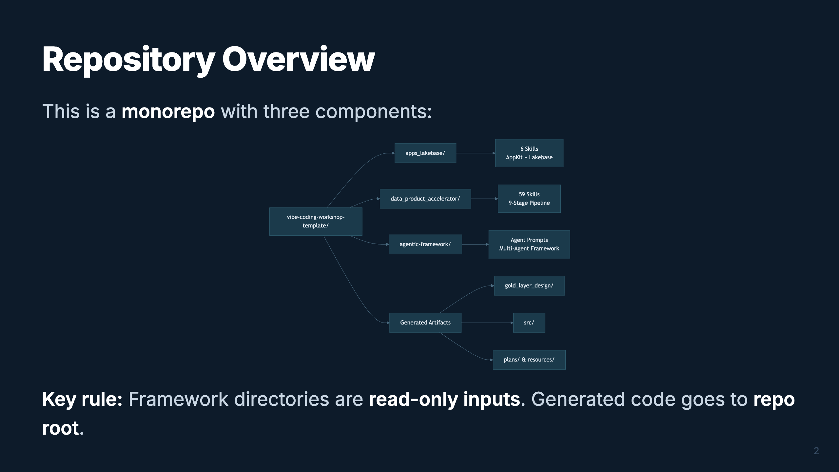
Notes:
Speaker: Three components live here. The Data Product Accelerator has 59 skills for the full
medallion architecture. AppKit has 6 skills for building Databricks Apps. The Agentic Framework
is for multi-agent systems. All generated code goes to the repo root — never inside the framework dirs.
Timing: ~2 min

Slide 5
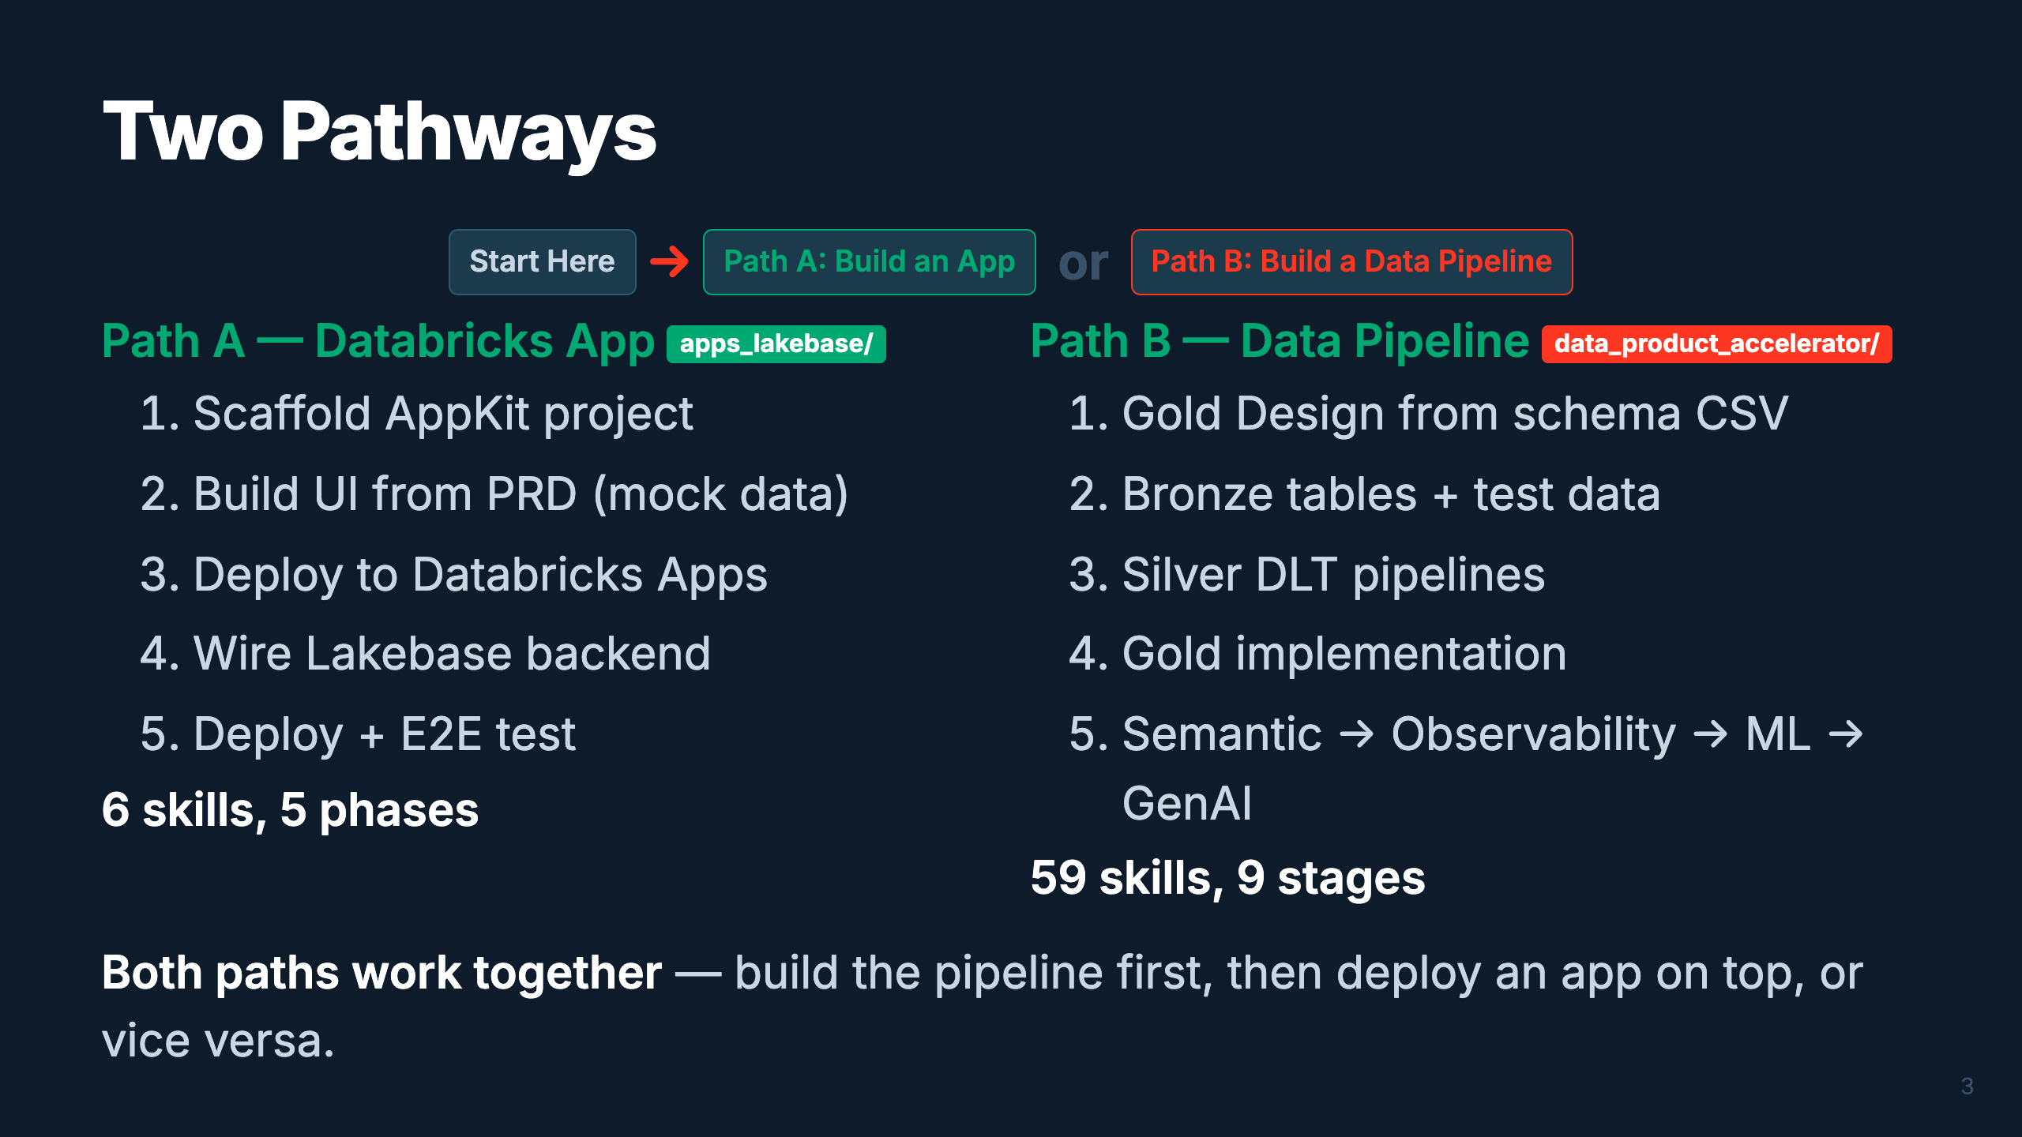
Notes:
Speaker: Two entry points, same destination. Path A is for the "I want an app" crowd — build
a full-stack Databricks App in 5 phases. Path B is for the data engineers — design-first
pipeline through the full medallion architecture. They converge: your app can query your pipeline's Gold tables.
Timing: ~2 min

Slide 6
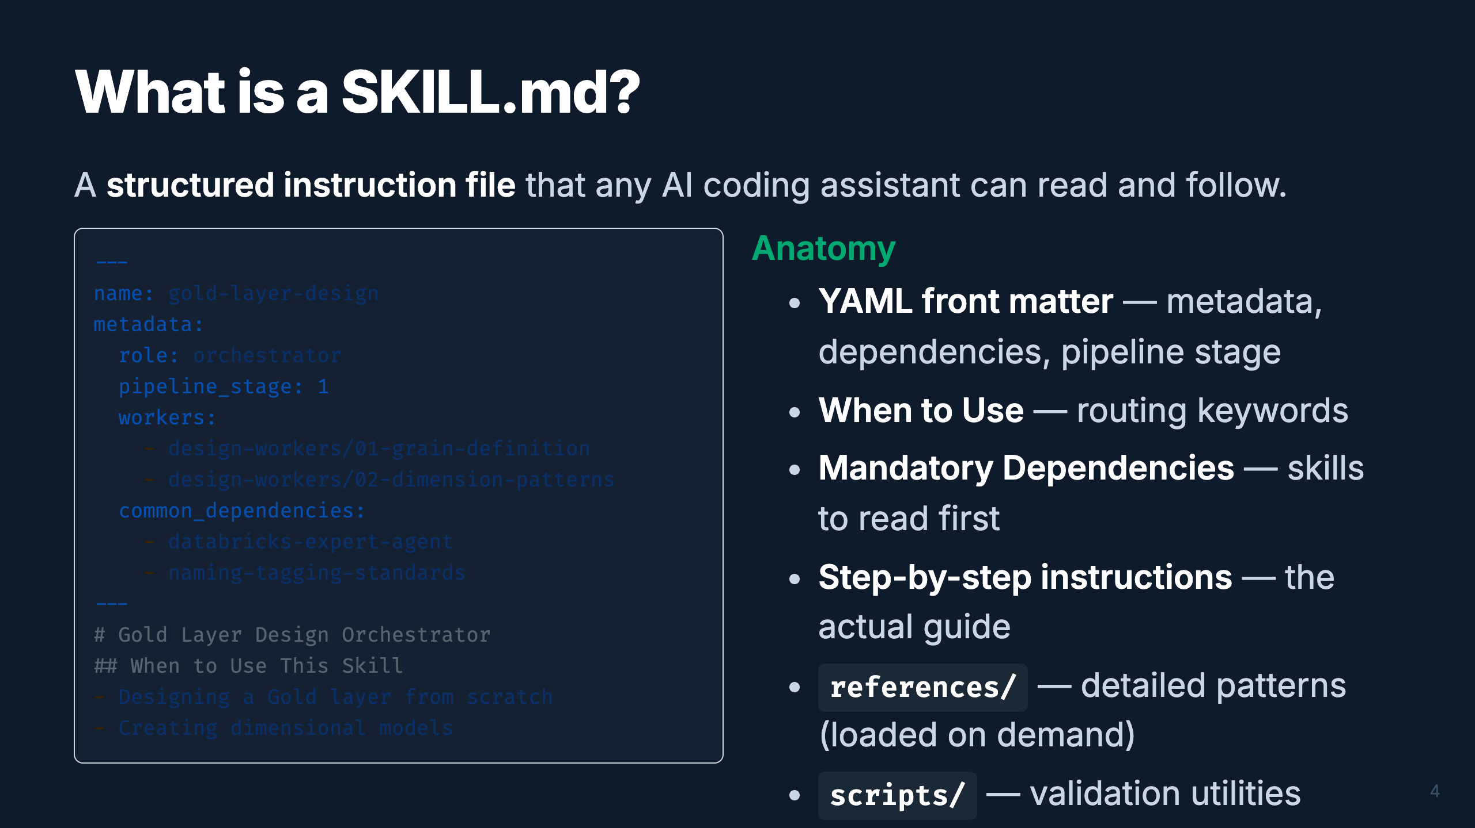
Notes:
Speaker: Every skill follows the same structure. YAML front matter has machine-readable metadata
for routing. The body has human-readable instructions. References directories hold the heavy
content, loaded only when needed. This keeps each SKILL.md under 2K tokens — lightweight for
the AI's context window.
Timing: ~2 min

Slide 7
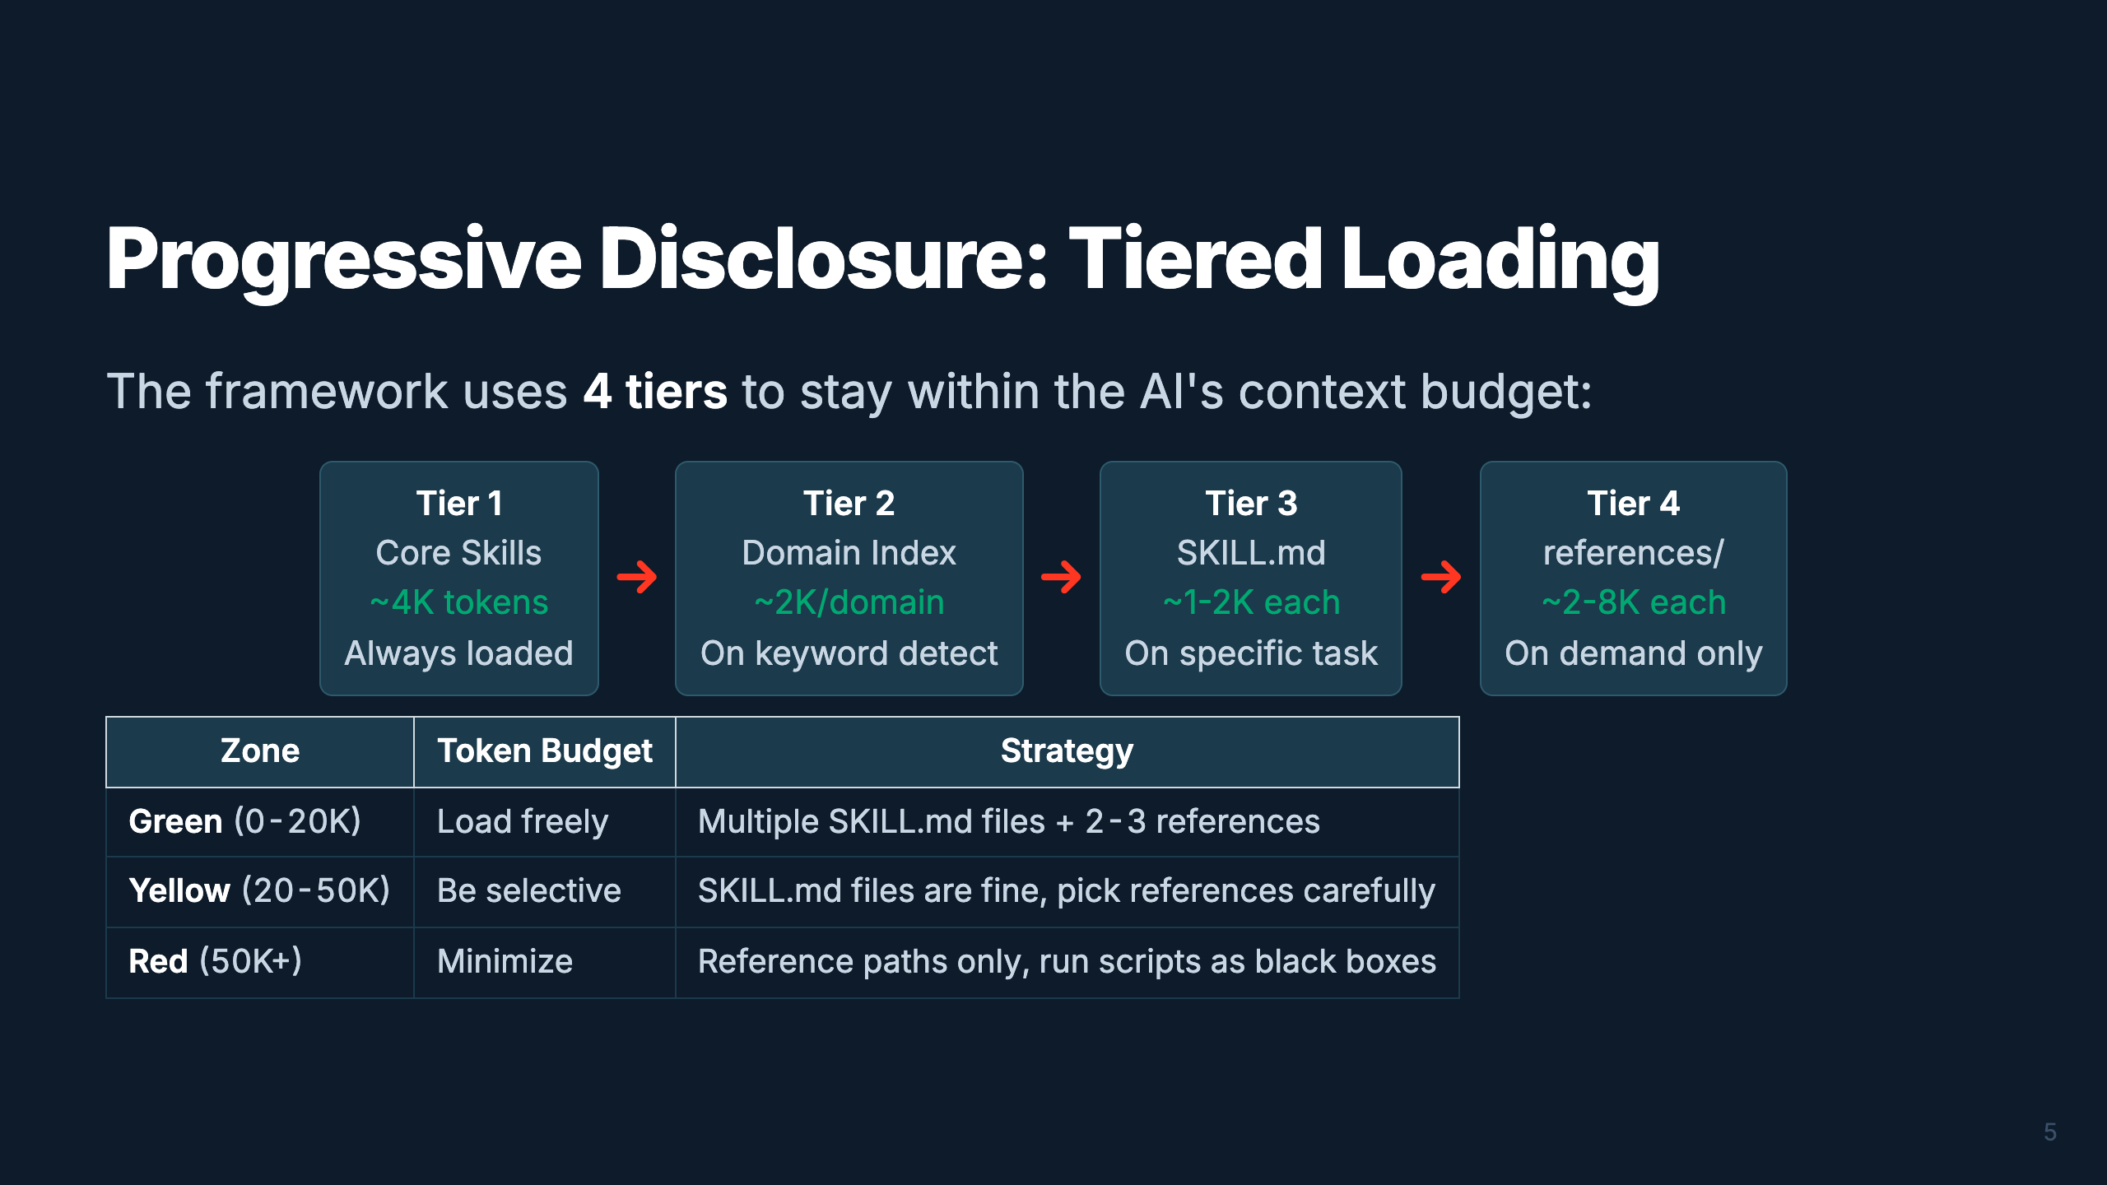
Notes:
Speaker: Why tiers? Claude Opus has a 200K token window, but performance drops if you overload
it. We keep the operating budget at 40-60K tokens. Tier 1 is always loaded. Each subsequent tier
loads only what's needed for the current task. This is how 59 skills fit without blowing the context.
Timing: ~2 min

Slide 8
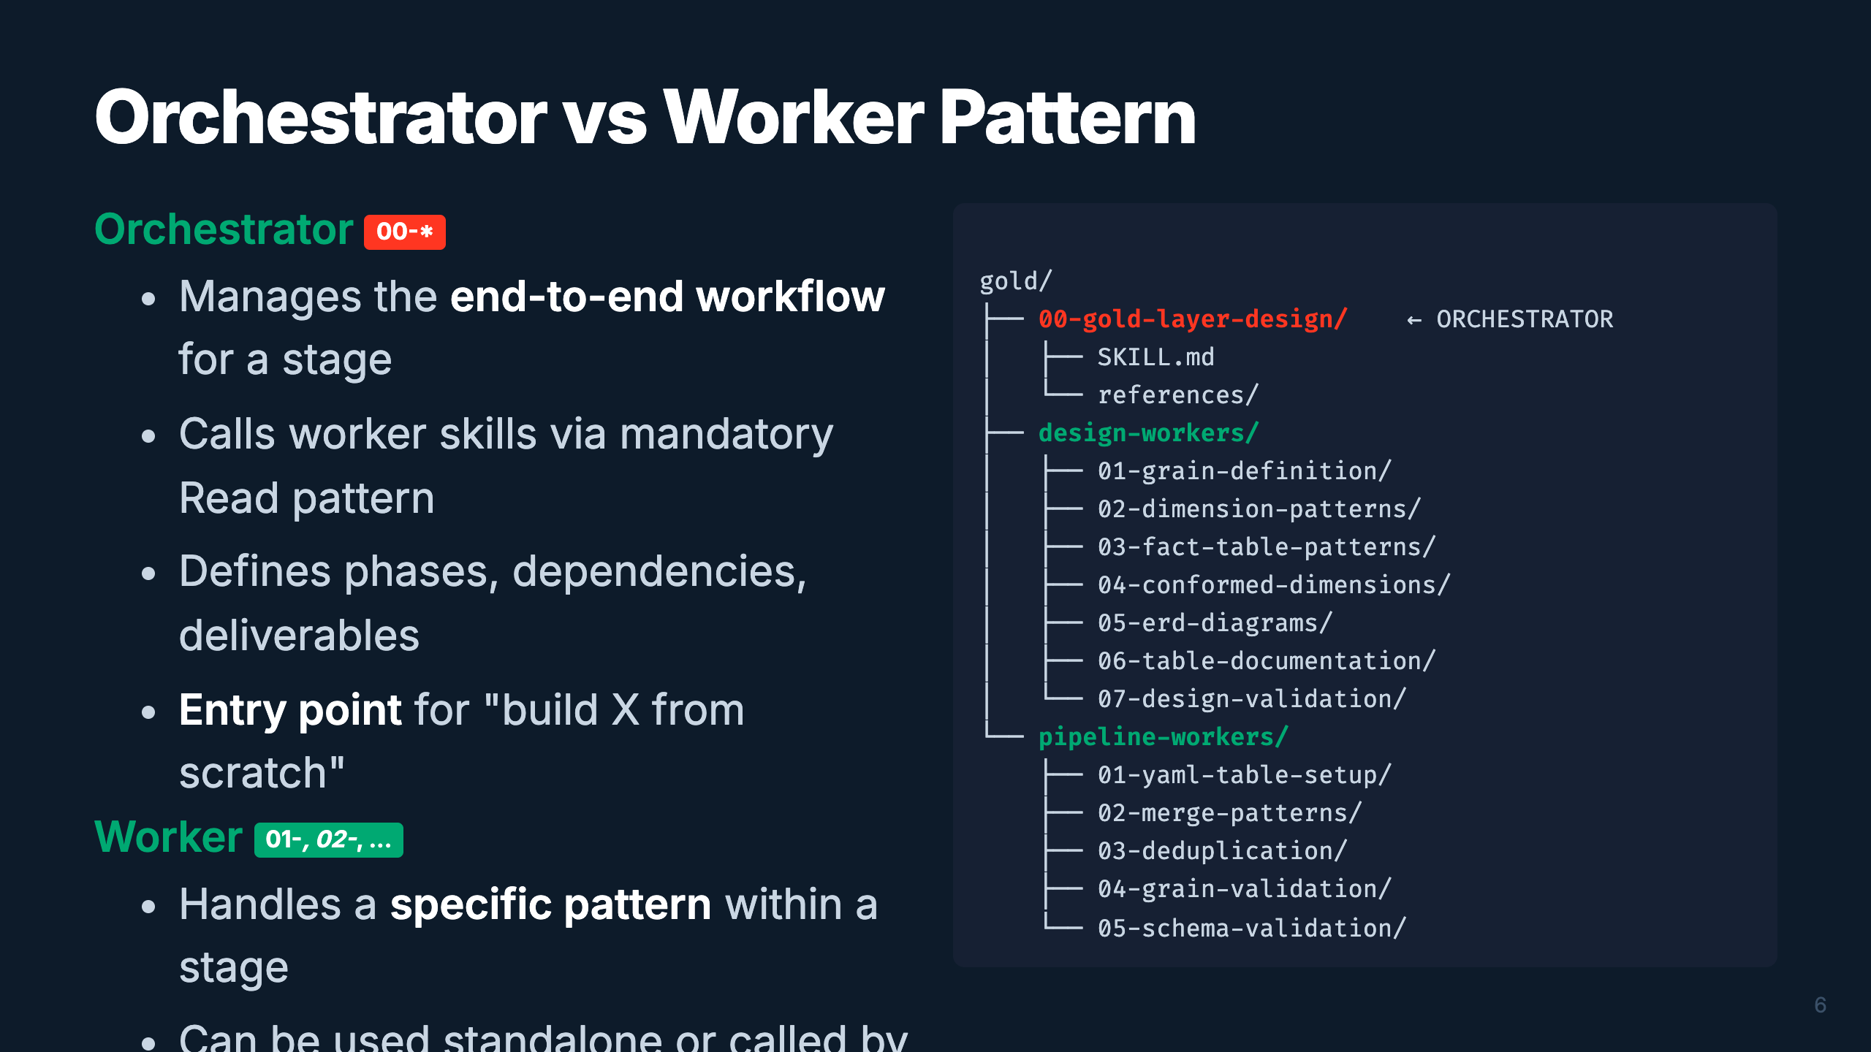
Notes:
Speaker: The orchestrator/worker pattern is the backbone of the framework. Orchestrators are
your "00-" numbered entry points — they manage the full workflow for a pipeline stage.
Workers are the specialists — they handle one specific pattern. The Gold domain is unique:
it has two sub-groups of workers (design-time vs implementation-time).
Timing: ~2 min

Slide 9
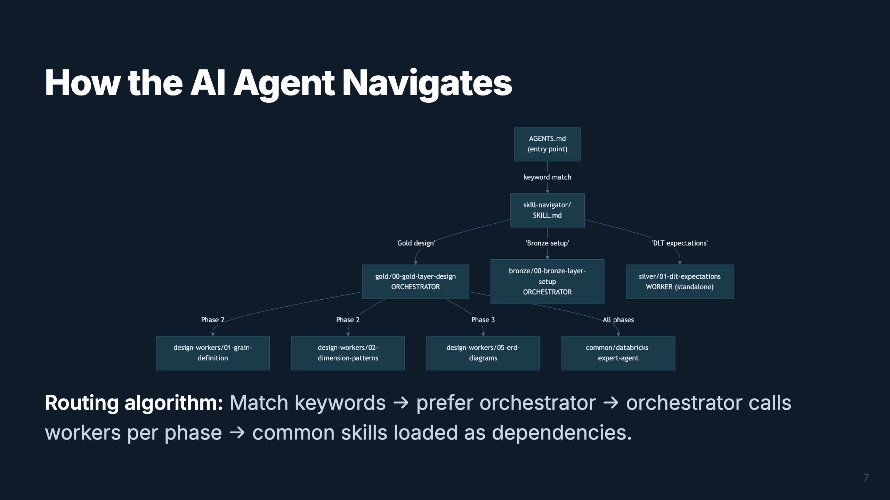
Notes:
Speaker: This is the navigation flow. The AI reads AGENTS.md at the repo root, which routes
to the skill-navigator. The navigator matches keywords to the right orchestrator or worker.
Orchestrators then progressively load workers phase by phase. Common skills like naming-standards
and expert-agent are loaded as cross-cutting dependencies.
Timing: ~2 min

Slide 10
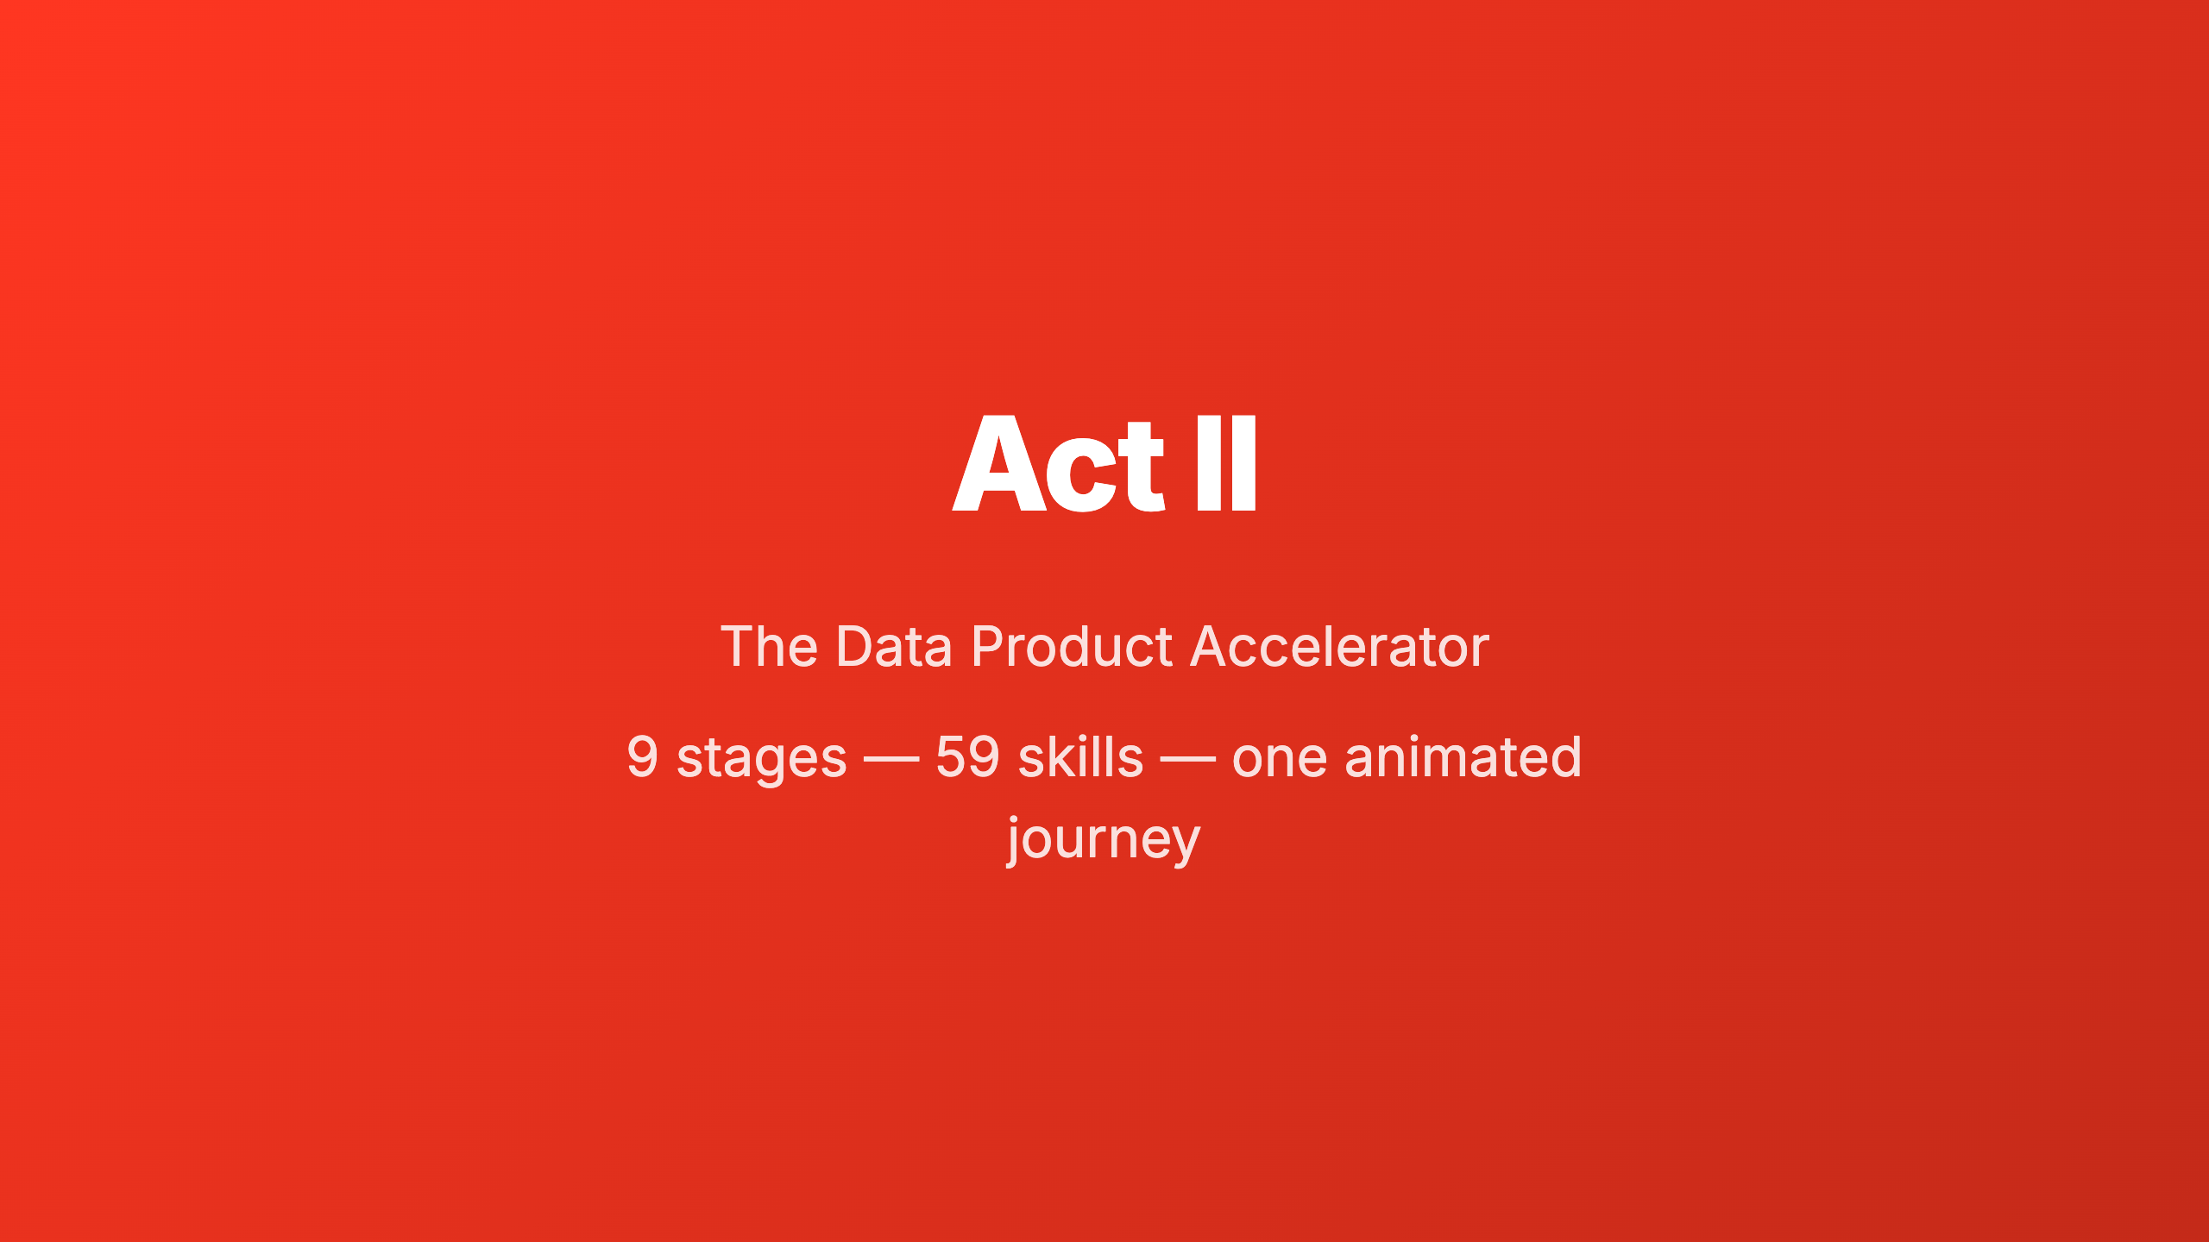
Notes:
_transition: cover
Speaker: Now let's walk through the entire Data Product Accelerator pipeline. I'll show you
each of the 9 stages as a journey through the skill tree, progressively revealing how the
orchestrators and workers connect. Watch the pipeline bar at the top — it tracks our position.
Timing: ~30 sec transition

Slide 11
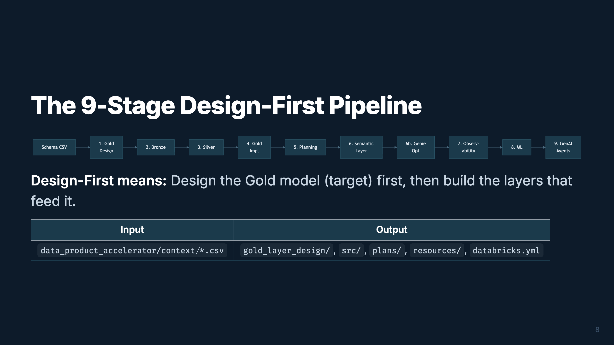
Notes:
Speaker: This is the full pipeline. It starts with a customer schema CSV and ends with GenAI
agents in production. The key insight is "design-first" — you design the Gold dimensional model
BEFORE building Bronze and Silver. This prevents rework. Let's walk through each stage.
Timing: ~2 min

Slide 12
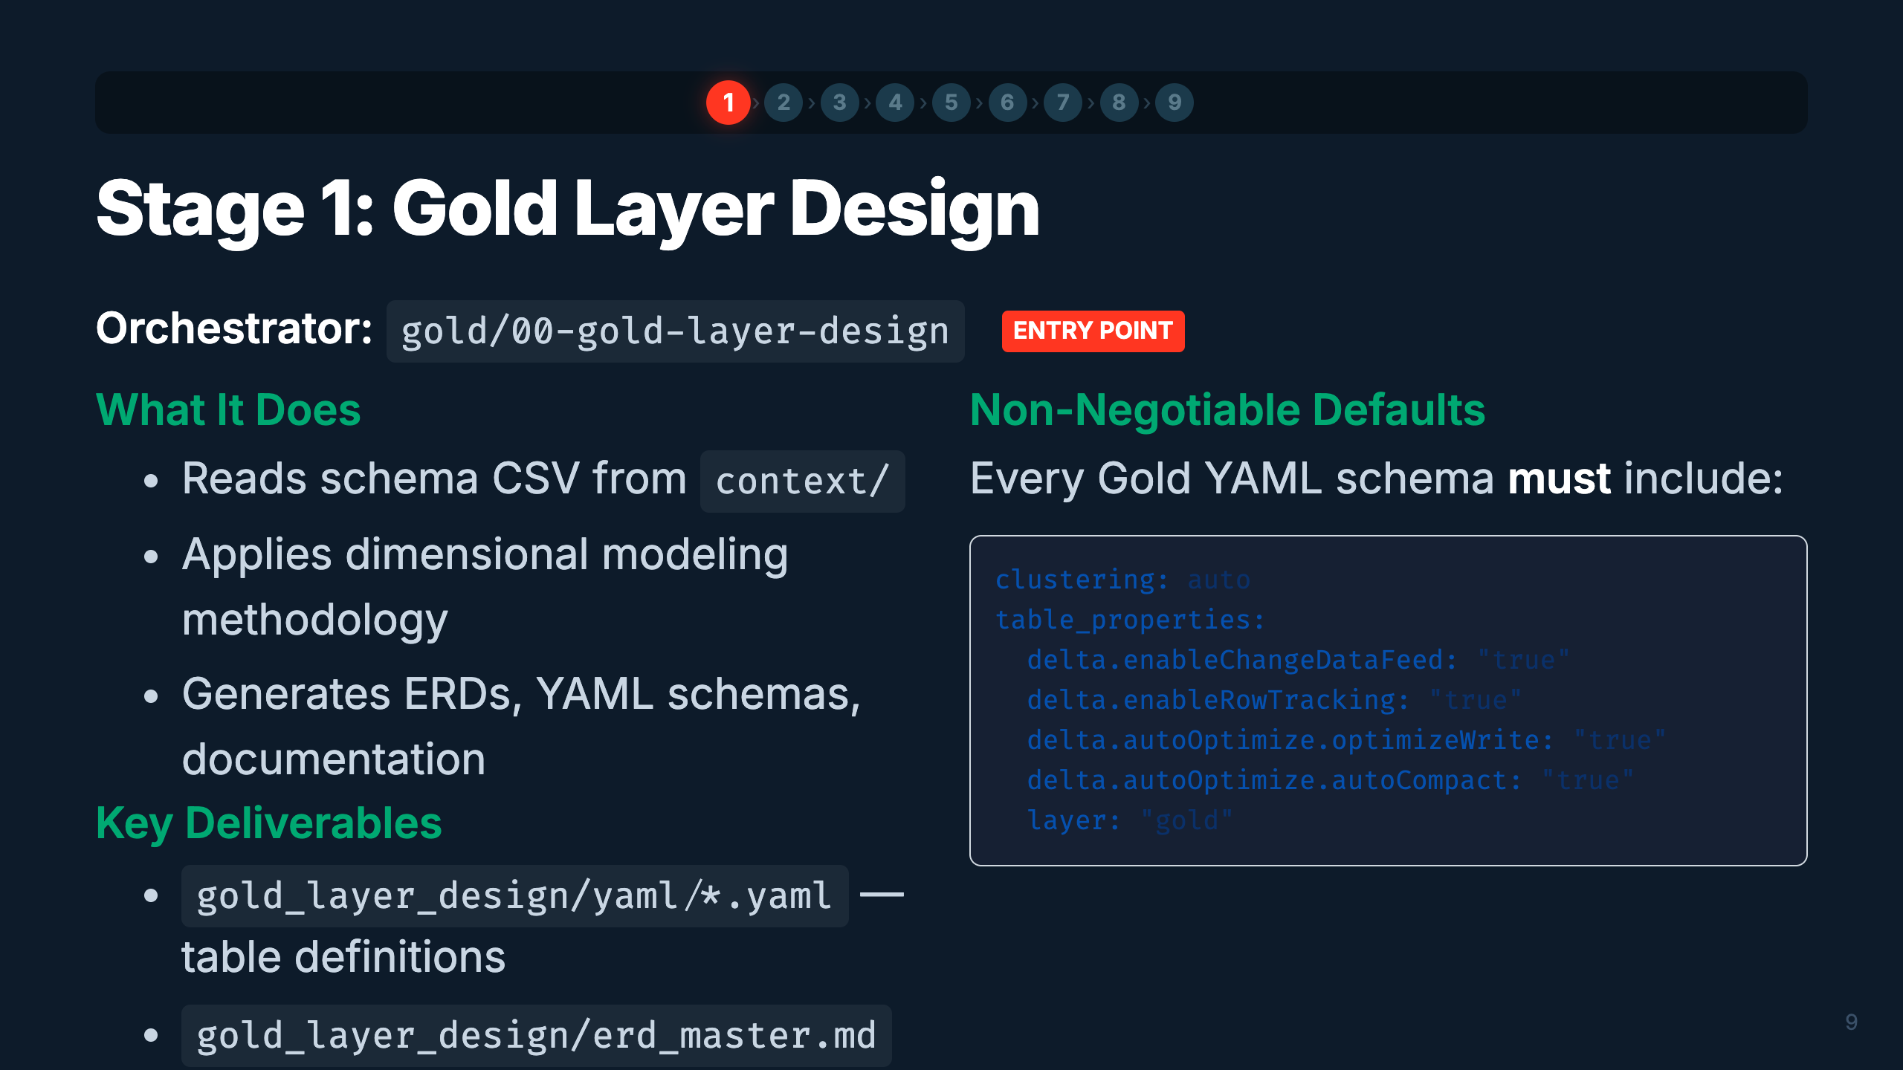
Notes:
Speaker: Stage 1 is where everything begins. You feed in a schema CSV and the orchestrator
drives dimensional modeling — grains, dimensions, facts, conformed dimensions, ERDs, and
documentation. The YAML schemas it produces become the contract that drives ALL downstream stages.
Notice the non-negotiable defaults — every table gets auto liquid clustering, change data feed, etc.
Timing: ~3 min

Slide 13
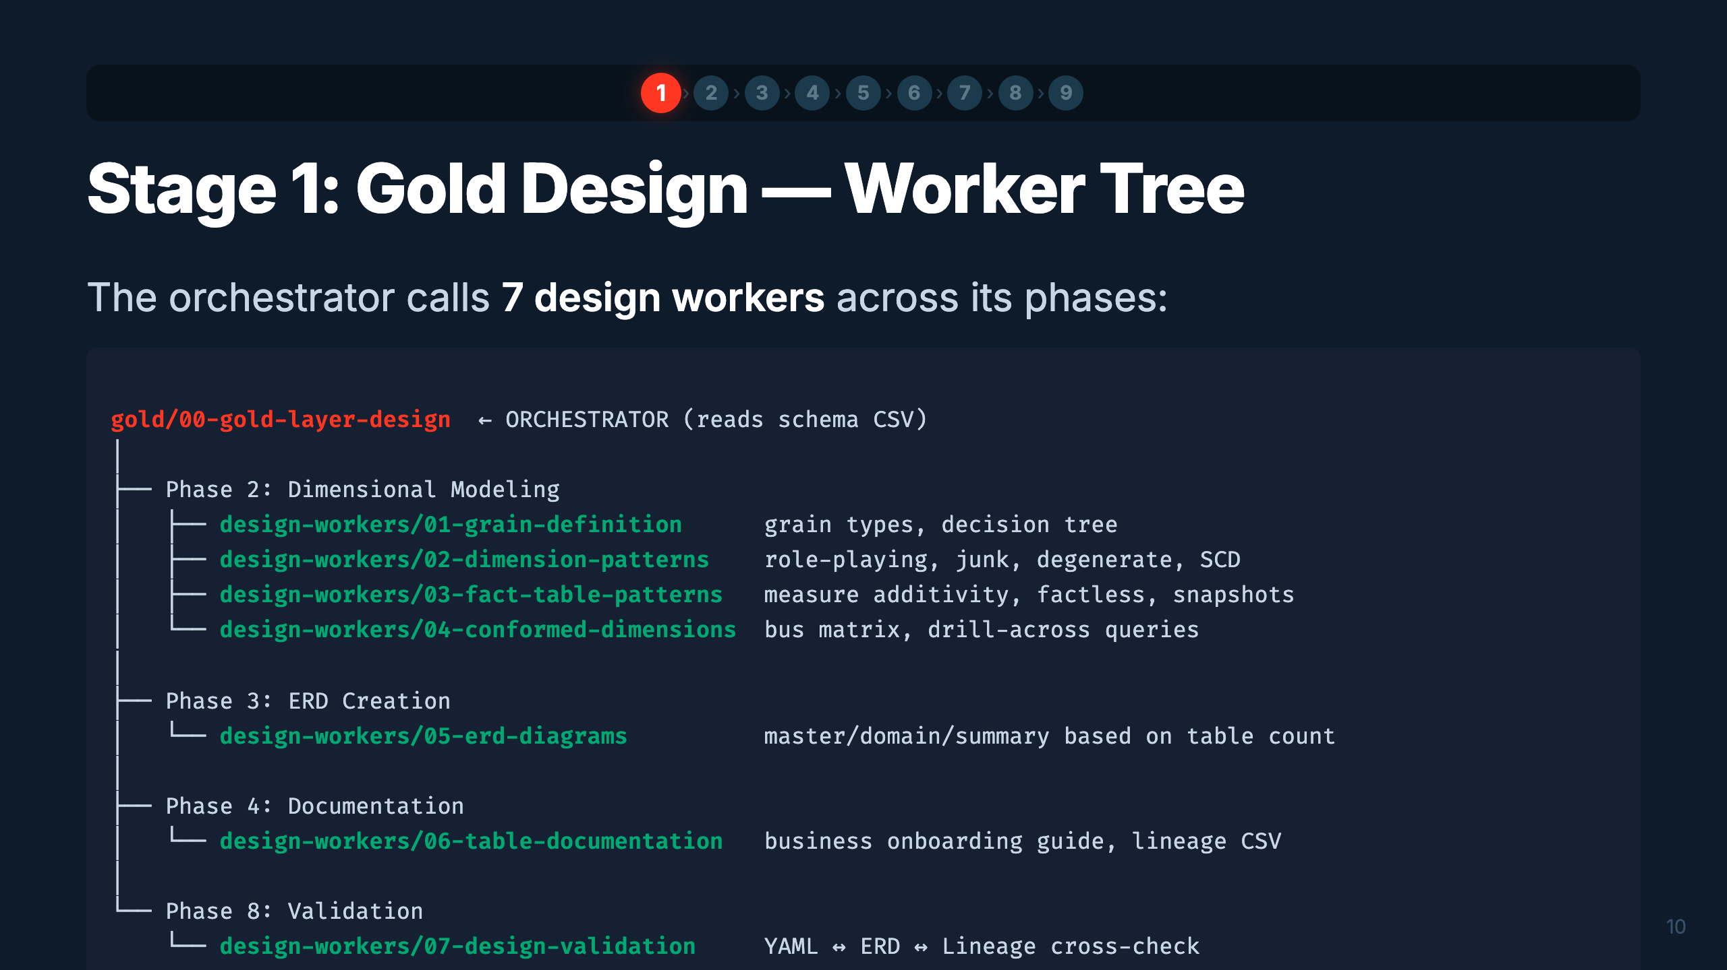
Notes:
Speaker: Here's the worker tree for Gold Design. Each worker is loaded by the orchestrator at
the right phase. Grain definition comes first — it determines the granularity of each fact table.
Then dimension and fact patterns. ERDs get created, then documentation, and finally validation
cross-checks everything. The orchestrator manages the sequence.
Timing: ~2 min

Slide 14
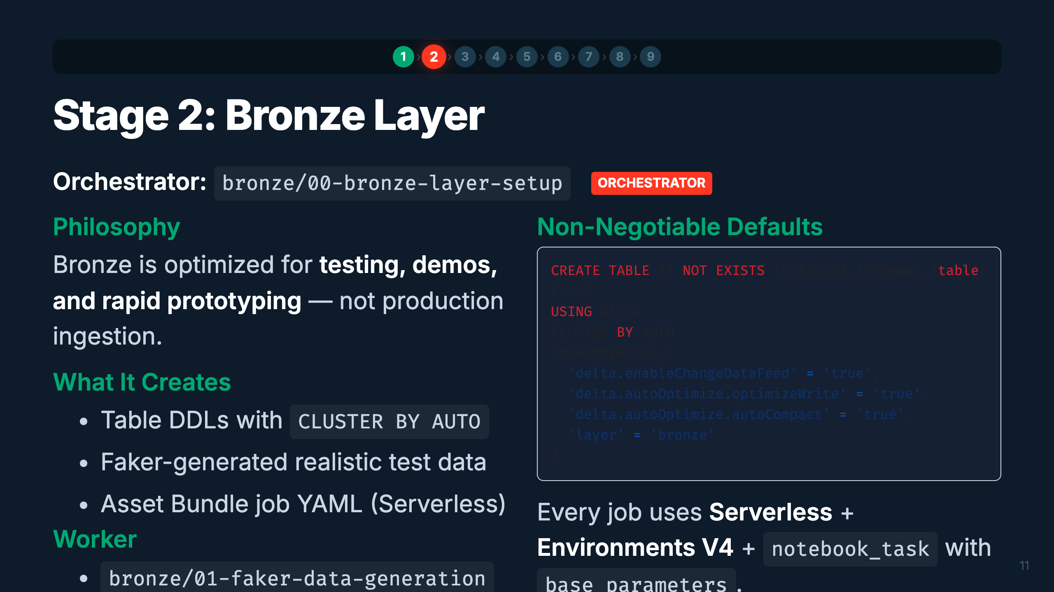
Notes:
Speaker: Bronze is our test data factory. The orchestrator reads the same schema CSV and creates
DDLs that match the source system. The Faker worker generates realistic synthetic data with
configurable corruption rates for testing data quality rules downstream. Everything runs Serverless.
Timing: ~2 min

Slide 15
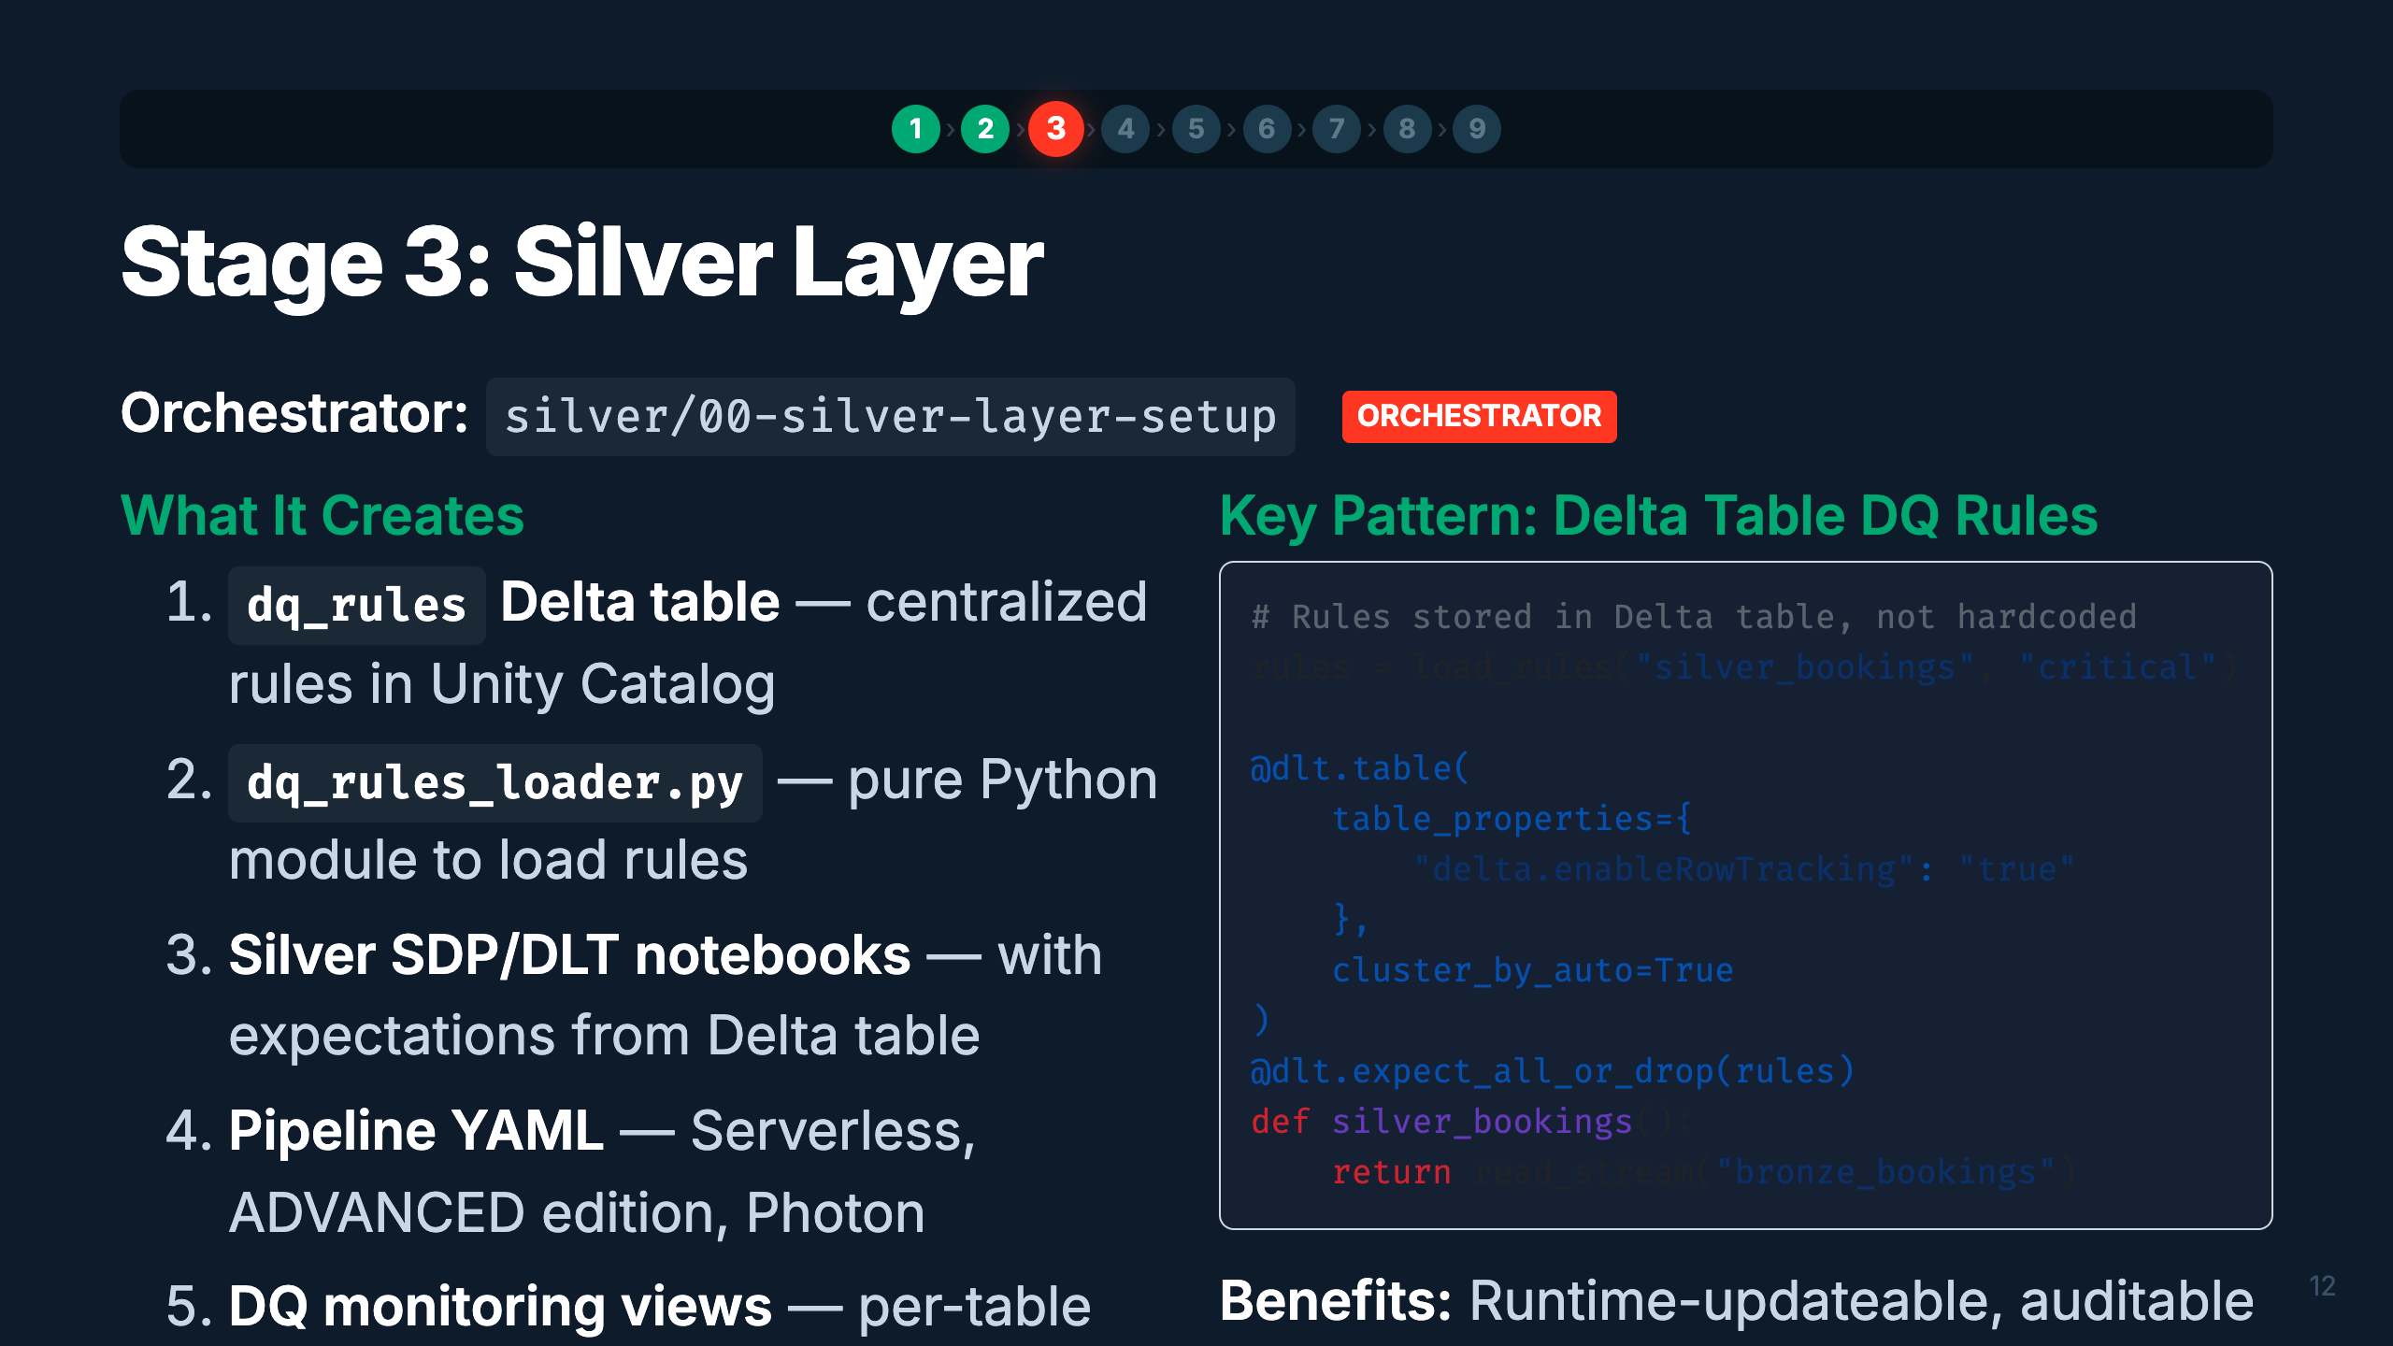
Notes:
Speaker: Silver is where data quality lives. The key pattern is storing DQ rules in a Delta table
rather than hardcoding them. This means you can update rules with a simple SQL UPDATE — no
redeployment needed. The orchestrator creates the rules table, the loader module, and the
DLT/SDP pipeline that applies them.
Timing: ~3 min

Slide 16
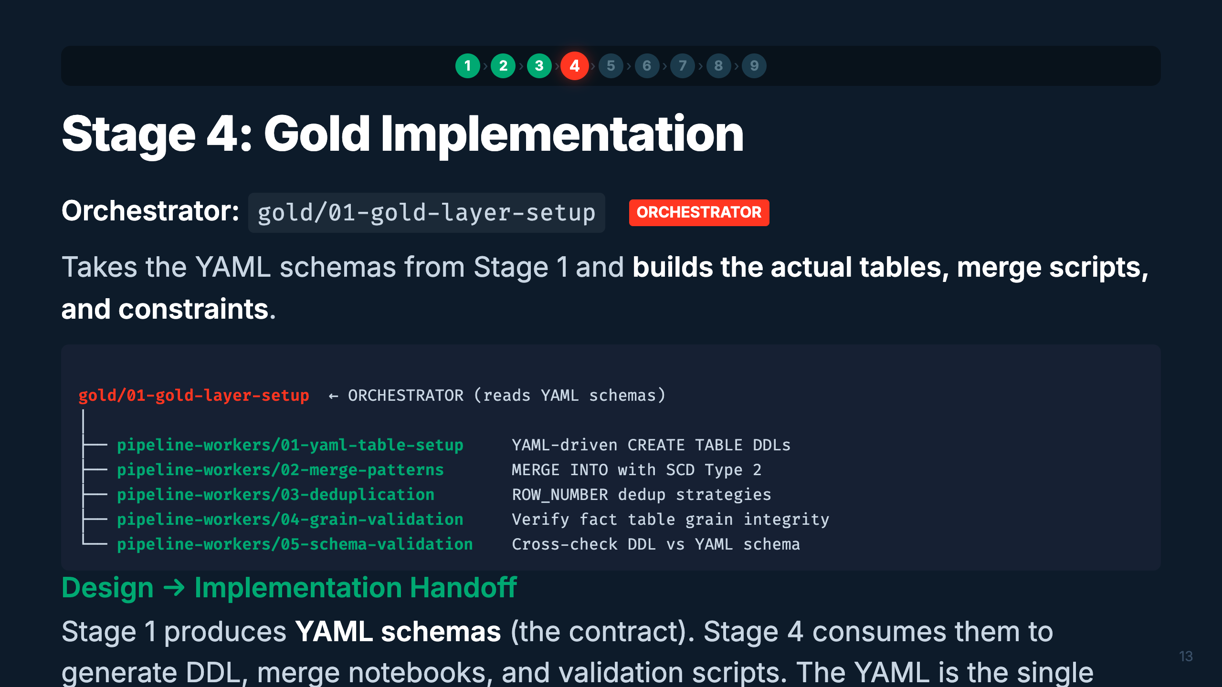
Notes:
Speaker: Stage 4 is the implementation counterpart to Stage 1's design. It reads the YAML schemas
and materializes them as actual Delta tables with proper MERGE scripts, deduplication logic, and
validation. Notice this is the same gold/ directory but different workers — pipeline-workers vs
design-workers. The YAML contract ensures design and implementation stay in sync.
Timing: ~2 min

Slide 17
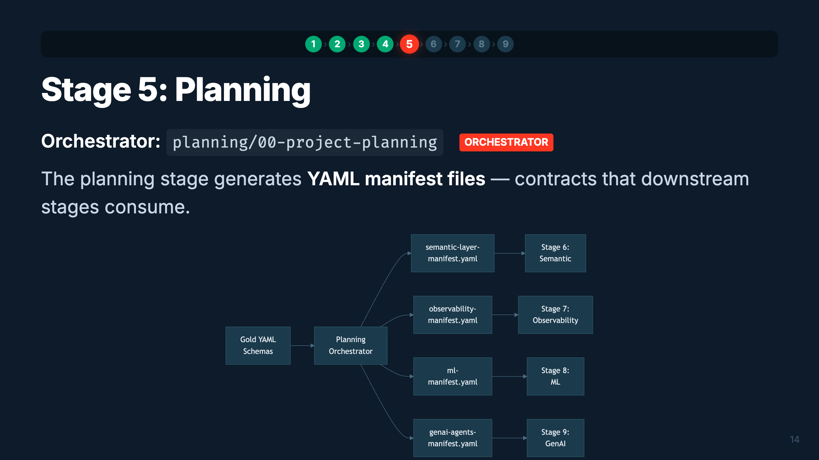
Notes:
Speaker: Planning is the coordination layer. It reads the Gold schemas and produces 4 YAML
manifests — one for each downstream stage. These manifests are contracts: they specify exactly
what metric views, monitors, ML models, and agents to build. If a manifest is missing (user
skipped planning), orchestrators fall back to self-discovery from Gold tables.
Timing: ~2 min

Slide 18
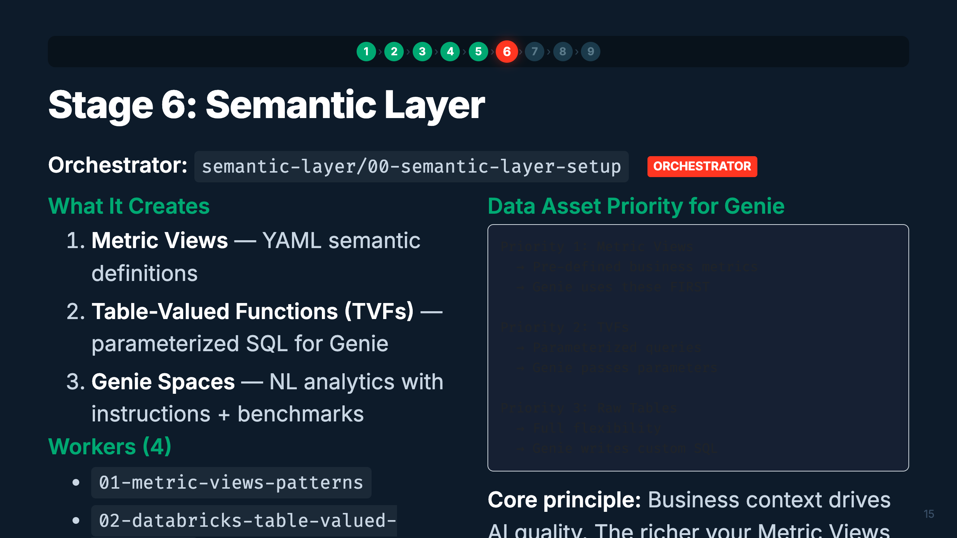
Notes:
Speaker: The semantic layer sits on top of Gold tables and makes them accessible to business
users via natural language. Metric Views are the highest priority — they pre-define business
metrics so Genie doesn't have to figure them out. TVFs handle parameterized patterns. Raw
tables are the fallback. The quality of Genie responses directly correlates with the depth
of context you provide.
Timing: ~3 min

Slide 19
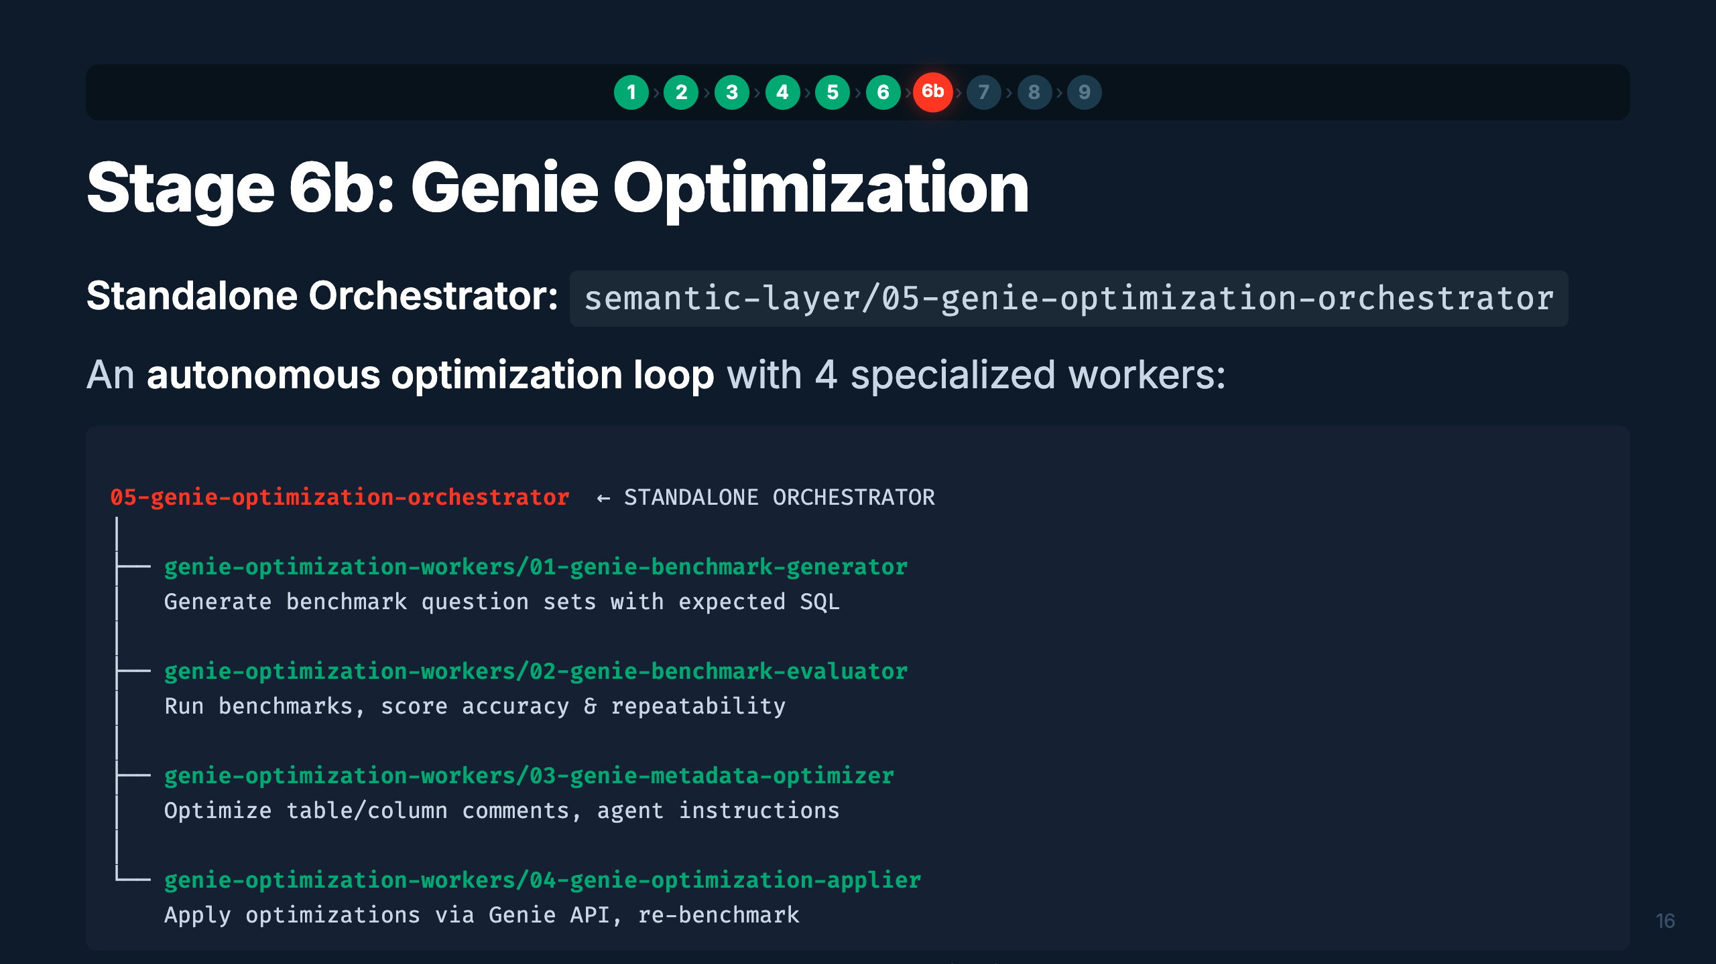
Notes:
Speaker: Stage 6b is unique — it's a standalone orchestrator with its own optimization loop.
It generates benchmark questions, evaluates Genie's accuracy, optimizes the metadata (comments,
instructions), applies changes via the API, and re-benchmarks. It's like a training loop for
your Genie Space.
Timing: ~2 min

Slide 20
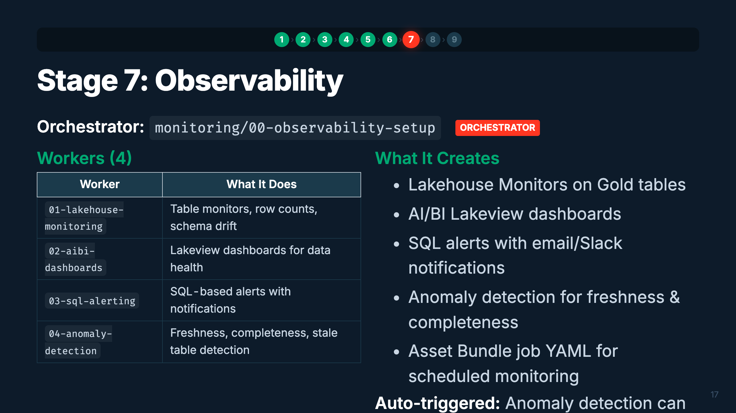
Notes:
Speaker: Observability ensures your data products stay healthy in production. Four workers cover
different aspects — monitoring tables, building dashboards, setting up alerts, and detecting
anomalies. The anomaly detection worker is special — it can auto-trigger after Silver or Gold
setup, adding freshness and completeness checks proactively.
Timing: ~2 min

Slide 21
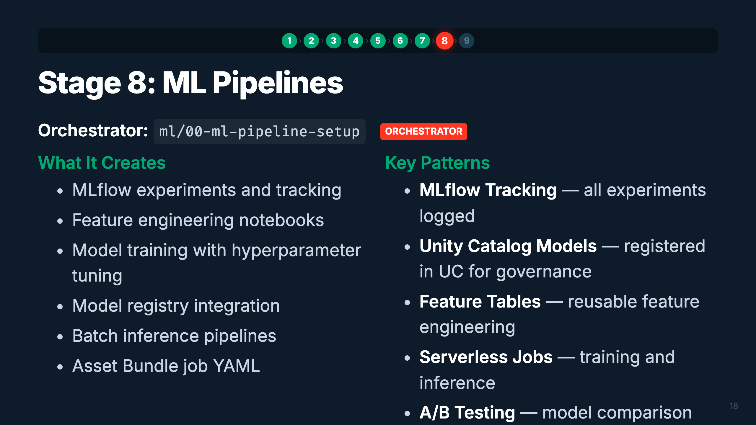
Notes:
Speaker: ML pipelines consume Gold tables as feature sources. The orchestrator sets up the full
MLflow workflow — experiments, training, model registry, and inference. Everything is governed
through Unity Catalog. Models registered here can be served as endpoints for GenAI agents in Stage 9.
Timing: ~1.5 min

Slide 22
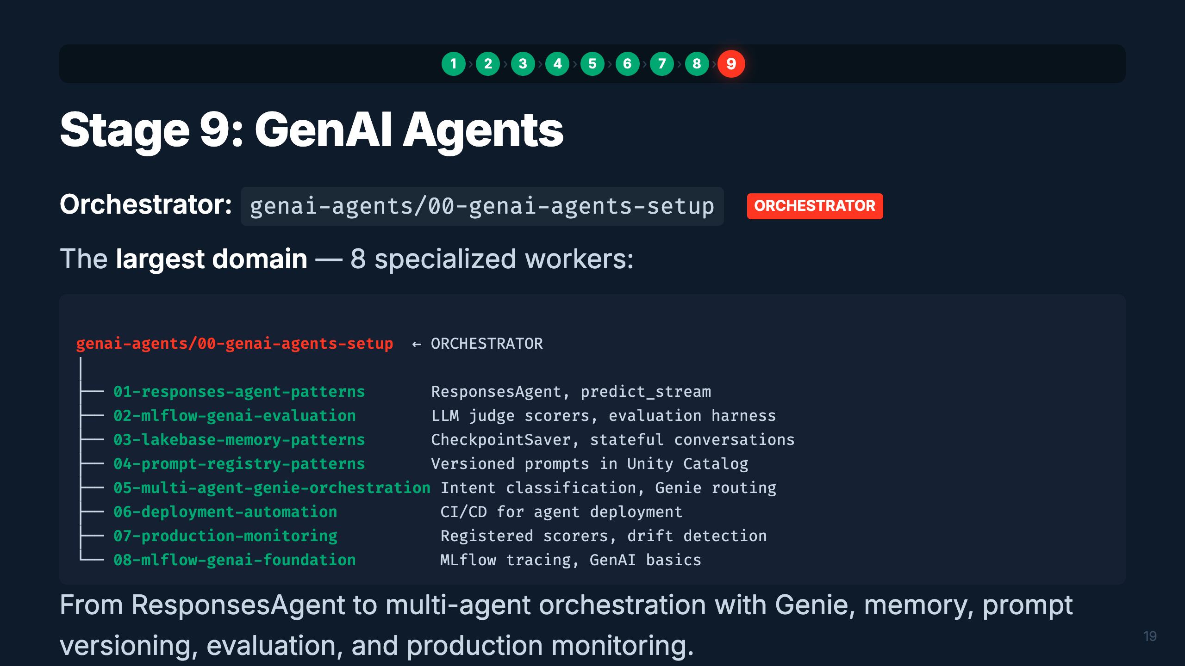
Notes:
Speaker: The GenAI domain is the most expansive — 8 workers covering the full agent lifecycle.
You start with the ResponsesAgent pattern, add memory via Lakebase, version prompts through
Unity Catalog, orchestrate multiple agents with Genie integration, evaluate with LLM judges,
deploy with CI/CD, and monitor in production. This is the capstone of the pipeline.
Timing: ~2 min

Slide 23
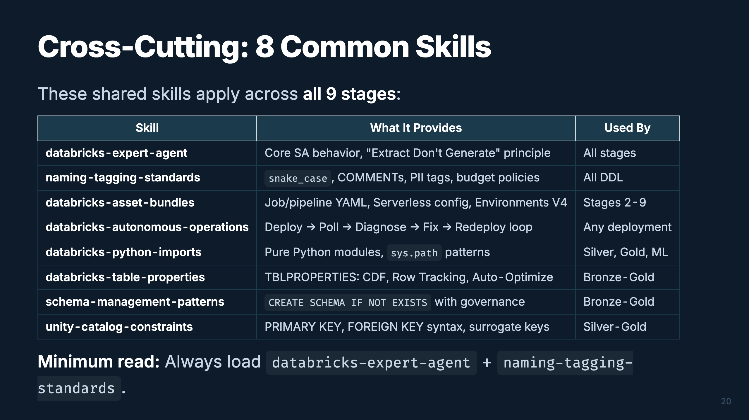
Notes:
Speaker: These 8 common skills are the shared foundation. They're not tied to any single stage —
orchestrators pull them in as dependencies. The two you should always have loaded are
expert-agent (core behavior) and naming-tagging-standards (enterprise naming). Asset-bundles
is critical for any deployment. Autonomous-operations handles the "deploy, wait, diagnose, fix,
redeploy" loop automatically.
Timing: ~2 min

Slide 24
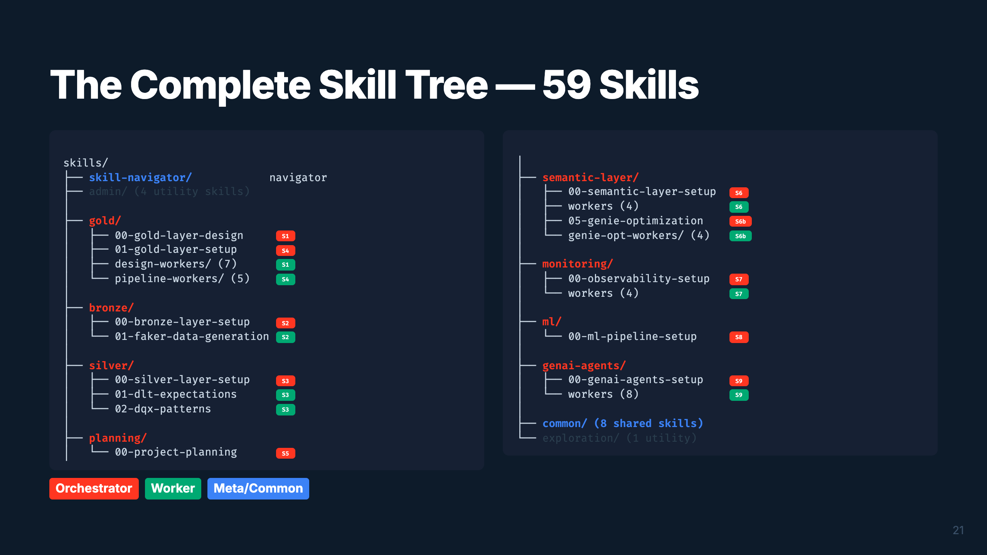
Notes:
Speaker: Here's the entire tree — 59 skills organized by domain. Orange badges are orchestrators
(entry points), green are workers (specific patterns). The skill-navigator routes to the right
one based on keywords. Common skills (8) are shared dependencies. This tree IS the framework.
Timing: ~2 min

Slide 25
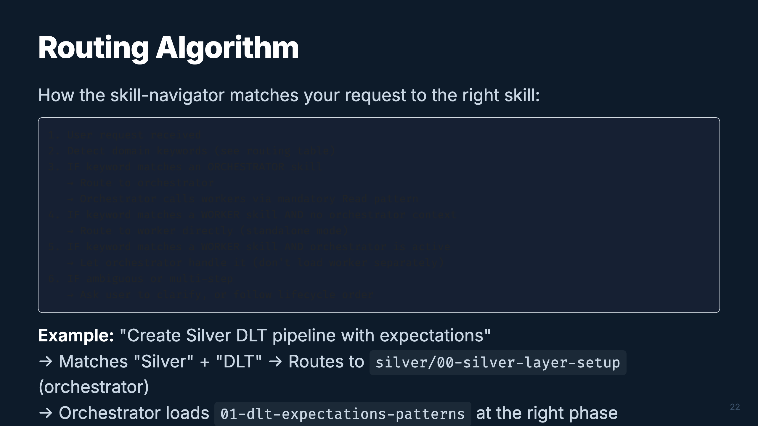
Notes:
Speaker: The routing algorithm is simple but effective. Keywords drive everything. The key rule:
prefer orchestrators for end-to-end work, workers for specific standalone tasks. The orchestrator
manages when to load each worker — you never need to manually sequence them.
Timing: ~1.5 min

Slide 26
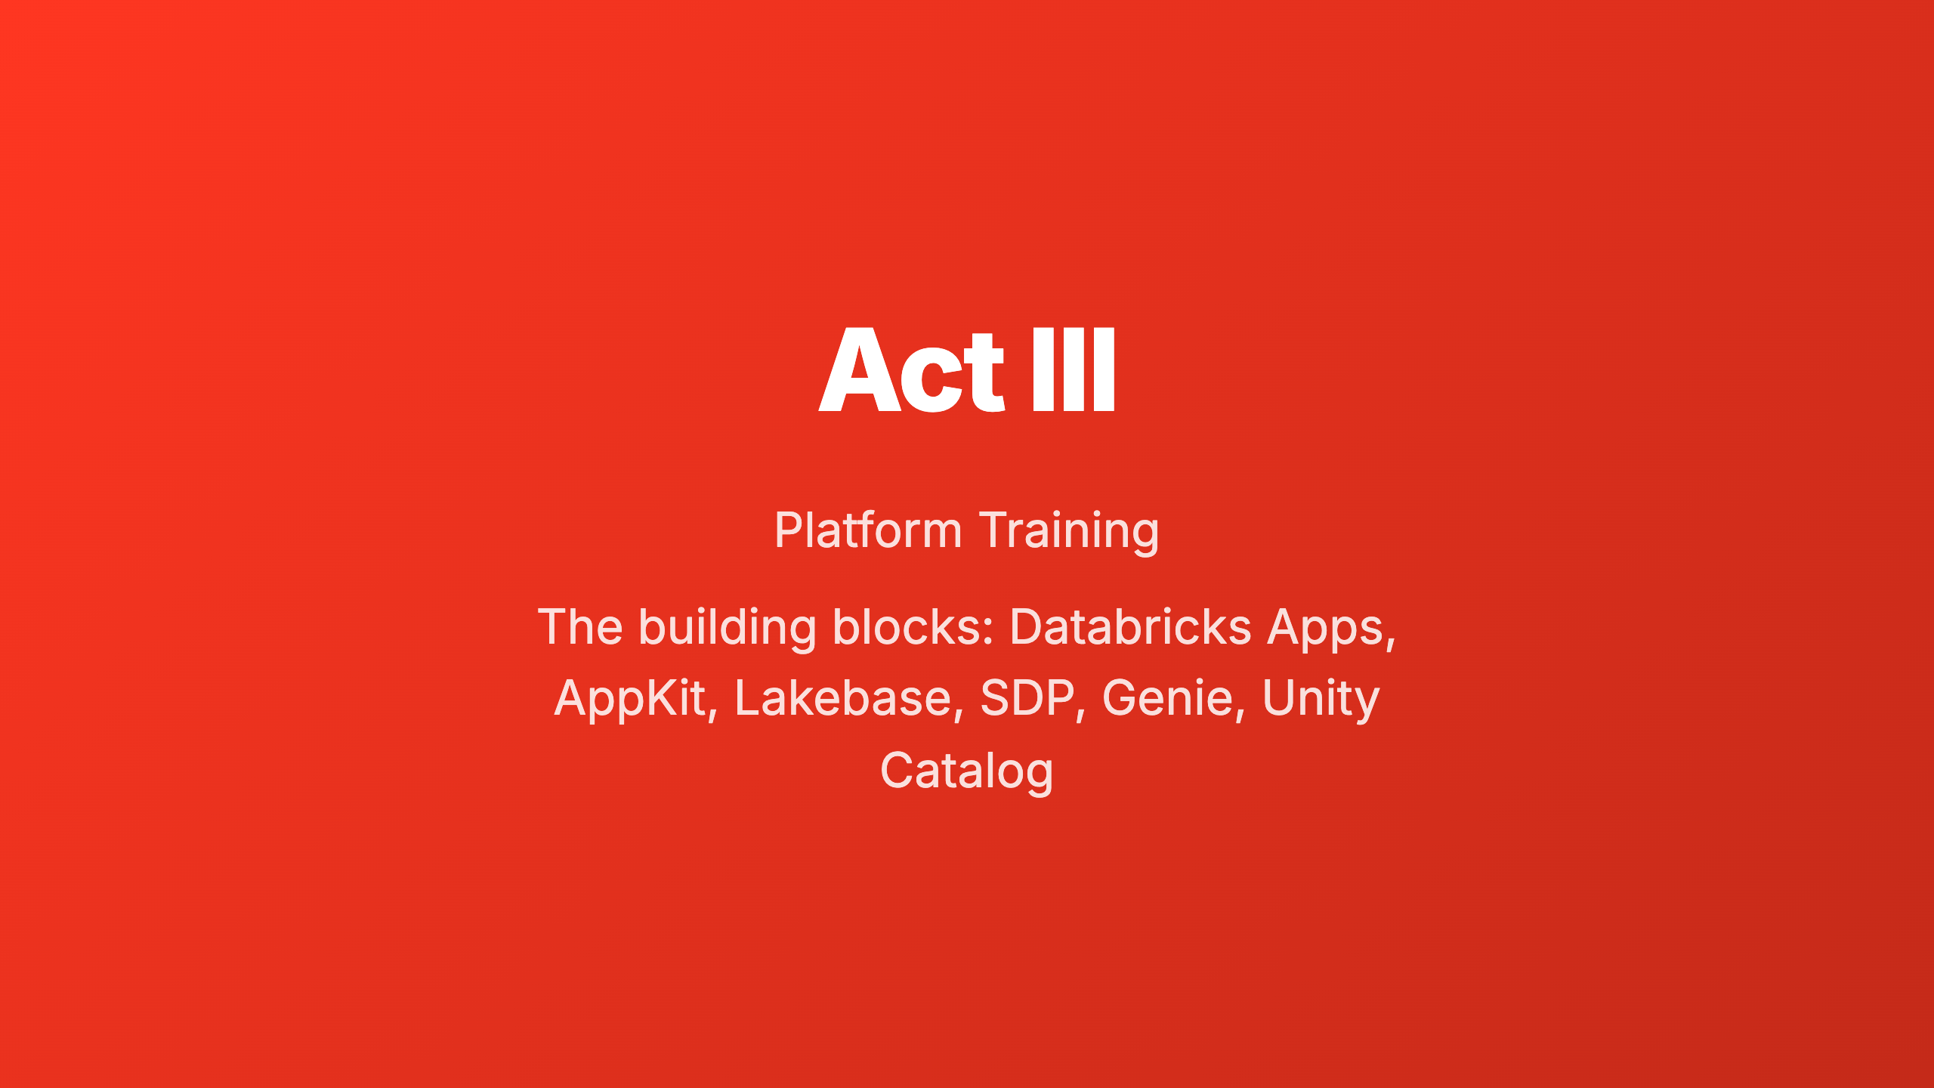
Notes:
_transition: cover
Speaker: Before we dive into the hands-on workshop, let's make sure everyone understands the
platform components we'll be building on. Six mini-modules, each 2-3 slides, covering the key
concepts and architecture patterns.
Timing: ~30 sec transition

Slide 27
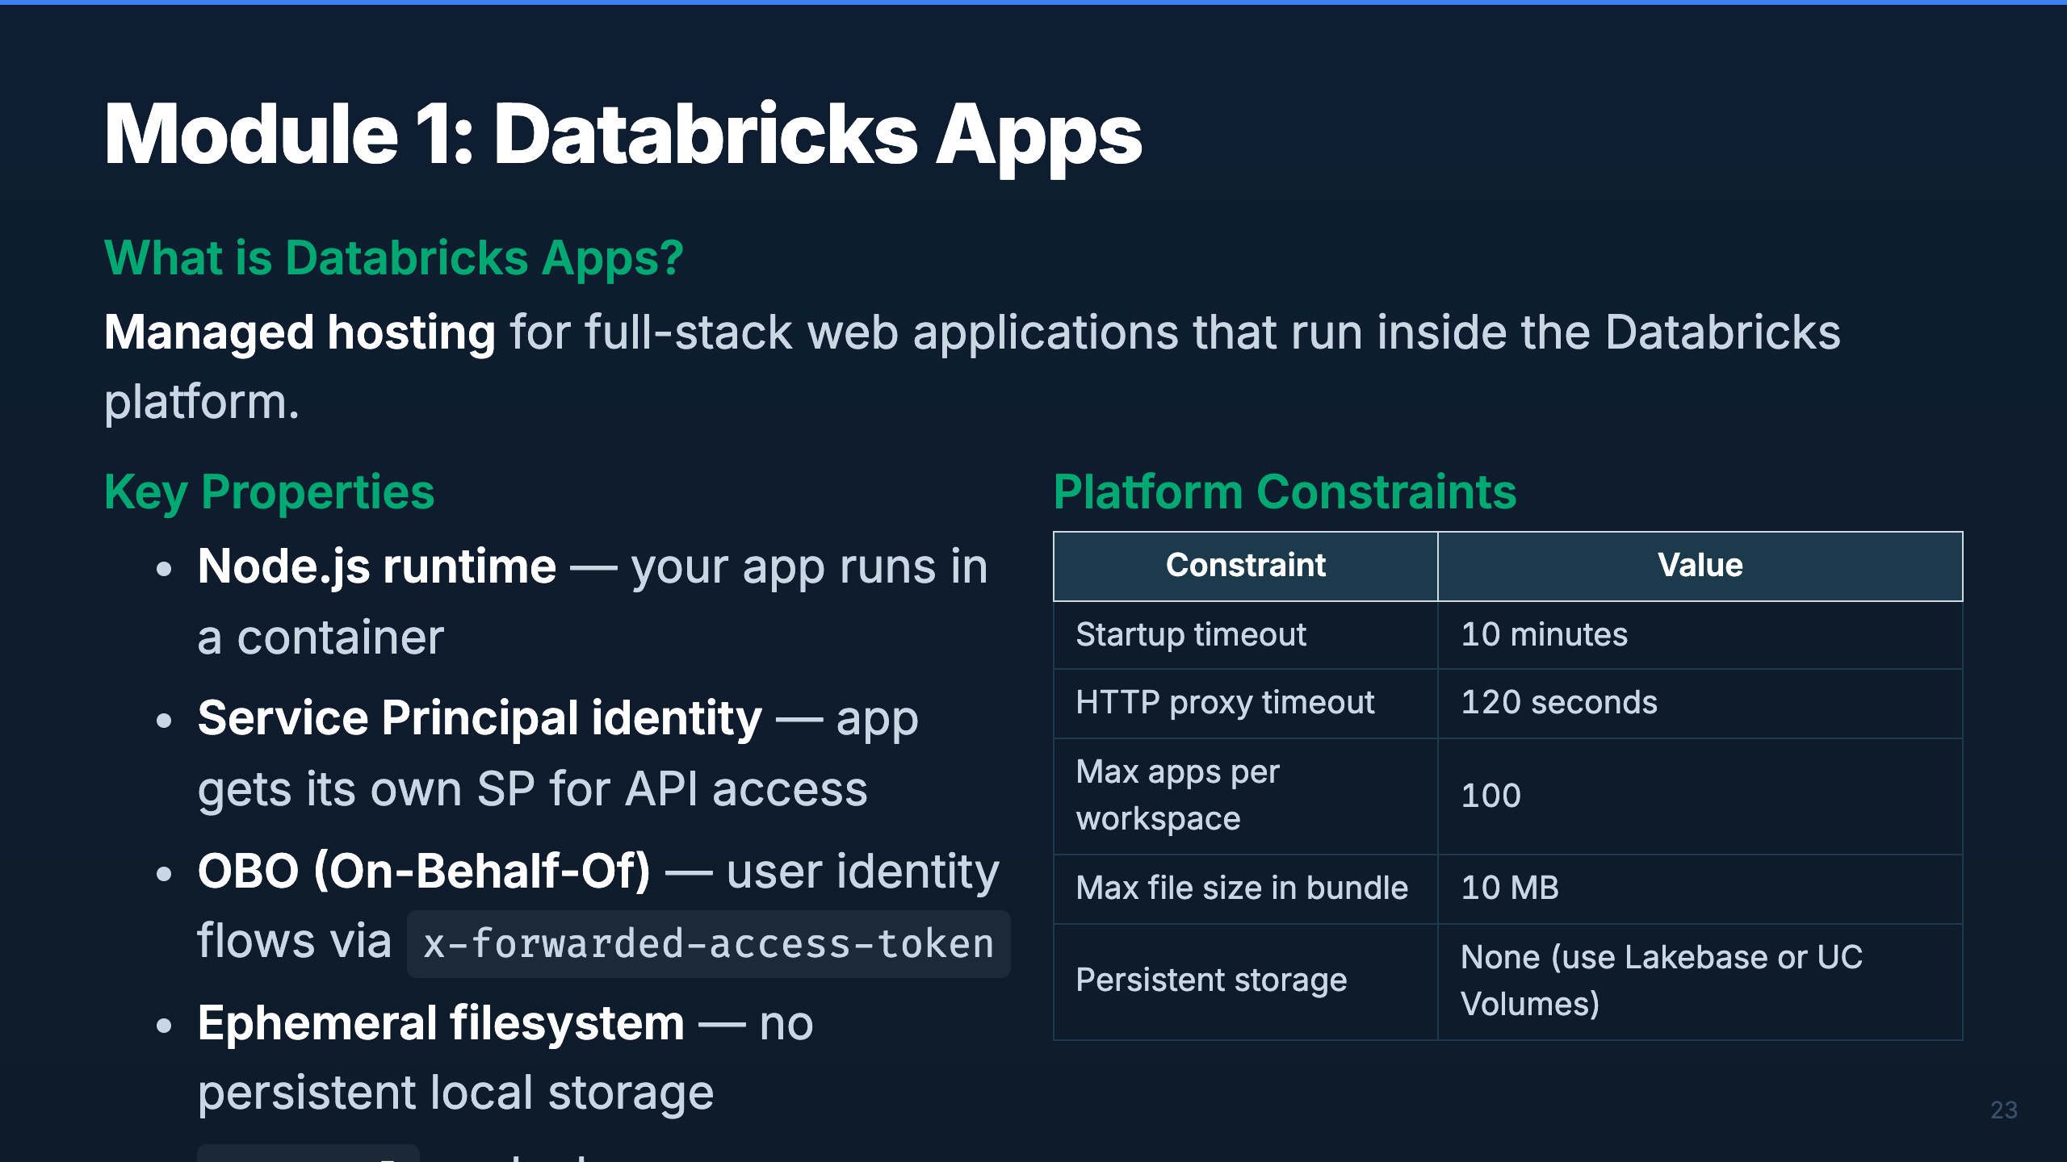
Notes:
Speaker: Databricks Apps is a managed hosting service. Your app gets a container with Node.js,
a Service Principal for API calls, and auto-injected environment variables. The key constraint
is the ephemeral filesystem — anything your app writes locally is lost on restart. That's why
we use Lakebase for persistence and UC Volumes for files.
Timing: ~2 min

Slide 28
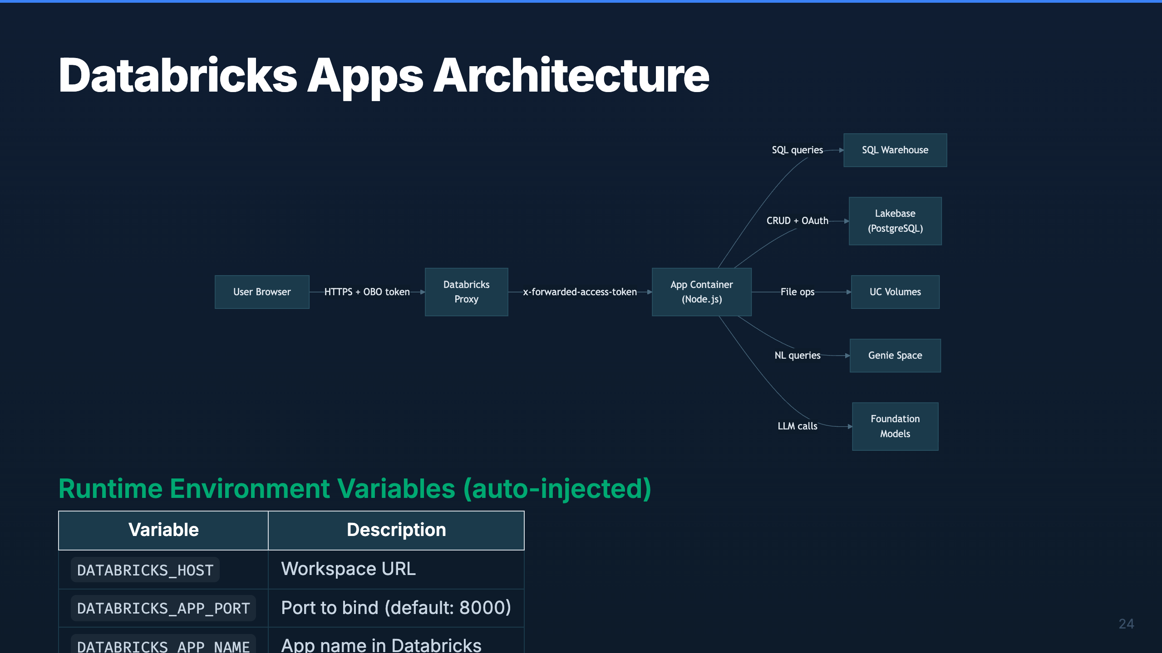
Notes:
Speaker: The architecture is straightforward. Users hit the Databricks proxy, which forwards
requests to your app container. The proxy attaches the user's access token so your app can
make OBO calls. Your app connects to backend services — SQL Warehouse for analytics, Lakebase
for CRUD, UC Volumes for files, Genie for NL queries, and Foundation Models for LLM calls.
Timing: ~2 min

Slide 29
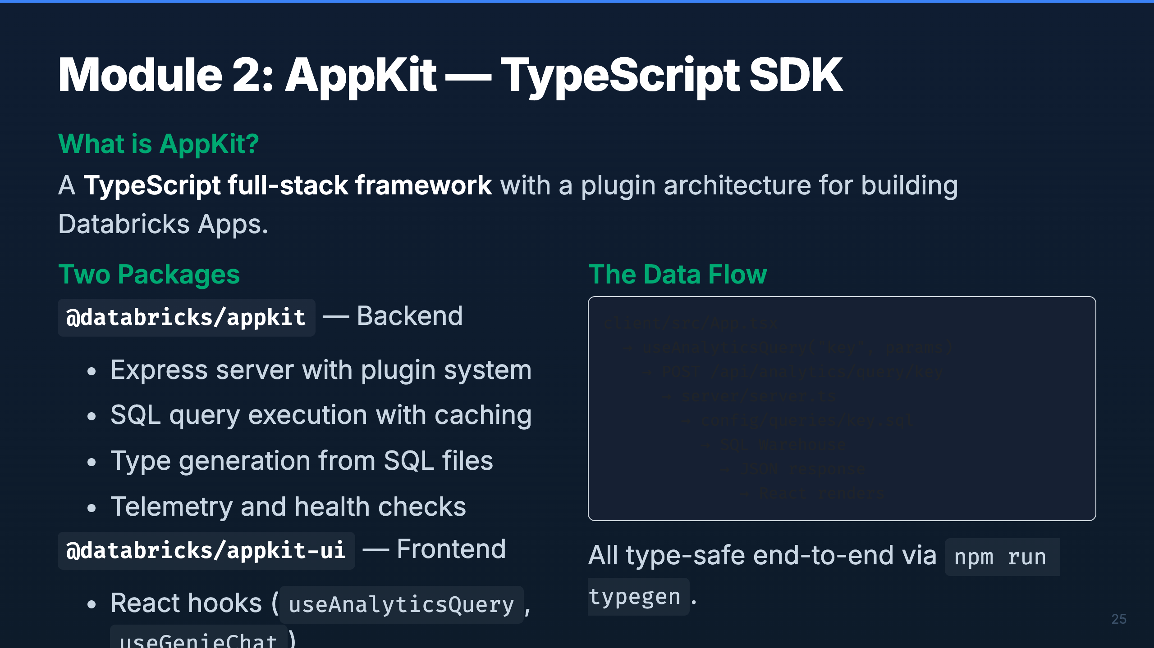
Notes:
Speaker: AppKit gives you a TypeScript backend and a React frontend in one package. The backend
handles SQL query execution with caching and retries. The frontend provides type-safe hooks
that call those queries. The typegen step bridges them — it reads your SQL files and generates
TypeScript types automatically.
Timing: ~2 min

Slide 30
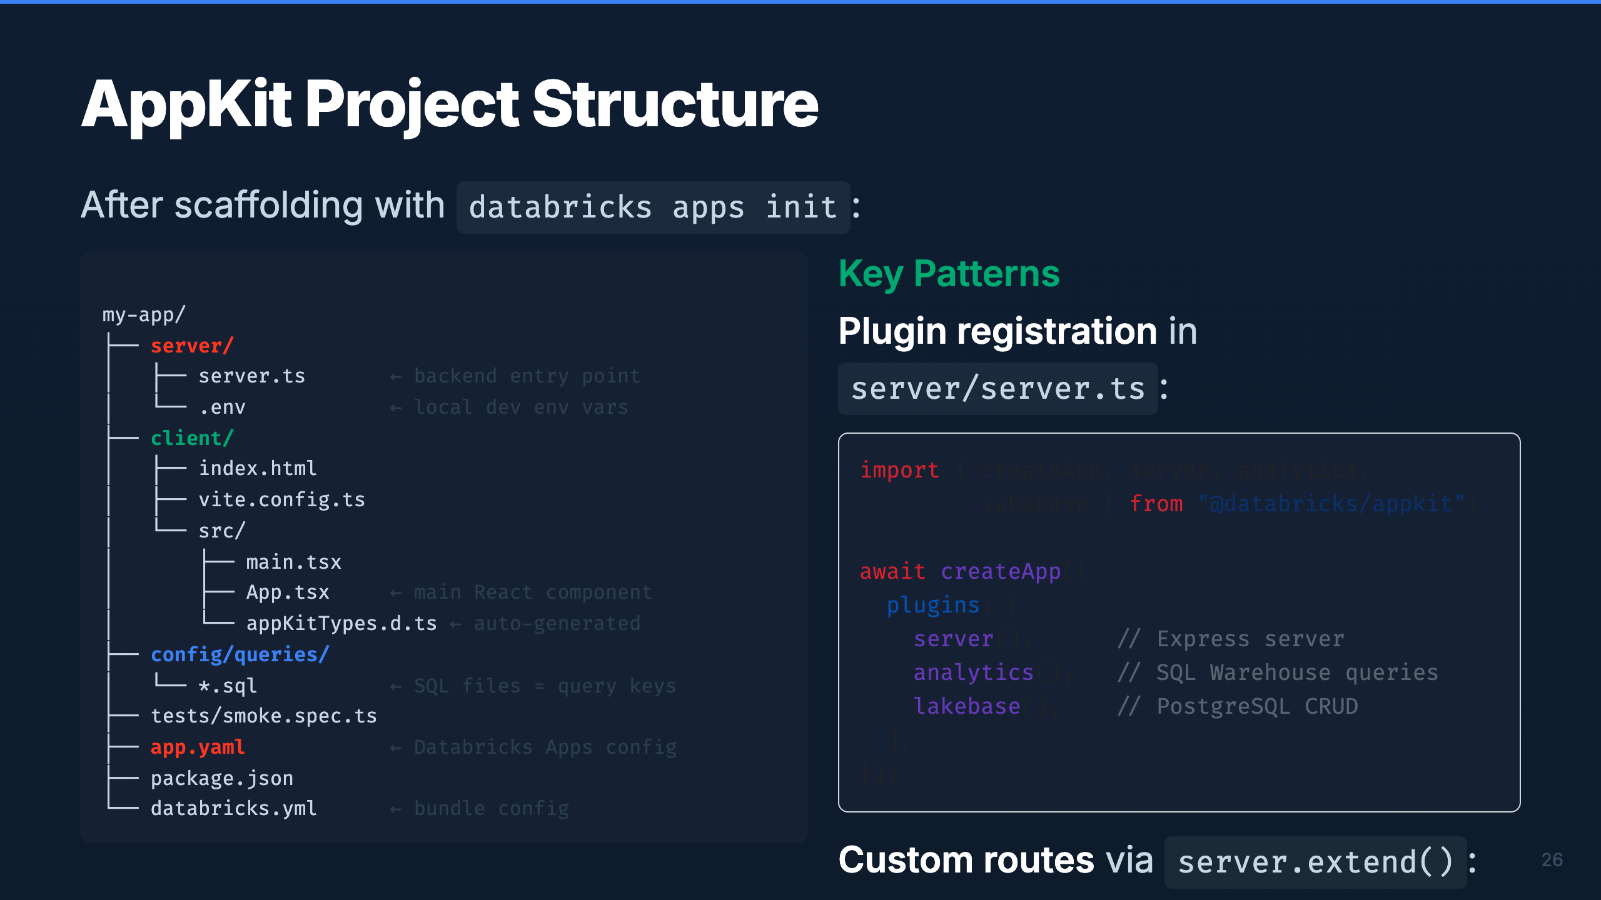
Notes:
Speaker: This is the canonical project layout. Server code in server/, React in client/, SQL
queries in config/queries/. The filename of each .sql file becomes the query key. Plugin
registration happens in server.ts — you compose plugins freely. For custom API routes beyond
what plugins provide, use server.extend().
Timing: ~2 min

Slide 31
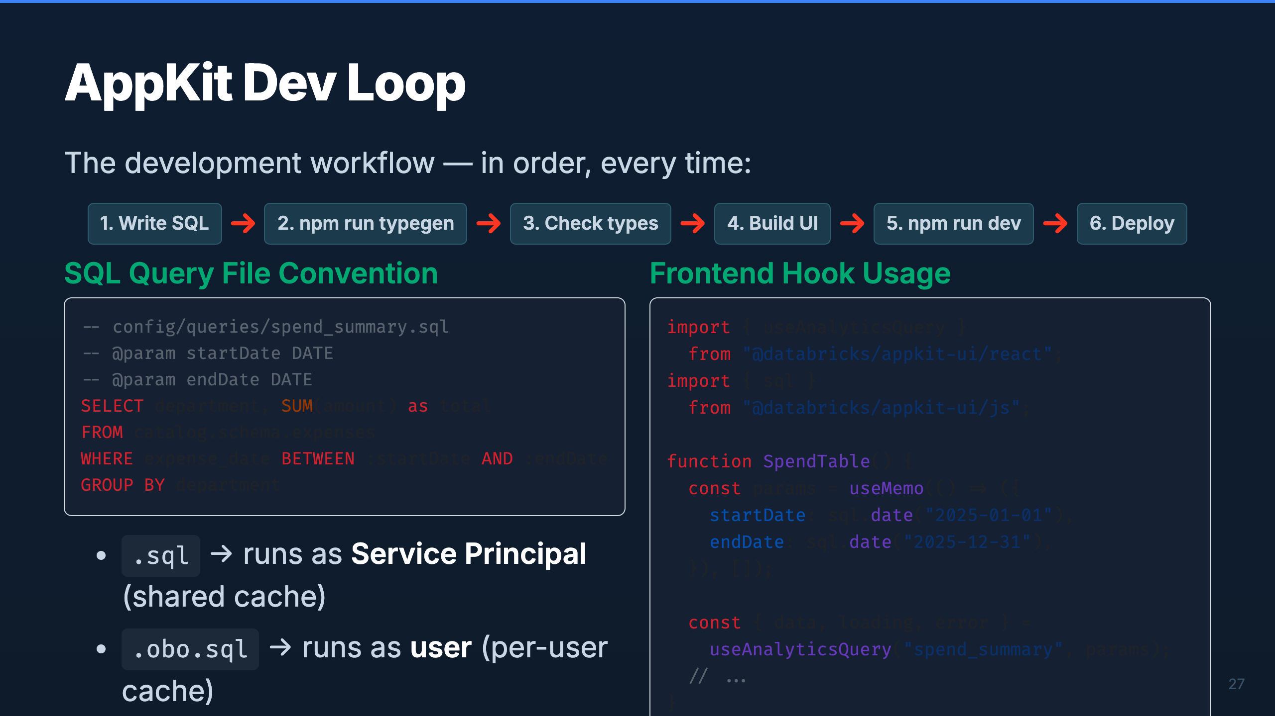
Notes:
Speaker: The dev loop is strict — SQL first, typegen second, UI third. Never write UI code before
running typegen or your types won't exist. The SQL file convention is powerful — the filename
becomes the API endpoint, and .obo.sql runs as the user for per-user access control. On the
frontend, always memoize your params to avoid infinite refetch loops.
Timing: ~2 min

Slide 32
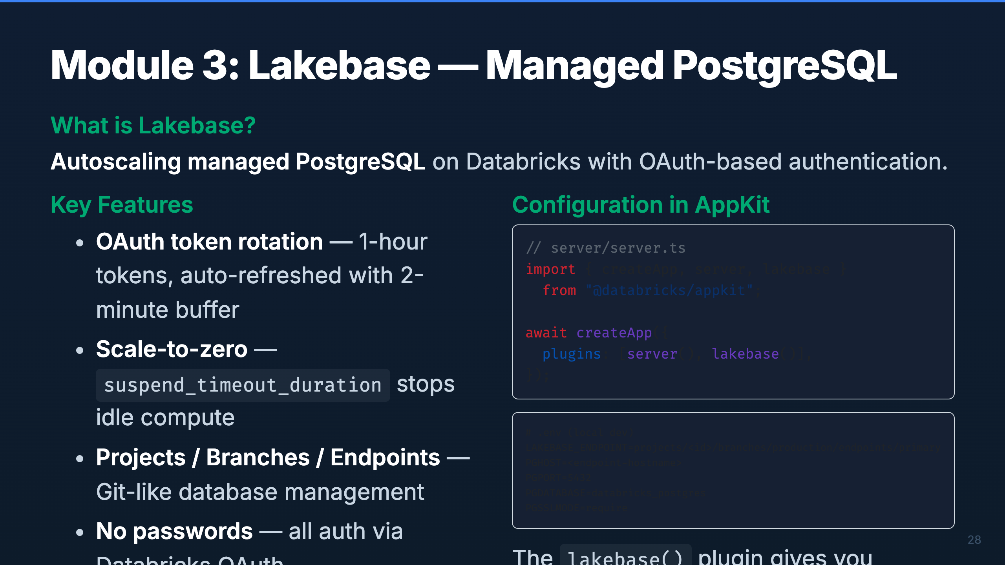
Notes:
Speaker: Lakebase is managed Postgres — but with OAuth instead of passwords. The plugin handles
token rotation automatically (tokens expire every hour, refreshed 2 minutes early). The key
architectural decision: use Lakebase for CRUD operations (writes, user data, app state) and
SQL Warehouse for read-only analytics (dashboards, aggregations). They complement each other.
Timing: ~2 min

Slide 33
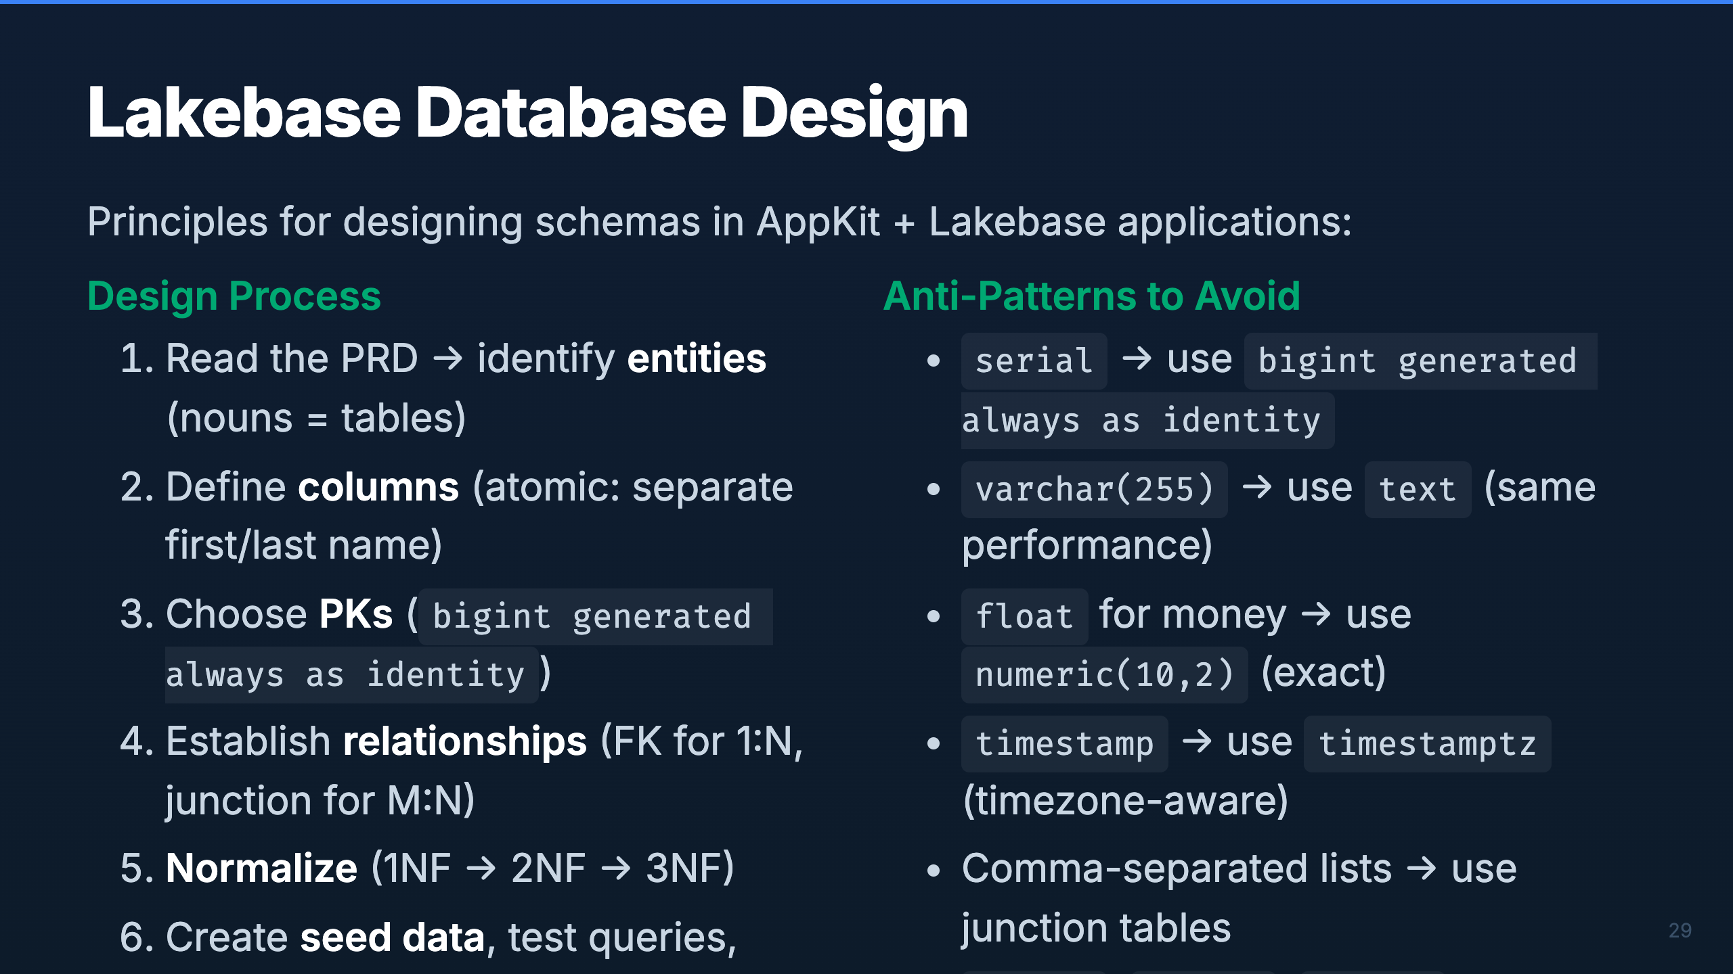
Notes:
Speaker: Database design follows standard relational principles, but with Postgres-specific
conventions. Key callouts: use bigint identity (not serial), text (not varchar), numeric for
money (not float), and timestamptz (always timezone-aware). Schema isolation via DB_SCHEMA
prevents apps from stepping on each other's tables.
Timing: ~2 min

Slide 34
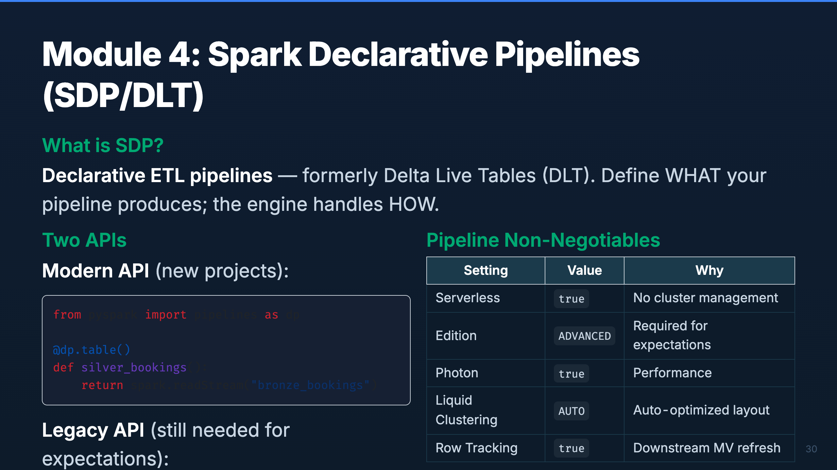
Notes:
Speaker: SDP (formerly DLT) lets you define pipelines declaratively. The engine manages execution,
retries, and dependencies. There are two Python APIs — the modern dp API and the legacy dlt API.
We still need the legacy API for data quality expectations. Everything runs Serverless with
ADVANCED edition for full feature access.
Timing: ~2 min

Slide 35
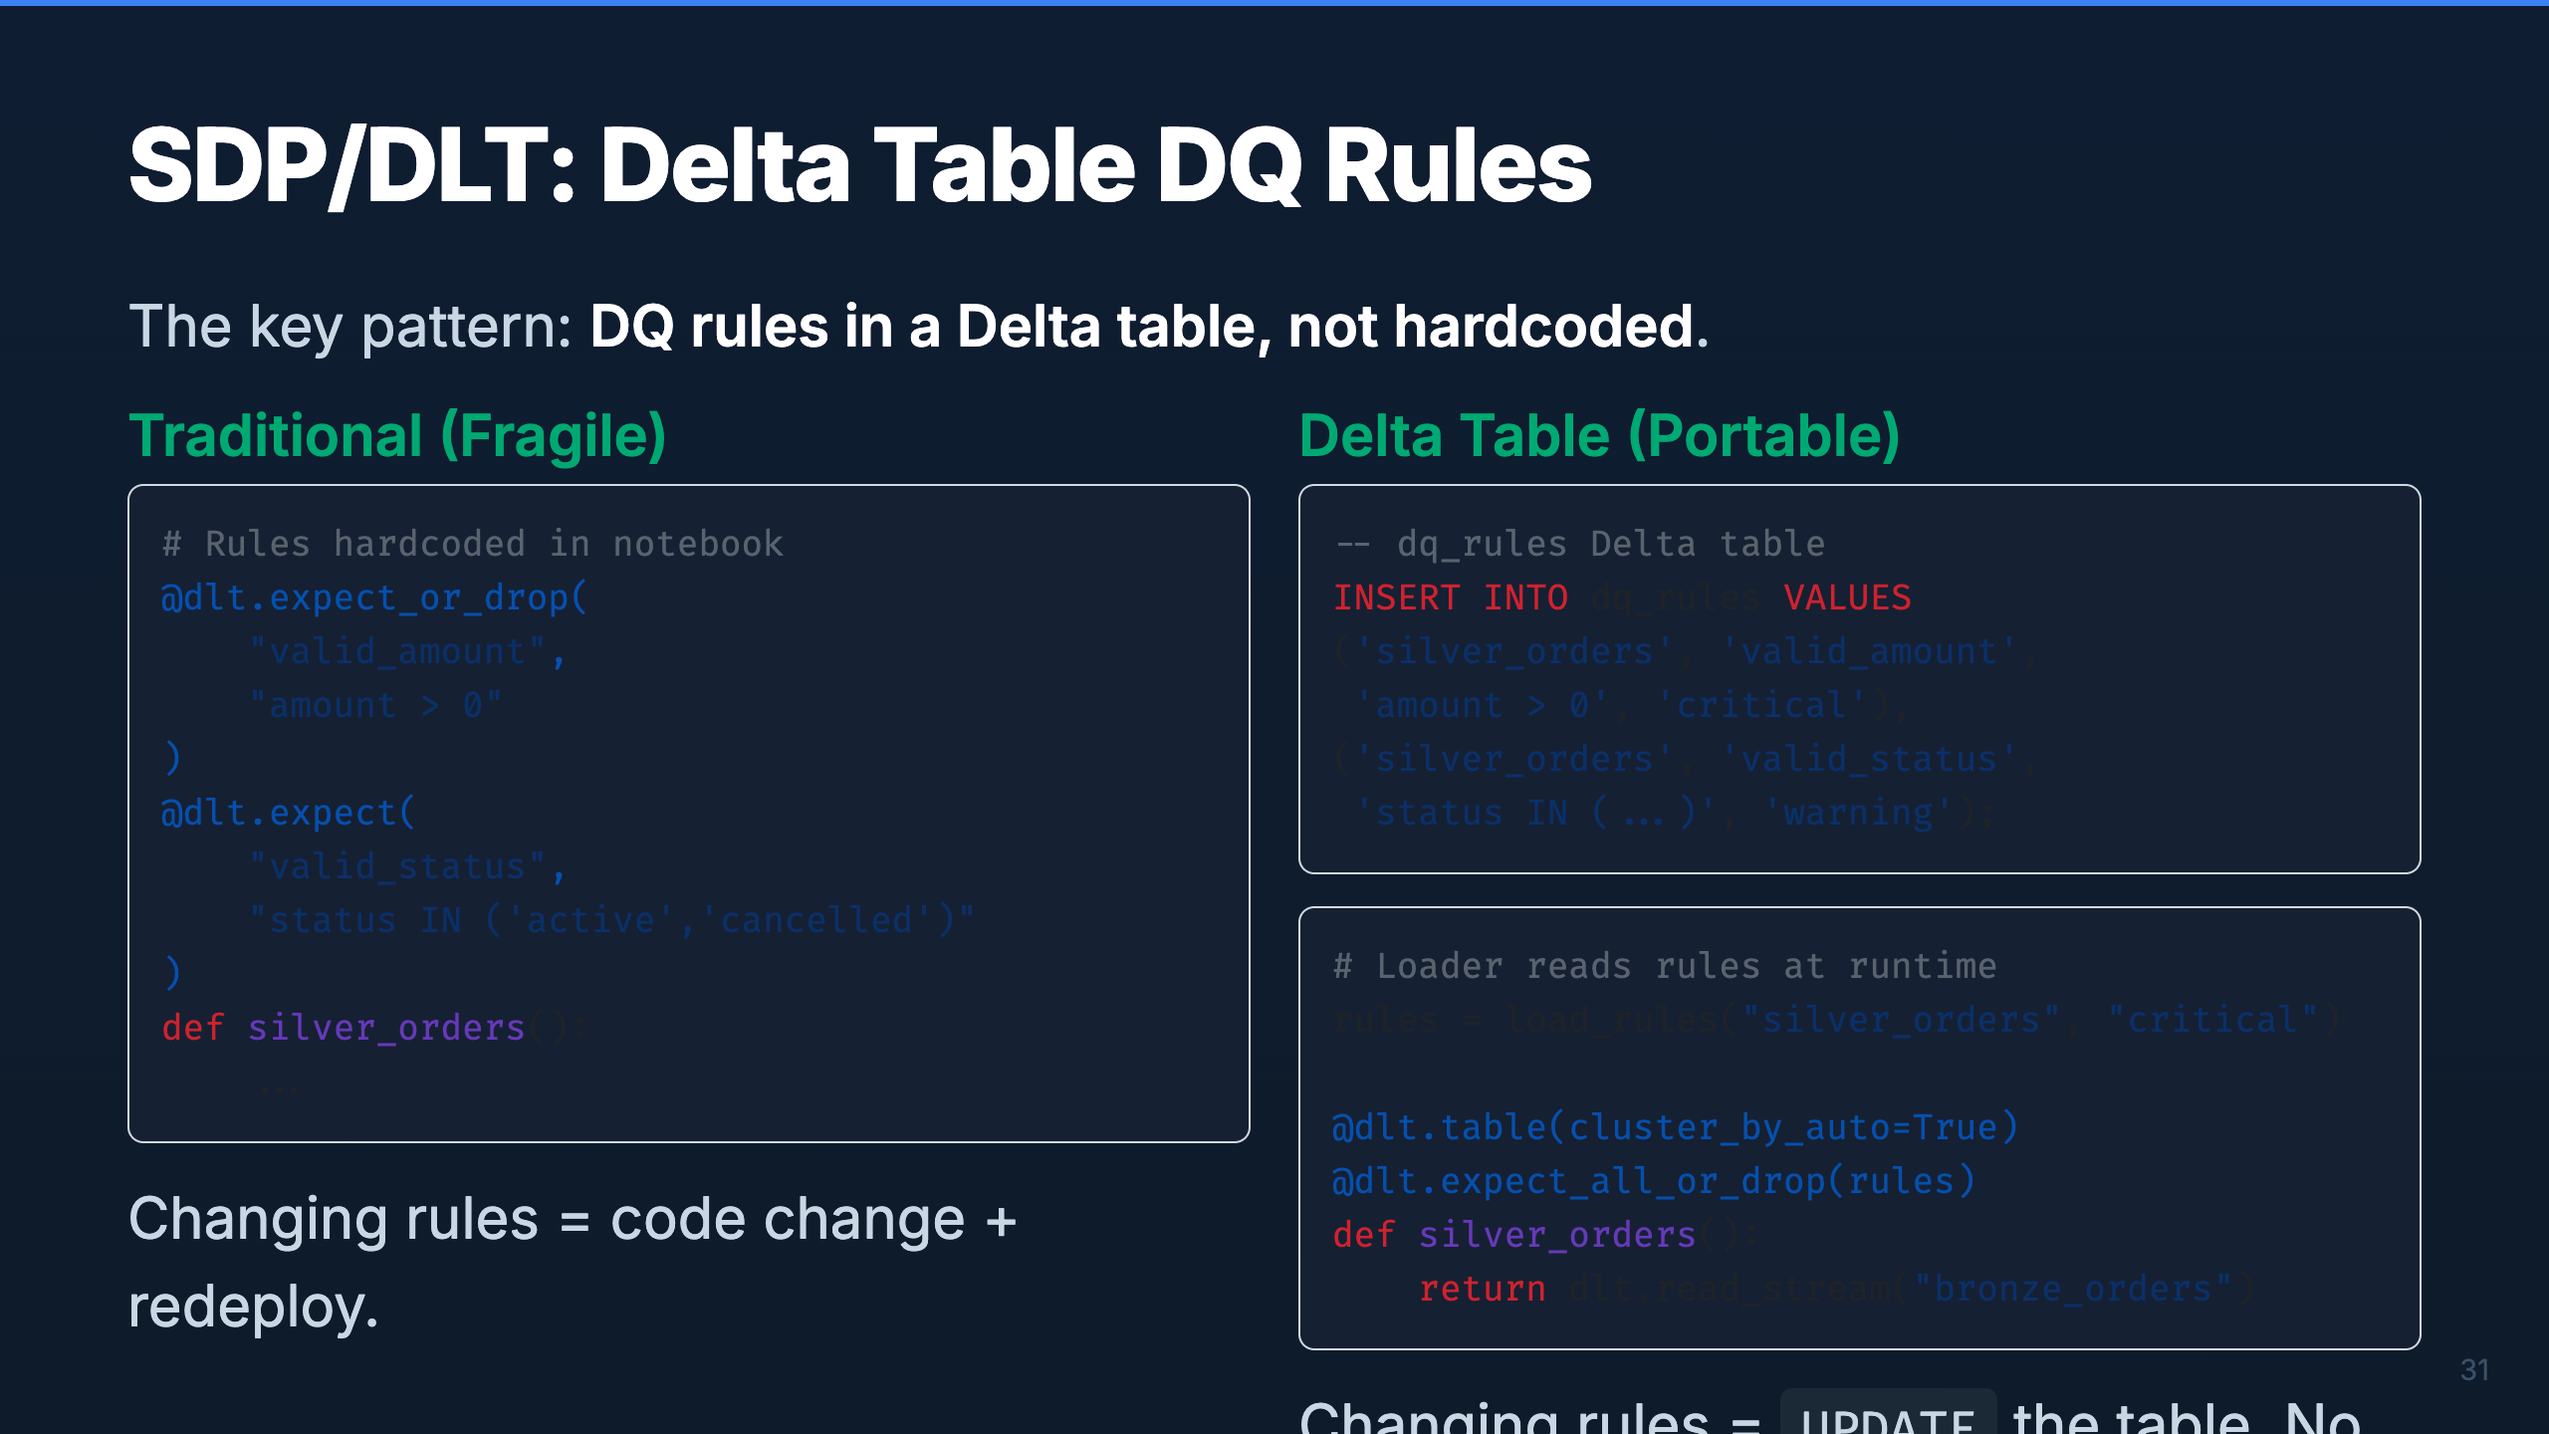
Notes:
Speaker: This is the single most impactful pattern in the Silver layer. By storing DQ rules in
a Delta table, you decouple rule management from code deployment. Data stewards can update rules
with SQL. The pipeline picks them up on the next run. Critical rules drop bad records; warning
rules log them but pass through. Delta time travel gives you a full audit history.
Timing: ~2 min

Slide 36
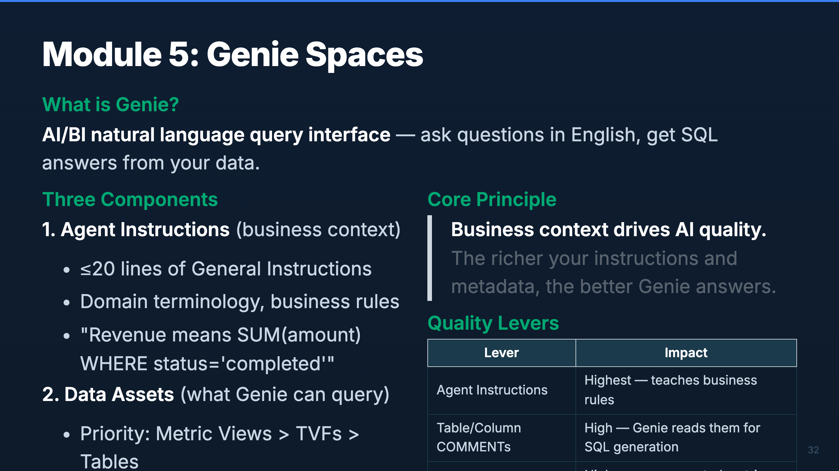
Notes:
Speaker: Genie translates natural language to SQL. The quality of its output depends entirely
on the context you provide. Agent instructions are the highest-impact lever — they teach Genie
your business rules. Table and column COMMENTs are next — Genie reads them when generating SQL.
Metric Views pre-define common aggregations so Genie doesn't have to figure them out.
Timing: ~2 min

Slide 37
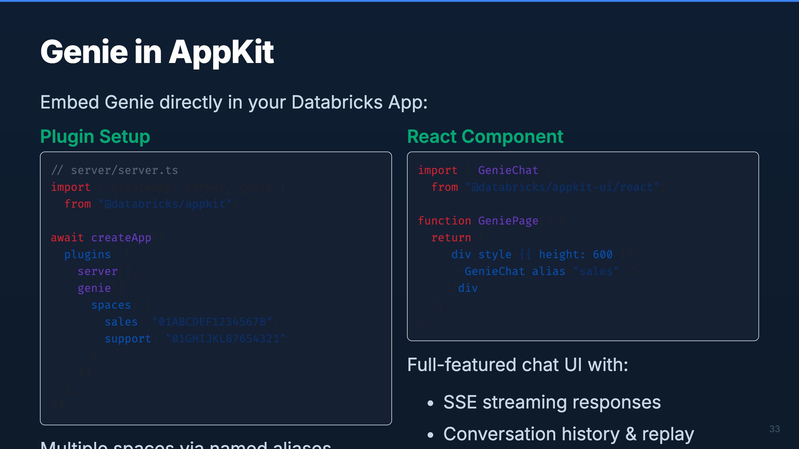
Notes:
Speaker: The Genie plugin makes it trivial to embed natural language analytics in your app. You
configure named space aliases in the server, then drop the GenieChat component in your React UI.
It handles streaming, history, and reconnection automatically. For custom UIs, the useGenieChat
hook gives you lower-level control over messages and status.
Timing: ~2 min

Slide 38
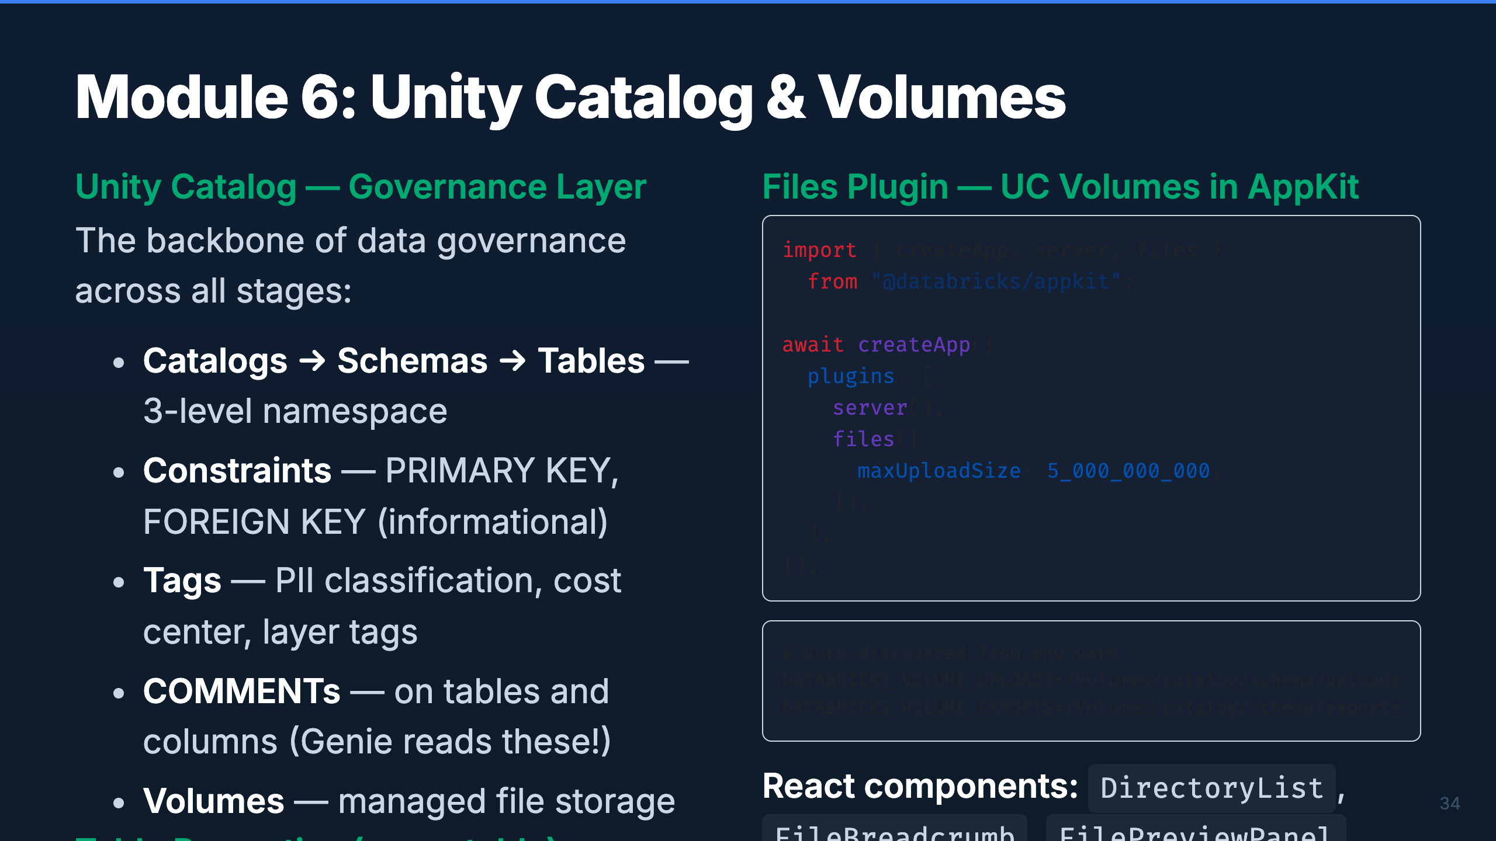
Notes:
Speaker: Unity Catalog is the governance layer that ties everything together. Every table, schema,
and volume is governed through UC. The key table properties — Change Data Feed, Row Tracking,
Auto-Optimize — are non-negotiable in this framework. The Files plugin connects AppKit to UC
Volumes for file upload/download, with env-based auto-discovery of volume paths.
Timing: ~2 min

Slide 39
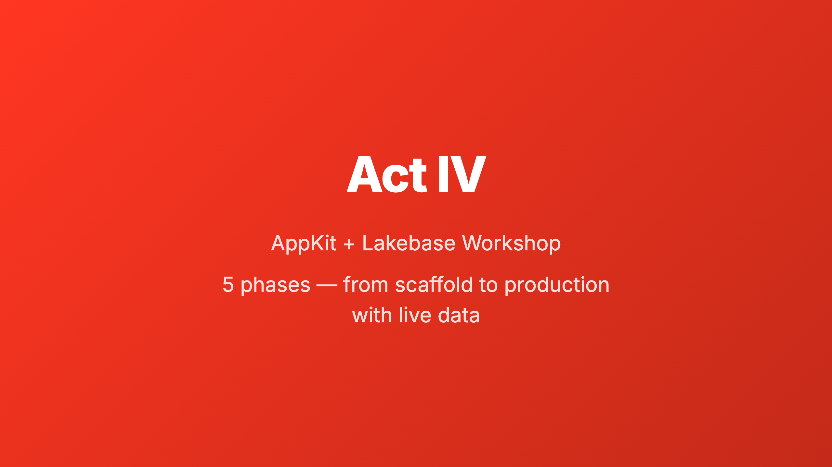
Notes:
_transition: cover
Speaker: Now for the hands-on part. We'll walk through the complete AppKit + Lakebase workshop
lifecycle — scaffolding a project, building a UI from a PRD, deploying with mock data, wiring
a Lakebase backend, and finally deploying with live data and running E2E tests.
Timing: ~30 sec transition

Slide 40
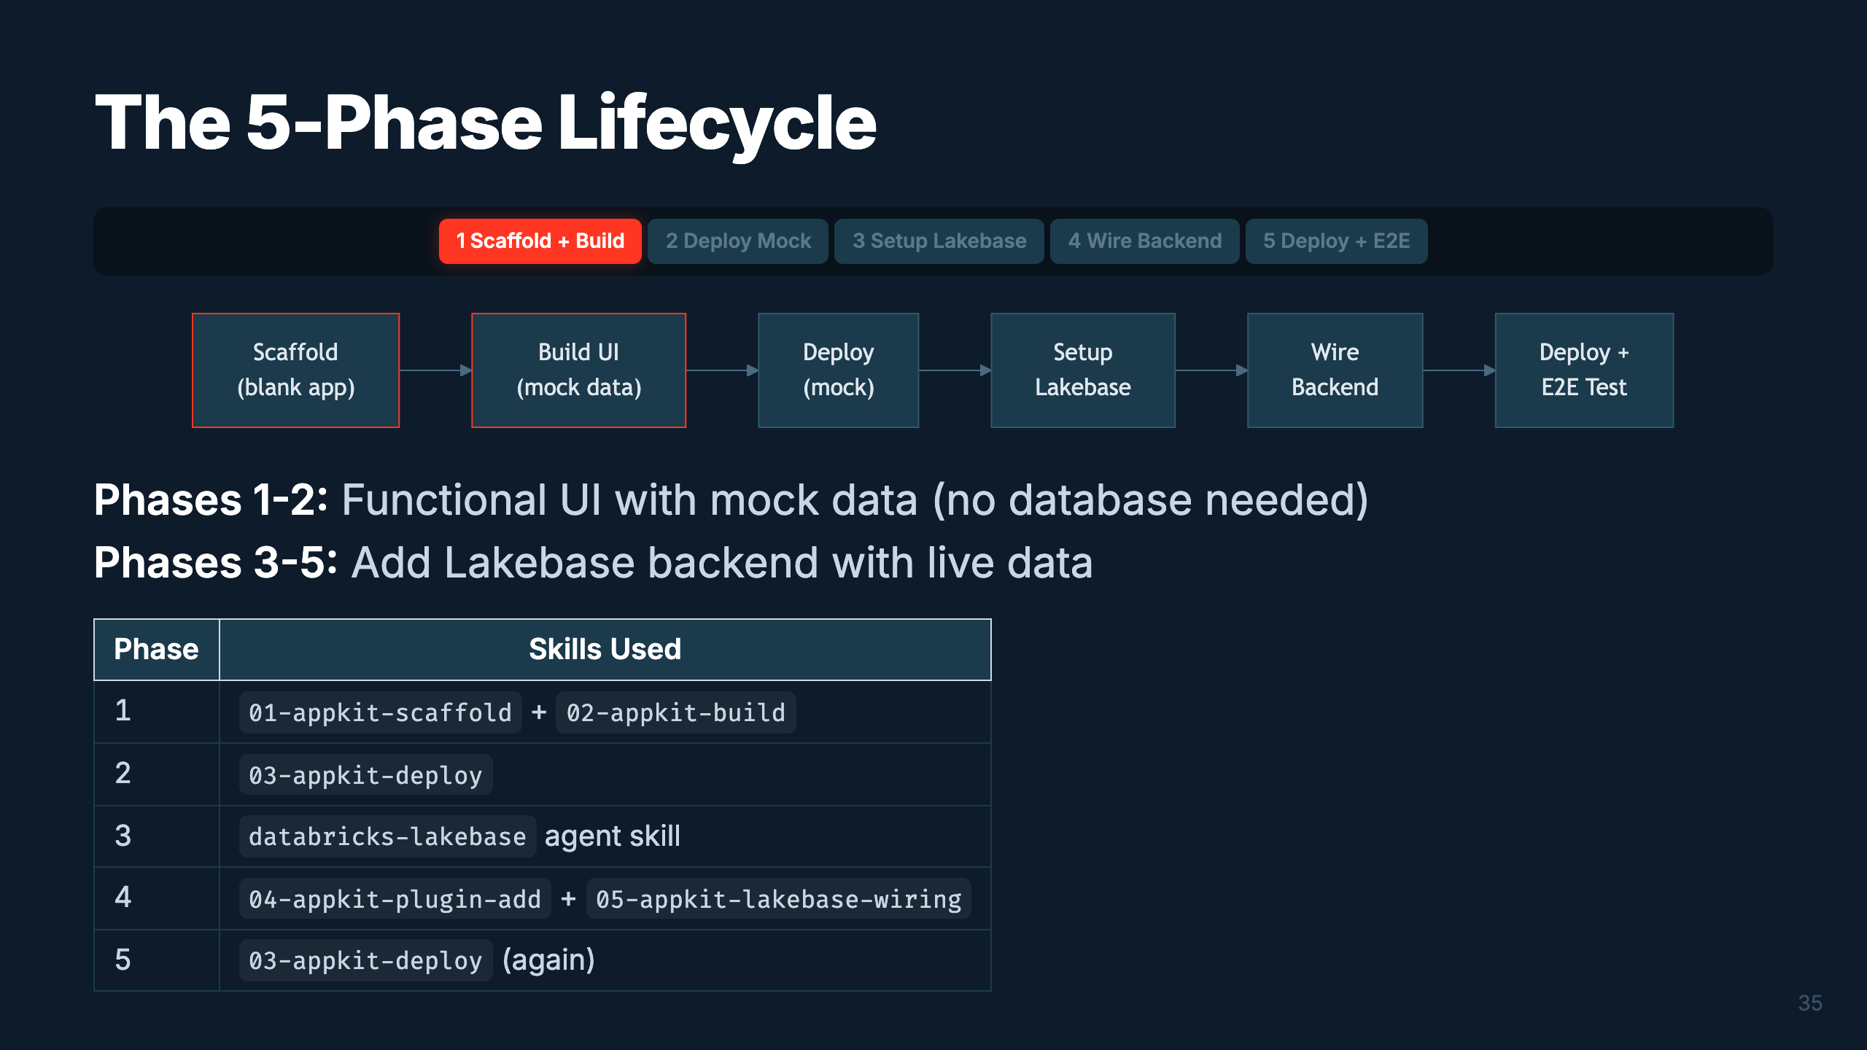
Notes:
Speaker: Five phases, each building on the last. The first two give you a deployed app with mock
data — no database needed. Phases 3-5 add the Lakebase backend. This split is intentional:
you validate the UI first, then wire the data layer. Each phase maps to specific skills.
Timing: ~2 min

Slide 41
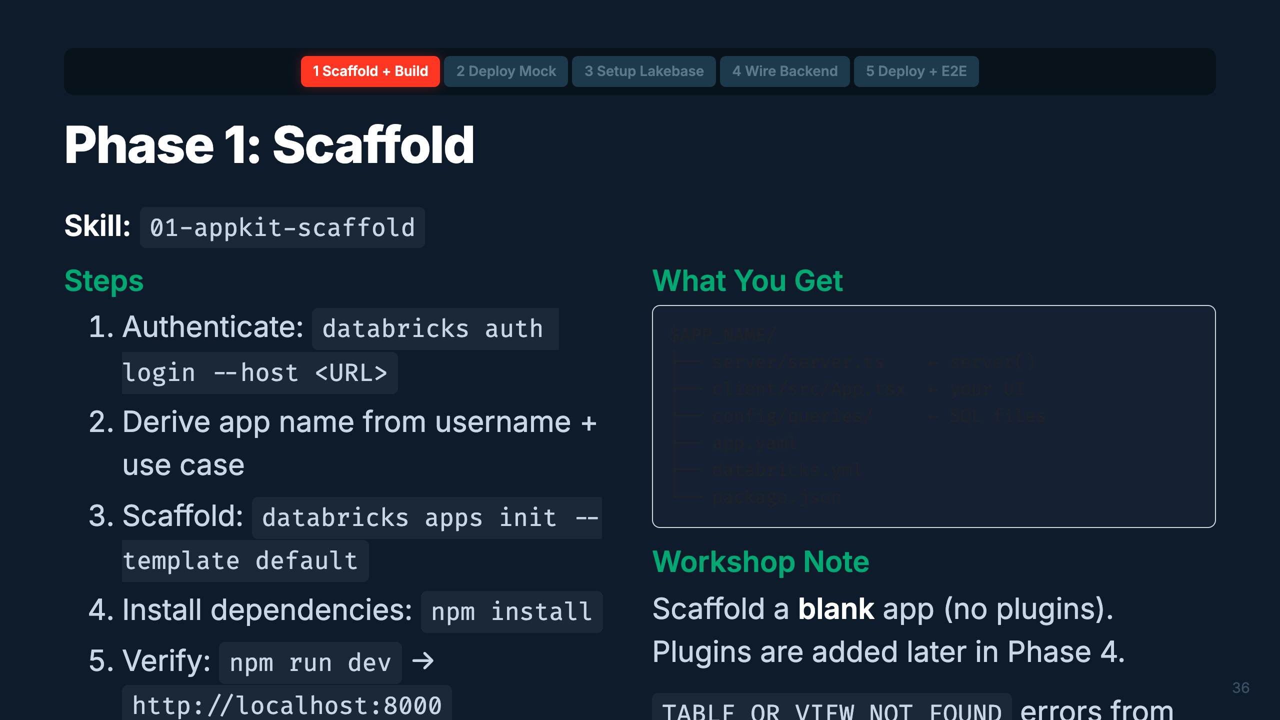
Notes:
Speaker: Phase 1 starts with authentication and scaffolding. The CLI generates the full project
structure. We scaffold blank — no plugins yet — because we want to build the UI with mock data
first. The typegen errors are normal at this point since we haven't added any SQL files.
Timing: ~2 min

Slide 42
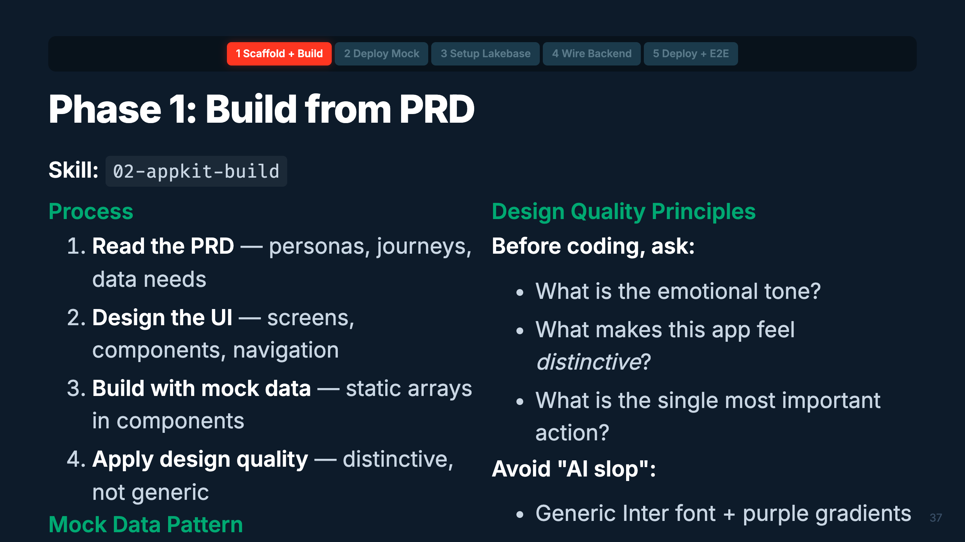
Notes:
Speaker: Building from a PRD is where the app takes shape. The key insight: use mock data arrays
first. This lets you validate the entire UI flow without a database. Design quality matters —
the skill references the Anthropic frontend-design patterns to avoid generic-looking AI output.
Make it distinctive.
Timing: ~2 min

Slide 43
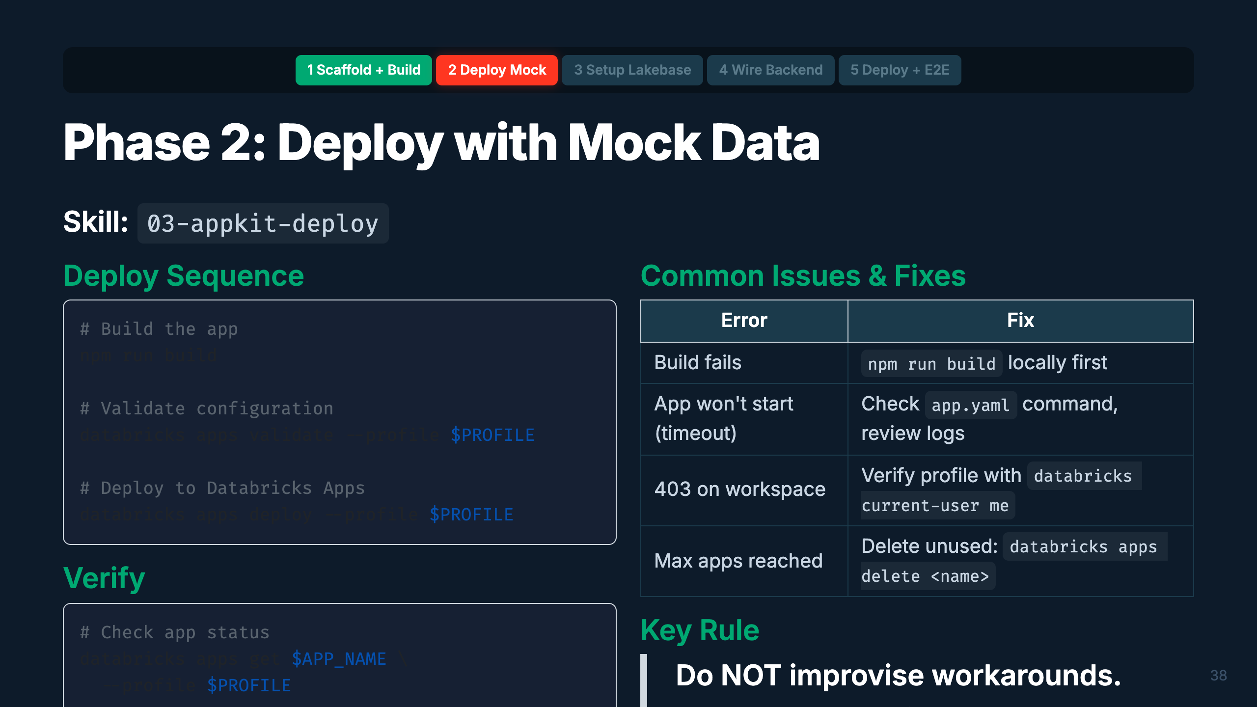
Notes:
Speaker: First deploy! Build locally, validate, deploy. The validate step catches config issues
before they hit the platform. If the deploy fails, stream logs and match against known errors.
The most important rule: don't improvise workarounds. The skill has a comprehensive error table —
use it. Improvised fixes (like adding npm lifecycle hooks) consistently cause cascading failures.
Timing: ~2 min

Slide 44
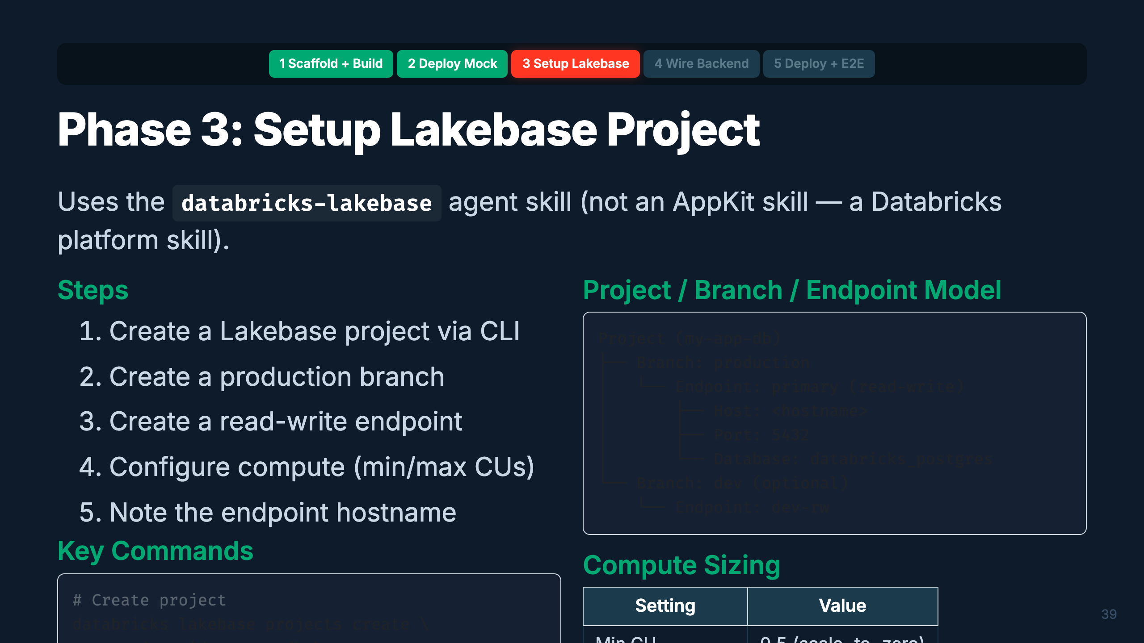
Notes:
Speaker: Phase 3 creates the Lakebase project. The CLI gives you a managed Postgres instance with
a project/branch/endpoint hierarchy (similar to git). For the workshop, we use a single production
branch with one read-write endpoint. Scale-to-zero keeps costs minimal when idle.
Timing: ~2 min

Slide 45
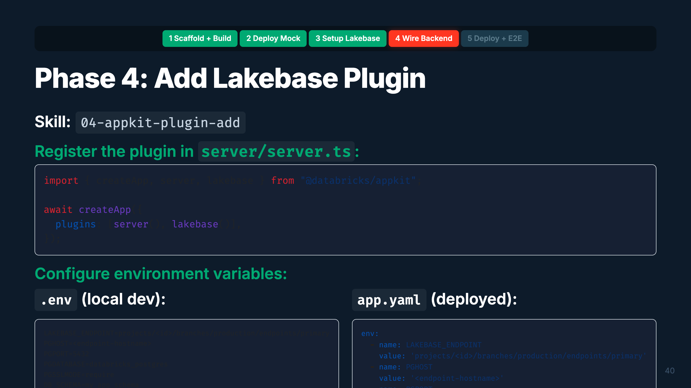
Notes:
Speaker: Now we add the Lakebase plugin. Two steps: register in server.ts and configure env vars.
The plugin handles OAuth token rotation automatically — no passwords needed. DB_SCHEMA isolates
your app's tables within the shared database. Verify with npm run build to make sure the import compiles.
Timing: ~2 min

Slide 46
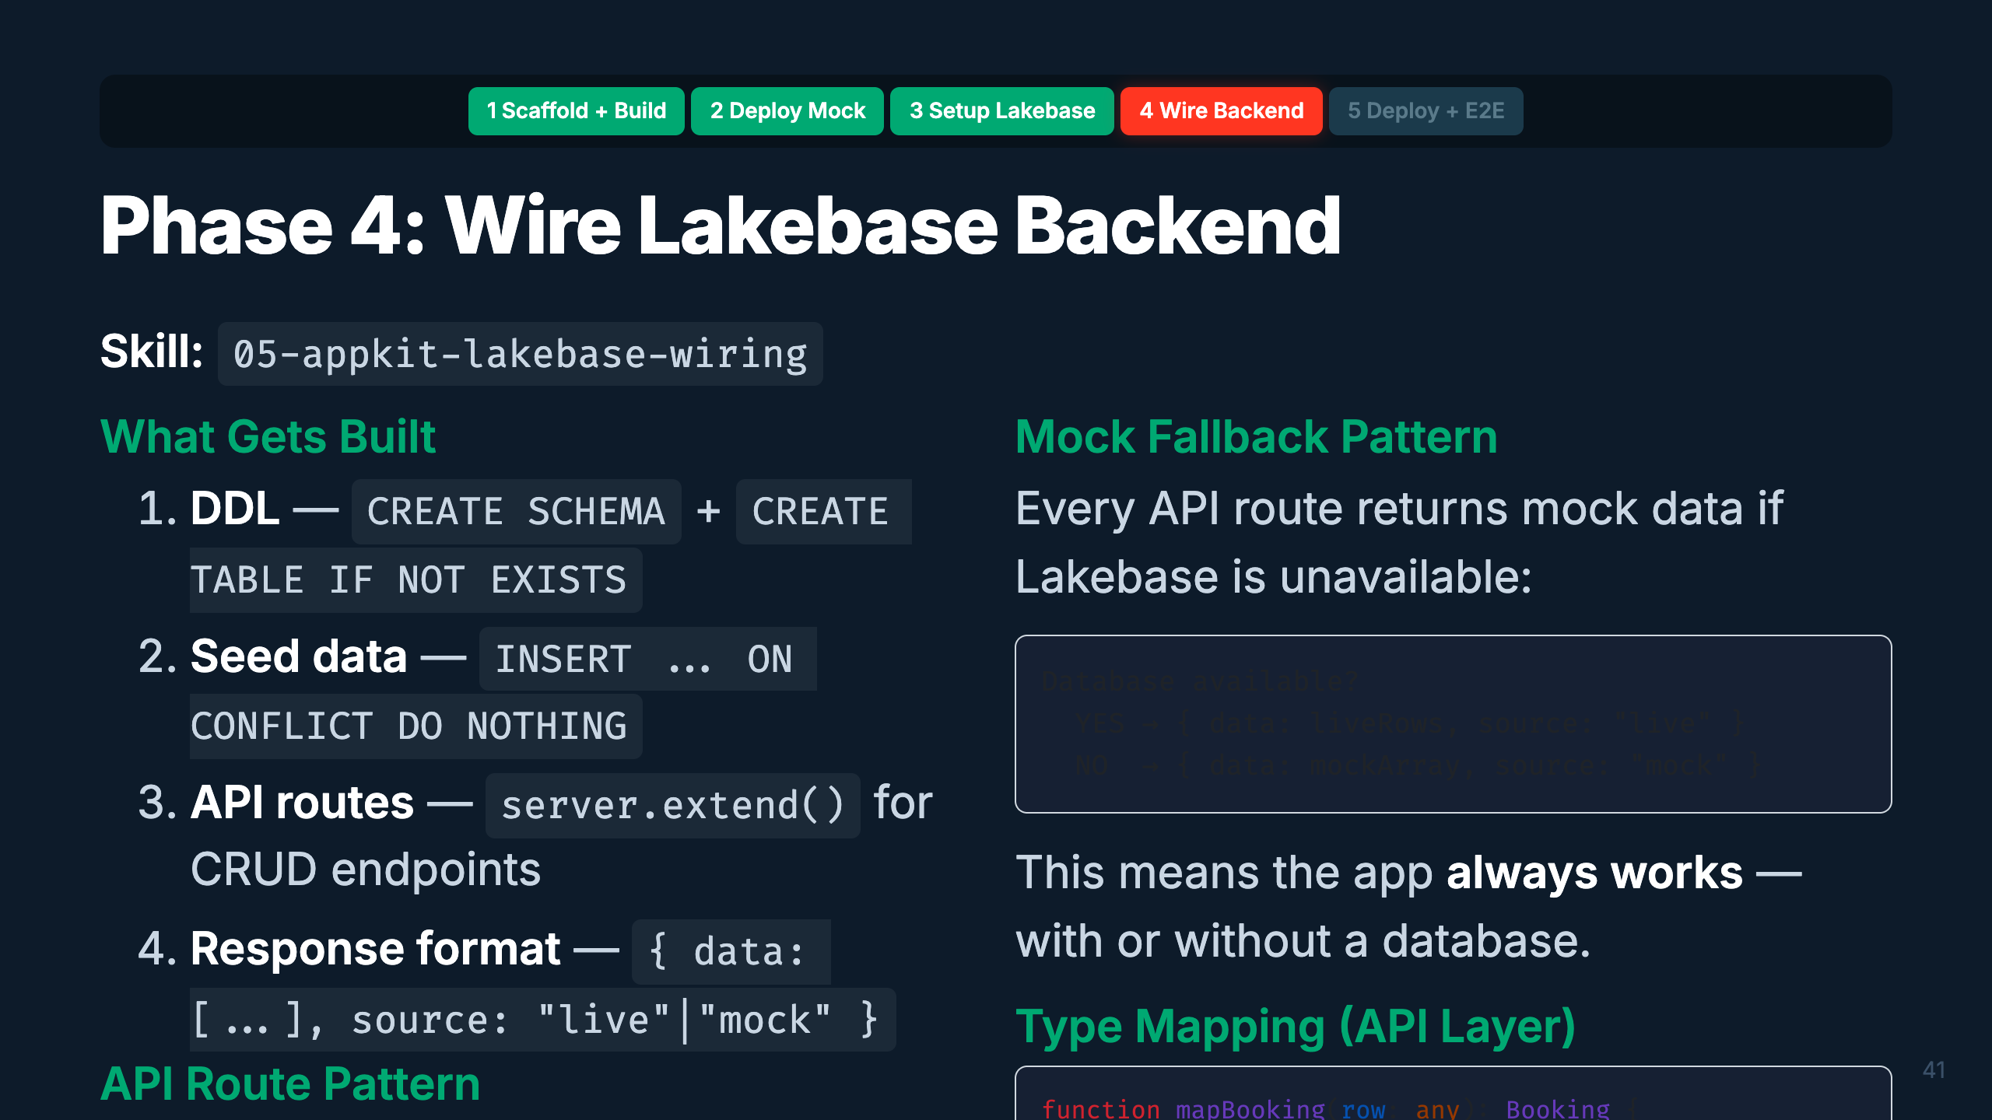
Notes:
Speaker: This is the most substantial phase. You design the schema from the PRD, write DDL,
create API routes with server.extend(), and build the mapper layer. The mock fallback pattern
is critical — every endpoint returns mock data if the database isn't available. This means
the app works locally without Lakebase AND degrades gracefully in production.
Timing: ~3 min

Slide 47
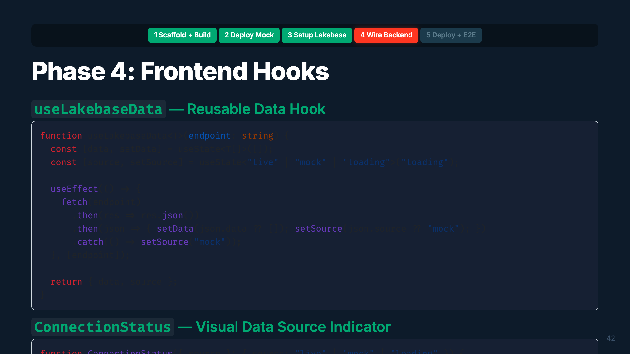
Notes:
Speaker: Two reusable patterns for the frontend. useLakebaseData wraps fetch/useState/useEffect
into a single hook — pass an endpoint, get back data and source. ConnectionStatus shows a green
or yellow indicator so users always know if they're seeing live or mock data. Put it on every page.
Timing: ~1.5 min

Slide 48
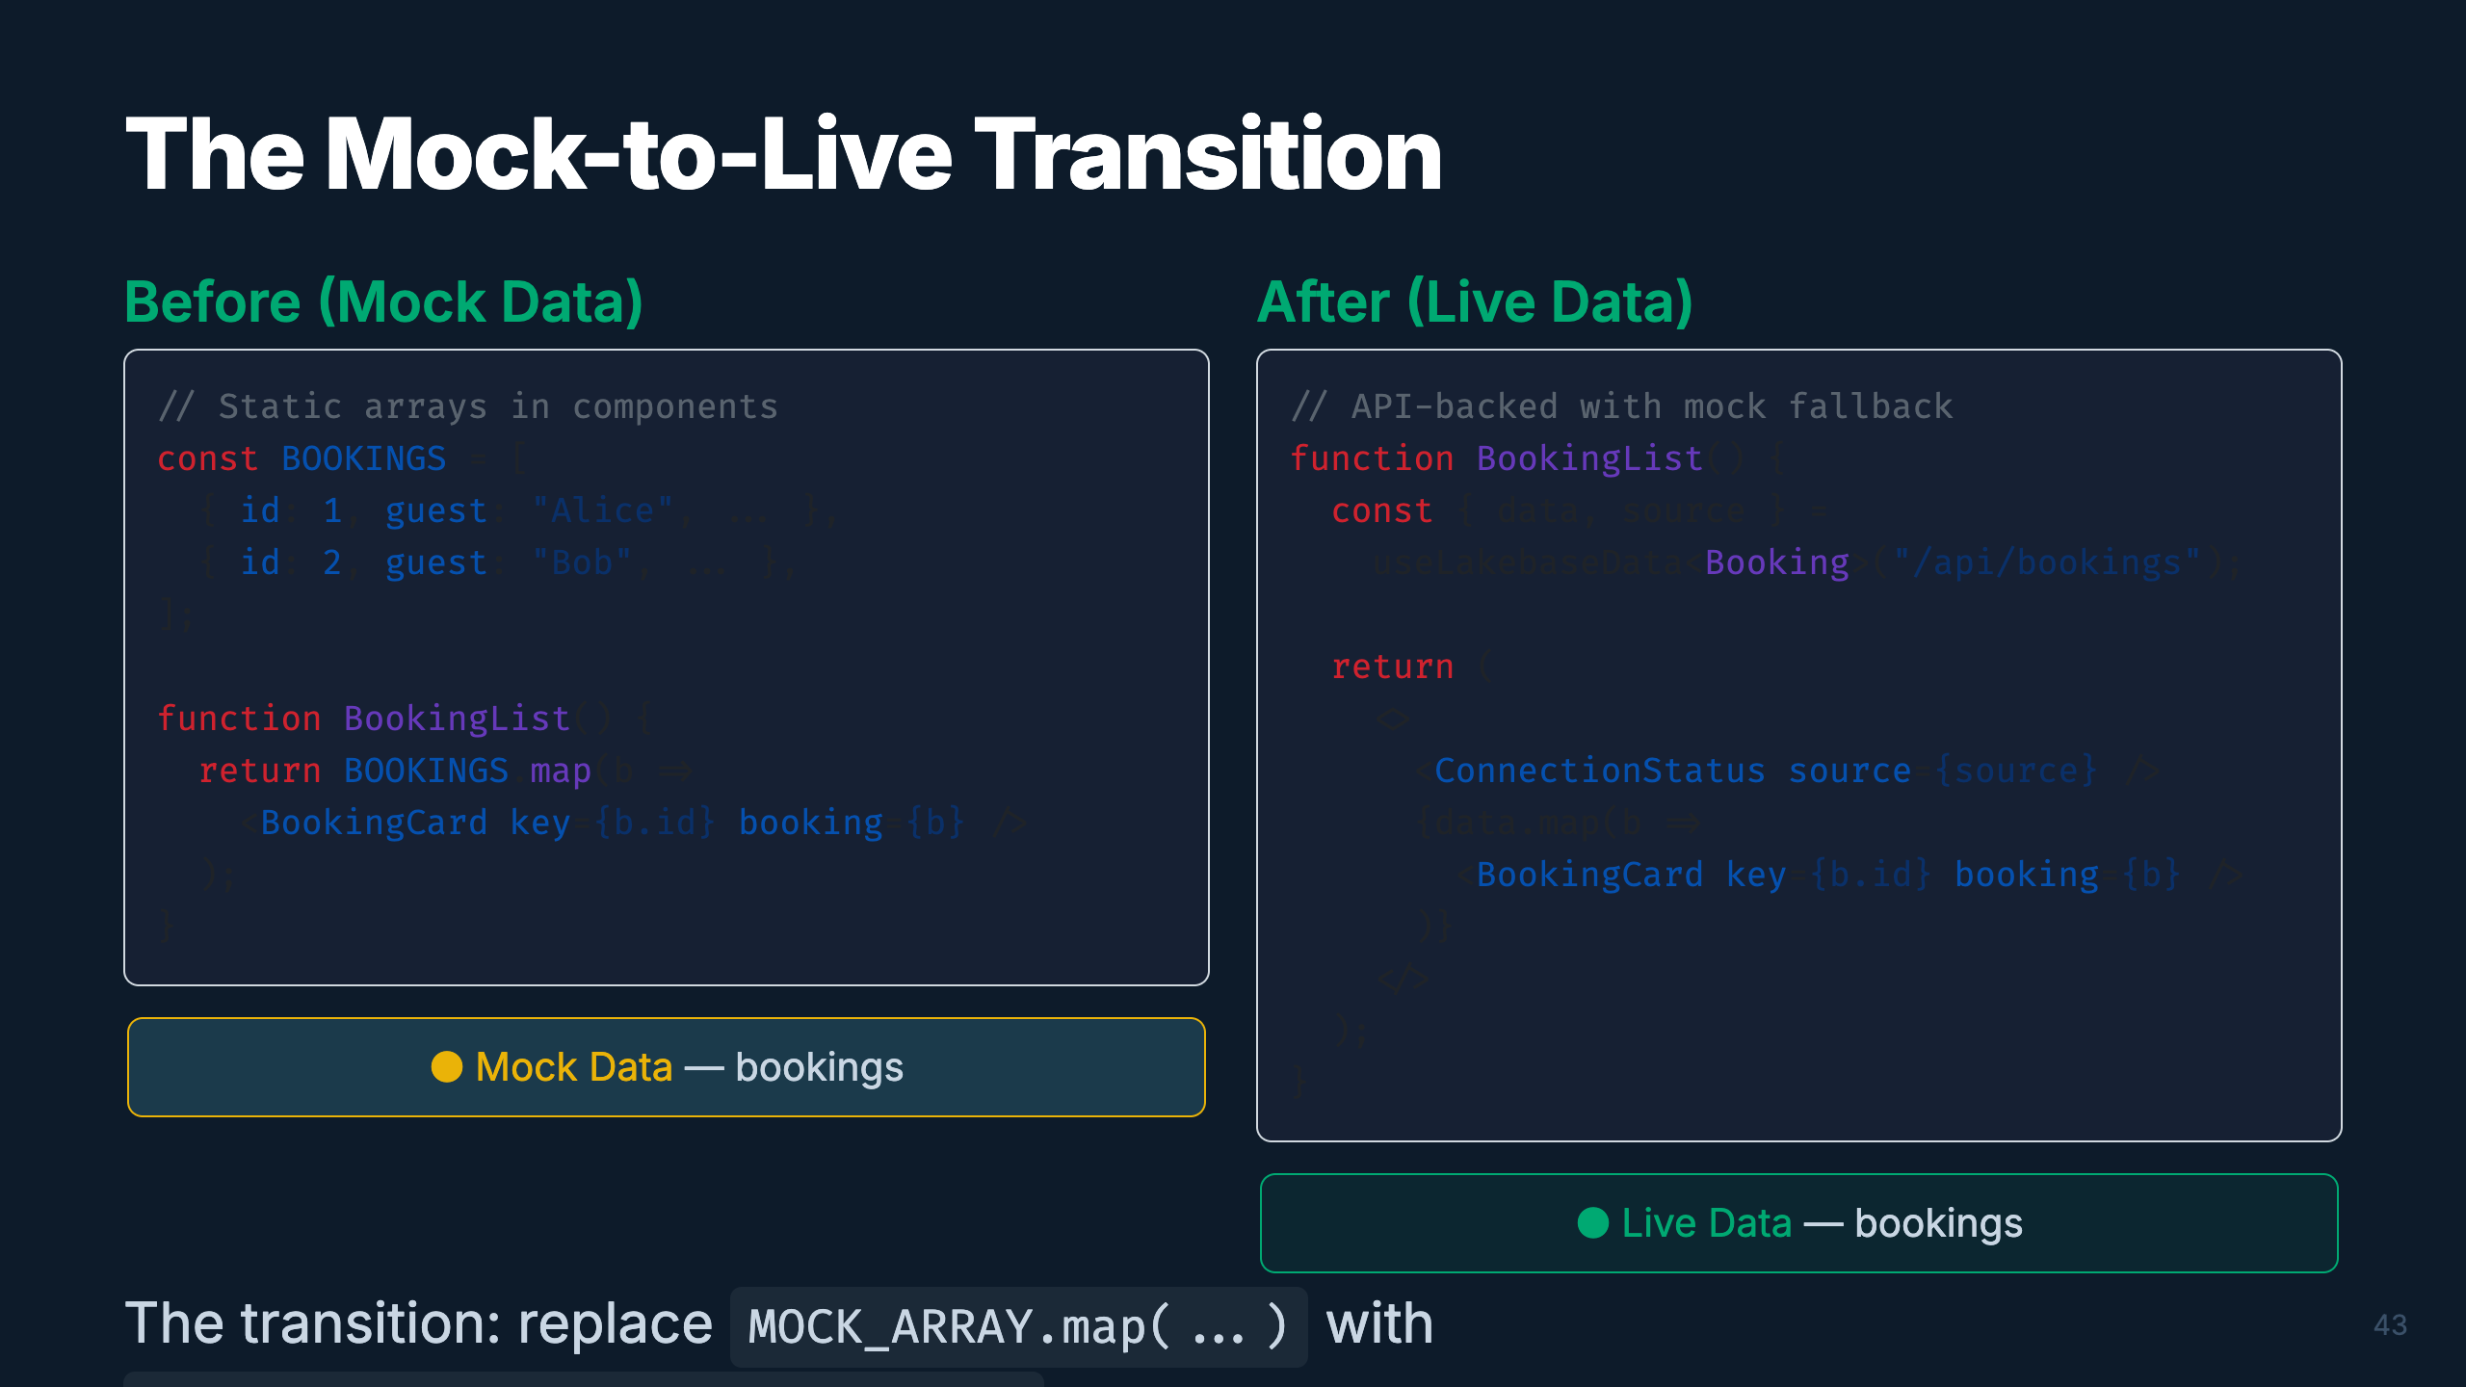
Notes:
Speaker: Here's the before and after. On the left, static mock arrays rendered directly. On the
right, the same component but now powered by the useLakebaseData hook. The data comes from the
API, which returns live data from Lakebase or falls back to mock. The ConnectionStatus indicator
switches from yellow "Mock" to green "Live" when the database connects.
Timing: ~2 min

Slide 49
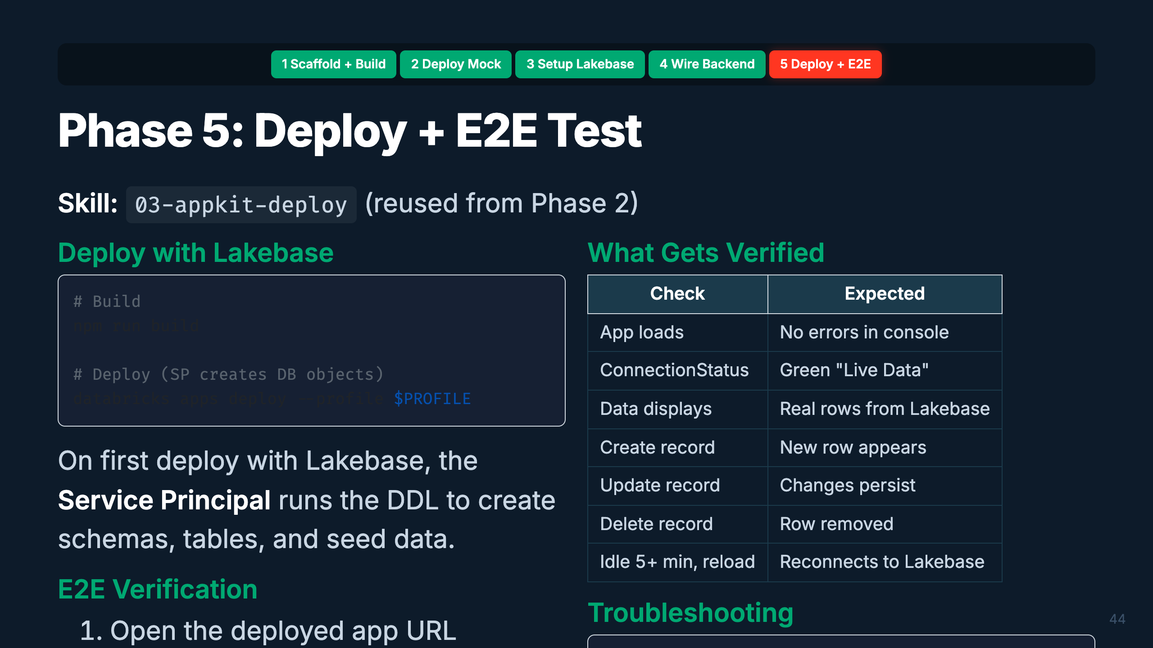
Notes:
Speaker: The final deploy. This time the app has Lakebase wired in, so the Service Principal
creates the database objects on first run. E2E testing verifies everything: the app loads,
shows live data, CRUD works, and — critically — the app handles Lakebase going idle (scale-to-zero)
and reconnecting gracefully.
Timing: ~2 min

Slide 50
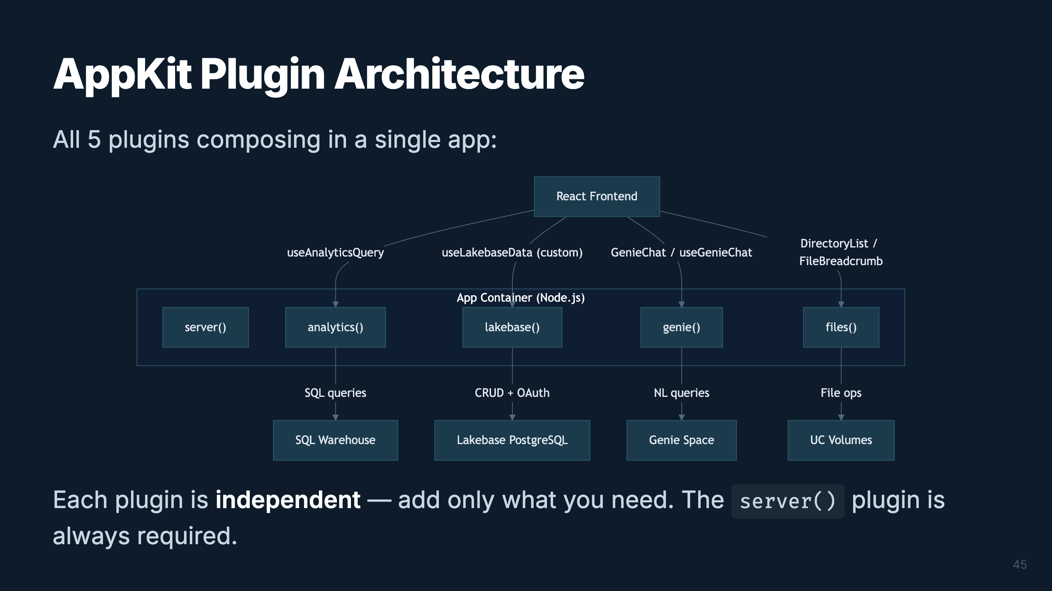
Notes:
Speaker: Here's the full plugin architecture. Five plugins, each connecting to a different backend
service. The frontend uses specialized hooks and components for each. Plugins compose freely —
you can start with just server(), add analytics() for dashboards, lakebase() for CRUD, genie()
for natural language, and files() for document management. Mix and match.
Timing: ~1.5 min

Slide 51

Notes:
Speaker: This map shows how skills connect to phases and how the training modules support each
phase. Notice 03-appkit-deploy is used twice — Phase 2 (mock) and Phase 5 (live). The dependency
chain is linear: scaffold → build → deploy, then plugin-add → lakebase-wiring → deploy again.
Timing: ~1.5 min

Slide 52

Notes:
_transition: cover
Speaker: Let's bring it all together. Both paths — the data pipeline and the app — converge into
a complete, production-grade solution. I'll show you how to get started with copy-paste prompts.
Timing: ~30 sec transition

Slide 53

Notes:
Speaker: Here's the convergence. Your data pipeline produces Gold tables, a semantic layer, ML
models, and GenAI agents. Your Databricks App queries those Gold tables via the analytics plugin,
embeds Genie via the genie plugin, stores app state in Lakebase, and can serve agent responses.
The two paths aren't separate — they're two halves of the same product.
Timing: ~2 min

Slide 54

Notes:
Speaker: Before you start, fill in these parameters. You'll need your workspace URL, a short
name for your app, and your CLI profile. The Lakebase values get filled in during Phase 3.
Run the pre-flight checks to make sure your environment is ready.
Timing: ~1.5 min

Slide 55

Notes:
Speaker: These are your copy-paste prompts. Start a new AI conversation for each phase. The @
syntax references files in your workspace — the AI reads the skill and follows its instructions.
Adjust the workspace URL and app name for your setup.
Timing: ~2 min

Slide 56

Notes:
Speaker: Path B follows the same pattern — one prompt per stage, one conversation per stage.
Start with Gold Design and your schema CSV. Each orchestrator handles the entire workflow for
its stage. The QUICKSTART.md file has the complete set of prompts for all 9 stages.
Timing: ~2 min

Slide 57

Notes:
Speaker: Bookmark these. The AGENTS.md is your entry point for any AI assistant. The AppKit docs
are the source of truth for API details. The Agent Skills repo has the latest Databricks-maintained
skills. And the framework docs have visual walkthroughs of how orchestrators work.
Timing: ~1 min

Slide 58

Notes:
_transition: cover
Speaker: That's the full journey — from a schema CSV or PRD to a production data product with
a beautiful Databricks App, all powered by AI-assisted development. The skills are ready. Your
AI assistant is ready. All you need is a workspace and a use case. Let's open it up for questions.
Timing: Q&A

