Slide 1





STOCK MARKET MOVEMENT PREDICTION USING SENTIMENT ANALYSIS
Using Data to Understand Market Trends
Submitted by: Diksha Pandey
MBA (Business Analytics)
School of Business & Managemnet
Submitted to: Dr. Himani Saraswat

Slide 2






TABLE OF CONTENT
Introduction & Business Problem
Objective of the Study
Dataset & Variables
Exploratory Data Analysis
Methodology & Model
Results & Insights
Conclusion & Future Scope
This is the material point that I will be delivering in the presentation

Slide 3





BUSINESS PROBLEM & OBJECTIVE
BUSINESS PROBLEM
Stock markets are influenced by news, opinions, and public sentiment
Investors face challenges in interpreting large volumes of unstructured information
OBJECTIVE
To analyze sentiment and predict market movement (Up/Down)
To convert qualitative sentiment into data-driven insights for decision-making

Slide 4



DATA & KEY INSIGHTS
DATA USED:
Sentiment Score:
-1 → Negative
0 → Neutral
1 → Positive
Market Movement:
0 → Down
1 → Up
Key Insights:
Sentiment distribution reflects the overall market mood
Market movement shows trend patterns (up/down)
Relationship analysis suggests sentiment has partial influence on market direction

Slide 5

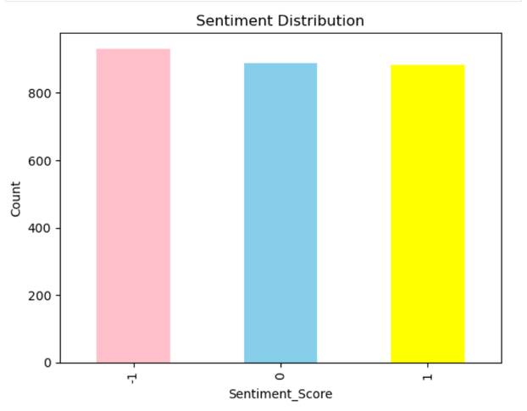
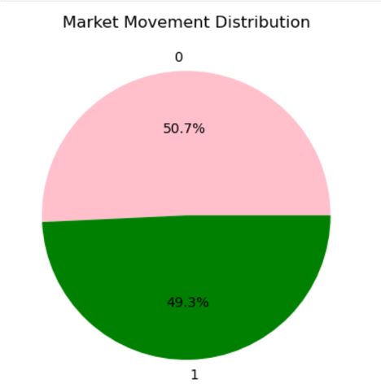
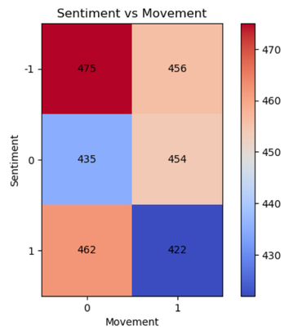

EXPLORATORY DATA ANALYSIS
Shows the frequency of positive, neutral, and negative sentiments in the dataset.
Displays how often the market moves up or down.
Shows the relationship between sentiment and market direction using value intensity.

Slide 6


APPROACH:
APPROACH
&
MODEL
Used a Machine Learning model (Logistic Regression)
Input: Sentiment Score
Output: Market Movement (Up/Down)
Model Used: Logistic Regression
PROCESS:
Data split into Training (80%) and Testing (20%)
Model trained on historical data
Performance evaluated using accuracy and classification metrics

Slide 7




RESULTS & KEY INSIGHTS
RESULTS
CONCLUSION
SCOPE
Sentiment shows a partial influence on market trends
Model provides useful but limited predictive insights
Incorporate additional data (news, stock prices, volume)
Use advanced models for improved accuracy
Model predicts market movement based on sentiment
Accuracy achieved: ~70–75%

Slide 8



THANK YOU
for listening—hope this gave you some meaningful insights!

