Slide 1
King County sales price Analysis for for real estate investor
Analysis by shradha waddepalli

Slide 2
Business Problem
I am creating a model to predict the sales prices for real estate investor in King County

Slide 3
Data
King County dataset has 21,597 rows and 17 columns consisting of important information number of factors such as bedrooms, bathrooms, square foot area etc.
Data cleaning: Square foot basement, year renovated, waterfront and View columns needed to be cleaned to be able to proceed with analysis.
After recognizing continuous variable and discreet variables. I performed One Hot Encoding, which produced additional columns to be a total of 88 columns

Slide 4
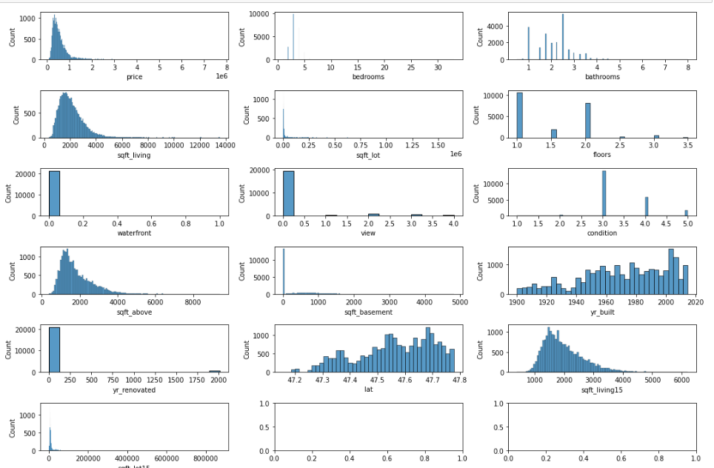
EDA- continuous variables

Slide 5
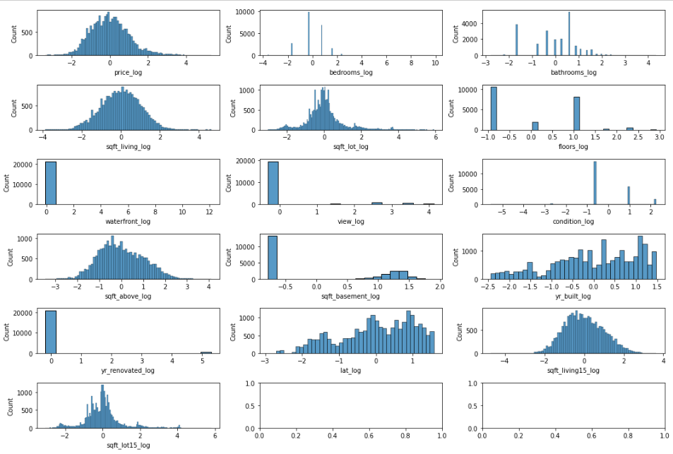
EDA- Log transformed and Normalised

Slide 6
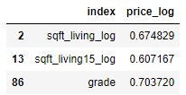
Pearson’s correlation >0.6 variables
Splitting Train and test with a ratio of 75% - 25%
Created simple regression model with these three variables.
Also predicted values within train and test data

Slide 7
Statistical parameters for analysis R squared adjusted R squared Mean squared error Cross Validation to refine model using 10 splits.

Slide 8
Simple regression model with three variables
Microsoft should produce movies with either of following Directors.

Slide 9
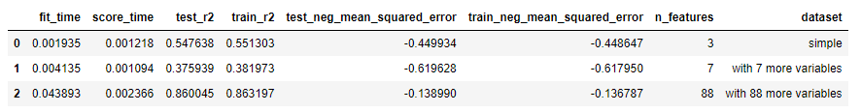
Final model
Microsoft should get the stories written by either of following Writers or combination of writers

Slide 10
Summary
Coefficient of determination : R Squared is between 0-1, higher is better.
MSE : lower the better.

Slide 11
Thank You!
Email: shradha.waddepalli@gmail.com
GitHub: @shrwad

