Slide 1

Spotify
SPOTIFY TRACKS ANALYSIS
DATA-DRIVEN INSIGHTS ON LISTENS, ENGAGEMENT & AUDIO FEATURES
Phone, email, or username
Password
Log in
Forgot password? Sign up for Spotify
Analyzed using SQL the Spotify dataset and deliver actionable insights on tracks, artists and albums.
Notes:
4

Slide 2
PROBLEM STATEMENT
Spotify’s content and marketing team aims to analyze:
Which tracks and artists drive the highest engagement
Differences in listener behavior across platforms (Spotify vs YouTube)
High-potential tracks for promotion based on streams, views, and energy
Album-level performance and consistency in audio characteristics
Opportunities to improve recommendations and playlist strategies
PLAY

Slide 3





Search
About our dataset
Find dataset here.
PLAY
FOLLOWING
…
Tables used:
The dataset contains attributes such as:
Artist: The performer of the track.
Track: The name of the song.
Album: The album to which the track belongs.
Album_type: The type of album (e.g., single or album).
Various metrics such as danceability, energy, loudness, tempo, and more.
Dataset

Slide 4

SQL
Search
Technical Skills Demonstrated
SELECT Statements
GROUP BY
ORDER BY
Aggregate Functions
CASE Statements
Joins
Subqueries
CTEs
Window Functions
Ranking Functions
Yawar Ali
Leader
FOLLOW
SHUFFLE PLAY
SEE MORE

Slide 5


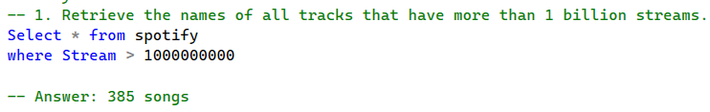
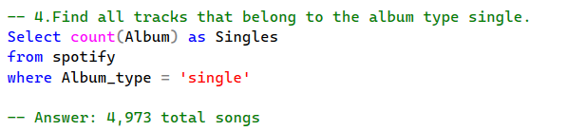
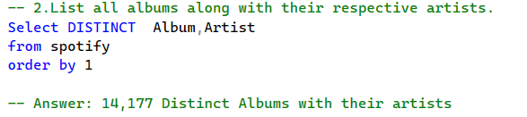
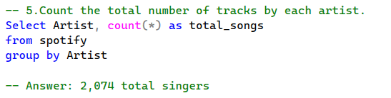
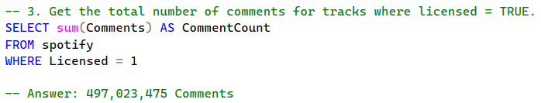
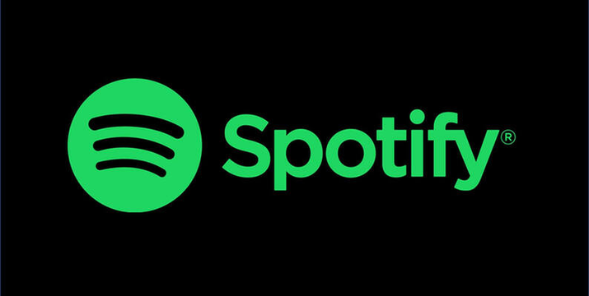
Streaming Performance Analytics
Notes:
Note: At the back of the logo there’s a loading gif
5

Slide 6

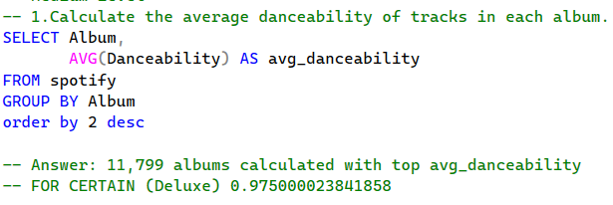
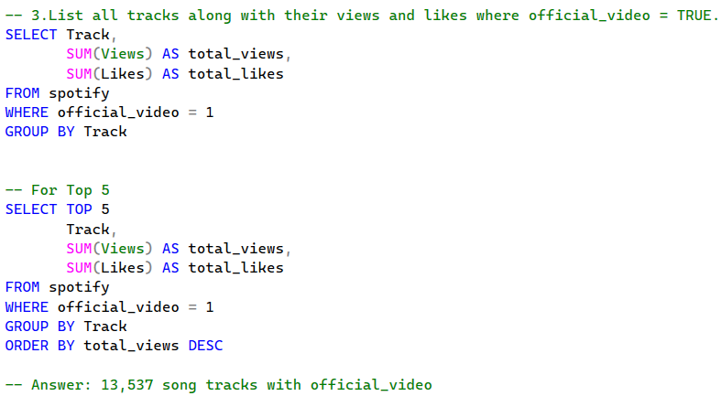
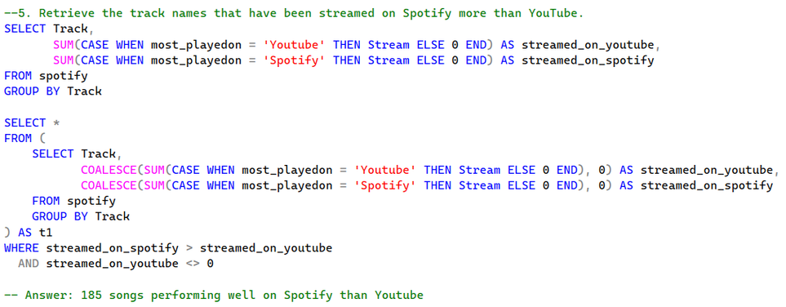
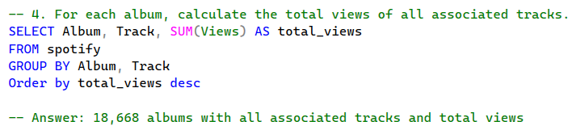
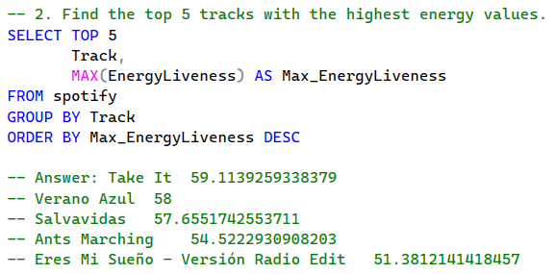
Engagement & Trend Analytics
Notes:
Note: At the back of the logo there’s a loading gif
5

Slide 7

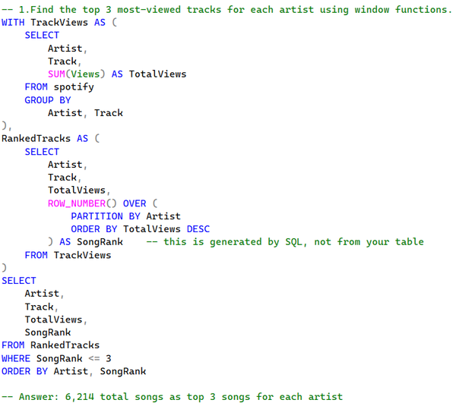
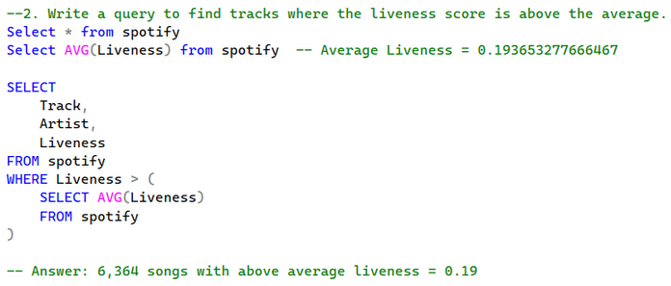
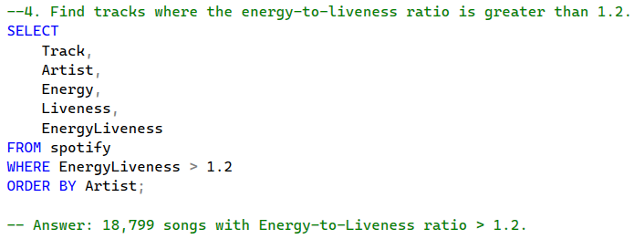
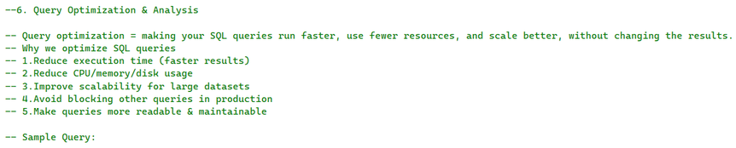
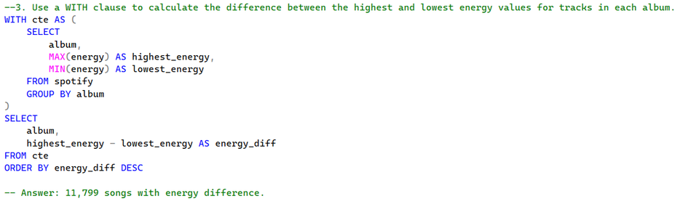
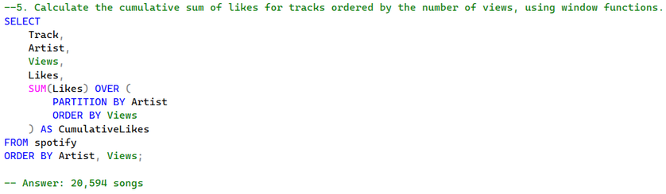
Statistical & Ranking Analytics
Notes:
Note: At the back of the logo there’s a loading gif
5

Slide 8

Business Insights & Learnings
Tracks with higher energy and danceability showed stronger audience engagement and streaming performance.
Official videos significantly increased views, likes, and overall audience interaction across platforms.
Singles consistently outperformed other album types, indicating stronger listener attention and market reach.
A small number of top-performing tracks contributed heavily to overall artist visibility and platform engagement.
Cross-platform analysis revealed that listener behavior differs between Spotify and YouTube consumption patterns.

Slide 9
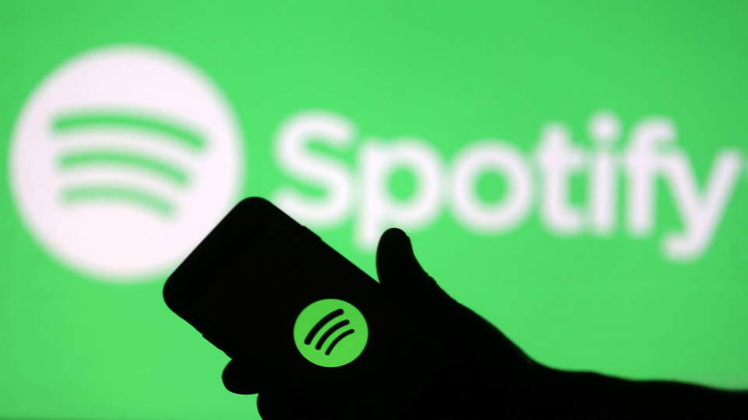
Thanks for tuning in
Don’t forget to like and subscribe to our channel.

