Slide 1


Software & Data Carpentry: Training to Enable More Effective Research
Greg Wilson, PhD Tracy Teal, PhD
Software Carpentry Data Carpentry
Executive Director Executive Director
@swcarpentry @datacarpentry
http://software-carpentry.org http://datacarpentry.org

Slide 2
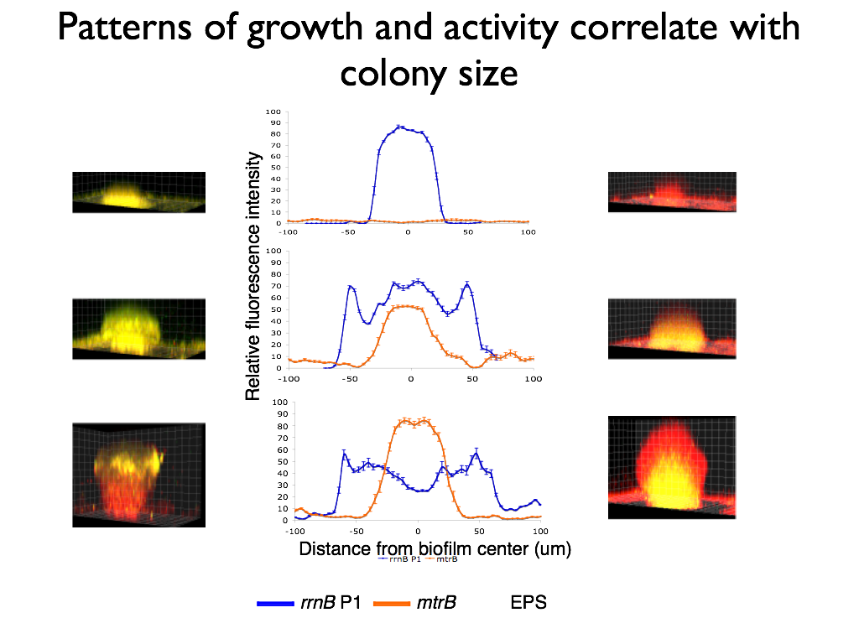
Notes:
Strategies and Techniques for Analyzing Microbial Population Structure
Explorations in Data Analyses for Metagenomic Advances in Microbial Ecology

Slide 3
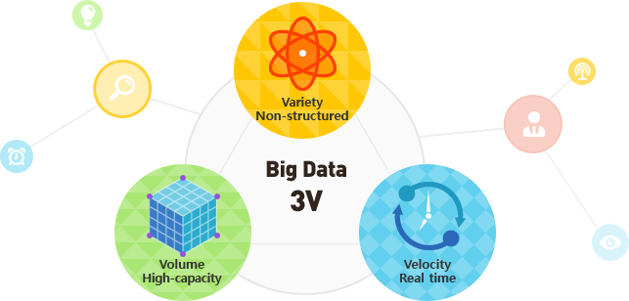
Data is increasing in volume, velocity and variety
Image: http://widerplanet.org
Notes:
This isn’t an audience I need to convince of the current and increasing velocity, volume and variety of data, and we’re all here to discuss the challenges and opportunities this data generation is presenting. Why are we all here though, why is now different than say when microscopes first were invented or telescopes had greater capacity.
Deception -> Disruption (Phil Bourne)

Slide 4

Large scale data is being generated in all domains
Digital text
Genomics
Satellite
Notes:
We’re all here, and these conversations are getting broader and there’s more interest and investment in this issue, is because what’s different about now is that this data is being generated in all domains of research
Informing every scholarly endeavor

Slide 5
As well as in the non-academic sector
Health care
Marketing
Finance
Notes:
As well as in the non-academic sector. This lends itself to broad alignment on these issues in a way that we haven’t seen before, and also adds an urgency to the challenges. Industry might see how to turn this data in to value for the company, biomedical researchers see opportunities to save lives, geoscientists to address climate change. People think this data has the potential to address important issues affecting our lives and society.

Slide 6
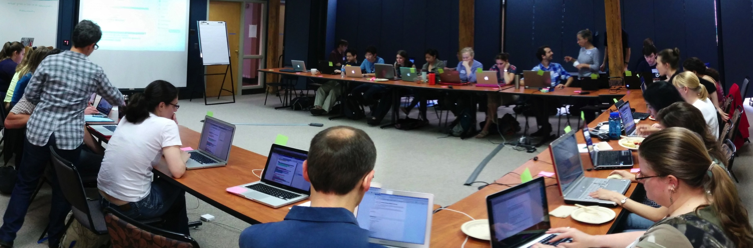
With the emergence of new technologies generating large datasets in all domains of research, data analysis and software development is no longer the domain of specialists and is instead widely done by all researchers.
Notes:
Lack of expertise was identified as the single biggest difficulty facing researchers in their bioinformatics activities, and training as the most valuable thing that BRAEMBL could do to support those activities.”

Slide 7
Data potential
Notes:
Now what we have is a lot of data potential. The data available has the potential to answer new research questions, suggest solutions to societal challenges or save lifes
Now we have two types of researchers – those who are excited about this data and are generating it themselves or engaging with public data efforts, and those who don’t yet see a use for this data. But that slice of the pie who won’t be able to derive value or discovery from these digital data collections is starting to become smaller. .
As librarians you’re all the more aware of the data being generated.

Slide 8
Data is not information
Notes:
However data is not information or scientific insight on its own and we need to unlock the potential of that data – some of that is tools and software, databases and infrastructure. But the key to that is the researchers themselves and their ability to conduct this research and good practice around data management and analysis and the software development to analyze this data.

Slide 9

Training is a missing piece between data collection & data-driven discovery
Training
Notes:
Researchers need to be trained in how to effectively manage and use this data. Researchers don’t know how to address the questions they want to ask or aren’t even aware of the types of questions they can ask with this data.
Story about genomics researcher
It’s no longer the case where we’re saying ‘researchers should’. Researcher themselves want this training, feel limited by their own current data analysis skills. You likely have anecdotal evidence of this in your own community or domain

Slide 10
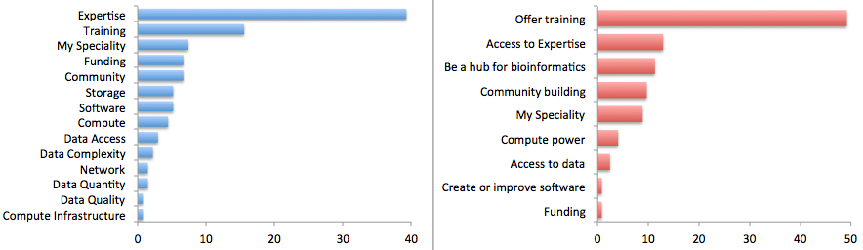
Researchers view the major limiting factor in research progress as a lack of expertise in how to handle and analyze data
Survey by Bioinformatics Resource Australia – EMBL
Biggest Bioinformatics Difficulty
Most useful thing BRAEMBL could do
http://braembl.org.au/news/braembl-community-survey-report-2013
Notes:
, but for instance …
Biomedical researchers in the UK had similar sentiments in a survey
https://storify.com/biocrusoe/elixir-uk-node-meeting-2014-10-14
And an internal study at PLOS showed a lack of data management expertise has a dramatic impact on the ability
of researchers to share their data

Slide 11
Software and Data Carpentry are filling that training gap
Our goal is to provide researchers high-quality
training covering the fundamentals and best practices in software development and the full lifecycle of data-driven research.
Notes:
We need more Meridith’s
Not everyone can be a Meridith (15 year old girl)

Slide 12

We teach basic lab skills
for scientific computing
so that researchers can do more
in less time and with less pain.
Teach basic concepts, skills and tools for working more effectively with data. Workshops are designed for people with little to no prior computational experience.

Slide 13
Grassroots training effort
Developed by practitioners for practitioners
Identify skills and best practices needed in software development, data management and analysis in given domains
Collaboratively and iteratively developed openly licensed (CC-BY) training materials (all available on github)
Organize and deliver two-day, intensive hands-on workshops in fundamental data analysis skills using a pool of volunteer helpers and instructors
Notes:
Deliverables are lessons and workshops

Slide 14
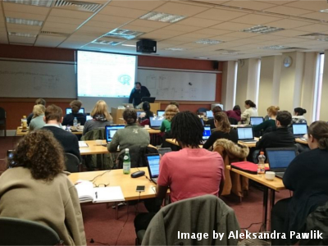
Hands-on intensive workshops
Two days
Hands-on
Qualified instructors
Helpers
Post-it notes!

Slide 15
Why workshops?
The curriculum is full
Researchers don’t have
much time
Allows for focused attention and collaborative learning
Building a community
Notes:
Next I’ll talk about each one of the organizations, what we teach and what our audience is

Slide 16
Sibling organization of Software Carpentry
Officially started November, 2014
Developed and ran workshops prior to November with NSF support
Curriculum
Focused on data - teaches how to manage and analyze data in an effective and reproducible way.
Initial focus is on workshops for novices - there are no prerequisites, and no prior knowledge computational experience is assumed.
Domain specific by design – currently have lessons in biology and are developing lessons for genomics, geosciences and social sciences.
Planning 24 workshops in 2015 and the development of materials in more domains and for more advanced data analysis topics.

Slide 17
Curriculum
Data organization in spreadsheets
Data cleaning in OpenRefine
Introduction to data analysis and visualization in R or Python
SQL for data management
Text mining in R or Python
Introduction to cloud computing

Slide 18
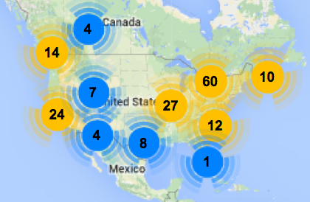
Software Carpentry
Greg Wilson founded in 1998
Since January 2013
scaled to teach
Over 270 two-day workshops
For over 8300 learners
Taught by over 200 volunteers
In over 20 countries
North American Workshops 2012-2014
Now its own non-profit the Software Carpentry Foundation
Notes:
Materials and workshop model founded on successful SWC model
Workshops fill gaps

Slide 19
Curriculum
Command line
Software development best practices in R, Python or MATLAB
Github for version control

Slide 20
Lessons

Slide 21
Software &Data Carpentry workshops
Goals:
We can’t teach everything in two days, but the goal is to teach foundational skills to reduce the activation energy for getting started and to know what’s possible
Notes:
More than a focus on particular analysis techniques, workshops are focused on data management and what might be called data wrangling, gettting your data in to and out of analysis programs, formatting the data for analysis, conducting visualization
We want to teach not only skills but affect attitudes – emphasizing importance and value of these approaches for effective and reproducible research

Slide 22
Demand is high
Workshops internationally
Started in November, 2014; since Jan 2015 have taught 10 workshops and have more than 24 scheduled for this year
Interest from broad domains – biology, genomics, social science, digital humanities, libraries, geosciences

Slide 23
People are learning things!
Level of data management and analysis skills prior to the workshop
Rate your level of data management and analysis skills following the workshop

Slide 24
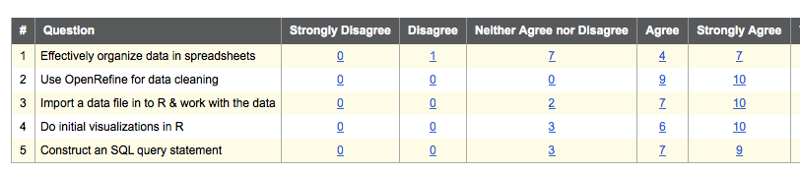
People are learning things!
Compared to before the workshop, I have a better understanding of how to

Slide 25
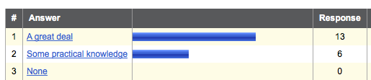
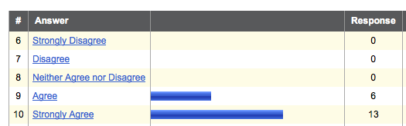
They feel the workshop was worthwhile
How much practical knowledge did you gain from this workshop?
This workshop was worth my time

Slide 26
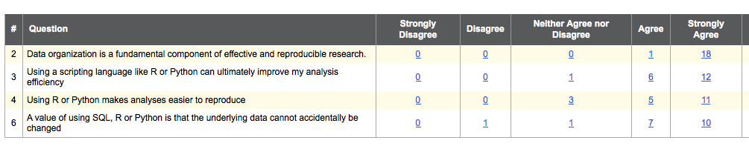
Thoughts on data best practices
Please rate your level of agreement with the following statements

Slide 27
Grassroots training effort
Developed by practitioners for practitioners
Identify skill needs in data management and analysis in given domains
Collaboratively and iteratively developed openly licensed (CC-BY) training materials
Organize and deliver two-day, intensive hands-on workshops in fundamental data analysis skills using a pool of volunteer helpers and instructors
Notes:
Deliverables are lessons and workshops, but another very positive outcome has been the pool of instructors

Slide 28
Software Carpentry Foundation train the trainers
Can become an instructor by going through the train the trainers program
Associated with being a SCF Partner or Affiliate
Likely a T3 workshop after the Digital Libraries conference in Vancouver
Notes:
Partner and affiliates

Slide 29
Hackathons to develop lessons
Genomics
project organization, command line, cloud
computing, using bioinformatics tools, data analysis and visualization
- CSHL, iPlant, SESYNC, iDigBio
Geospatial data
Working with geospatial data
Hackathon at NEON – Sept/Oct (Leah Wasser)
Social sciences
Working with data from social sciences
Hackathon at Berkeley – July (Dav Clark)

Slide 30
Workshops by and for Librarian
Been working with many librarians who are looking to teach or offer workshops to their scientific community
Engaged with librarians looking to learn these skills (library carpentry)

Slide 31
Getting involved
Requesting workshops
Becoming instructors
Developing content

Slide 32
Guiding the Carpentries
Software Carpentry Steering Committee:
Matt Davis (Bay area company)
Adina Howe (Iowa State)
Katy Huff (UC Berkeley)
Karin Lagenstrom (Norway)
Aleksandra Pawlik (Software Sustainability Institute)
Raniere Silva (Brazil)
Jason Williams (CSHL)
Data Carpentry Steering Committee:
Karen Cranston (NESCent / OpenTree of Life)
Hilmar Lapp (NESCent / Duke)
Aleksandra Pawlik (Software Sustainability Institute)
Karthik Ram (rOpenSci / Berkeley Institute of Data Science Fellow)
Ethan White (University of Florida / Moore DDD Investigator)
Greg Wilson (Software Carpentry)
Notes:
Truly collaborative effort

Slide 33






Software & Data Carpentry support

