Slide 1
Roles for STCs and Bio Centers in the Face of Big Data
Erik Goodman Director, BEACON and Dr. Tracy Teal Co-PI, BEACON Big Data Supplement Principal Investigator, Project Lead datacarpentry.org NSF STC Directors Meeting C-MORE, Manoa August 26, 2015

Slide 2
A little background on BEACON
BEACON is in the STC Class of 2010
BEACON MISSION: Illuminating and harnessing the power of evolution in action to advance science and technology and benefit society
Operating model: Seed new multidisciplinary 1-2-year research projects annually, encouraging/enabling faculty to seek external support for their continuation. This year, funded ~50 projects starting now—mostly research, some education/outreach/diversity. 24 were multi-institutional.

Slide 3
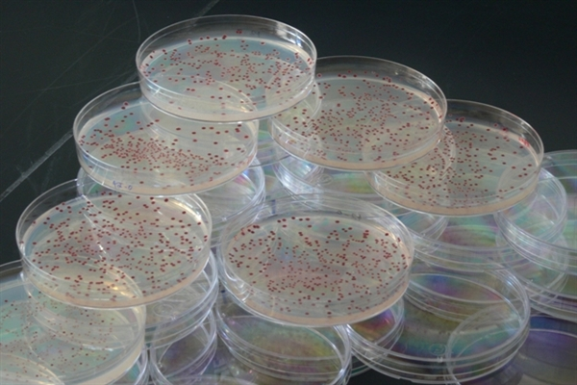
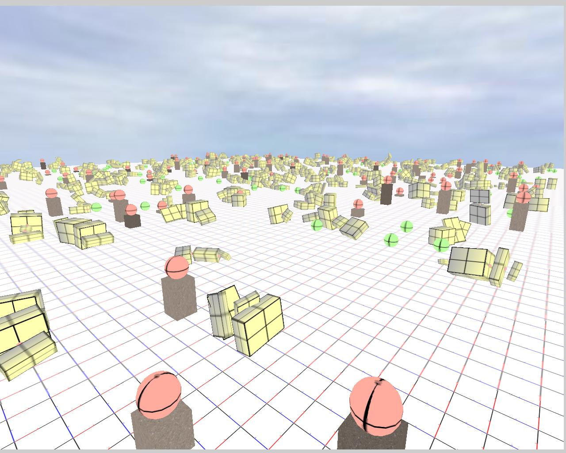
Two cross-cutting themes of
BEACON research
Biological Evolution
Computational Evolution

Slide 4
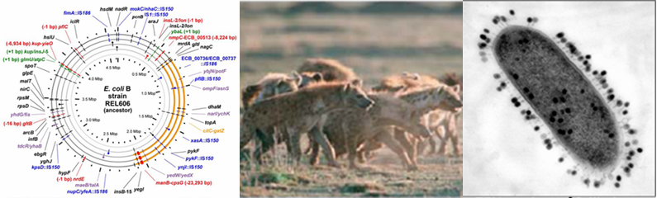
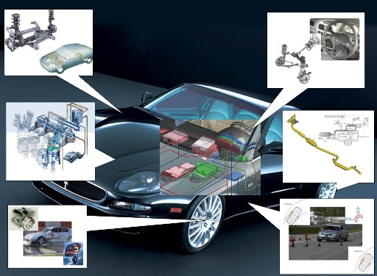
Research thrust groups
Genomes, Genetic Architectures and Evolvability
Evolution of Behavior and Intelligence
Ecological Communities and Collective Dynamics
Evolutionary Applications

Slide 5
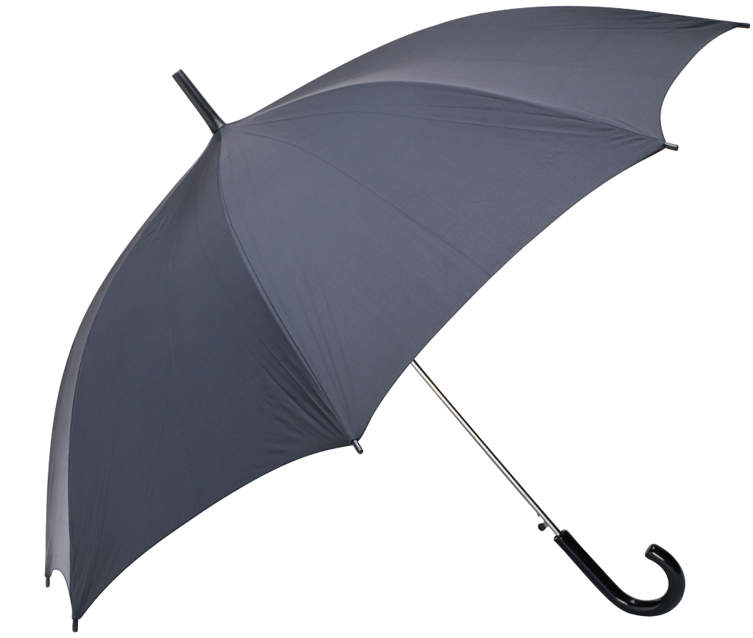
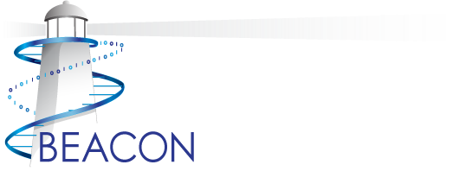
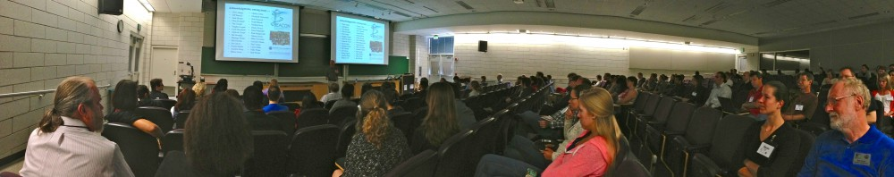
Centers in the deluge of data—
We can be an umbrella!

Slide 6
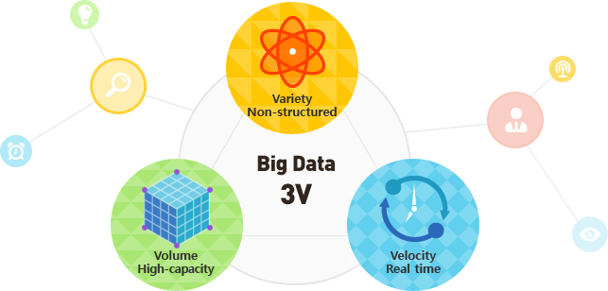
Data is increasing in
volume, velocity and variety

Slide 7
But particle physics has faced it for years!
In the 1980’s, MSU’s National Superconducting Cyclotron Laboratory experiments were limited by the “big data” issues of the time:
Acquisition rate & volume exceeded what any available hardware could store
But a center had the resources to solve the problem…
MSU’s Case Center for CAD/CAM/CAE enabled custom design of specialized circuit boards to allow data to be spread over many disk drives simultaneously (homemade RAID striping)

Slide 8

Now, large scale data is being generated in MANY domains
Digital text
Genomics
Satellite
Notes:
We’re all here, and these conversations are getting broader and there’s more interest and investment in this issue, is because what’s different about now is that this data is being generated in all domains of research
Informing every scholarly endeavor

Slide 9
As well as in the non-academic sector
Health care
Marketing
Finance
Notes:
As well as in the non-academic sector. This lends itself to broad alignment on these issues in a way that we haven’t seen before, and also adds an urgency to the challenges. Industry might see how to turn this data in to value for the company, biomedical researchers see opportunities to save lives, geoscientists to address climate change. People think this data has the potential to address important issues affecting our lives and society.

Slide 10
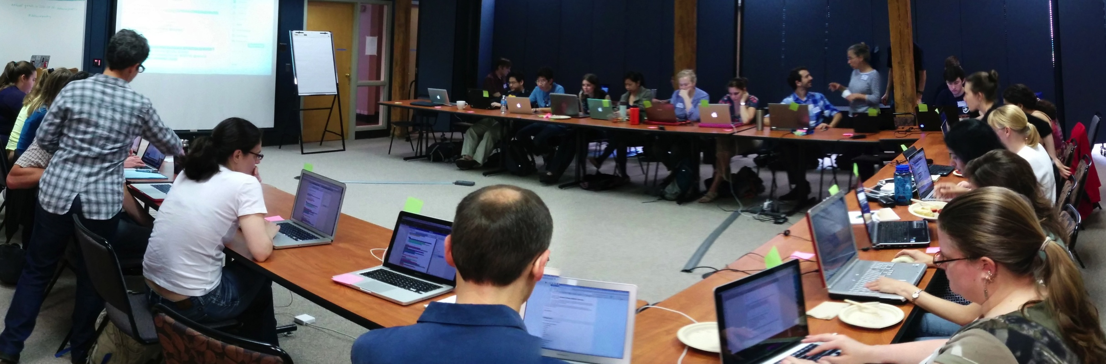
BIG DATA—Becoming a shared problem
New technologies generate large datasets in all domains of research
Data analysis and software development are no longer the domain of specialists and are instead widely done by many researchers.
Centers should play a pivotal role (and much of it’s about people)

Slide 11
Addressing challenges and opportunities requires a multifaceted approach
Infrastructure
Innovative solutions
Training
Engaging with the public
Growing and supporting a strong and diverse community of data scientists

Slide 12
Centers as infrastructure resources…
Data storage capacity
Compute capacity
Personnel to support these resources
Portals or infrastructure for data or code sharing
Notes:
What BEACON is doing
- BEACON has a close relationship with the Institute for Cyber Enabled Research, the group that runs the HPC at MSU. We currently even have shared space. BEACON buys in to this HPC to have dedicated nodes and TBs of research storage space. We also work with iCER if we need to install particular software or schedule jobs in a particular way. In this way BEACON is helping to provide these resources without having to buy its own hardware. It also allows each researcher to maintain and manage their own space and compute resources, but BEACON is enabling this process. We also have an IT person who, along with the iCER staff, is available to help people get up and running on the HPC or work with iCER to install or run particular programs. Through iCER we also have the capacity to use Globus that can be used for big data transfer. We could do more in terms of making the data of BEACON researchers accessible and available, but much of that could/should be directed through already existing resources such as FigShare, DataDryad, github or the Center for OpenScience platform, or MSU versions of these such as Box or gitlab, and our role there, more than creating that infrastructure would be encouraging and training people to use those resources.

Slide 13
Centers as infrastructure resources… What BEACON does
BEACON cohabits with iCER, Institute for Cyber-Enabled Research, MSU’s HPC support: BEACON, not Physics, is their BIGGEST customer
BEACON “buys in” to provide some priority nodes for BEACONites, terabytes of research storage space. Lots more available to BEACONites
iCER’s HPC experts regularly help BEACONites 1:1 to find good solutions to big data issues
BEACON’s IT person regularly collaborates with iCER staff on problems BEACONites are facing
iCER provides us access to Globus for big data transfer
BEACON IT and iCER helps users use FigShare, DataDryad, github, Center for OpenScience or other such platforms
Notes:
What BEACON is doing
- BEACON has a close relationship with the Institute for Cyber Enabled Research, the group that runs the HPC at MSU. We currently even have shared space. BEACON buys in to this HPC to have dedicated nodes and TBs of research storage space. We also work with iCER if we need to install particular software or schedule jobs in a particular way. In this way BEACON is helping to provide these resources without having to buy its own hardware. It also allows each researcher to maintain and manage their own space and compute resources, but BEACON is enabling this process. We also have an IT person who, along with the iCER staff, is available to help people get up and running on the HPC or work with iCER to install or run particular programs. Through iCER we also have the capacity to use Globus that can be used for big data transfer. We could do more in terms of making the data of BEACON researchers accessible and available, but much of that could/should be directed through already existing resources such as FigShare, DataDryad, github or the Center for OpenScience platform, or MSU versions of these such as Box or gitlab, and our role there, more than creating that infrastructure would be encouraging and training people to use those resources.

Slide 14
Centers as places for developing innovative technical solutions
Collaborative and interdisciplinary approaches
Trusting relationships between researchers in diverse fields
Expertise in HPC meets expertise in domains
Space and opportunities to work together
Infrastructure to try things out
Notes:
What BEACON is doing:
We need new approaches that think 'out of the box' BEACON is great for that because it brings together people from
different fields and domains; Titus' digital normalization and graph based approaches to genomics are examples of this, and I'm sure there
are others. The BEACON Congress sandboxes give people opportunities to get together to propose and discuss particular topics. Funding in internal BEACON grants for travel and collaboration. BEACON Friday talks across all the centers and weekly blog posts let people know what others in the center are working on. These events are very well attended and people actively engage!
Something BEACON could do is have working group ‘hackathons’ on particular topics, perhaps ones identified out of the Congress sandboxes, and even invite people outside BEACON to participate (Berkeley Institute for Data Science just started doing this)

Slide 15
Centers as places for developing innovative technical solutions What BEACON does
Unites many disciplines—especially biologists and computer scientists (not programmers)
BEACON’s 5-university weekly seminars, weekly blog posts, “sandbox” sessions at BEACON Congress, all spawn ideas, internal seed grants
BEACON travel support facilitates cross-disciplinary training
BEACON enables visits of researchers from outside BEACON, facilitating collaboration
Example: Titus Brown’s digital normalization & graph-based genomics approaches emerged from such multidisciplinarity
Notes:
What BEACON is doing:
We need new approaches that think 'out of the box' BEACON is great for that because it brings together people from
different fields and domains; Titus' digital normalization and graph based approaches to genomics are examples of this, and I'm sure there
are others. The BEACON Congress sandboxes give people opportunities to get together to propose and discuss particular topics. Funding in internal BEACON grants for travel and collaboration. BEACON Friday talks across all the centers and weekly blog posts let people know what others in the center are working on. These events are very well attended and people actively engage!
Something BEACON could do is have working group ‘hackathons’ on particular topics, perhaps ones identified out of the Congress sandboxes, and even invite people outside BEACON to participate (Berkeley Institute for Data Science just started doing this)

Slide 16
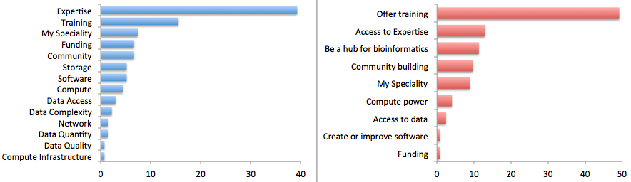
Places supplying/sharing expertise
Many biological researchers view
lack of expertise and training opportunities
in how to handle and analyze data as
the major limiting factor in research progress
Survey by Bioinformatics Resource Australia – EMBL
Biggest Bioinformatics Difficulty
Most useful thing BRAEMBL could do
http://braembl.org.au/news/braembl-community-survey-report-2013
Notes:
In a survey of biological researchers in Australia, training was the most requested resource.

Slide 17
Centers provide training
If researcher doesn’t need NEW ways of analyzing & managing data, but only know-how about state-of-the-art ways of doing it, then the need is for:
TRAINING!!! (in current data management and analysis approaches)
State-of-the-art knowledge and high degree of multidisciplinarity at a center also allows training the next generation of innovators
Notes:
What BEACON is doing?
Training in current practices - many workshops on different topics, Avida, bioinformatics, using the HPC resources taught. Data Carpentry has been developed out of BEACON and with a collaboration with the NSF BIO Centers, a now international non-profit that teaches two-day workshops on fundamental data analysis and management skills.
Training the next generation of innovators - the BEACON set of courses of ‘biology for computational people’ and ‘computation for biologists’ and the ‘projects’ course. Postdoctoral fellows let postdocs get interdisciplinary training and are also mentors for grad students. I’m sure there are other things.

Slide 18
Centers provide training What BEACON does
MANY workshops are taught at BEACON and elsewhere, often joint with iCER or other centers
Avida, for digital evolution, has thousands of users; we offer many training opportunities, including for K-16 teachers
BEACON, with other NSF BIO Centers, developed Data Carpentry, new international non-profit, teaching 2-day workshops on fundamental data analysis & management skills. Also taught many Software Carpentry workshops.
BEACON’s cross-disciplinary grad courses (CS for bio, evo bio for CS, and projects course) and seminars develop shared language/concepts among biologists and engineers/CS
40-some postdocs benefit annually from BEACON environment, seminars, mentoring opportunities
Notes:
What BEACON is doing?
Training in current practices - many workshops on different topics, Avida, bioinformatics, using the HPC resources taught. Data Carpentry has been developed out of BEACON and with a collaboration with the NSF BIO Centers, a now international non-profit that teaches two-day workshops on fundamental data analysis and management skills.
Training the next generation of innovators - the BEACON set of courses of ‘biology for computational people’ and ‘computation for biologists’ and the ‘projects’ course. Postdoctoral fellows let postdocs get interdisciplinary training and are also mentors for grad students. I’m sure there are other things.

Slide 19
Centers also play a role engaging with those outside the center
Communicating about the power and potential of the data
Communicating with a broader community on how they can use the data or data analysis approaches generated at the center
Notes:
What BEACON is doing?
Weekly blog posts. Going to meetings. Other outreach efforts.

Slide 20
Centers also play a role engaging with those outside the center What BEACON does
Research projects report in understandable blog posts 52 times/year!
Tweets and Facebook posts access many others
BEACON hosts booth or co-sponsors many professional activities
BEACON has a HUGE education/outreach program, now even receiving financial support from several professional societies!
Notes:
What BEACON is doing?
Weekly blog posts. Going to meetings. Other outreach efforts.

Slide 21
Centers foster and support a strong and DIVERSE community of data scientists
A culture of reproducible research and open access
A culture of thoughtful data production - don’t just generate data because you can
An environment that respects and values all researchers.
An environment that promotes discussion and where it’s OK (and even good!) to fail – and learn from failure
An environment supporting those in the center to take their scientific thinking to jobs in academics, teaching and industry
Notes:
What BEACON is doing:
There are workshops in ethics and reproducible research. There are career talks and on things like using social media. Rich, Titus, Ian and others do their work openly, releasing their code and data. They are good role models. Diversity coordinator who helps encourage and support those from diverse backgrounds. Talks from Judi and others on things like imposter syndrome or how to find careers. BEACON has ties to industry. Grad student groups get together for discussion regularly and support each other. Articles from students from diverse perspectives on the blog. Student organized panels on things like career topics.

Slide 22
Centers foster and support a strong and DIVERSE community of data scientists What BEACON does
Developing tools (workshops) on scientific virtues, promoting understanding of differences in understanding about conduct of science across disciplines. Already in regular use in BEACON as part of RCR.
Strong role models that promotes open research, open release of code and data
Talks to BEACONites in weekly seminars or Congress help with scientific communication skills, career planning, understanding of diversity, etc.
Regular, professional surveying of BEACONites uncovers potential problems, allowing them to be addressed.
Diversity coordinator one of the core staff and team members (and she’s an actual Olympian!)
Notes:
What BEACON is doing:
There are workshops in ethics and reproducible research. There are career talks and on things like using social media. Rich, Titus, Ian and others do their work openly, releasing their code and data. They are good role models. Diversity coordinator who helps encourage and support those from diverse backgrounds. Talks from Judi and others on things like imposter syndrome or how to find careers. BEACON has ties to industry. Grad student groups get together for discussion regularly and support each other. Articles from students from diverse perspectives on the blog. Student organized panels on things like career topics.

Slide 23
Big data is about people
Data
potential
Discoveries

Slide 24
Big data is about people
Data
potential
Discoveries
People
Notes:
What BEACON is doing:
There are workshops in ethics and reproducible research. There are career talks and on things like using social media. Rich, Titus, Ian and others do their work openly, releasing their code and data. They are good role models. Diversity coordinator who helps encourage and support those from diverse backgrounds. Talks from Judi and others on things like imposter syndrome or how to find careers. BEACON has ties to industry. Grad student groups get together for discussion regularly and support each other. Articles from students from diverse perspectives on the blog. Student organized panels on things like career topics.

Slide 25
Big data is about people What BEACON does
Data
potential
Discoveries
People
BEACON brings TOGETHER 650 people
From diverse disciplines
With diverse racial/ethnic backgrounds
With diverse genders/orientations
With diverse abilities/disabilities
And encourages them to TALK and WORK with each other
The result is absolutely amazing!
Notes:
What BEACON is doing:
There are workshops in ethics and reproducible research. There are career talks and on things like using social media. Rich, Titus, Ian and others do their work openly, releasing their code and data. They are good role models. Diversity coordinator who helps encourage and support those from diverse backgrounds. Talks from Judi and others on things like imposter syndrome or how to find careers. BEACON has ties to industry. Grad student groups get together for discussion regularly and support each other. Articles from students from diverse perspectives on the blog. Student organized panels on things like career topics.

Slide 26
BEACON’s “secret weapon”— Evolution in Action
BEACON is at the forefront in generating EVOLUTIONARY algorithms for single-objective and multi-objective problem solving
Sometimes, evolutionary algorithms can be used to prevent BIG PROBLEMS from generating BIG DATA
Typically requires EXPERTISE in several distinct domains

Slide 27
Example: Taming a gigantic land use management problem
A forester trained in control systems brought us a land-use problem with 10⁶⁰⁰ possible plans—14 objectives to be traded off
Impossible to evaluate 10⁶⁰⁰ solutions in 14 dimensions, and if we could, impossible for a human to interpret the results
Current EMOO methods did not work in this domain
Instead, we developed a new multi-objective evolutionary optimization method to identify a Pareto front in this high-dimensionality search space—not an “off-the-shelf” method.
Evaluate an algorithmically chosen 10³ – 10⁴ solutions; high probability that most interesting ones are represented.
No longer “big data,” but still had to develop sophisticated visualization and decision-making tools to allow people to understand the tradeoffs/make a decision in a 14-objective space

Slide 28
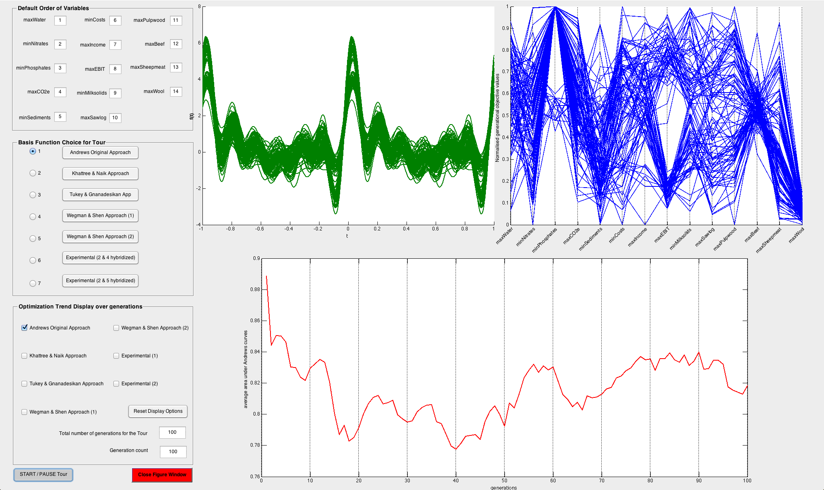
Data visualization may be intuitive or not
Screen capture of data visualization software developed in BEACON. A parallel coordinate plot appears on the upper right, and the Andrews Curve representation of those data appears on the left, given that the user pressed the “Andrews Original Approach” radio button at the left center. It is one of seven transform-based visualization methods provided in the software. Lower curve depicts total area under curves at upper left versus generations of evolution of the solution.

Slide 29
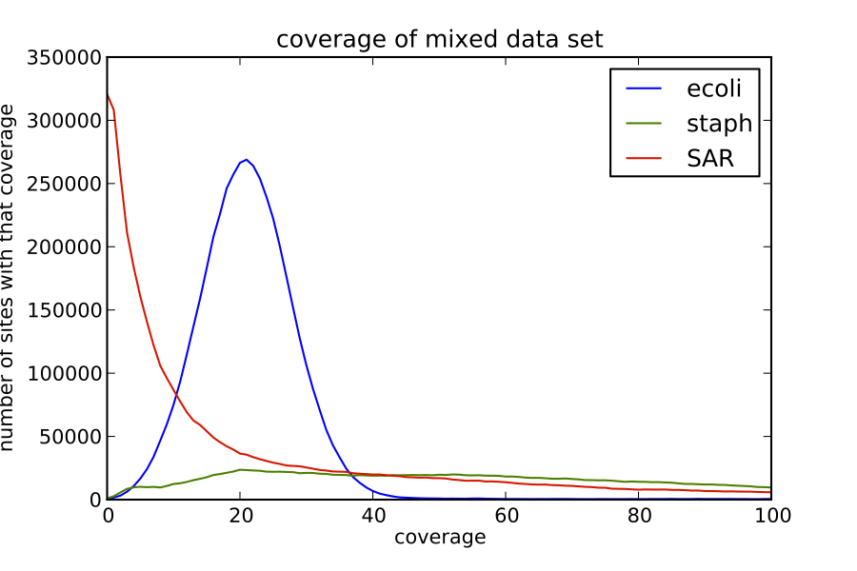
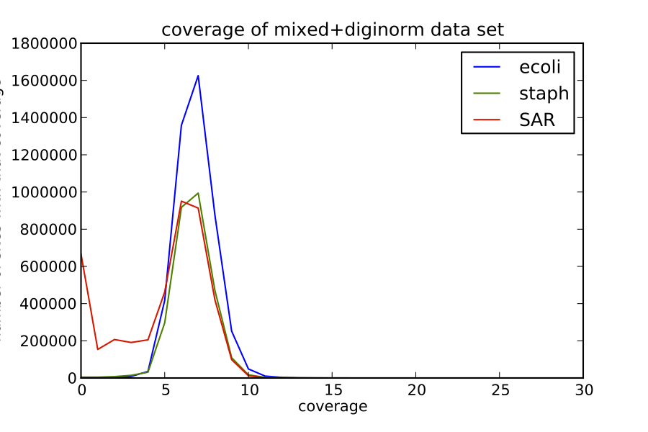
Digital Normalization
C. Titus Brown
Three genomes sequenced together
Different number of reads for each genome makes it hard to assemble them, and you have data you don’t need!
Digital normalization is an algorithm that removes redundant reads
More consistent coverage of each genome and less data to analyze!
Makes analyses possible that might
previously have been
computationally intractable.

Slide 30
Centers in the deluge of data—
let’s make them an umbrella!

Slide 31
Questions?

