Slide 1

Data Carpentry: The Power of Intensive Workshops
Tracy K. Teal, PhD
Data Carpentry
Executive Director
@datacarpentry
http://www.datacarpentry.org
Notes:
Strategies and Techniques for Analyzing Microbial Population Structure
Explorations in Data Analyses for Metagenomic Advances in Microbial Ecology

Slide 2
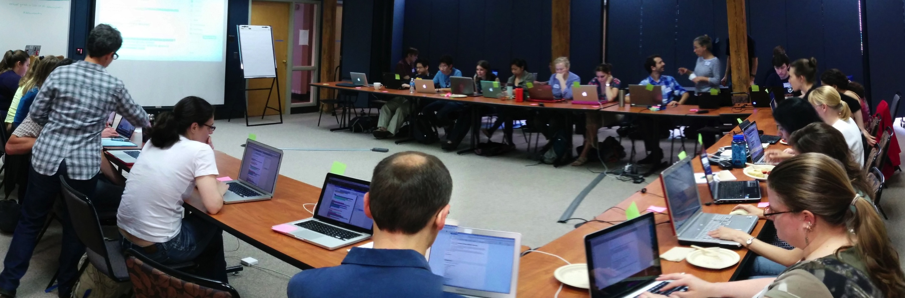
With the emergence of new technologies generating large datasets in all domains of research, data analysis and software development is no longer the domain of specialists and is instead widely done by all researchers.
Training is the missing piece between data and data-driven discovery
Notes:
Don’t need my usual slide of there’s lots of data,

Slide 3
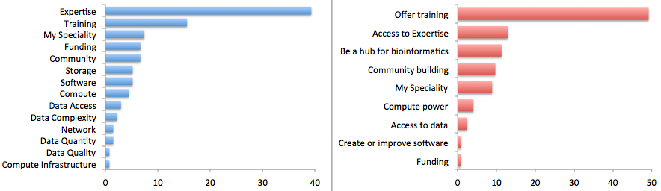
Researchers view the major limiting factor in research progress as a lack of expertise in how to handle and analyze data
Survey by Bioinformatics Resource Australia – EMBL
Biggest Bioinformatics Difficulty
Most useful thing BRAEMBL could do
Notes:
We’re in a situation where what we’re talking about in this room, aligns with what researchers want. A rare opportunity!
So, the question is what will we teach and how will we deliver the training. The answer is probably some variation of all the things in all the ways.
In this talk I’m going to focus on how Data Carpentry is developing and teaching workshops, and how it’s not only building skills but communities of practice.
I’m going to talk abou

Slide 4

Deliver domain-specific hands-on intensive workshops covering the full lifecycle of data-driven research. Current workshops are designed for people with little to no prior computational experience.
Notes:
FSP NumFOCUS

Slide 5

Grassroots training effort
This model developed by Greg Wilson and Software Carpentry
Notes:
Deliverables are lessons and workshops

Slide 6
Grassroots training effort
Developed by practitioners for practitioners
Identify skills and best practices needed in data management and analysis in given domains
Collaboratively and iteratively developed openly licensed (CC-BY) training materials (all available on github)
Organize and deliver two-day, intensive hands-on workshops in fundamental data analysis skills using a pool of volunteer helpers and instructors
Notes:
Deliverables are lessons and workshops

Slide 7
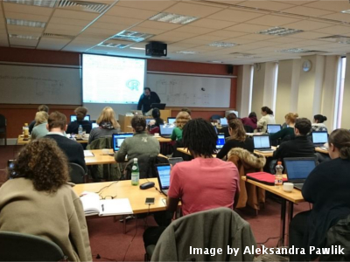
Hands-on intensive workshops
Two days
Hands-on
Qualified instructors
Helpers
Post-it notes!

Slide 8
Why workshops?
The curriculum is full
Researchers don’t have
much time
Allows for focused attention and collaborative learning
Building a community
Notes:
Next I’ll talk about each one of the organizations, what we teach and what our audience is

Slide 9

Sibling organization of Software Carpentry
Officially started November, 2014
Developed out of CollabIT meeting with NSF support
Curriculum
Focused on data - teaches how to manage and analyze data in an effective and reproducible way.
Initial focus is on workshops for novices - there are no prerequisites, and no prior knowledge computational experience is assumed.
Domain specific by design – currently have lessons in ecology and genomics, and spatial data under development

Slide 10
Curriculum
Dependent on Domain, but generally
Data organization and project setup
Data cleaning in OpenRefine
Introduction to data analysis and visualization in R or Python
SQL for data management
Text mining in R or Python
Introduction to cloud computing
Introduction to the command line

Slide 11
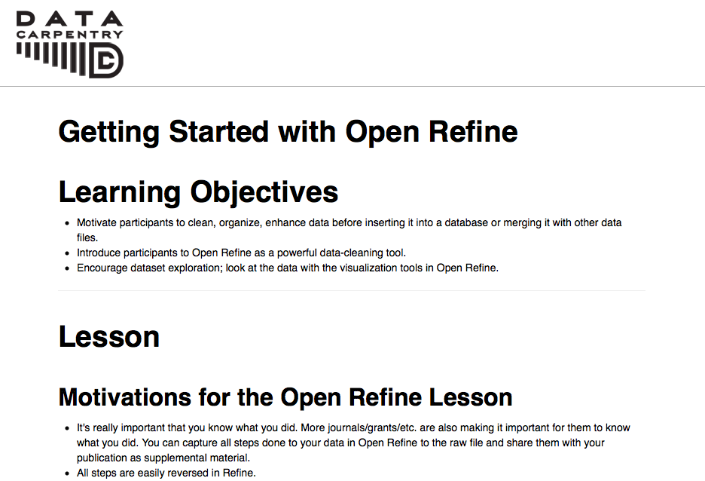

Slide 12
Software &Data Carpentry workshops
Goals:
We can’t teach everything in two days, but the goal is to teach foundational skills to reduce the activation energy for getting started and to know what’s possible
Notes:
More than a focus on particular analysis techniques, workshops are focused on data management and what might be called data wrangling, gettting your data in to and out of analysis programs, formatting the data for analysis, conducting visualization
We want to teach not only skills but affect attitudes – emphasizing importance and value of these approaches for effective and reproducible research

Slide 13
Demand is high
Workshops internationally
Have already taught over 34 this year, with consistent demand
Interest from broad domains – biology, genomics, social science, digital humanities, libraries, geosciences

Slide 14
People are learning things!
Level of data management and analysis skills prior to the workshop
Rate your level of data management and analysis skills following the workshop

Slide 15
Hackathons to develop lessons
Genomics
project organization, command line, cloud
computing, using bioinformatics tools, data analysis and visualization
- CSHL, iPlant, SESYNC, iDigBio
Geospatial data
Working with geospatial data
Hackathon at NEON – Sept/Oct (Leah Wasser)

Slide 16
Grassroots training effort
Developed by practitioners for practitioners
Identify skill needs in data management and analysis in given domains
Collaboratively and iteratively developed openly licensed (CC-BY) training materials
Organize and deliver two-day, intensive hands-on workshops in fundamental data analysis skills using a pool of volunteer helpers and instructors
Notes:
Deliverables are lessons and workshops, but another very positive outcome has been the pool of instructors

Slide 17
Building a community of practice
Volunteer instructors are a strong community building best practices
After we teach workshops, we’re building a local community, opportunities for continued engagement after a workshop. Often learners become instructors.

Slide 18
Guiding the Carpentries
Software Carpentry Steering Committee:
Matt Davis (Bay area company)
Adina Howe (Iowa State)
Katy Huff (UC Berkeley)
Karin Lagenstrom (Norway)
Aleksandra Pawlik (Software Sustainability Institute)
Raniere Silva (Brazil)
Jason Williams (CSHL)
Data Carpentry Steering Committee:
Karen Cranston (NESCent / OpenTree of Life)
Hilmar Lapp (NESCent / Duke)
Aleksandra Pawlik (Software Sustainability Institute)
Karthik Ram (rOpenSci / Berkeley Institute of Data Science Fellow)
Ethan White (University of Florida / Moore DDD Investigator)
Greg Wilson (Software Carpentry)
Notes:
Truly collaborative effort

Slide 19






Data Carpentry support

