Slide 1

Data Carpentry: Data Skills Training to Enable More Effective Research
Tracy K. Teal, PhD
Data Carpentry
Executive Director
@datacarpentry @tracykteal
http://www.datacarpentry.org
Notes:
Strategies and Techniques for Analyzing Microbial Population Structure
Explorations in Data Analyses for Metagenomic Advances in Microbial Ecology

Slide 2
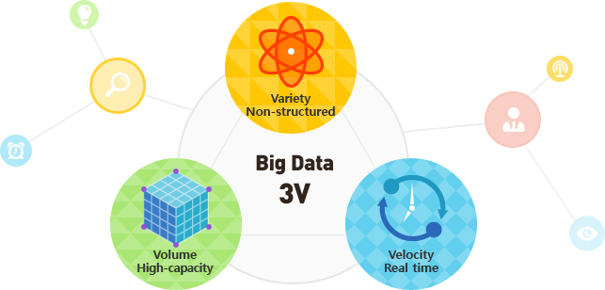
Our increasing capacity to collect data is changing science
Notes:
Our increasing capacity to collect data is changing science.
In the last 5 years, more scientific data has been generated than in the entire history of mankind, and this trend towards more data production is not slowing down.

Slide 3
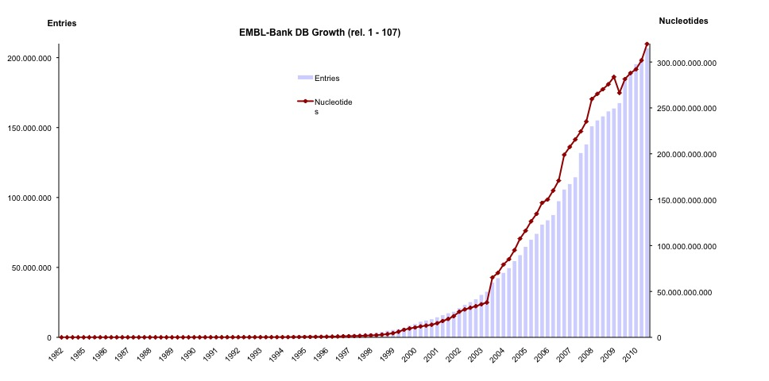
In genomics, data production is no longer the bottleneck
Notes:
Our increasing capacity to collect data is changing science. This is particularly true in genomics where, with high-throughput sequencing, data production is no longer a bottleneck.
Again, these plots keep increasing with technologies like NanoPore coming in to wider use, and we can only imagine what the next technologies will be.
This isn’t only genomics data either, there’s also all the ‘omics along with high throughput phenotype screening, imaging and even environmental data. And ideally we’d like to be able to integrate these different datasets.

Slide 4


Data pain
Notes:
Once you get the data back though, often instead of being seen as an exciting opportunity, it’s seen as an insurmountable challenge how to manage, store, analyze or even view the data.

Slide 5
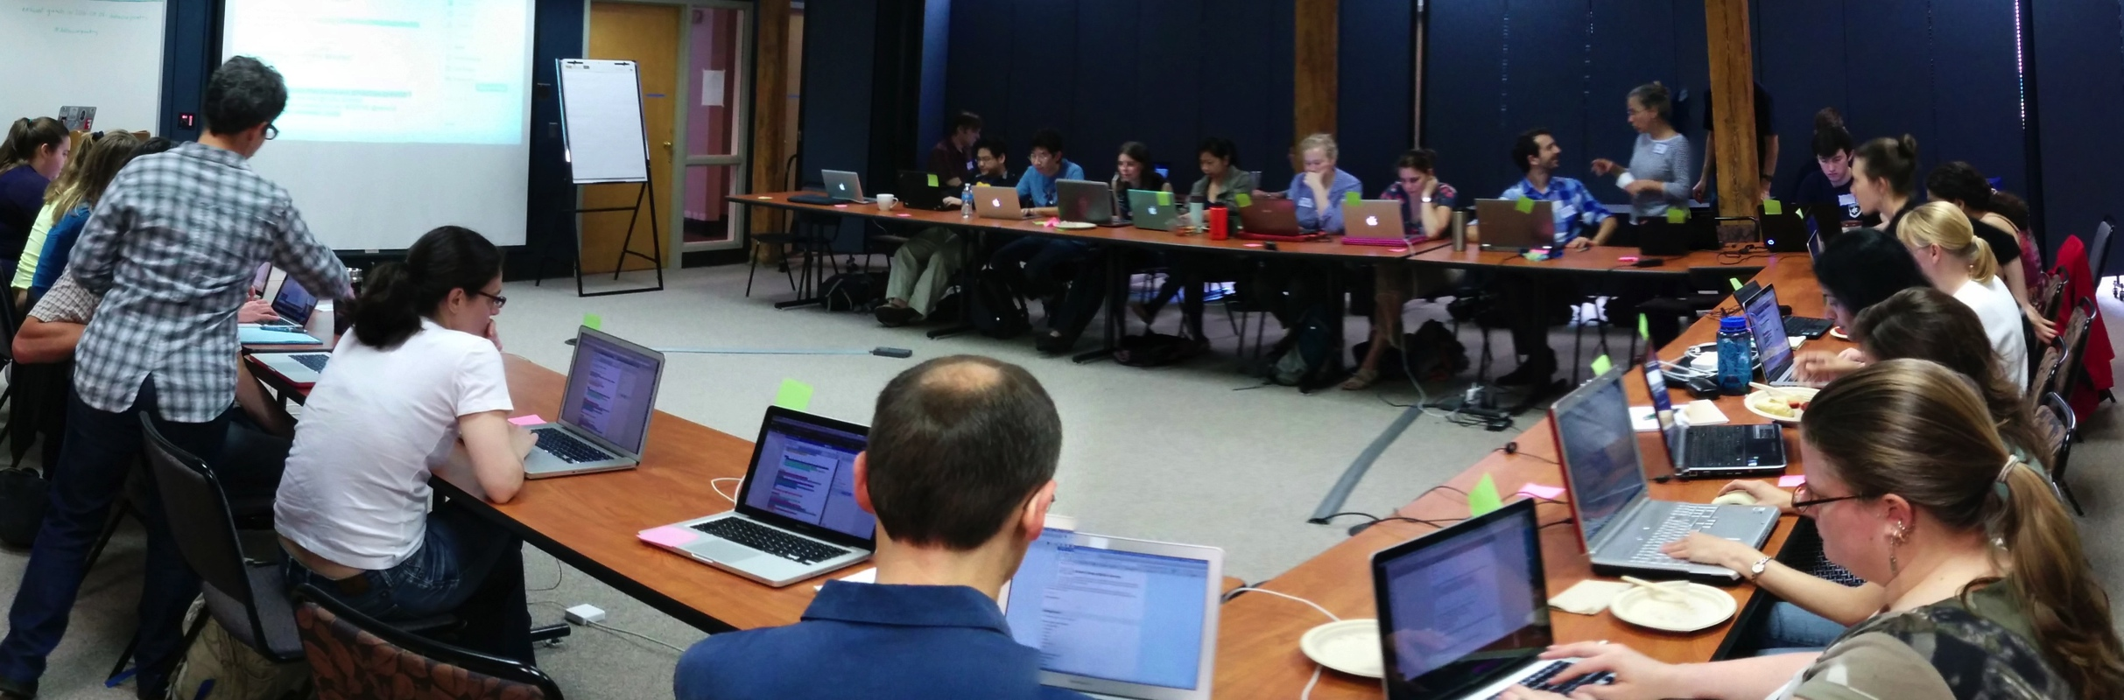
Working with ‘big data’ is no longer the domain of specialists and is instead widely done by all researchers.
Notes:
Lack of expertise was identified as the single biggest difficulty facing researchers in their bioinformatics activities, and training as the most valuable thing that BRAEMBL could do to support those activities.”

Slide 6
How do we scale ‘data literacy’ along with data production?
Notes:
However data is not information or scientific insight on its own and we need to unlock the potential of that data – some of that is tools and software, databases and infrastructure. But the key to that is the researchers themselves and their ability to conduct this research and good practice around data management and analysis and the software development to analyze this data.

Slide 7

Training is a missing piece between data collection & data-driven discovery
Training
Notes:
Researchers need to be trained in how to effectively manage and use this data. Researchers don’t know how to address the questions they want to ask or aren’t even aware of the types of questions they can ask with this data.
Story about genomics researcher
It’s no longer the case where we’re saying ‘researchers should’. Researcher themselves want this training, feel limited by their own current data analysis skills. You likely have anecdotal evidence of this in your own community or domain

Slide 8
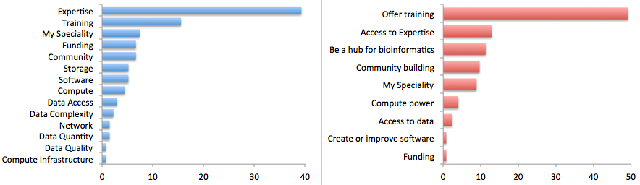
Researchers view the major limiting factor in research progress as a lack of expertise in how to handle and analyze data
Survey by Bioinformatics Resource Australia – EMBL
Biggest Bioinformatics Difficulty
Most useful thing BRAEMBL could do
http://braembl.org.au/news/braembl-community-survey-report-2013
Notes:
, but for instance …
Biomedical researchers in the UK had similar sentiments in a survey
https://storify.com/biocrusoe/elixir-uk-node-meeting-2014-10-14
And an internal study at PLOS showed a lack of data management expertise has a dramatic impact on the ability
of researchers to share their data

Slide 9
Where does this training come from?
Notes:
Curriculum is full. Not enough teachers at universities with these skills. Short courses are over subscribed.

Slide 10
Data and Software Carpentry develop and run workshops to fill that training gap
Our goal is to provide researchers high-quality
training covering the fundamentals and best practices in the full lifecycle of data-driven research and software development.
Notes:
We need more Meridith’s
Not everyone can be a Meridith (15 year old girl)

Slide 11


We teach basic lab skills
for scientific computing
so that researchers can do more
in less time and with less pain.
Founded in 1998 by Greg Wilson
Teach basic concepts, skills and tools for working more effectively with data. Workshops are designed for people with little to no prior computational experience.
Founded as a sibling organization in 2014 out of NSF BIO Centers

Slide 12
Grassroots training effort
Developed by practitioners for practitioners
Identify skills and best practices needed in software development, data management and analysis in given domains
Collaboratively and iteratively developed openly licensed (CC-BY) training materials (all available on github)
Organize and deliver two-day, intensive hands-on workshops in fundamental data analysis skills using a pool of volunteer helpers and instructors
Notes:
Deliverables are lessons and workshops

Slide 13
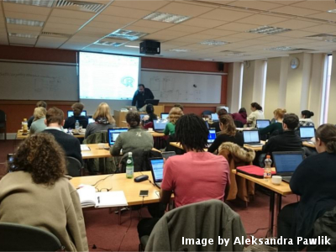
Hands-on intensive workshops
Two days
Hands-on
Qualified instructors
Helpers
Post-it notes!
Friendly learning environment
We can’t teach everything in two days, but the goal is to teach foundational skills to reduce the activation energy for getting started and to know what’s possible.

Slide 14
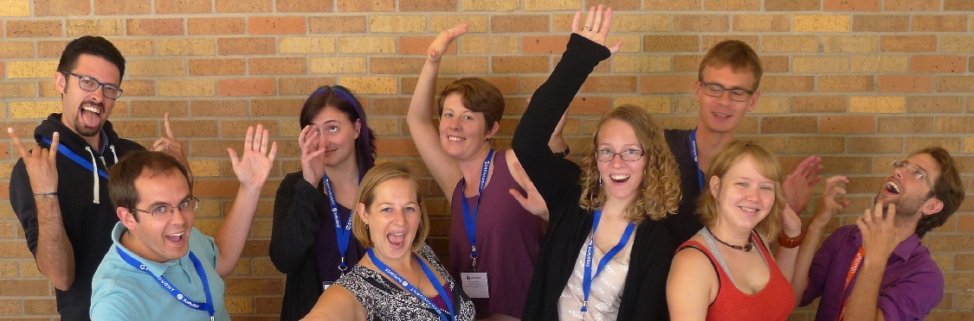
Volunteer instructors
The Software Carpentry Foundation runs the Instructor Training program that teaches volunteers teaching pedagogy and specific strategies for teaching computational skills in a workshop format.

Slide 15
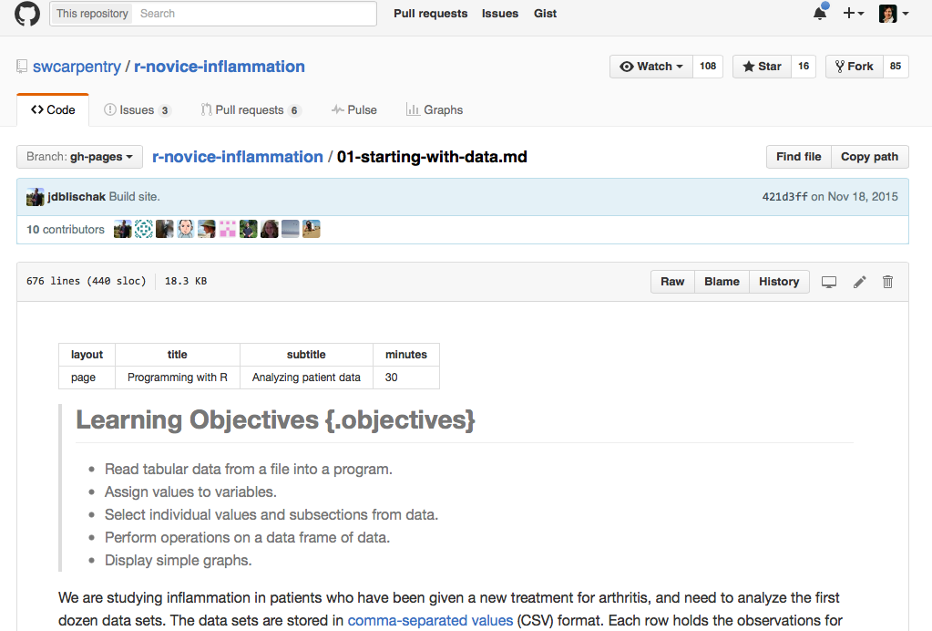
Collaboratively developed curriculum

Slide 16
Focused on data - teaches how to manage and analyze data in an effective and reproducible way.
Initial focus is on workshops for novices - there are no prerequisites, and no prior knowledge computational experience is assumed.
Domain specific by design – currently have lessons in ecology, in genomics developed with iPlant, in geospatial data developed with NEON, and on APIs with rOpenSci
Curriculum
Project and data organization
Data cleaning and quality control
Data analysis and visualization in R or Python
Domain dependent
Introduction to cloud computing
Command line
Text mining

Slide 17
Focused on better scientific programming practices, for writing software or analysis scripts
Novice and more advanced levels
Domain agnostic
Curriculum
Command line
Software development best practices in R, Python or MATLAB
Github for version control

Slide 18
Workshops Worldwide
Since 2014:
Over 300 two-day workshops
Over 9000 learners
Taught by over 200 volunteers
In over 20 countries
Notes:
Materials and workshop model founded on successful SWC model
Workshops fill gaps
Demand continues to grow with a minimum of two workshops a week already scheduled in 2016

Slide 19
People are learning things!
Level of data management and analysis skills prior to the workshop
Rate your level of data management and analysis skills following the workshop

Slide 20
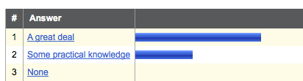
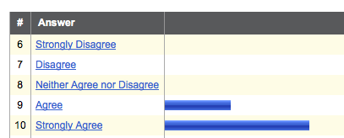
They feel the workshop was worthwhile
How much practical knowledge did you gain from this workshop?
This workshop was worth my time

Slide 21
What can the Carpentries do for training in Genomics?

Slide 22
Genomics curriculum
Day 1 Morning
Module 1: Data organization and management
Setting up the project, raw data and metadata
Module 2: Working with genomics file types
Understanding genomic data types and how to work with it
Day 1 Afternoon
Module 3: Using cloud computing for genomics
Logging in to and transfering data to the cloud (Amazon or local HPC)
Module 4: Introduction to the command line
Day 2 Morning
Module 5: Data wrangling and processing
Bioinformatics pipelines at the command line – FastQC, Trimmomatic
Day 2 Afternoon
Module 6: R for data analysis and visualization
importing data in to R and using it for analysis and visualization

Slide 23
Get Involved
Request a workshop
Be a helper at a workshop
Become a partner or affiliate and train local instructors
Contribute to lesson development

Slide 24
Guiding the Carpentries
Software Carpentry Steering Committee:
Matt Davis (Bay area company)
Adina Howe (Iowa State)
Katy Huff (UC Berkeley)
Karin Lagenstrom (Norway)
Aleksandra Pawlik (Software Sustainability Institute)
Raniere Silva (Brazil)
Jason Williams (CSHL)
Data Carpentry Steering Committee:
Karen Cranston (NESCent / OpenTree of Life)
Hilmar Lapp (NESCent / Duke)
Aleksandra Pawlik (Software Sustainability Institute)
Karthik Ram (rOpenSci / Berkeley Institute of Data Science Fellow)
Ethan White (University of Florida / Moore DDD Investigator)
Greg Wilson (Software Carpentry)
Notes:
Truly collaborative effort

Slide 25







Support
Data Carpentry
Software Carpentry
http://software-carpentry.org/scf/partners/
Jason Williams at iPlant

