Slide 1
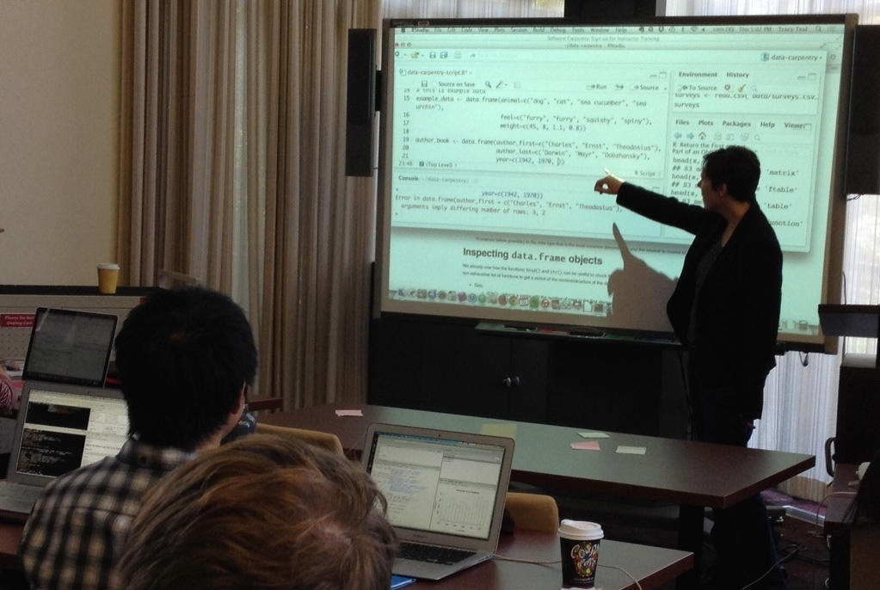


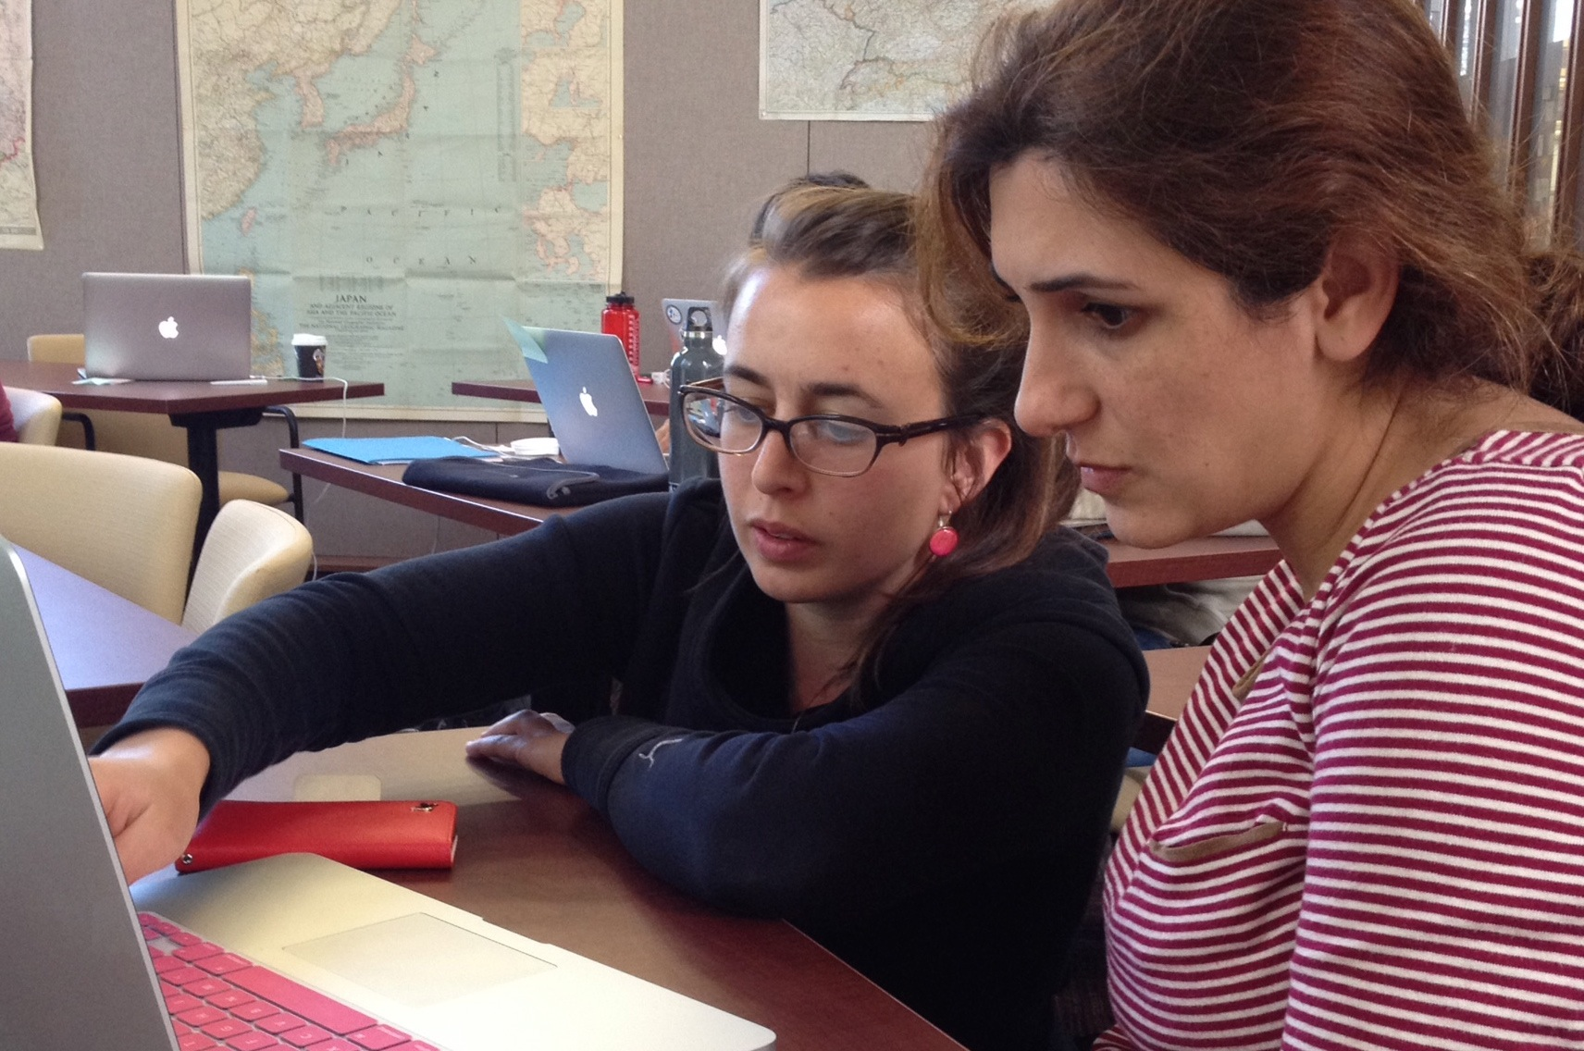
Tracy Teal, PhD
Executive Director, Data Carpentry
@datacarpentry, @swcarpentry

Slide 2
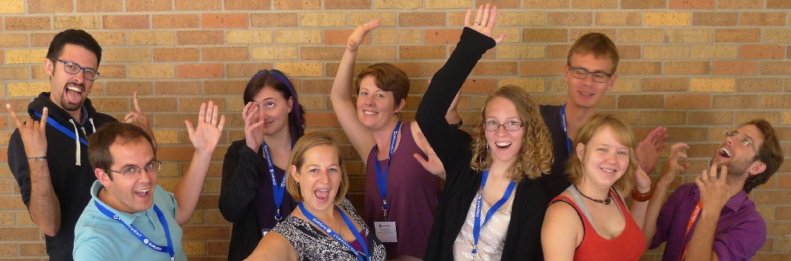
Volunteer instructors
475 instructors
Over 50 countries

Slide 3
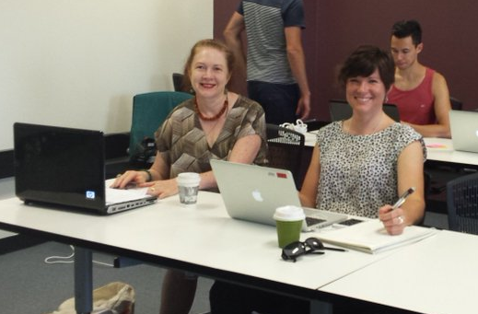
Who
Who are your typical audience and how are they recruited?
Researchers
Often been involved in a workshop
Want to provide value
Want opportunity to be a part of a community

Slide 4
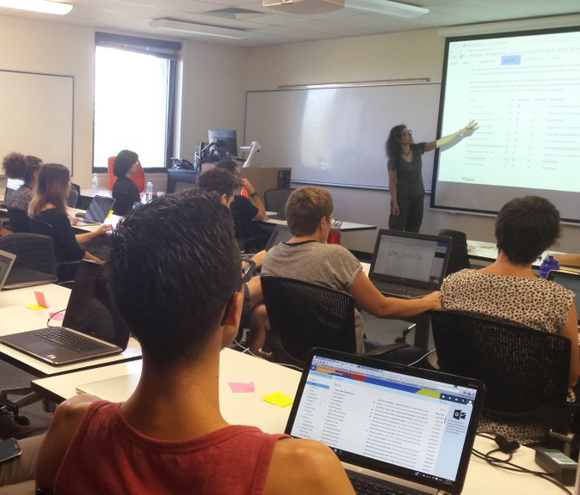
How
Mode of delivery? Length of typical course / trainer interaction?
Two days
Participants in the same space
Instructor online or in person
Active learning
~20 people per training
Delivered by TtT trainers

Slide 5

What
What is your main focus when training them? What approach do you take – what are the main topics covered in your TtT sessions?
Pedagogy & Instructional Design
Aspects of teaching SWC/DC workshops
Greg Wilson, SWC Director, Instructor Training
http://swcarpentry.github.io/instructor-training/

Slide 6
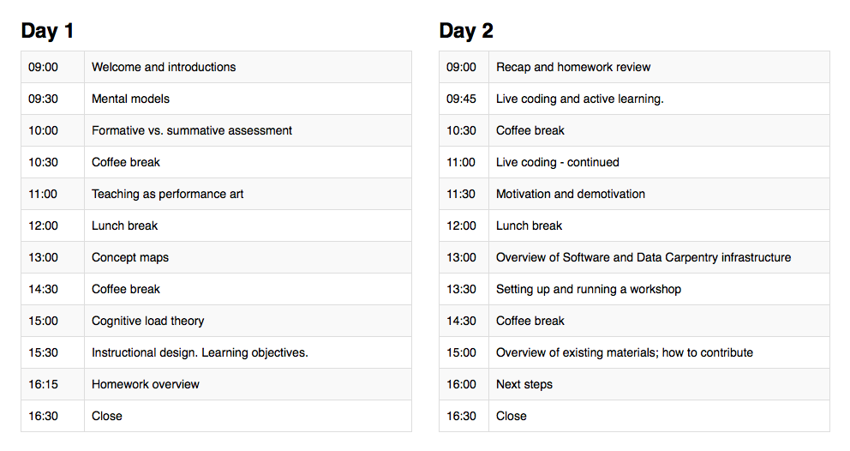
What
Opportunities to put concepts in to practice
Giving and receiving feedback

Slide 7
After Training
Check-out procedure
Teaching with experienced instructors
Online pre and post workshop debriefings
Mentoring subcommittee
Email lists/Twitter/Blog posts
Building a community

Slide 8
5 Things
Scaling training with a training program/set of trainers
Uniformity/availability of content
Valuing trainer efforts and giving credit
Pathways to advancement & continued training opportunities (e.g. handling negative feedback)
Building a community

