Slide 1

Workshops to increase data literacy for researchers

Slide 2
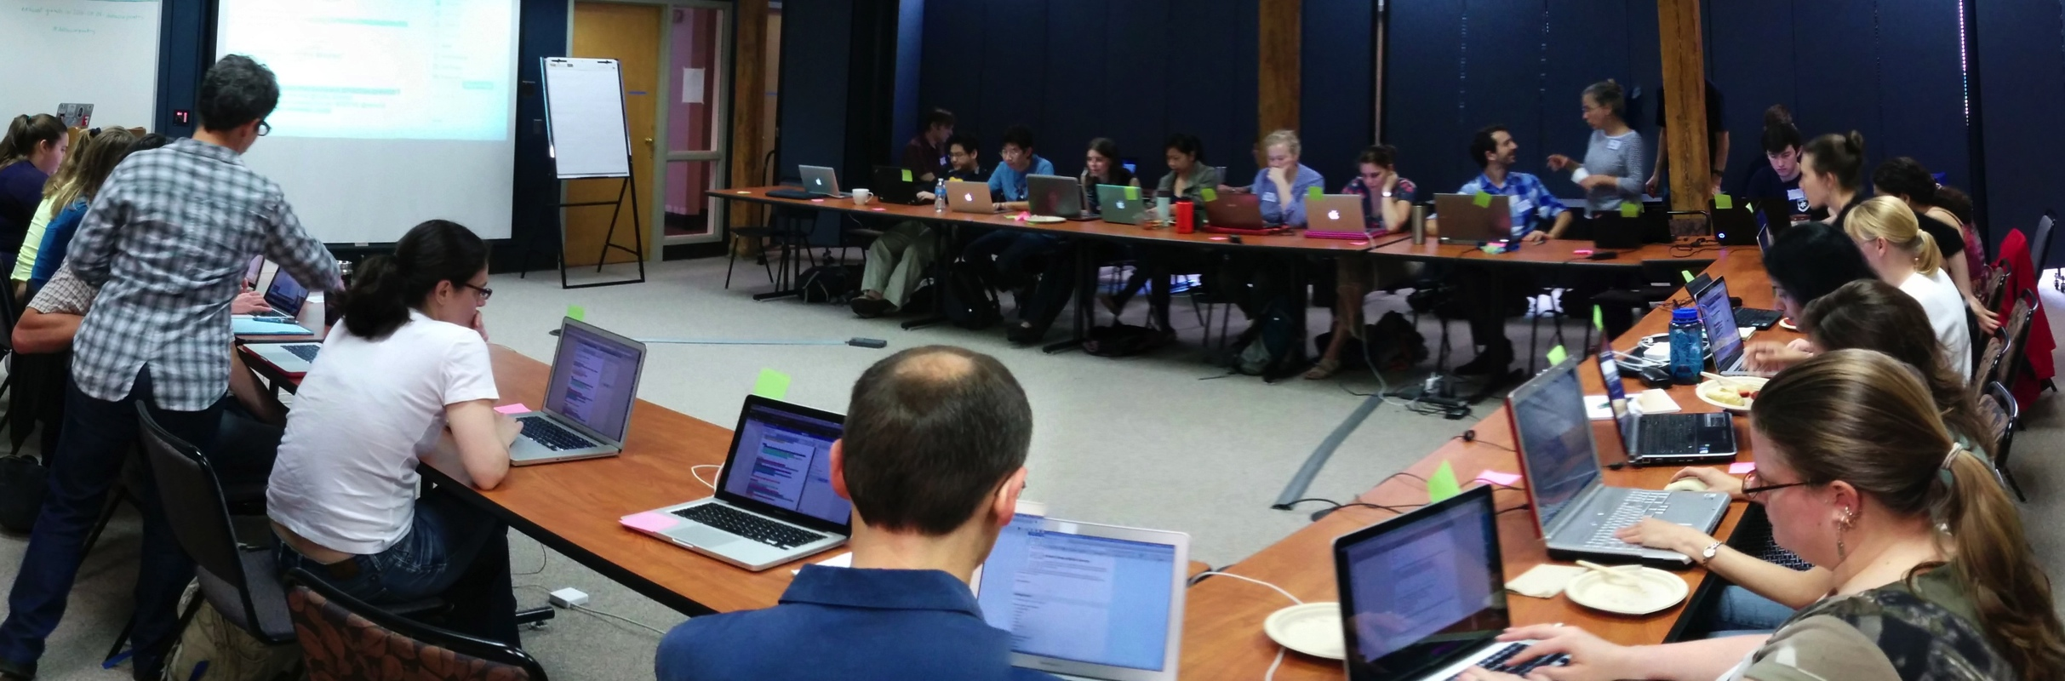
With the emergence of new technologies generating large datasets in all domains of research, data analysis is no longer the domain of specialists and is instead widely done by all researchers.
Notes:
Lack of expertise was identified as the single biggest difficulty facing researchers in their bioinformatics activities, and training as the most valuable thing that BRAEMBL could do to support those activities.”

Slide 3
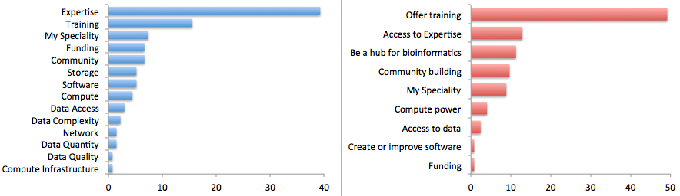
Researchers view the major limiting factor in research progress as a lack of expertise in how to handle and analyze data effectively and efficiently.
This can only be addressed through high quality, widely available training and is the resource most highly desired by researchers.
Survey by Bioinformatics Resource Australia – EMBL
http://braembl.org.au/news/braembl-community-survey-report-2013
Biggest Bioinformatics Difficulty
Most useful thing BRAEMBL could do
Notes:
Biomedical researchers in the UK had similar sentiments in a survey
https://storify.com/biocrusoe/elixir-uk-node-meeting-2014-10-14
And an internal study at PLOS showed a lack of data management expertise has a dramatic impact on the ability
of researchers to share their data

Slide 4
NSF BIO Center effort
At a NSF BIO Center CollabIT meeting organized by SESYNC & supported by an NSF Supplemental grant we saw this same shared need for training.
People from the different centers got together and identified pain points and fundamental data analysis skills.
BEACON – Tracy Teal
iDigBio – Deb Paul, Shari Ellis & Francois Michonneau
iPlant – Jason Williams
NEON – Leah Wasser
NESCent – Hilmar Lapp & Karen Cranston
SESYNC – Mike Smorul & Mary Shelley

Slide 5
Training goals:
We would like people to be able to retrieve, view, manipulate, analyze and store their own and other's data in an open and reproducible way.
We should start at a beginner level - there seem to be workshops already for more advanced levels. E.g., courses that are available at universities are often limited to majors.
Have a shared, consolidated curriculum across the centers to increase scalability of the materials.
Customize materials for different domains.

Slide 6

We teach basic lab skills
for scientific computing
so that researchers can do more in less time and with less pain.

Slide 7

We teach basic lab skills
for scientific computing
so that researchers can do more in less time and with less pain.
Teach basic concepts, skills and tools for working more effectively with data. Workshops are designed for people with little to no prior computational experience.

Slide 8
Target audience
SKILLS
Multiple disciplines
bioinformatics
ecology
genomics
sociology
digital humanities
neuroscience
geosciences
….
Different levels of career
PhD students
postdoctoral researchers
research assistants
researchers in industry
….
Full
computational
lab
skillset
Good knowledge of programming (R, Python or other), structured data, metadata, proficiency in building workflows and automating tasks
Some knowledge of scripting, using workflow tools, command line
Data + spreadsheets + some statistics and…?

Slide 9
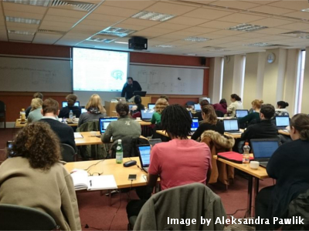
Workshops & Curriculum
2 days
Hands-on
Qualified instructors
Helpers
Post-it notes!
Core curriculum
Effective use of spreadsheets
Limitations and caveats of data analysis using spreadsheets
Moving from spreadsheets into more powerful tools (R or Python)
Using databases (introduction to SQL)
Workflows and automating repetitive tasks (command line shell and shell scripts)

Slide 10
Progress so far
Workshops:
10 in total
4 at the NSF BIO Centers
iDigBio
BEACON
SESYNC
NESCent
Data Carpentry workshops in the UK, Finland and Bangalore (CODATA)
Hackathons for material development
Genomics materials hackathon at CSHL
ELIXIR hackathon in Finland
Plans for Geospatial data lessons hackathon
Open source materials https://github.com/datacarpentry/
Partnership with Software Carpentry Foundation

Slide 11

Plans for the future
Workshops and hackathons in the United States and internationally
Aim for 24 workshops in the first calendar year (2015)
Working with ELIXIR Europe and UK to run workshops there and Research
Platforms in Australia.
Working to develop a sustainable plan for delivering workshops and
developing material in new domains (NSF, Moore Foundation)
Working across BIO Centers with Leah Wasser from NEON as lead, to develop a data lessons catalog

