Slide 1
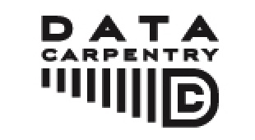

Researchers are experiencing a lot of data pain and are frustrated or limited by their current workflows

Slide 2
Sentiments on data within the NSF BIO Centers
(BEACON, SESYNC, NESCent, iPlant, iDigBio)
I usually manage data in Excel and it's terrible and I want to do it better.
I'm organizing GIS data and it's becoming a nightmare.
My advisor insists that we store 50,000 barcodes in a spreadsheet, and something must be done about that.
I'm having a hard time analyzing microarray, SNP or multivariate data with Excel and Access.
I want to use public data.
I work with faculty at undergrad institutions and want to teach data practices, but I need to learn it myself first.
I'm interested in going in to industry and companies are asking for data analysis experience.
I'm trying to reboot my lab's workflow to manage data and analysis in a more sustainable way.
I'm re-entering data over and over again by hand and know there's a better way.
I have overwhelming amounts of data.
I'm tired of feeling out of my depth on computation and want to increase my confidence.

Slide 3
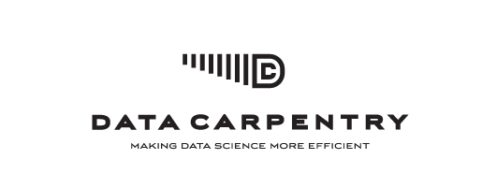
Goal:
Develop and teach workshops to help train the next generation of researchers in good data analysis and management practices to enable individual research progress and open and reproducible research.

Slide 4
What’s Data Carpentry?
Two day intensive workshops, modeled on Software Carpentry
Learning objective:
Researchers should be able to retrieve, view, manipulate, analyze and store their and other's data in an open and reproducible way.
Data Carpentry is focused on data - The workshop introduces one data set at the beginning of the workshop. This data set is used throughout the workshop to teach how to manage and analyze data in an effective and reproducible way.
Data Carpentry is designed for novices - there are no prerequisites, and no prior knowledge about the tools is assumed.
Data Carpentry is domain specific by design.

Slide 5
Data Carpentry curriculum
Preparing data for analysis
How to organize data and use spreadsheet programs more effectively, but also to recognize their limitations.
Getting data out of spreadsheets and into tools such as R or Python that allow for reproducible workflows and have more capabilities.
Using databases, including managing and querying data in SQL.
Workflows and automating repetitive tasks, in particular using the command line shell and shell scripts.
Using data and computational resources, in particular publicly available ones such as Amazon, DataDryad and Figshare
Overall, conducting data and computation-heavy research more efficiently, reproducibly and openly.

Slide 6
Data Carpentry instructor development and resources
Training and supporting instructors is another primary goal of Data Carpentry
Providing open source/creative commons materials for re-use
Potentially acting as a hub for instructional materials on data analysis and management

Slide 7
Materials development
Currently materials for multiple domains and topics and working with people in different domain to develop more
Topics:
Shell, R, Python, SQL, Excel, data cleaning, text mining, HDF5
Domains:
Ecology, genomics, social science, neuroscience, geosciences

Slide 8
Community driven effort
Data Carpentry board:
Karen Cranston (NESCent), Hilmar Lapp (Duke), Aleksandra Pawlik (ELIXIR UK), Karthik Ram (rOpenSci), Tracy Teal (Michigan State), Ethan White (Univ of Florida), Greg Wilson (Software Carpentry)
Contributors:
20 people contributing to materials development already
4 workshops taught, 11 instructors, ~20 helpers
Open source materials
https://github.com/datacarpentry/datacarpentry/

