Slide 1

Data Carpentry: Enabling Researchers to Work More Effectively with Data
Tracy K. Teal, PhD
Data Carpentry Project Lead
Assistant Professor, BEACON, Michigan State University
@datacarpentry
http://datacarpentry.org

Slide 2
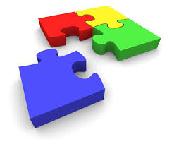
Training is a missing piece between data collection & data-driven discovery
Training
Notes:
The missing step between data collection and research progress is a lack of training for scientists in crucial skills for effectively managing and analyzing large amounts of data.

Slide 3
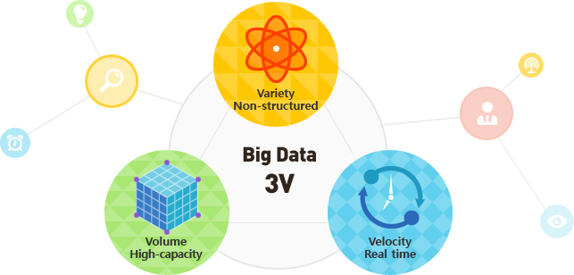
http://widerplanet.org
Notes:
This isn’t an audience I need to convince of the current and increasing velocity, volume and variety of data, and we’re all here to discuss the challenges and opportunities this data generation is presenting. Why are we all here though, why is now different than say when microscopes first were invented or telescopes had greater capacity.
Deception -> Disruption (Phil Bourne)

Slide 4

Large scale data is being generated in all domains
Digital text
Genomics
Satellite
Notes:
We’re all here, and these conversations are getting broader and there’s more interest and investment in this issue, is because what’s different about now is that this data is being generated in all domains of research
Informing every scholarly endeavor

Slide 5
As well as in the non-academic sector
Health care
Marketing
Finance
Notes:
As well as in the non-academic sector. This lends itself to broad alignment on these issues in a way that we haven’t seen before, and also adds an urgency to the challenges. Industry might see how to turn this data in to value for the company, biomedical researchers see opportunities to save lives, geoscientists to address climate change. People think this data has the potential to address important issues affecting our lives and society.

Slide 6
Data potential
Notes:
Now what we have is a lot of data potential. The data available has the potential to answer new research questions, suggest solutions to societal challenges or save lifes
Now we have two types of researchers – those who are excited about this data and are generating it themselves or engaging with public data efforts, and those who don’t yet see a use for this data. But that slice of the pie who won’t be able to derive value or discovery from these digital data collections is starting to become smaller. .

Slide 7
Data is not information
Notes:
However data is not information or scientific insight on its own and we need to unlock the potential of that data – some of that is tools and software, databases and infrastructure. But the key to that is the researchers themselves and their ability to conduct this research.

Slide 8
Training is a missing piece between data collection & data-driven discovery
Training
Notes:
Researchers need to be trained in how to effectively manage and use this data. Researchers don’t know how to address the questions they want to ask or aren’t even aware of the types of questions they can ask with this data.
Story about genomics researcher
It’s no longer the case where we’re saying ‘researchers should’. Researcher themselves want this training, feel limited by their own current data analysis skills. You likely have anecdotal evidence of this in your own community or domain

Slide 9
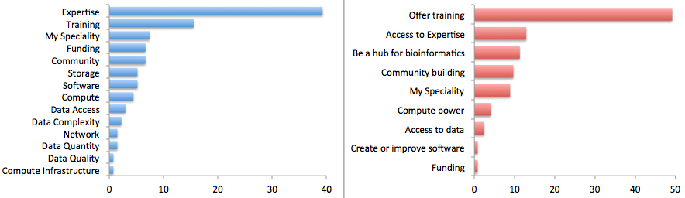
Researchers view the major limiting factor in research progress as a lack of expertise in how to handle and analyze data
Survey by Bioinformatics Resource Australia – EMBL
Biggest Bioinformatics Difficulty
Most useful thing BRAEMBL could do
http://braembl.org.au/news/braembl-community-survey-report-2013
Notes:
, but for instance …
Biomedical researchers in the UK had similar sentiments in a survey
https://storify.com/biocrusoe/elixir-uk-node-meeting-2014-10-14
And an internal study at PLOS showed a lack of data management expertise has a dramatic impact on the ability
of researchers to share their data

Slide 10
Data Carpentry is filling that training gap
Our mission is to provide researchers high-quality,
domain-specific training covering the full lifecycle of data-driven research.
Notes:
We need more Meridith’s
Not everyone can be a Meridith (15 year old girl)

Slide 11

We’re here to help
(the logo is a saw)

Slide 12

Training focused on data - teaching how to manage and analyze data in an effective and reproducible way.
Domain specific by design – currently have lessons in ecology and are developing lessons for genomics, geosciences and social sciences.
Initial focus is on novices - there are no prerequisites, and no prior knowledge computational experience is assumed. We plan to expand to more advanced topics.

Slide 13
Grassroots training effort
Developed by practitioners for practitioners
Identify skill needs in data management and analysis in given domains
Collaboratively and iteratively developed openly licensed (CC-BY) training materials
Organize and deliver two-day, intensive hands-on workshops in fundamental data analysis skills using a pool of volunteer helpers and instructors
Notes:
Deliverables are lessons and workshops

Slide 14
Grassroots training effort
Developed by practitioners for practitioners
Identify skill needs in data management and analysis in given domains
Collaboratively and iteratively developed openly licensed (CC-BY) training materials
Organize and deliver two-day, intensive hands-on workshops in fundamental data analysis skills using a pool of volunteer helpers and instructors
Notes:
Deliverables are lessons and workshops

Slide 15
Grassroots training effort
Developed by practitioners for practitioners
Identify skill needs in data management and analysis in given domains
Collaboratively and iteratively developed openly licensed (CC-BY) training materials
Organize and deliver two-day, intensive hands-on workshops in fundamental data analysis skills using a pool of volunteer helpers and instructors
Notes:
Deliverables are lessons and workshops, but another very positive outcome has been the pool of instructors

Slide 16

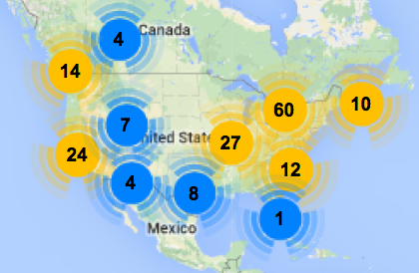
Software Carpentry
Greg Wilson founded in 1998
Since January 2013
With the help of the
Mozilla Science Lab
scaled to teach
Over 270 two-day workshops
For over 8300 learners
Taught by over 200 volunteers
In over 20 countries
North American Workshops 2012-2014
Now its own non-profit the Software Carpentry Foundation
Notes:
Materials and workshop model founded on successful SWC model
Workshops fill gaps

Slide 17
Data Carpentry workshops
Goals:
We can’t teach everything in two days, but the goal is to teach foundational skills to reduce the activation energy for getting started and know what’s possible
Curriculum: The data lifecycle from data organization to analysis and visualization
Notes:
More than a focus on particular analysis techniques, workshops are focused on data management and what might be called data wrangling, gettting your data in to and out of analysis programs, formatting the data for analysis, conducting visualization
We want to teach not only skills but affect attitudes – emphasizing importance and value of these approaches for effective and reproducible research

Slide 18
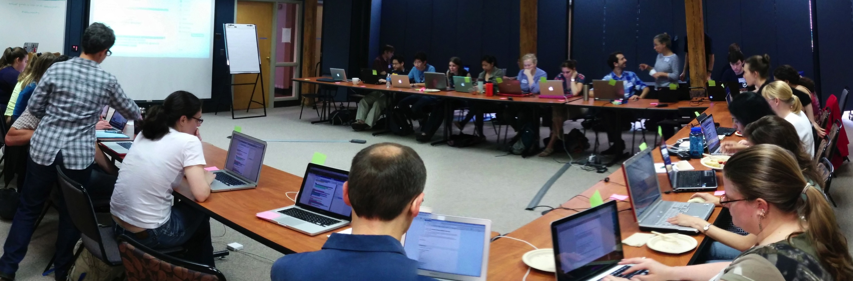
Data Carpentry workshops
Format
Two days
Hands on
Qualified instructors
Helpers
Sticky notes!

Slide 19
Demand is high
Workshops internationally
Started in November, 2014; since Jan 2015 have taught 10 workshops and have more than 24 scheduled for this year
Interest from broad domains – biology, genomics, social science, digital humanities, libraries, geosciences

Slide 20
Curriculum for ecology
The data lifecycle from data organization to analysis and visualization
Data organization in spreadsheets
OpenRefine for data cleaning
R for data analysis and visualization
SQL

Slide 21
Workshop at NDIC
https://github.com/datacarpentry/2015-05-03-NDIC/wiki

Slide 22
People are learning things!
Level of data management and analysis skills prior to the workshop
Rate your level of data management and analysis skills following the workshop

Slide 23
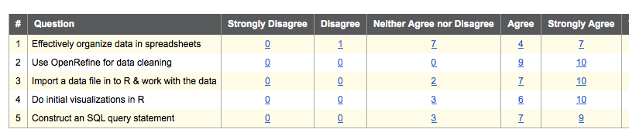
People are learning things!
Compared to before the workshop, I have a better understanding of how to

Slide 24
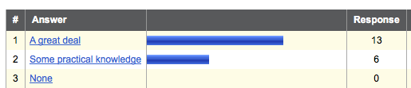
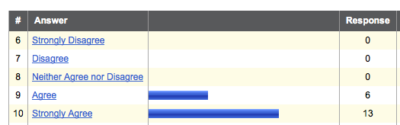
They feel the workshop was worthwhile
How much practical knowledge did you gain from this workshop?
This workshop was worth my time

Slide 25
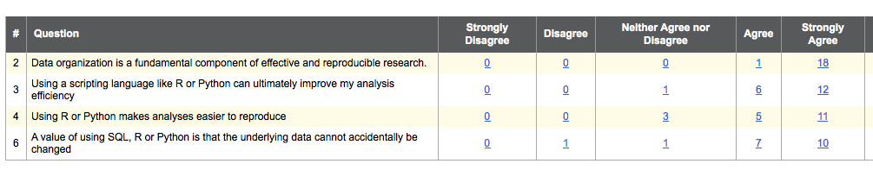
Thoughts on data best practices
Please rate your level of agreement with the following statements

Slide 26
Hackathons to develop lessons
Genomics
project organization, command line, cloud
computing, using bioinformatics tools, data analysis and visualization
- CSHL, iPlant, SESYNC, iDigBio
Geospatial data
Working with geospatial data
Hackathon at NEON – Sept/Oct (Leah Wasser)
Social sciences
Working with data from social sciences
Hackathon at Berkeley – July (Dav Clark)

Slide 27
What Students Learn
Capstone lesson

Slide 28
Guiding Data Carpentry
Steering Committee:
Karen Cranston (NESCent / OpenTree of Life)
Hilmar Lapp (NESCent / Duke)
Aleksandra Pawlik (Software Sustainability Institute)
Karthik Ram (rOpenSci / Berkeley Institute of Data Science Fellow)
Tracy Teal (Data Carpentry / Michigan State)
Ethan White (University of Florida / Moore DDD Investigator)
Greg Wilson (Software Carpentry)
Volunteer instructors and materials developers
Mike Smorul (SESYNC), Mary Shelly (SESYNC), Jason Williams (iPlant), Leah Wasser (NEON), Deb Paul (iDigBio), Francois (iDigBio), Ben Marwick (University of Washington), Dav Clark (Berkeley)
Notes:
Truly collaborative effort

Slide 29






Data Carpentry support

