Slide 1



Data Carpentry: workshops to increase data literacy for researchers
Aleksandra Pawlik, University of Manchester
International Digital Curation Conference
London, UK
10th February 2015

Slide 2

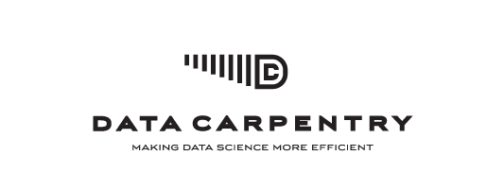
What is Data Carpentry
Researchers should be able to retrieve, view, manipulate, analyze and store their's and other's data in an open and reproducible way. Researchers learn best when material is taught in their domain, so workshops will be domain-specific.
Training specifically designed for scientists
http://datacarpentry.org
for novices:
there are no prerequisites, and no prior knowledge about the tools is assumed
Partner organisation to Software Carpentry
Hands-on workshops

Slide 3








Who is Data Carpentry
Project lead:
Tracy K. Teal (Michigan State University)
Steering Committee:
Karen A. Cranston (National Evolutionary Synthesis Center, NESCent)
Hilmar Lapp (National Evolutionary Synthesis Center, NESCent)
Ethan White (Utah State University)
Greg Wilson (Software Carpentry Foundation)
Karthik Ram (University of California)
Aleksandra Pawlik (University of Manchester)
Administrators: Arliss Collins (MSL) and Giacomo Peru (SSI)
Assessment support: Shari Ellis, iDigBio
Instructors: international volunteer network
Funders and partnership organisations

Slide 4
Target audience
SKILLS
Multiple disciplines
bioinformatics
ecology
genomics
sociology
digital humanities
neuroscience
geosciences
….
Different levels of career
PhD students
postdoctoral researchers
research assistants
researchers in industry
….
Full
computational
lab
skillset
Good knowledge of programming (R, Python or other), structured data, metadata, proficiency in building workflows and automating tasks
Some knowledge of scripting, using workflow tools, command line
Data + spreadsheets + some statistics and…?

Slide 5
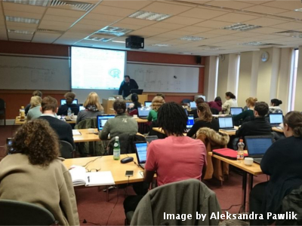
Workshops & Curriculum
2 days
Hands-on
Qualified instructors
Helpers
Post-it notes!
Core curriculum
Effective use of spreadsheets
Limitations and caveats of data analysis using spreadsheets
Moving from spreadsheets into more powerful tools (R or Python)
Using databases (introduction to SQL)
Workflows and automating repetitive tasks (command line shell and shell scripts)

Slide 6
Progress so far
Workshops:
8 in total
4 at the NSF BIO Centers
iDigBio
BEACON
SESYNC
NESCent
1st Data Carpentry workshop in the UK in collaboration with ELIXIR UK
Hackathons for material development
Mozilla Science Lab sprints July 22-23, 2015
Open source materials
https://github.com/datacarpentry/datacarpentry/
Partnership with Software Carpentry Foundation

Slide 7
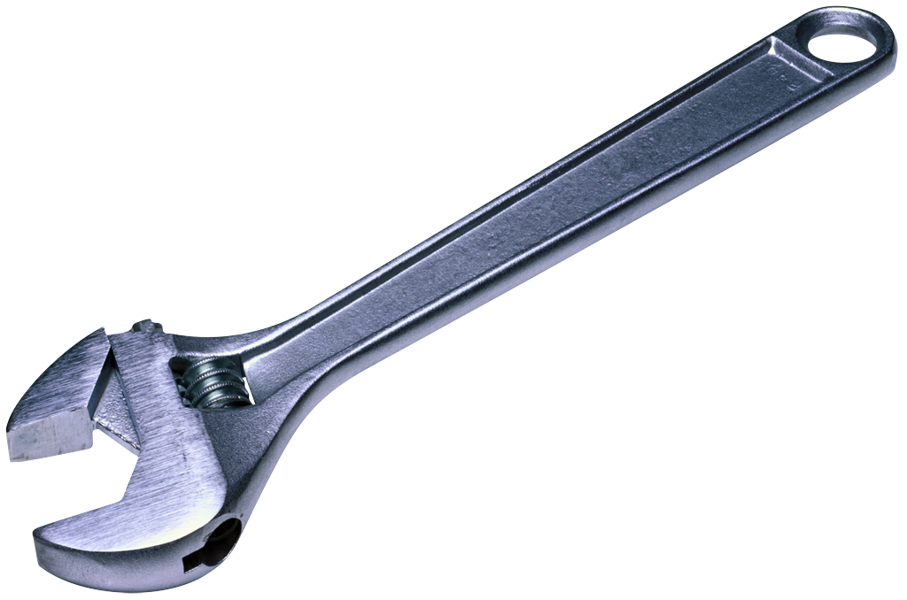
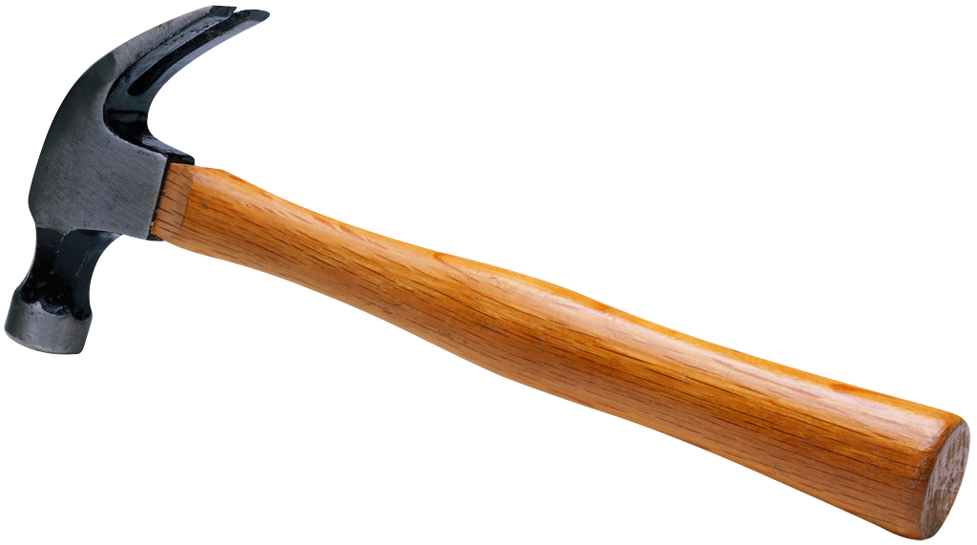
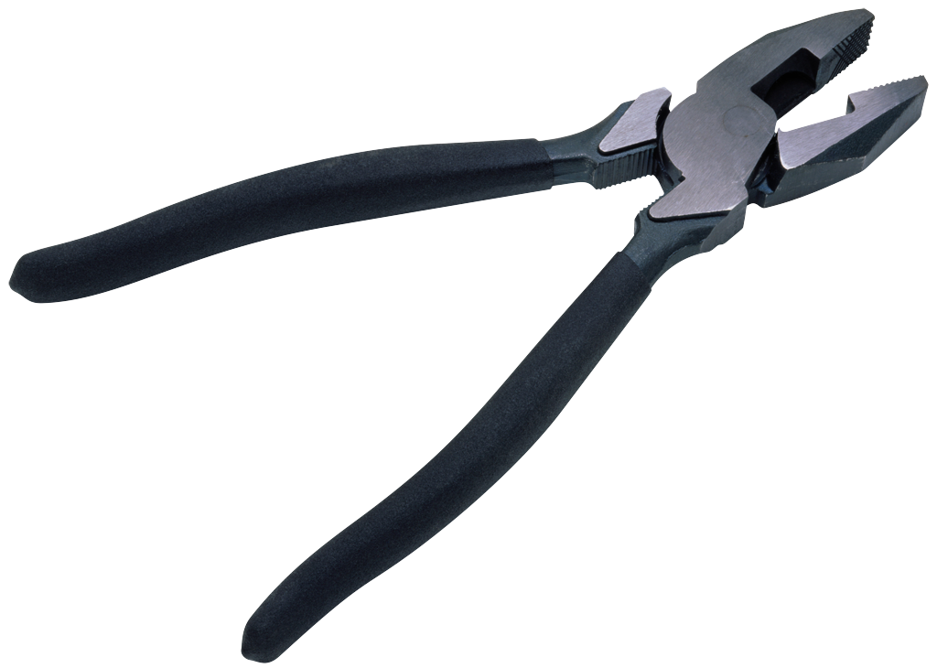
Challenges
Sustainability
Business model and funding
Partnerships to ensure
Instructors training
Growing demand for workshops
Working together with Software Carpentry Foundation
Assessment
Feedback to improve Data Carpentry
Evidence of impact making

Slide 8


Plans for the future
Pilot project to set foundations for Data and Software Carpentry in ELIXIR (coordinated by the ELIXIR UK Node)
2 European-wide Hackathons for materials development
2 DC workshops
1 Instructors training
Genomics Workshop Hackathon: Curriculum & Assessment Development, Cold Spring Harbor Laboratory
Aim for 24 workshops in the first calendar year (2015)

Slide 9
Workshop at IDCC2015!
Data Carpentry: using APIs to access life science data available on the web
Tomorrow, 11th February, 9-5pm
IDCC2015
demonstrate the power of programmatically accessing life science data
hands-on learning using API and ROpenSci packages
directly experience the Data Carpentry teaching style
discuss the applicability of Data Carpentry lessons in participants' own working context
hands-on experience on collaborative lesson development

Slide 10
Thank you!

