Slide 1
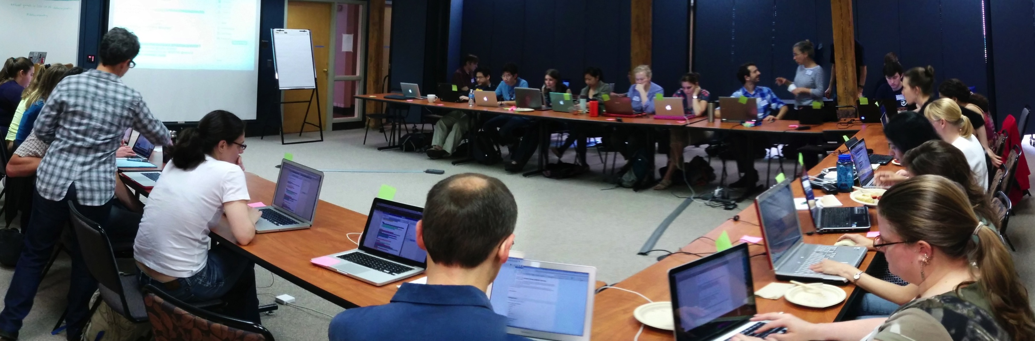
With the emergence of new technologies generating large datasets in all domains of research, data analysis and software development is no longer the domain of specialists and is instead widely done by all researchers.
Notes:
Lack of expertise was identified as the single biggest difficulty facing researchers in their bioinformatics activities, and training as the most valuable thing that BRAEMBL could do to support those activities.”

Slide 2
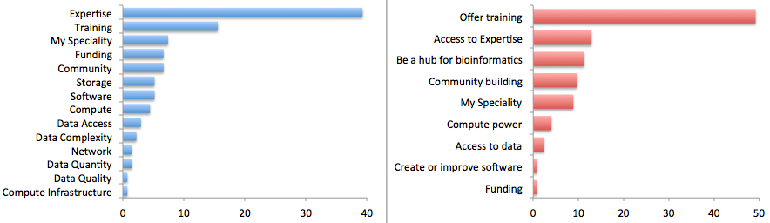
Researchers view the major limiting factor in research progress as a lack of expertise in how to handle and analyze data and develop software effectively and efficiently.
This can only be addressed through high quality, widely available training and is the resource most highly desired by researchers.
Survey by Bioinformatics Resource Australia – EMBL
http://braembl.org.au/news/braembl-community-survey-report-2013
Biggest Bioinformatics Difficulty
Most useful thing BRAEMBL could do
Notes:
Biomedical researchers in the UK had similar sentiments in a survey
https://storify.com/biocrusoe/elixir-uk-node-meeting-2014-10-14
And an internal study at PLOS showed a lack of data management expertise has a dramatic impact on the ability
of researchers to share their data

Slide 3


We teach basic lab skills
for scientific computing
so that researchers can do more
in less time and with less pain.
Teach basic concepts, skills and tools for working more effectively with data. Workshops are designed for people with little to no prior computational experience.

Slide 4
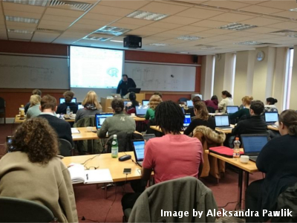
Workshops to increase data literacy and use of software development best practices
2 days
Hands-on
Qualified instructors
Helpers
Post-it notes!

Slide 5
Target audiences
Different levels of career
PhD students
postdoctoral researchers
research assistants
researchers in industry
….
SKILLS
Multiple disciplines
bioinformatics
ecology
genomics
sociology
digital humanities
neuroscience
geosciences
….
Full
computational
lab
skillset
Good knowledge of programming (R, Python or other), structured data, metadata, proficiency in building workflows and automating tasks
Some knowledge of scripting, using workflow tools, command line
Data + spreadsheets + some statistics

Slide 6
Target audiences
Different levels of career
PhD students
postdoctoral researchers
research assistants
researchers in industry
….
SKILLS
Multiple disciplines
bioinformatics
ecology
genomics
sociology
digital humanities
neuroscience
geosciences
….
Full
computational
lab
skillset
Good knowledge of programming (R, Python or other), structured data, metadata, proficiency in building workflows and automating tasks
Software Carpentry
Some knowledge of scripting, using workflow tools, command line
Data + spreadsheets + some statistics

Slide 7
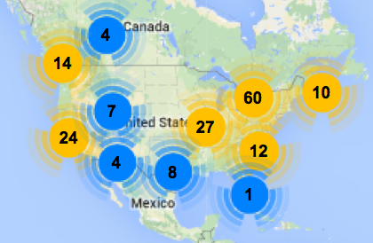
Since January 2012
Over 270 two-day workshops
For over 8300 learners
Taught by over 200 volunteers
In over 20 countries
With a paid staff of 1.75 FTE
Curriculum (all CC-BY licensed)
Unix shell (task automation)
Python or R (modular programming)
Git/GitHub (reproducibility & collaboration)
SQL (data management)
North American Workshops 2012-2014
Outcomes
Save half a day a week (or more) for the rest of their careers
Prepare them for reproducible research, HPC, and open science
Enable them to tackle entirely new kinds of problems
http://software-carpentry.org

Slide 8
Target audiences
Different levels of career
PhD students
postdoctoral researchers
research assistants
researchers in industry
….
SKILLS
Multiple disciplines
bioinformatics
ecology
genomics
sociology
digital humanities
neuroscience
geosciences
….
Full
computational
lab
skillset
Good knowledge of programming (R, Python or other), structured data, metadata, proficiency in building workflows and automating tasks
Some knowledge of scripting, using workflow tools, command line
Data
Carpentry
Data + spreadsheets + some statistics

Slide 9
Sibling organization of Software Carpentry
Officially started November, 2014
Developed and ran workshops prior to November with NSF support
Curriculum
Focused on data - teaches how to manage and analyze data in an effective and reproducible way.
Initial focus is on workshops for novices - there are no prerequisites, and no prior knowledge computational experience is assumed.
Domain specific by design – currently have lessons in biology and are developing lessons for genomics, geosciences and social sciences.
Planning 24 workshops in 2015 and the development of materials in more domains and for more advanced data analysis topics.
http://datacarpentry.org

Slide 10
Software Carpentry Foundation
Relationships
Became a 501(c)3 non-profit in October 2014
Partners: Sloan, Mozilla, SSI, LBL, UC Davis, …
Actively seeking new ways to reach more people
Train the Trainers
Scaling workshops by training more trainers
Online course for 135 people starting in January
At least three in person train-the-trainers planned with Partners and Affiliates in the US, UK and Australia

