Slide 1




How to Bridge
Dan McGlinn
danmcglinn@gmail.com
Weecology Lab

Slide 2

vs
Developed by programmers
Good style and clear rules enforced
Few functions
Numerical packages are cutting edge
Statistical packages are still relatively young
Ecologists not familiar with
Developed by stat gurus
Style not well defined or enforced
Lots of functions
Numerical operations not as powerful
Statistical packages are top notch
Ecologists familiar with

Slide 3
Our Goals
Call python and R scripts from the shell
Evoke the command line within R and python
Use Python modules to interactively call R

Slide 4
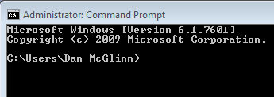
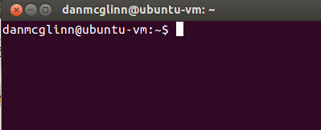
The Shell aka the terminal or command prompt
Provides a textual way to interact with your os
  control files, processes, and networking
We can use the shell to interact directly with R and python
Examples
$ python my_python_script.py
$ Rscript my_r_script.R

Slide 5

Communicating with the terminal
In Python
  >>> import os
  >>> os.system(“python my_python_script.py”)
  >>> # alternatively call an R script
  >>> os.system(“Rscript my_r_script.R”)
In R
  > system(“python my_r_script.r”)
  > # alternatively call a python script
  > system(“python my_python_script.py”)

Slide 6
Time to Try It out
Create a simple python script that prints anything to the console
From the shell call your script
From the python interpreter call your script using
  >>>import os
  >>>os.system(“python my_python_script.py”)

Slide 7
Python modules to link python and R
RSPython
  last development in 2005
  allows bidirectional interactive sessions
pypeR
  no recent (i.e. last year) development activity
  uses pipes to establish interactive R sessions
pyRserve
  in beta but stable
  uses Rserve to establish interactive R sessions
Rpy/Rpy2
  most popular module for interfacing with R
  python to R interactive sessions

Slide 8
pyRserve
Connects to an R process via Rserve
  Each R instance is like connecting to a server
Pros
  Can run on a remote machine
  Allows easy parallelization of R processes
  Pythonic style
  Plays nice with numpy
Cons
  Installing Rserve can be challenging even in linux

Slide 9
pyRserve examples
>>> conn = pyRserve.connect()
>>> conn.r(“3 + 4”)
7.0
>>> conn.r(“mean(c(3, 4, 5)”)
4
>>> conn.r(“a = 3”)
# or alternatively set a with an attribute
>>> conn.r.a = 3
>>> print conn.r.a
3

Slide 10

Rpy/Rpy2
Rpy is older and no longer being developed
Rpy2 adds greater capabilities and object classes
Rpy2 is the backbone of Rmagic in ipython
Pros
  Rpy & Rpy2 are popular -> there is a user group to query when you have trouble
  Play nice with numpy
  Pythonic style
  Rpy and Rpy2 are easy to install in linux
Cons
  In Windows, it is difficult to get Rpy2 installed; however, Rpy is straightforward to install.

Slide 11
Rpy/Rpy2 sub-packages
rpy2.rinterface
  Low-level interface to R, when speed and flexibility matter most. Close to R’s C-level API.
rpy2.robjects
  High-level interface, when ease-of-use matters most. Should be the right pick for casual and general use. Based on the previous one.
rpy2.interactive
  High-level interface, with an eye for interactive work. Largely based on rpy2.robjects.
rpy2.rpy_classic
  High-level interface similar to the one in RPy-1.x. This is provided for compatibility reasons, as well as to facilitate the migration to RPy2.
rpy2.rlike
  Data structures and functions to mimic some of R’s features and specificities in pure Python (no embedded R process).

Slide 12
Time for an Rpy2 Demo

