Slide 1
Cisco Nexus Data Broker
Migration Project from Open Flow to NXAPI

Slide 2
OF to NXAPI Migration - Steps
NDB upgrade to NDB 3.6 and above
Export the device configuration in NDB 3.6
NDB configuration cleanup
Device conversion from OF to NXAPI, device upgrade(if needed)
Import the NXAPI device configuration in NDB 3.6

Slide 3
Tool Feature
Single Touch Migration for OF to NXAPI devices
Supports NDB version from NDB 3.5.
Supports all NDB Platform devices.
Supports Atomic & Non-Atomic operations.
Multiple Device Upgrade in a single Migration job.

Slide 4
Open Flow to NXAPI
NDB centralized deployment migration from Open Flow to NXAPI
How ?
NDB Tool does this Migration from current NDB version to NDB 3.6 along with the NDB switch conversion from OF to NXAPI

Slide 5
NDB Migration Script - Prerequisites
Prerequisites :
1.User with Administrative access
2. Packages : python(2.7) , pip(10.0.1) , git , Open SSL
Pexpect
yaml
Requests
ExScript
Configobj
Paramiko
The above packages will be installed using requirements.txt using command
“pip install –r requirements.txt”

Slide 6
Migration Script usage
Clone the code from the below link.
git clone http://ndb-build.cisco.com/gerrit/NDBMigration
Navigate to script path Ex: /home/cisco/NDBMigration
Fill up the the device details in Input.yaml file . Input Yaml file will be under Utilities folder Ex: /home/cisco/NDBMigration/Utilities .Refer example_migration.yaml under the same folder for more information.
For Script run - python NDBMigration.py

Slide 7
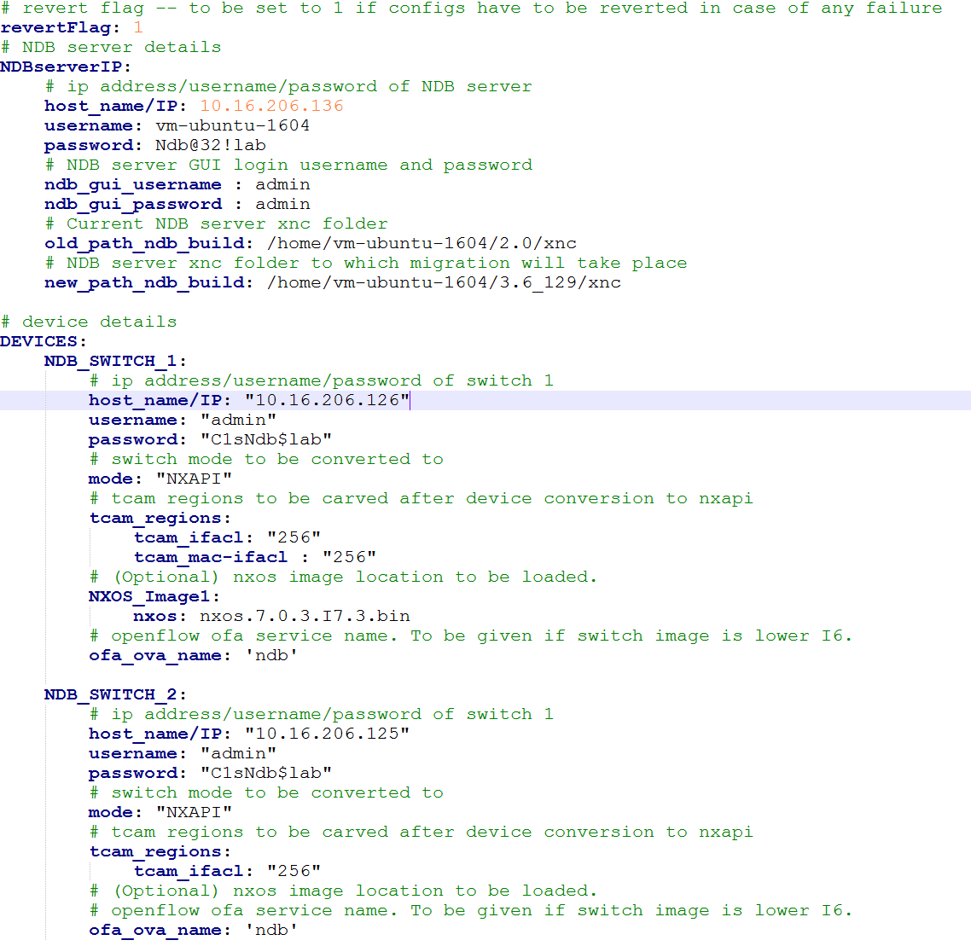
Migration Script Input

Slide 8
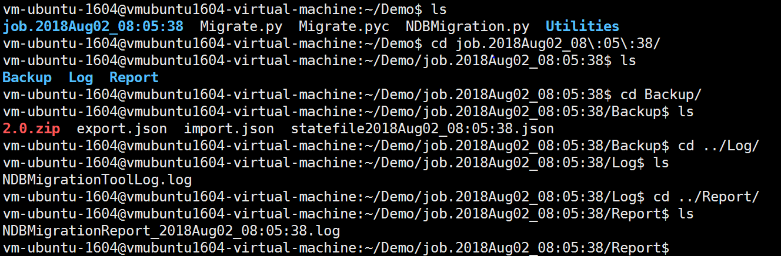
Migration Script Logs and Reports
Unique jobid folder created in script directory for every run.
jobid folder contains three subfolder – “Backup”, “Log” and “Report”
Backup contains old ndb zip file, export json, import json and state file
Log folder contains script log file.
Report folder contains report of script run.

Slide 9
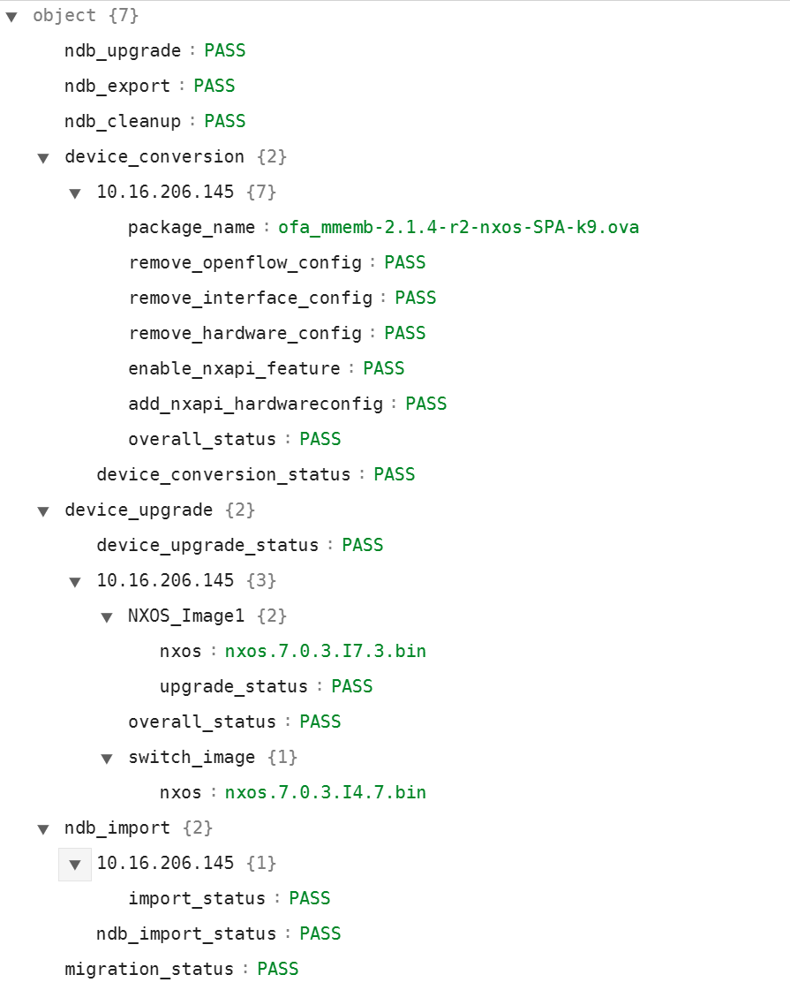
State file
State file created for every run.
Pass
Fail
Skip
The above status maintained for every
operation by NDB Migration script.

Slide 10
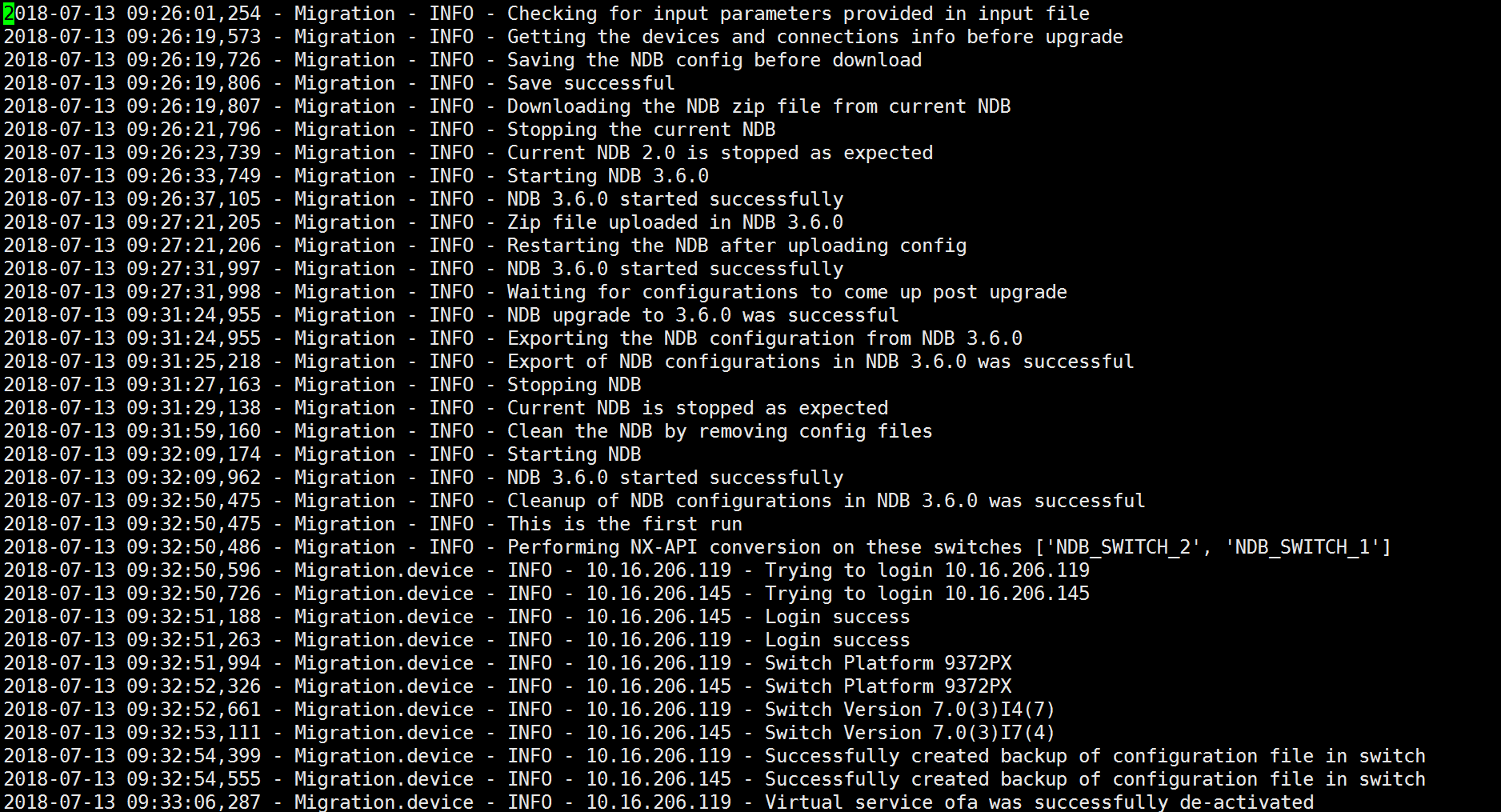
Migration log file

Slide 11
Migration Sample Report

Slide 12
What happens when script fails?
If revertFlag is set to 1, upon failure in any steps, NDB and device configurations are reverted back to old NDB version along with OF device configurations
If revertFlag is set to 0, below is behavior.
NDB upgrade failure – reverted back to initial NDB
NDB export failure – reverted back to initial NDB
NDB clean up failure – reverted back to initial NDB
Device conversion failure – script run will continue and state for failed device will be “FAIL”
NDB import failure – script run will continue and state for failed device will be “FAIL”.
User can do a rerun when script run fails as below.
python NDBMigration.py –rerun <failedjobid>
Ex: python NDBMigration.py –rerun job.2018Aug07_04:49:39
Rerun will create a new jobid and the script will start from the place where it failed.

Slide 13
FAQ’s
1) If user hit any proxy issue while adding device user has to unset proxy which is configured .Steps-
unset http_proxy
unset https_proxy
JAVA_HOME variable needs to be set in NDB server in /etc/environment file.
export JAVA_HOME=/opt/jdk1.8.0_141
Ex:
ERROR - HTTPSConnectionPool(host='10.16.206.197', port=8443): Max retries exceeded with url: /monitor (Caused by ProxyError('Cannot connect to proxy.', error('Tunnel connection failed: 504 Gateway Timeout',)))
2) Where to run migration?
User can run the migration script from a VM in which NDB is running or from a new VM(Ubuntu/Redhat). The recommended way is to go for a new VM
3) What happens if user already has python packages with older version in Redhat?
Use the below commands –
pip install pur
pur –r requirements.txt

Slide 14
FAQ’s
4) NDB Import Failure on N3K device
Check the switching mode of N3K :
N3K-123# show system switch-mode
system switch-mode n3k
N3K-123#
N3K-3132Q-40GX , N3K-3172PQ-10GE - Supports both N3K and N9K mode ( by default it’s N3K), NDB supports 3K mode

Slide 15
Limitations
Portgroups are not supported. In case NDB has port groups configured, user has to manually configure portgroups and related configuration after NDB migration is done.
Special characters in ports description is not supported. As a prerequisite, before running script user has to remove the special characters in ports description.(For any NDB version below 3.4)

