Slide 1


Cisco Nexus 9000 Demo VXLAN, Programmability, Automation, Troubleshooting

Slide 2
VXLAN
PRGM
AUTO
TSHOOT
Nexus 9000 Demo
VXLAN
Programmability
Automation
Troubleshooting
Overview
Setup
1) Get up and running using pre-configured Cisco recommended configurations
Overview
Use Cases
1) Finding unused IP addresses
2) Custom command
3) CDP based interface descriptions
4) LLDP based interface descriptions
5) PIM and OSPF
6) Menu driven configuration
Overview
Use Cases
1) VXLAN CLI generation tool
2) NX-API Sandbox
3) NXOS version compliance
Overview
Use Cases
1) CPU
2) Memory usage
3) Interface counters

Slide 3
Prerequisites
3 Nexus 9000 Switches
NXOS 7.0(3)I1(2) or above
L2 Hub/Switch for connecting switch management ports
Git account to clone OneCloud Partner Demo Nexus 9000 repository
SCP (or TFTP) server to copy scripts to switch bootflash:
Internet connectivity*
* - Required to demo the OneCloud VXLAN automation tool

Slide 4



Demo Topology
Management IP Addresses
Spine-1 192.168.1.101/24
Leaf-1 192.168.1.103/24
Leaf-2 192.168.1.104/24
PC
Loopback IP Addresses
Spine-1 10.1.1.1/32
Leaf-1 3.3.3.3/32
Leaf-2 4.4.4.4/32
Spine-1
Ethernet IP Address
PC 192.168.1.200/24
Ethernet1/1
Ethernet1/2
Ethernet1/47
Ethernet1/47
Leaf-1
Leaf-2

Slide 5
DEMO 1: VXLAN Configuration
VXLAN
Problem
VXLAN takes time to learn and setup for network engineers exposed to the capability the first time
Use Case
Bring up VXLAN with BGP EVPN with little experience
Advantages
Save time
Get VXLAN BGP EVPN up and running quickly
Learn VXLAN by playing with a tested setup

Slide 6
DEMO 2: Finding Unused IP addresses
PRGM
Problem
Many times network engineers need to find IP addresses that are available or which hosts are UP but doing so is cumbersome
Use Case
Allow a network engineer to ping a range of IP addresses and print messages of which are UP and summary of which are unused
Advantage
Repeatable process
Saves time

Slide 7
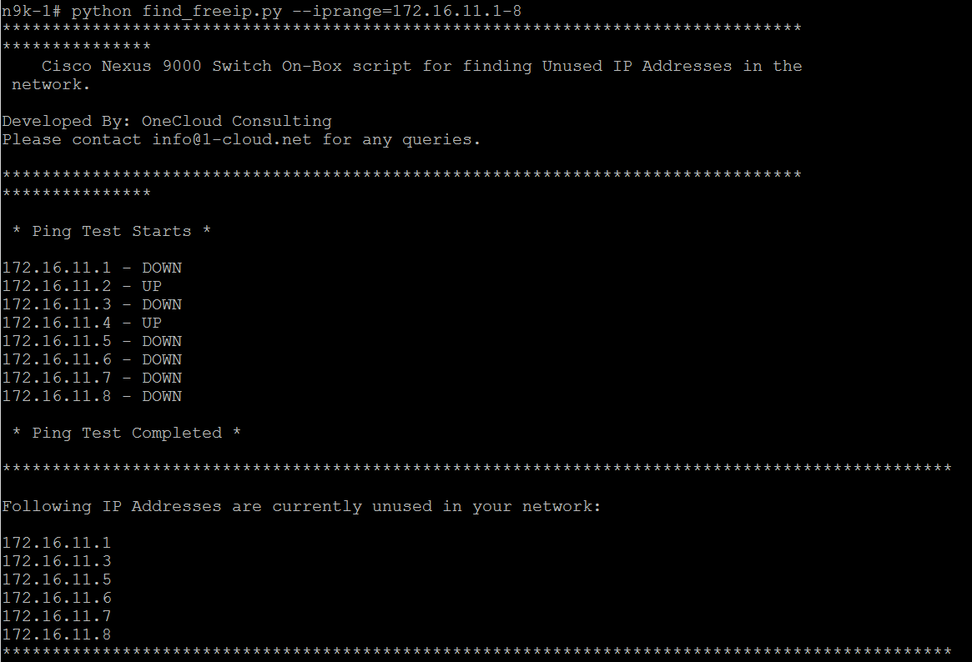
How to run the script
PRGM
Prerequisites: Any Nexus 9000 switch
Steps to run script:
1) Copy find_freeip.py to bootflash:
2) Command to run script on switch: python find_freeip.py --iprange=172.16.11.1-8

Slide 8
DEMO 3: Custom Command
PRGM
Problem
NOC engineers often issue multiple commands just to get simple details from the network. This process is manual and repetitive.
Use Case
Display specific details from neighbour using a single programmatic Python instruction versus a series of CLI commands
Advantages
Single command
Speed
Consistency
Information you only care about

Slide 9
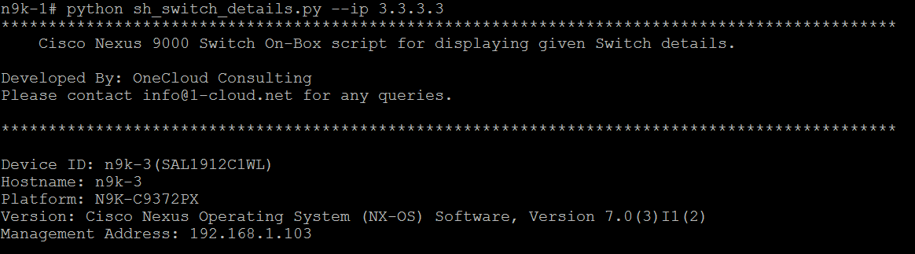
How to run the script
PRGM
Prerequisites: Nexus 9000 switches connected to each other
Steps to run script:
Copy sh_switch_details.py to bootflash:
Command to run script on switch: python sh_switch_details.py --ip 3.3.3.3
(Note: 3.3.3.3 is an address of neighbor that is reachable.)

Slide 10
DEMO 4: CDP Based Interface Descriptions
PRGM
Problem
Network engineers would like to maintain good interface descriptions but it takes time, especially, when there are lot of interfaces to manage
Use Case
Use CDP information to programmability add interface descriptions
Advantages
Consistent
Removes human error (eg: fat fingering)
Saves time

Slide 11
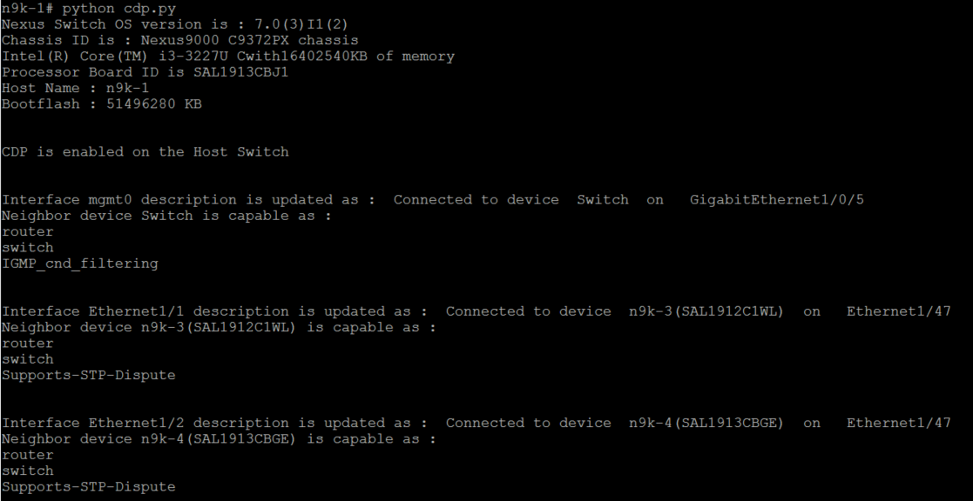
How to run the script
PRGM
Prerequisites: Nexus 9000 switches with CDP enabled
Steps to run script:
Copy cdp.py to switch bootflash:
Issue “show cdp neighbor” to show all cdp neighbors
Run command on switch: python cdp.py

Slide 12
DEMO 5: LLDP Based Interface Descriptions
PRGM
Problem
Network engineers would like to maintain good interface descriptions but it takes time, especially, when there are lot of interfaces to manage
Use Case
Use LLDP information to programmability add interface descriptions
Advantages
Consistent
Removes human error (eg: fat fingering)
Saves time

Slide 13
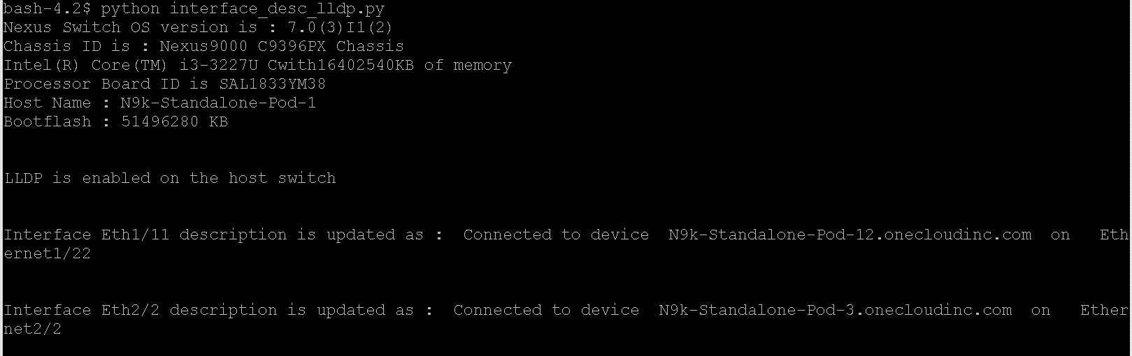
How to run the script
PRGM
Prerequisites: Nexus 9000 switches with LLDP enabled
Steps to run script:
Copy lldp.py to switch bootflash:
Issue “show lldp neighbor” to show all lldp neighbors
Run command on switch: python lldp.py

Slide 14
DEMO 6: OSPF and PIM Interfaces
PRGM
Problem
OSPF and PIM interface configuration can be burdensome and error prone, especially, when there are lots of interfaces to configure
Use Case
Provide menu driven options for junior engineers to configure OSPF and PIM interface attributes
Advantages
CLI expertise not required
Human error removed
Consistent
Time saved

Slide 15
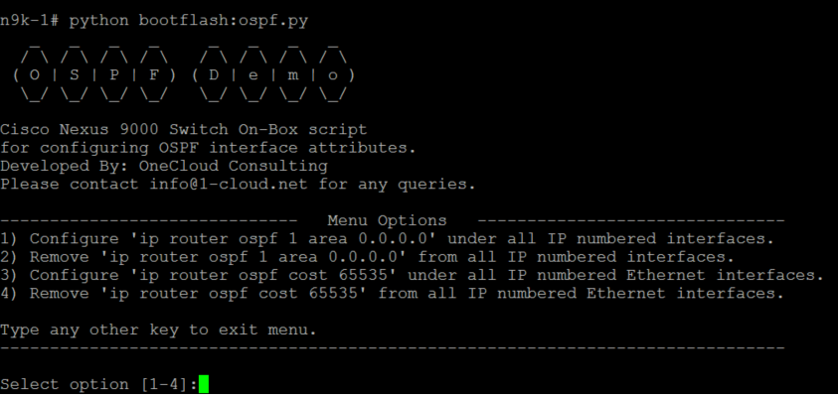
How to run the script (for OSPF)
PRGM
Prerequisites: Nexus 9000 switches with OSPF feature enabled
feature ospf
router ospf 1
Steps to run script:
1) Copy ospf.py to switch bootflash:
2) Run command on switch: python ospf.py

Slide 16
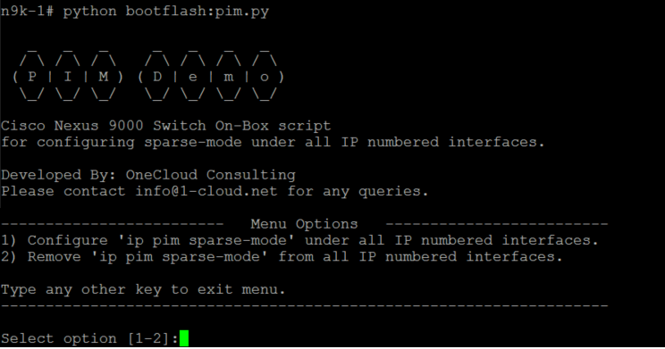
How to run the script (for PIM)
PRGM
Prerequisites: Nexus 9000 switches with PIM feature enabled
feature pim
Steps to run script:
1) Copy the script to Switch bootflash:
2) Run the script on the switch using below command: python pim.py

Slide 17
DEMO 7: More Menu Driven Configuration Examples
PRGM
Problem
Removing repetitive CLI commands can be burdensome and error prone
Use Case
Provide menu driven options for junior engineers to remove repetitive CLI commands
Advantages
CLI expertise not required
Human error removed
Time saved

Slide 18
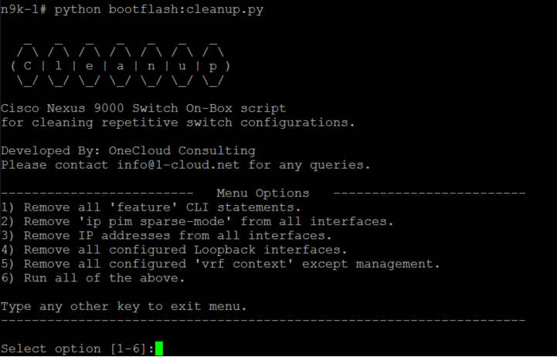
How to run the script
PRGM
Prerequisites: Any Nexus 9000 switch
Steps to run script:
1) Copy cleanup.py to switch bootflash:
2) Run command on switch: python cleanup.py

Slide 19
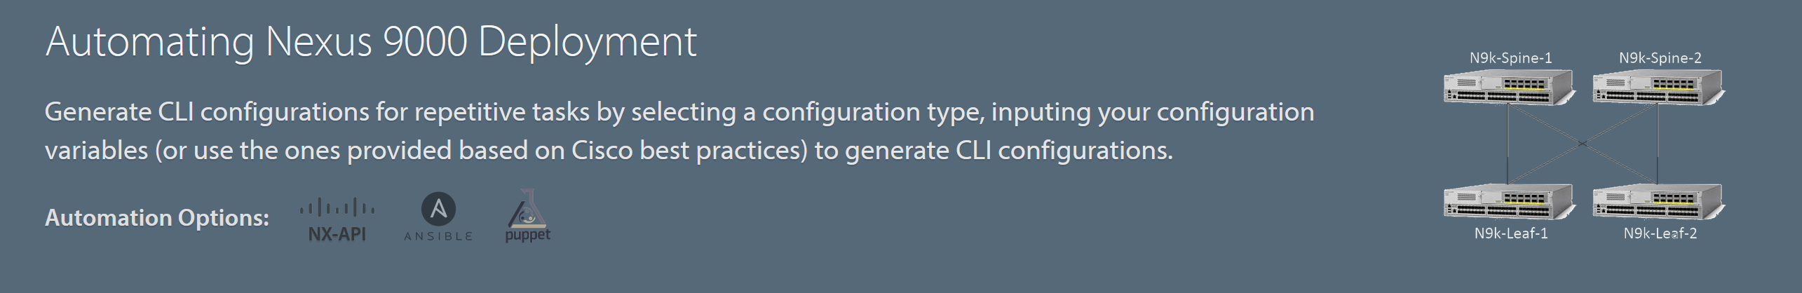

DEMO 8: Automate VXLAN Fabric Configuration
AUTO
http://1-cloud.net/nexus9k-automation/
Problem
It takes a lot of time to configure VXLAN fabric manually and it’s repetitive
Use Case
Use “Automating Nexus9K Deployment” tool developed by OneCloud Consulting
Provide inputs on the configuration variables (or use defaults)
Advantages
Easy steps to generate desired formats of VXLAN configuration (CLI, NX-API, Ansible, Puppet)

Slide 20
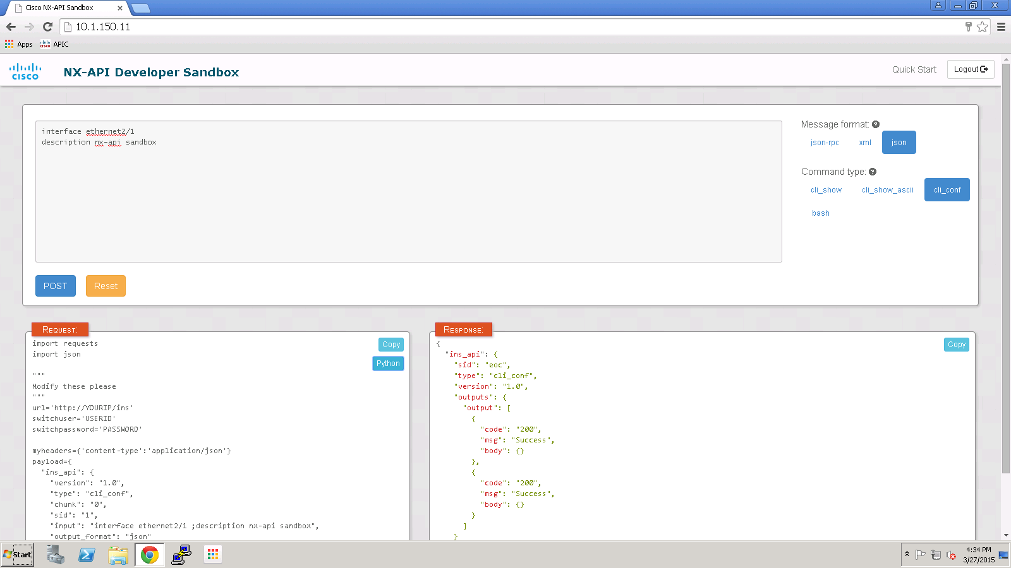
Demo 9: NX-API Sandbox
AUTO
3
CLI commands
1
Message format
4
Generate Python Code
2
CLI configuration

Slide 21
DEMO 10: NX-API to Check NXOS Version Compliance
AUTO
Problem
Checking what software versions are running in the network for compliance can be time consuming.
Use Case
Using automation compare expected NX-OS version against actual NX-OS versions running in the network.
Advantages
No 3rd party tools required
Time saved

Slide 22
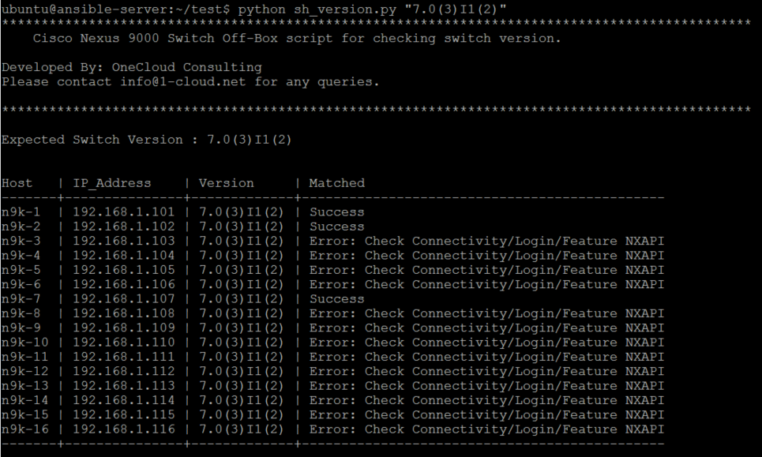
How to run the script
AUTO
Prerequisites: NX-API enabled on Nexus 9000 switches and Python 2.7.x installed on off-box server
Steps to run script:
2) Run script on off-box server: python sh_version.py “7.0(3)I1(2)”

Slide 23
DEMO 11: Troubleshooting CPU Utilization
TSHOOT
Problem
Checking the CPU health of a switch is a repetitive task and often only a portion of the information displayed is relevant
Use Case
Check CPU health of switch at regular intervals and log output to file for TAC
Advantages
Extract relevant information
Automate repetitive tasks

Slide 24
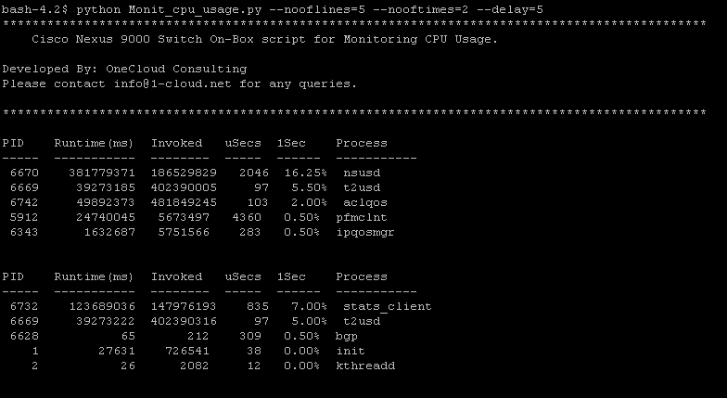
How to run the script
TSHOOT
Prerequisites: Any Nexus 9000 switch
Steps to run script:
1) Copy sh_proc_cpu_sort.py to Switch bootflash
2) Run command on switch:
python sh_proc_cpu_sort.py --nooflines 5 --nooftimes 2 --delay 5 [--log yes]

Slide 25
DEMO 12: Troubleshooting Memory Utilization
TSHOOT
Problem
Manually checking memory usage on a switch at regular intervals is repetitive and often too verbose
Use Case
Check memory utilization of switch at regular intervals and generate log for TAC
Advantages
Extract relevant information
Automate repetitive tasks

Slide 26
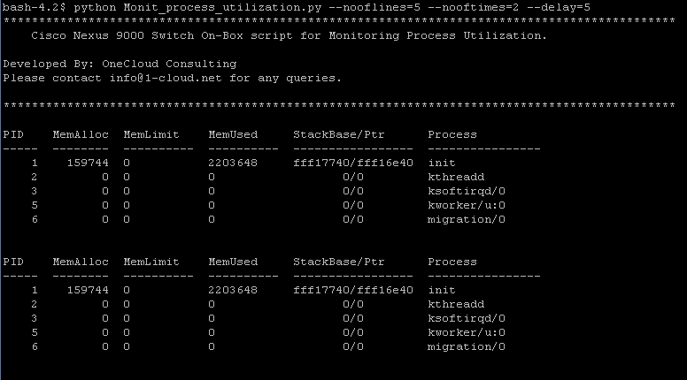
How to run the script
TSHOOT
Prerequisites: 1 Nexus 9000 switch up and running
Steps to run script:
1) Copy sh_proc_mem.py to switch bootflash:
2) Run command on switch:
python sh_proc_mem.py --nooflines 5 –-nooftime 2 –-delay 5 [--log yes]

Slide 27
DEMO 13: Troubleshooting Traffic Loss Issues
TSHOOT
Problem
When there are problems with traffic flow in the network, network engineers have to use multiple commands at different intervals for checking traffic flow through an interface.
Use Case
Check RX packet count from an interface at regular intervals and generate log for TAC.
Advantage
Execute commands programmatically to check for traffic drops/errors.

Slide 28
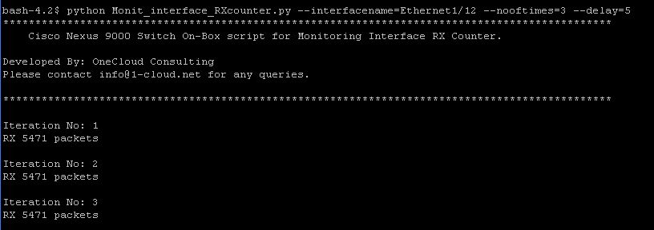
How to run the script
TSHOOT
Prerequisites: Any Nexus 9000 switch
Steps to run script:
1) Copy sh_int_count.py to switch bootflash:
2) Run command on switch:
python sh_int_count.py --interfacename Ethernet1/12 --nooftimes 3 --delay 5 [--log yes]

Slide 30
DEMO :
TSHOOT
Problem
Use Case
Advantages

