Slide 1

DOIs for PGRFA

Slide 2
Need for PID
User community has been struggling for years trying to agree on a PID technology
Purpose: assign PIDs to Plant Genetic Resources for Food and Agriculture (PGRFA) to facilitate aggregation and exchange of scientific knowledge
Asked the Secretariat for guidance in 2015. We went through a consultative selection process resulting in the choice of DOIs
Article 17 of the Treaty calls for the creation of the Global Information System (GLIS), to be based on existing systems
The cost of DOI minting in GLIS is covered by the Secretariat
The Secretariat of the Treaty became DataCite Member in 2017

Slide 3
Key issues
PGRFA are living organisms that change and evolve
DOIs are associated to the physical object, not to its description
Mistakes can be easily corrected
Taxonomy changes can be accommodated
DOIs are also associated to the holder of the PGRFA
When the material is exchanged, the Recipient assigns a new DOI
GLIS collects a minimum set of descriptors and facilitates access to information on PGRFA where it is created and maintained
FAO/Bioversity MultiCrop Passport Descriptors (MCPD) are the standard for genebank collections
Some GLIS-specific extensions added (e.g. MLS status, links)
Mapping the 40+ GLIS descriptors to the DataCite metadata structure (4.0, now 4.3)
HasMetadata used to provide access to full descriptor set (XML and DwC-A formats)
GLIS maintains a graph of the relationships among PGRFA
GLIS uses EventData to link to publications and datasets citing GLIS DOIs
Google for PGRFA

Slide 4
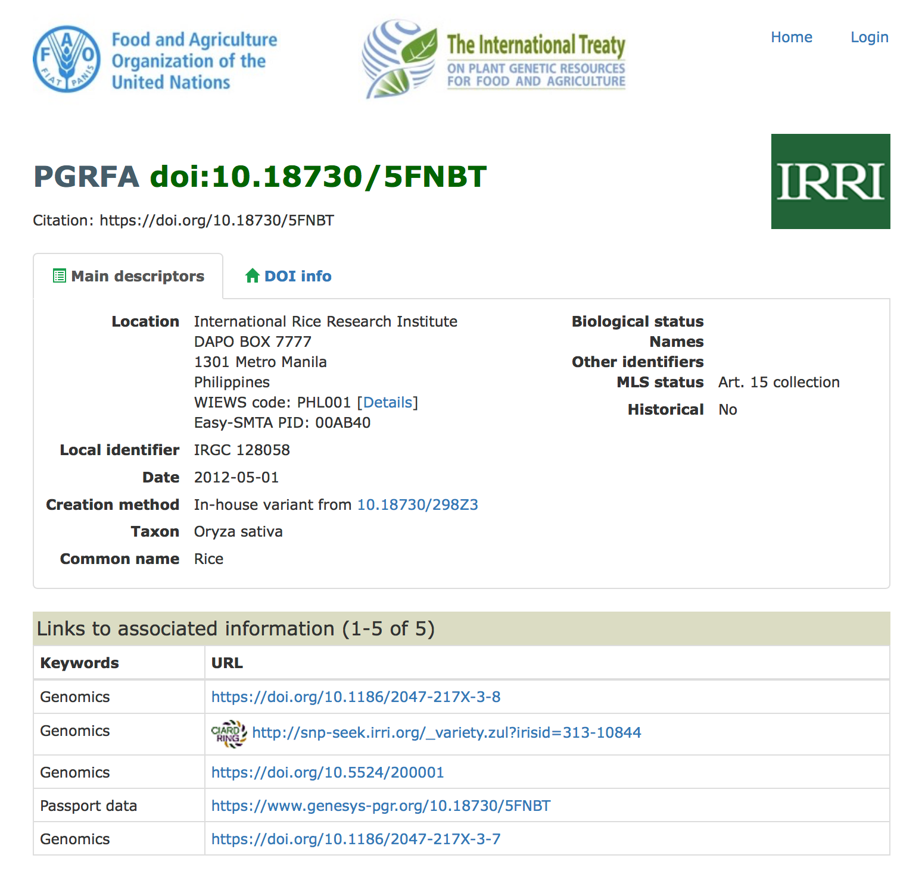
GLIS detail page example

Slide 5
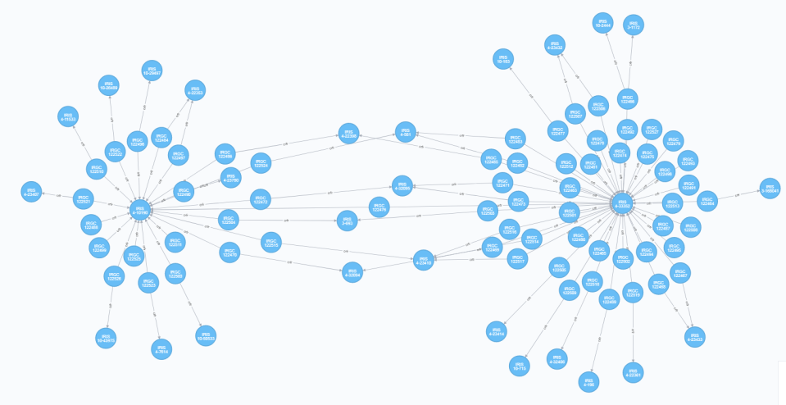
Relationships among PGRFAs in GLIS
PGRFA (DOI)
Method

Slide 6
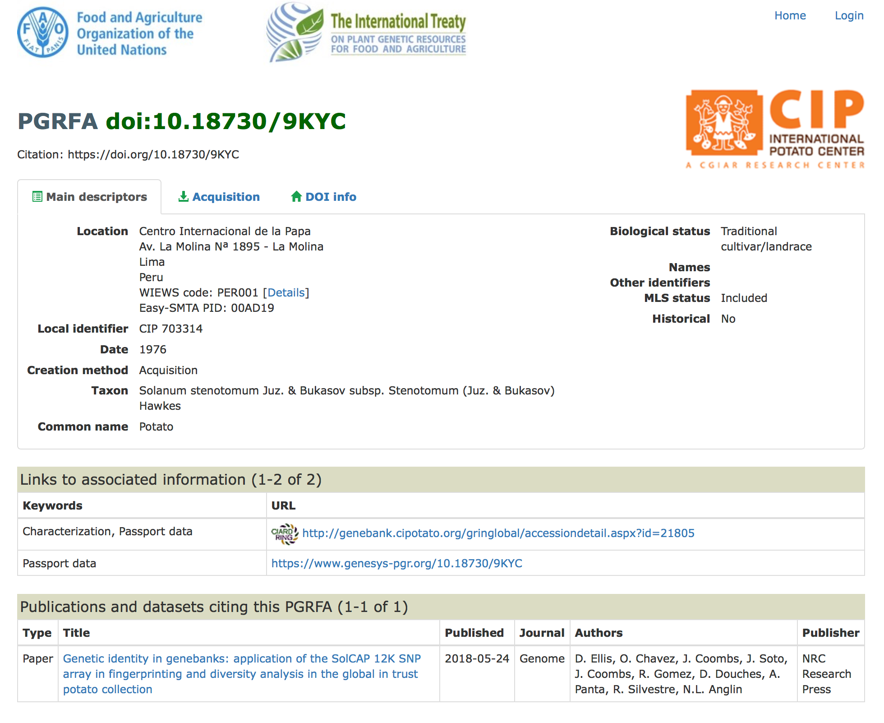
Publication details from EventData

Slide 7
Challenges
Stakeholder evangelization is difficult because of established (sub-optimal) practices
Reluctant to accept that local identifiers cannot be used globally
Some stakeholders prefer to go their own way
Lack of coordination resulting in reduced effectiveness of DOIs assigned by others
Editors and publishers are having troubles with data citation
Don't like citing GLIS DOIs among bibliographic references...
Unfamiliar with data citation, stuck to the traditional concept of citation

Slide 8
Thank you!
Q&A
marco.marsella@fao.org
PGRFA-Treaty@fao.org

