Slide 1
05-11-2019
Showing Scholix links: when do relations become citations?
Helena Cousijn
Kristian Garza

Slide 2

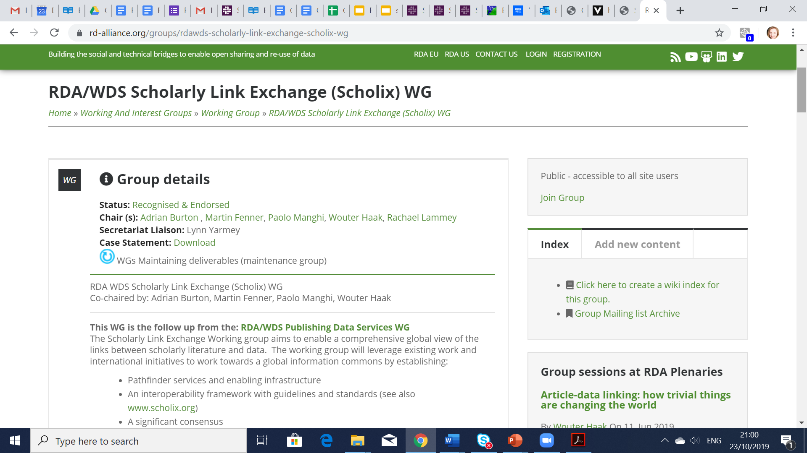
Scholarly Link Exchange

Slide 3
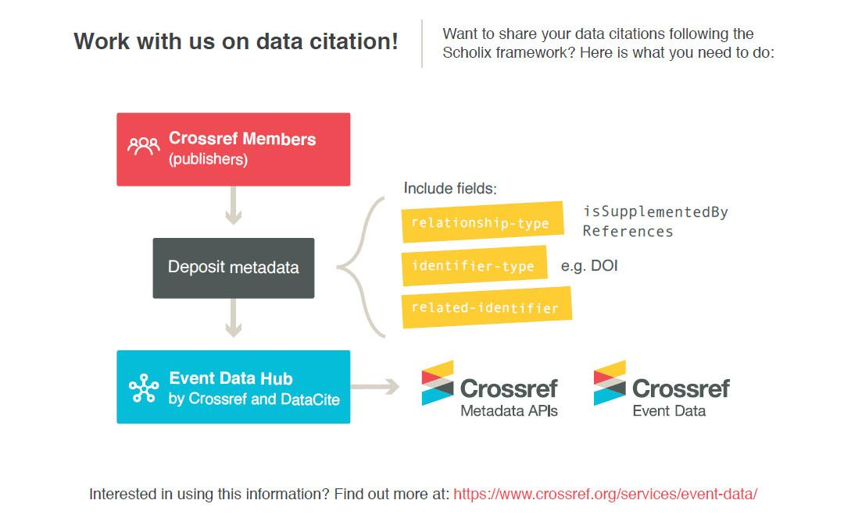
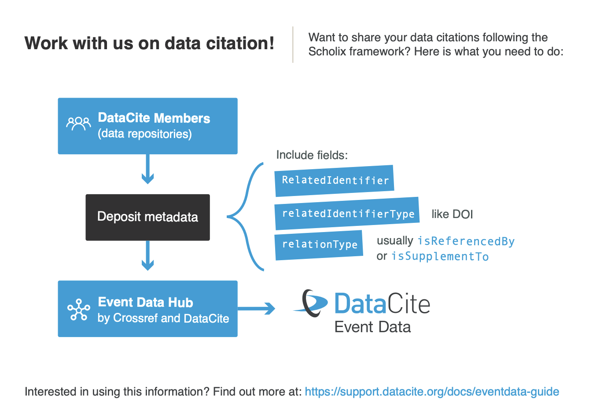
Links from multiple sources
*
* Relations has not been implemented yet.

Slide 4
Related identifiers
https://schema.datacite.org
Current version 4.3
IsCitedBy Cites
IsSupplementTo IsSupplementedBy IsContinuedBy Continues IsDescribedBy Describes
HasMetadata IsMetadataFor HasVersion IsVersionOf IsNewVersionOf PreviousVersionOf IsPartOf HasPart
IsReferencedBy References IsDocumentedBy Documents IsCompiledBy Compiles IsVariantFormOf IsOriginalFormOf IsIdenticalTo
IsReviewedBy Reviews
IsDerivedFrom IsSourceOf IsRequiredBy Requires
IsObsoletedBy Obsoletes

Slide 5
Scholix schema
ID | Property Label | Occ | Element name | Property definition | Allowed values | Examples |  | Guidance on usage
3 | Relationship Type | 1 | Relation-ship Type | The nature of the relationship between the source object and target object in this Link Information Package | [structured property]
3.1 | Relationship Type Name |  | Name | The relationship type chosen from a Scholix controlled vocabulary | Controlled list Values: IsReferencedBy References IsSupplementTo IsSupplementedBy IsRelatedTo |  |  | See Appendix for definitions, examples and usage notes for the values in the controlled list. The Scholix Controlled List for Relationships is based on the main DataCite and CrossRef vocabulary terms, plus one generic, and are intended to provide a common set of standard values across the Scholix initiative reflecting common scenarios and supporting common user needs. Relationship Type Name is mandatory; if unsure, use the generic value “IsRelatedTo”.
https://doi.org/10.5281/zenodo.1120265

Slide 6


Current proposal
Citations
References
Relations
IsReferencedBy
IsCitedBy
IsSupplementTo
References
Cites
IsSupplementedBy
Everything else
References
Cites
IsSupplementedBy
IsReferencedBy
IsCitedBy
IsSupplementTo

Slide 7
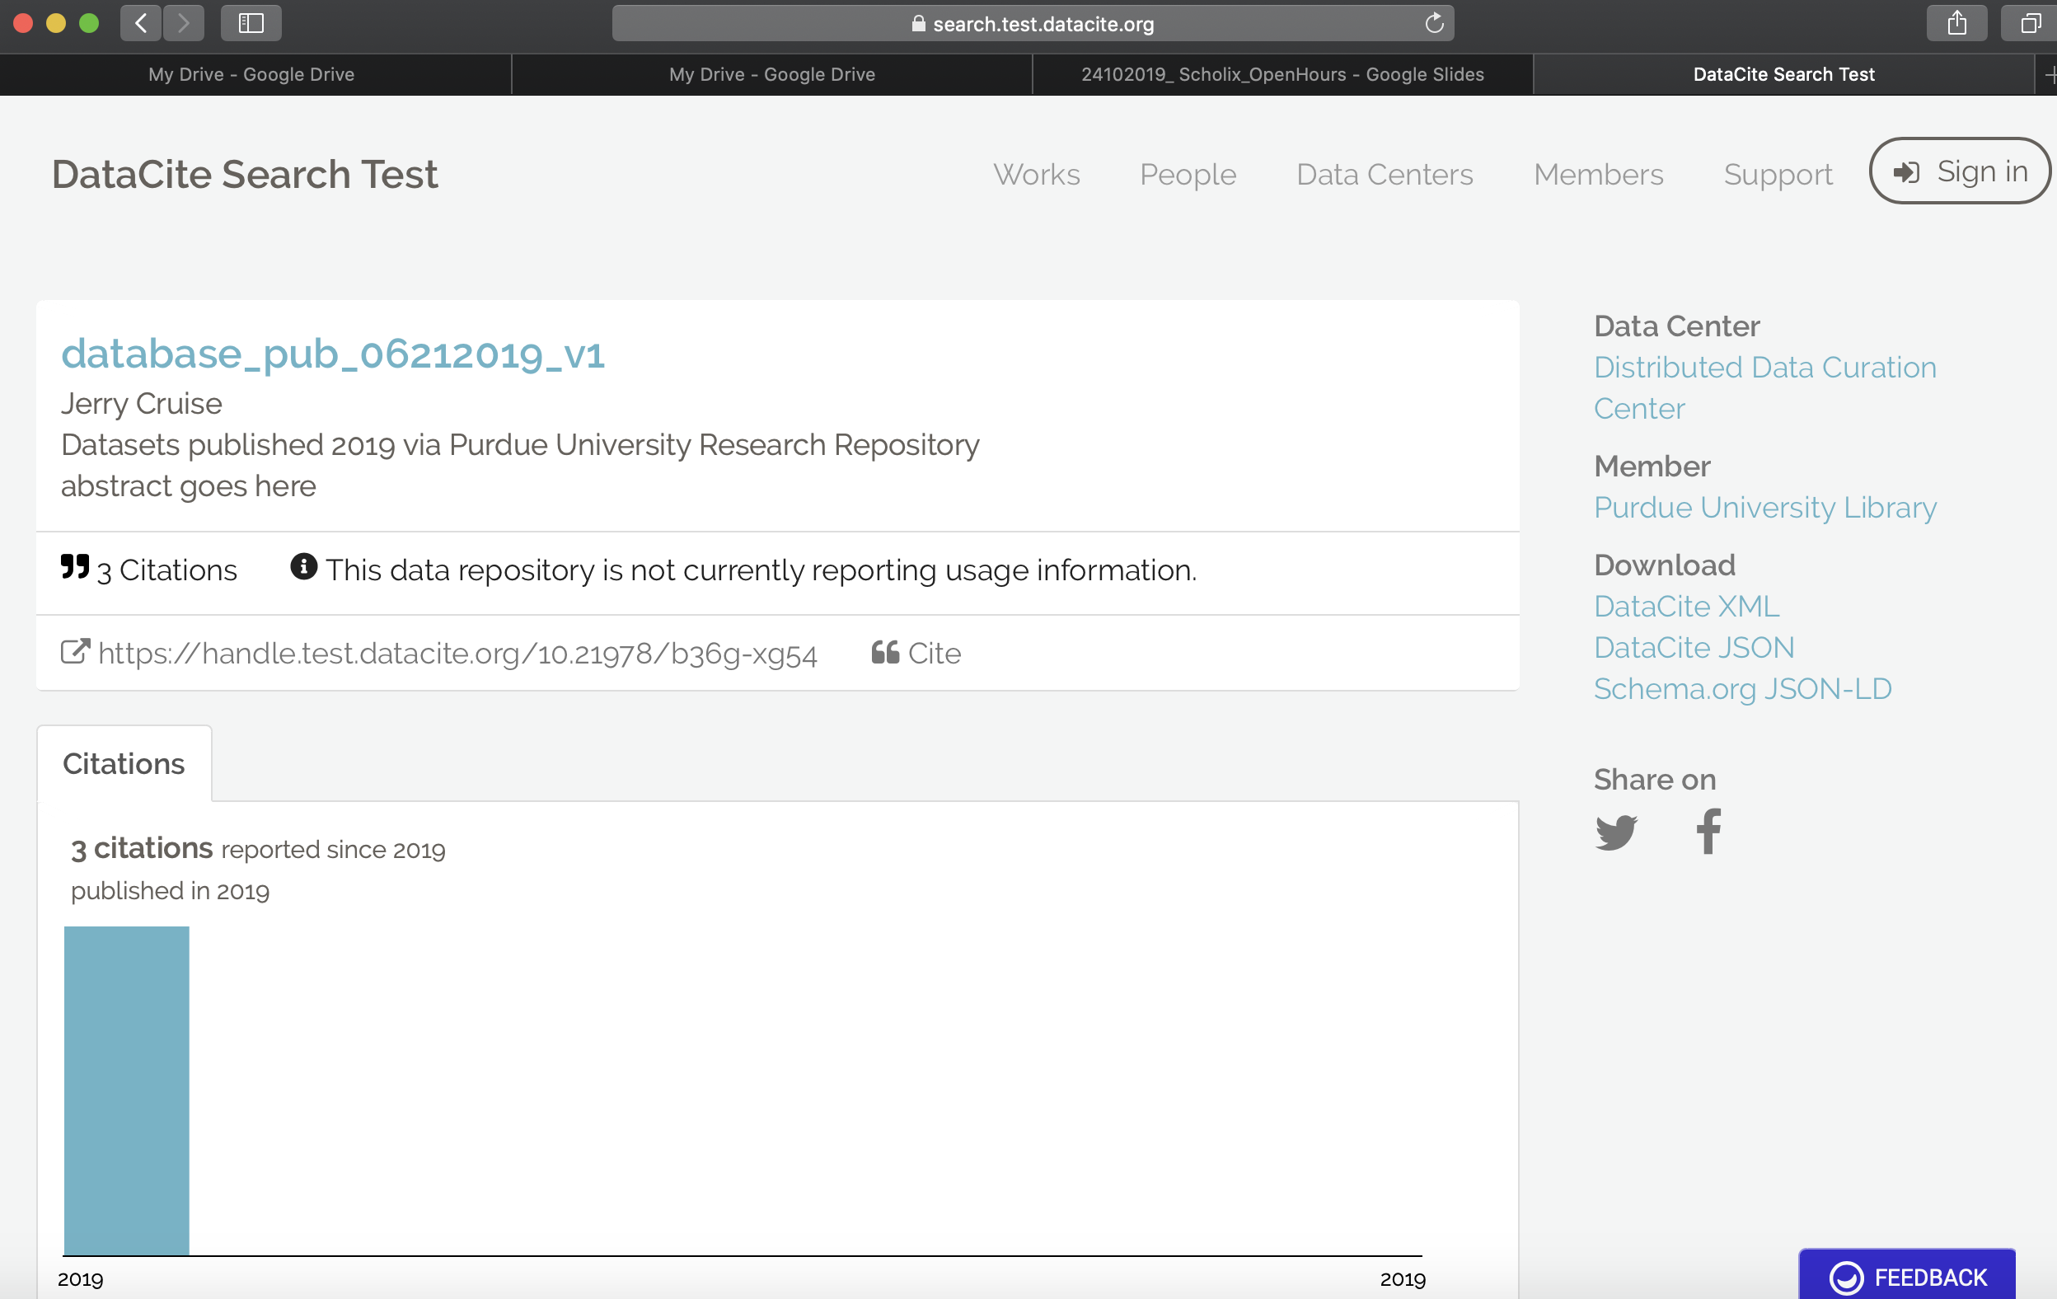
Explaining data citations

Slide 8
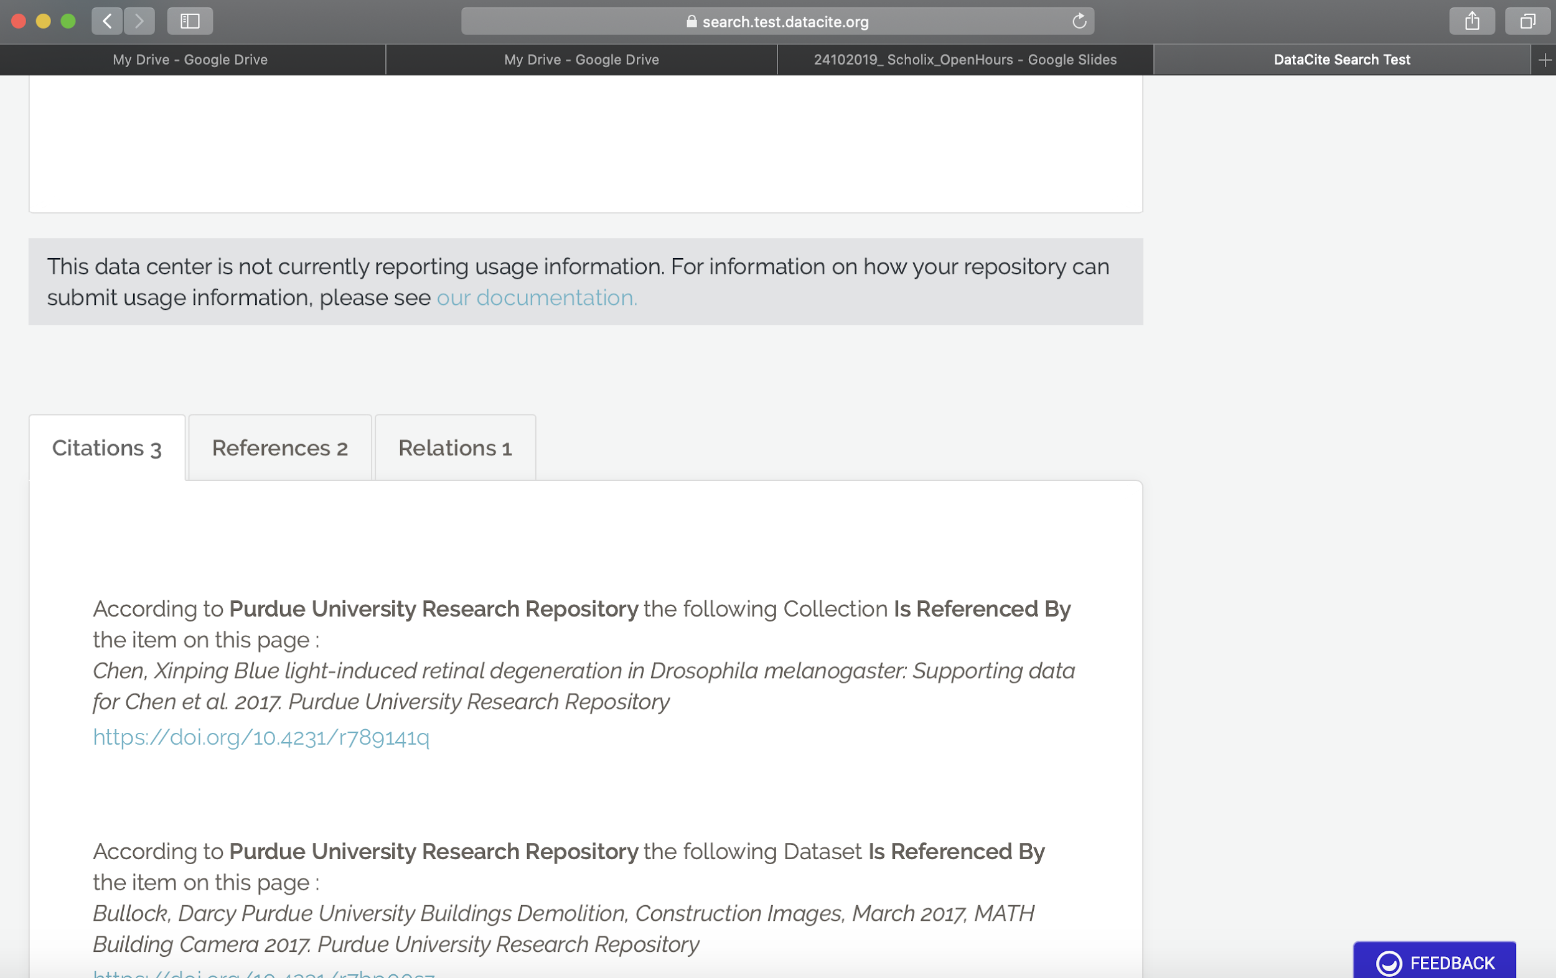
Explaining data citations
Zoomed

Slide 9
We need your input!
info@datacite.org @datacite pidforum.org

