Slide 1
The 2019 Member survey
Helena Cousijn,
15/01/2020

Slide 2

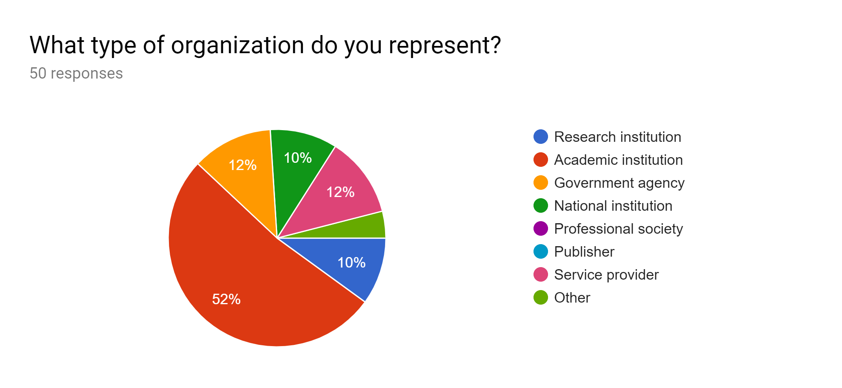
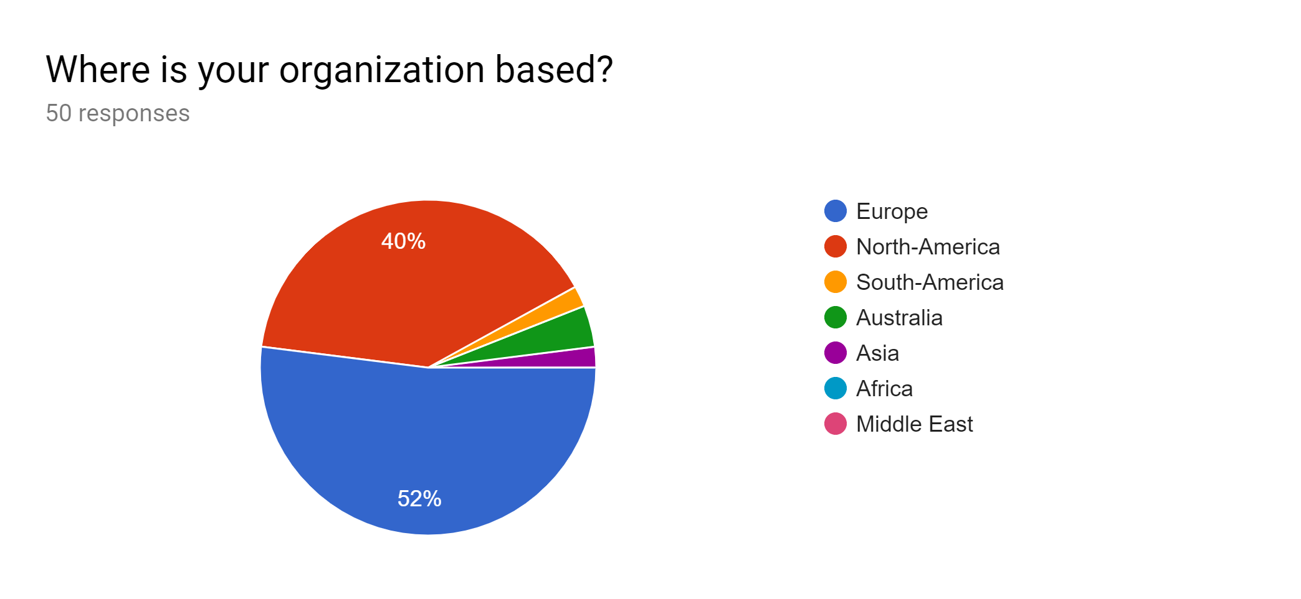
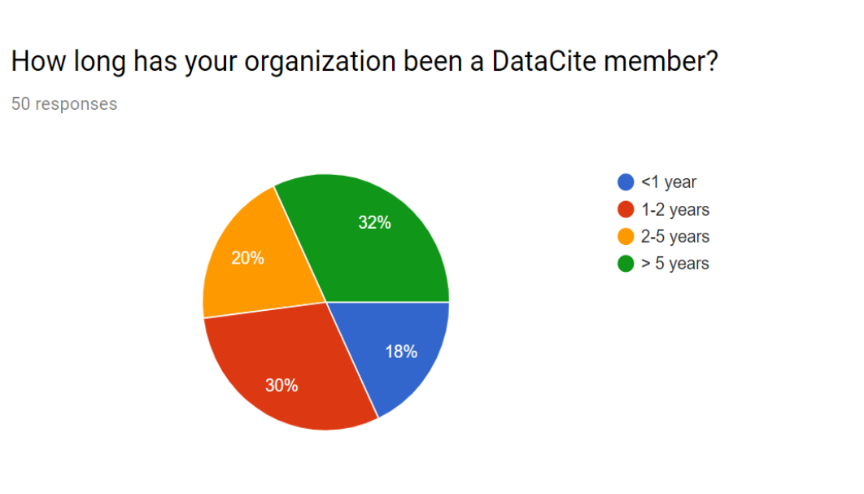
Who responded?

Slide 3
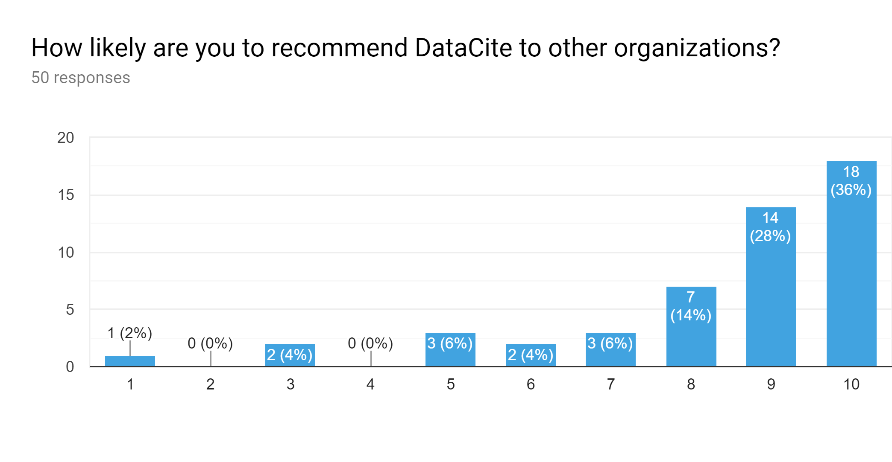
General – about DataCite

Slide 4
What we do well & should do better
What we do well:
DOI registration
Good support
Community & communication
What we should do better:
Fee structure
Communication about member model
- Announcing changes to services

Slide 5
The use of other identifiers
Service | How often mentioned | Comments
Handles | IIIIII
Crossref DOIs | IIIII | superior metadata for bibliographic entities
ARK | IIII
ORCID | IIII
URN | III
National identifiers | II
None | II
Yes | II

Slide 6
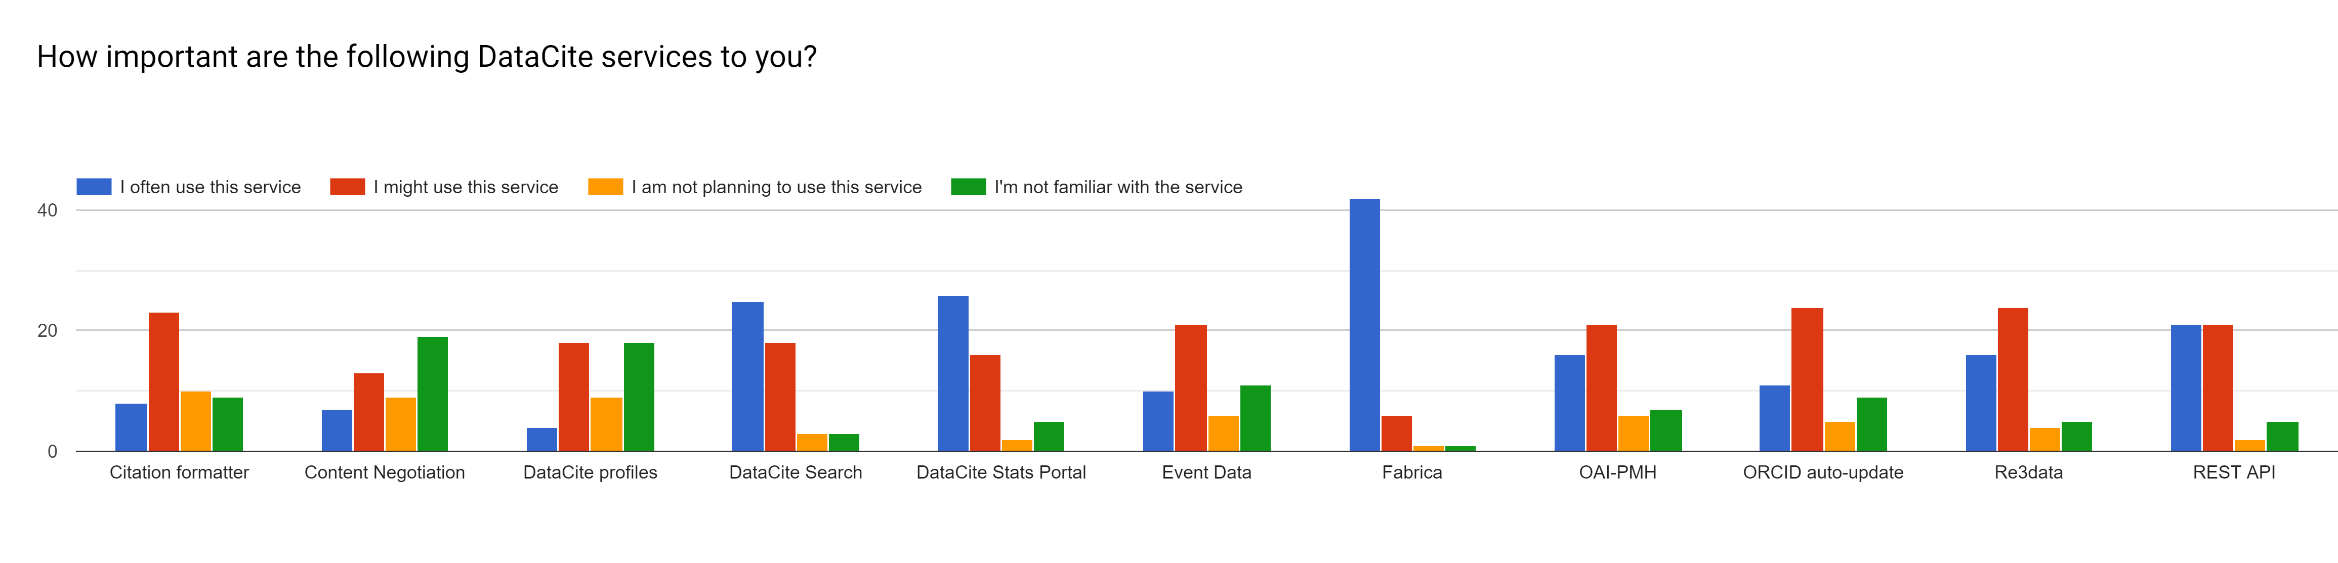
Which services are being used?

Slide 7
Which services should we improve?
Service | How often mentioned | Comments
Fabrica | IIIIIII | Better UI, easier to use
Event Data | IIII
Search | IIII | Old one better, need better documentation
Stats portal | IIII | better statistics on registered DOIs per country, per data center, per year. Dashboard view.
API | I
Citation formatter | I
re3data | I

Slide 8
Which additional services should we provide?
Service | How often mentioned | Comments
None | IIIIIIIII | I suspect that DataCite do to much already. I think DataCite should focus on its key service and not add others. Support the basics before moving on to other things!
register multiple DOIs at a time/batch process DOIs | III
Better descriptions/documentation | I
Connection to subject specific metadata | I
Data usage accounting | I
Doi registration via OAI PMH | I
iThenticate | I
More analytical tools around datasets with DOIs. | I

Slide 9
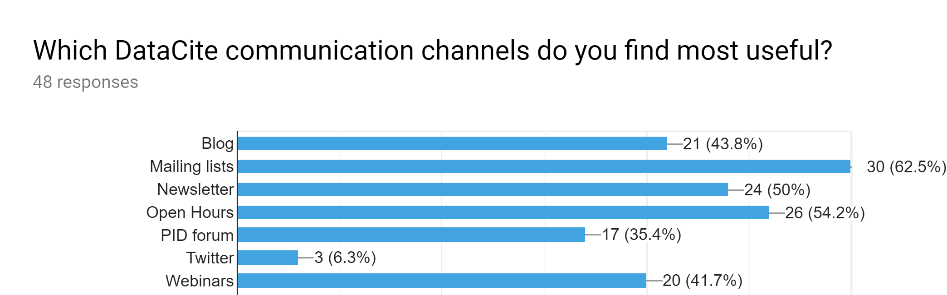
Communication channels

Slide 10
Extra support
Please indicate whether you agree with each of the following statements:
43 responses
38 (88,4%)
16 (37,2%)
12 (27,9%)
23 (53,5%)

Slide 11
What is the most important thing DataCite can help you with?
Topic | How often mentioned | Comments
DOI registration | IIIIII
Help us keep track of changes | IIII
Understanding services | IIII
Support | III
Linking | II
Documentation | I
Limit diversity of solutions | I

Slide 12
Thank you

