Slide 1
Account Structure Changes in Fabrica
Open Hours, November 2019

Slide 2
Clients —> Repositories

Slide 3
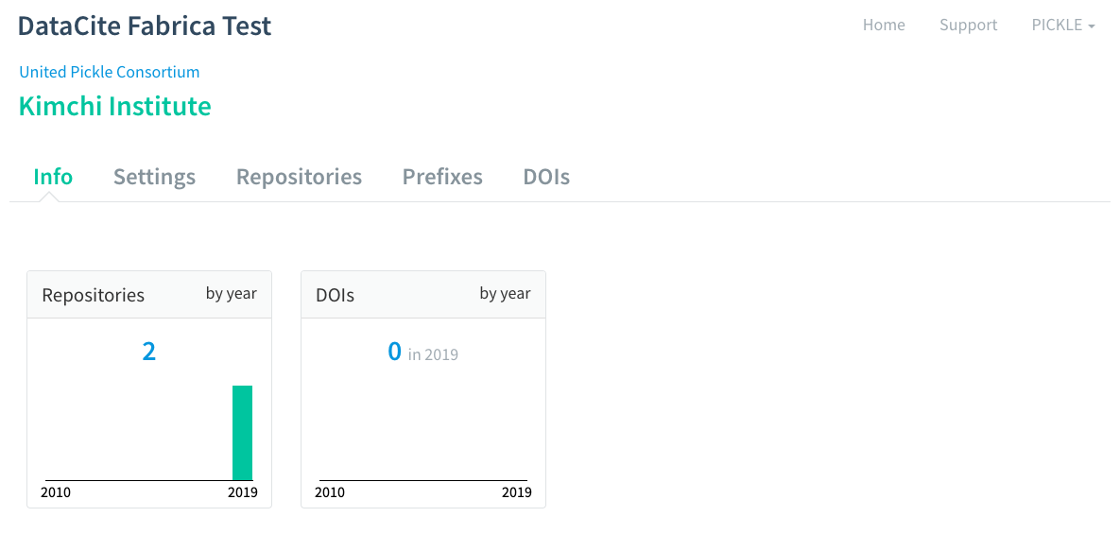
Terminology changes from “Clients” to “Repositories”.
Terminology is otherwise the same.

Slide 4
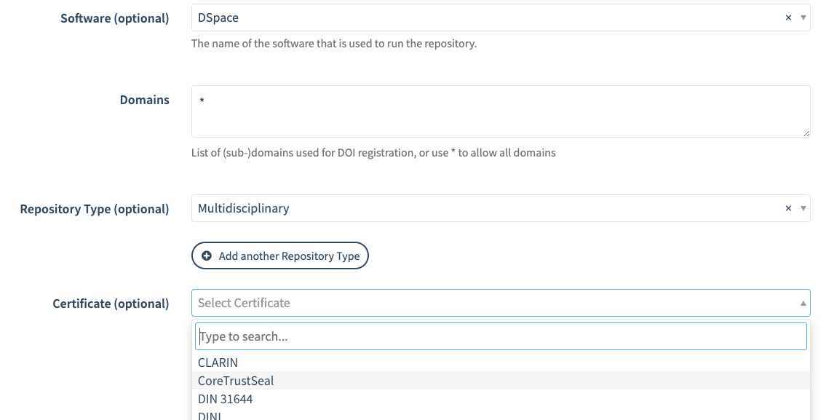
Additional fields in Repository settings specific to Repositories.
Software (like DSpace or Fedora)
Repository Type
Certificate (like CoreTrustSeal)

Slide 5
Three-tier structure for Consortia

Slide 6
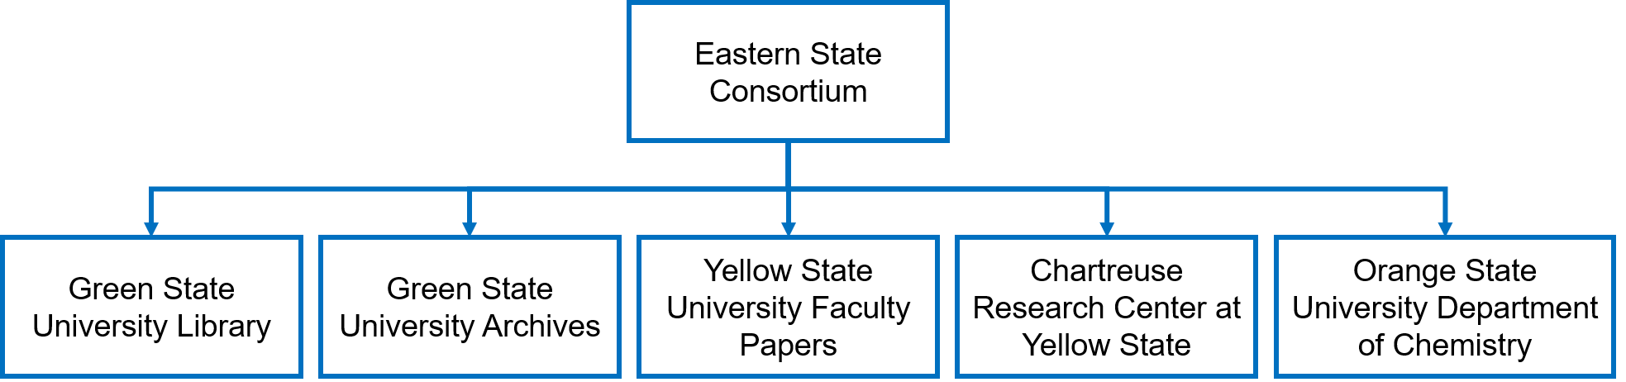
Previously, Consortia were crammed in the same two-tier structure as Direct Members.
The hierarchy isn’t obvious, and the Consortium Organizations have to ask the parent Consortium to perform day-to-day management tasks, like creating Repositories and assigning prefixes.

Slide 7
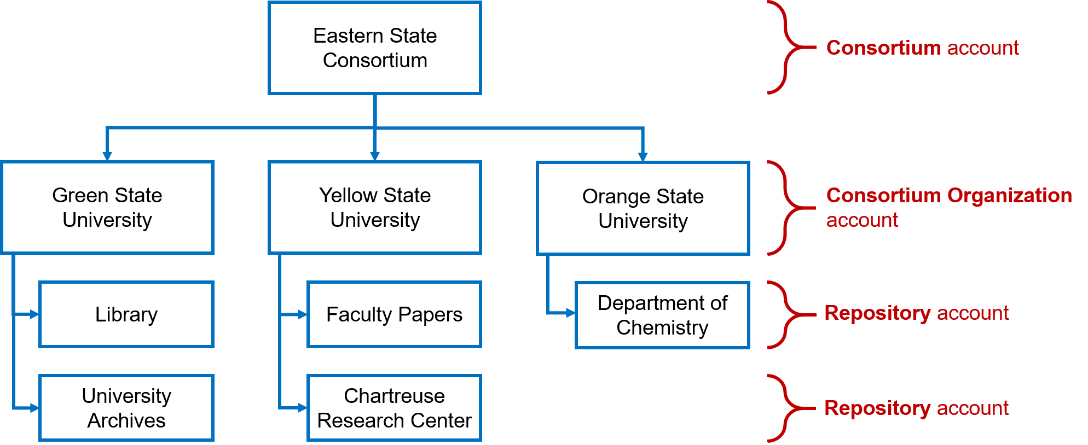
We’ve created a new three-tier structure for Consortia that maintains the hierarchy but allows Consortium Organizations to manage their Repositories and prefixes themselves. The top-level Consortium is still DataCite’s primary point of contact.

Slide 8
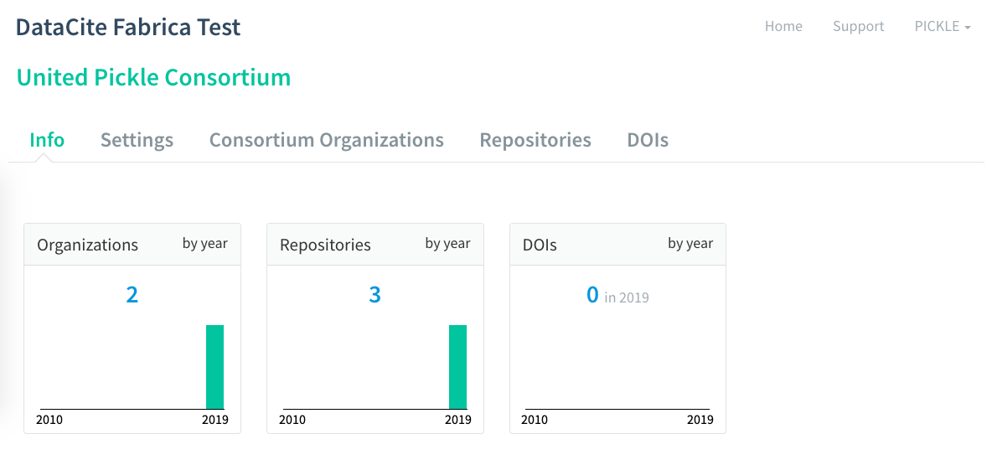
A Consortium can see all the Consortium Organizations and Repositories under them.
The Consortium is responsible for billing and voting on governance issues.

Slide 9
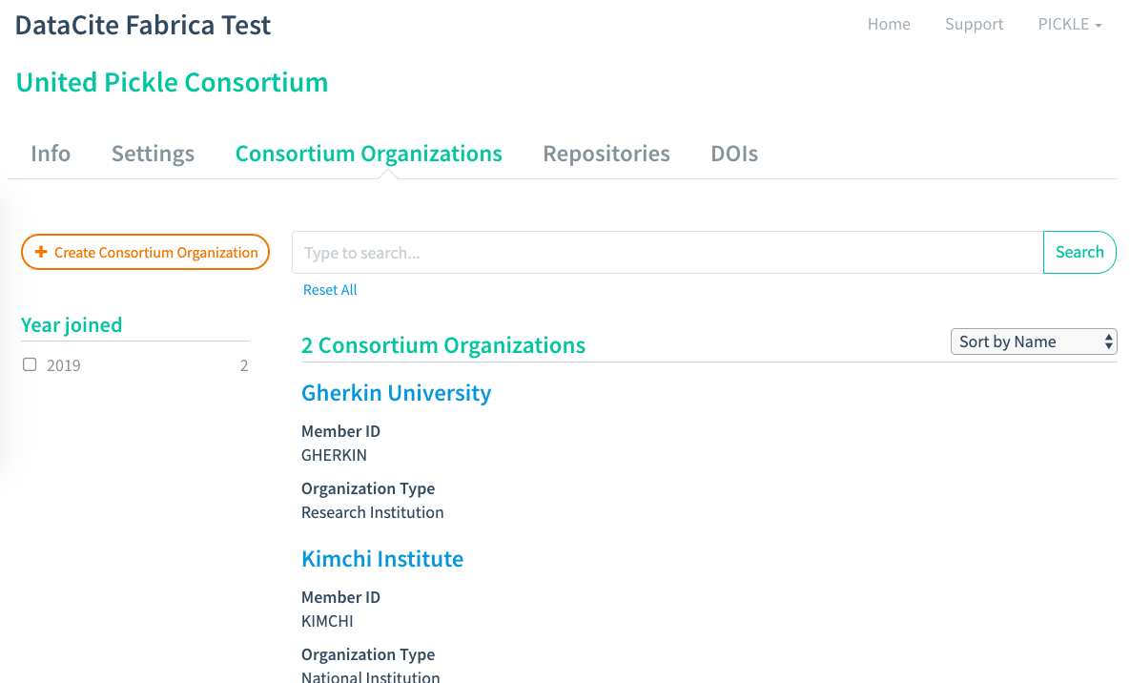
The Consortium creates and manages the Consortium Organizations under them.

Slide 10
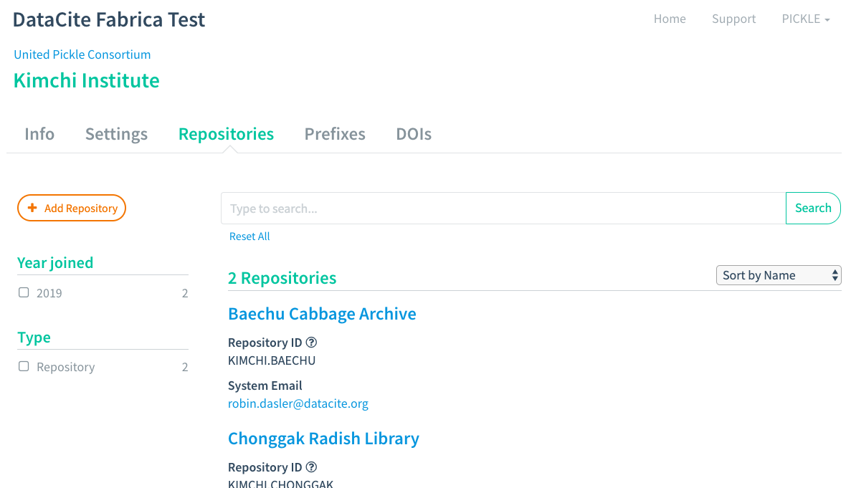
Consortium Organizations look like Direct Members, but they aren’t responsible for billing or voting.

Slide 11
Timeline
We’re making some final tweaks to Fabrica before we go live. We’re aiming for a mid-November release.
For Direct Members, this release will not affect how you create DOIs. You’ll just see some new terms and fields that you might not be used to.
If you’re an existing Consortium, we’ll need to migrate your accounts into the new structure, which will affect how you create DOIs. We have already contacted consortium leads to discuss this process. In the meantime, just carry on as normal.

