Slide 1



Setting up a DataCite Consortium in New Zealand
DataCite Member Meeting – APAC 2020
Andrea Goethals, National Library of New Zealand
21 October 2020
Notes:
This is targeted mainly at organisations that are considering setting up and leading a DataCite Consortium.
The National Library of New Zealand is the consortium lead for New Zealand.
We formed the consortium almost 2 years ago. At the time I felt like we were making it up as we went along without a lot of examples from others so this presentation focuses on:
some of the decisions we made along the way,
some of our current challenges, and
some of the lessons we learned

Slide 2
New Zealand researchers
Research institutes - 7 Crown Research Institutes
8 universities
Research consortia - 10 Centres of Research Excellence (CoREs)
18 independent research organisations (IRANZ)
Private businesses
NZ government departments
Notes:
For context I wanted to give you an overview of what the research community looks like in NZ. These are some of the key organizations conducting research and so producing research data.
We have 7 Crown Research Institutes or CRIs. These are science research businesses owned by the NZ government. Just over 4000 staff are employed in the CRIs. They do research in areas like the natural resources, and climate.
We have 8 Universities that are all research-based institutions, spread across NZ.
We have 10 Centres of Research Excellence or CoREs. These are university-hosted inter-institutional research networks, that enable scientists from the CRIs, universities and other research organizations to work together on strategically focused areas, for example brain research or earthquake resilience.
We also have independent or non-government owned research organizations, private businesses, and government agencies that conduct research.

Slide 3
BC (before the consortium)
Pre-2017 – University of Auckland, GNS Science and Landcare Research were acquiring DOIs through California Digital Library’s EZID service
2017/2018 – began exploring Consortium idea in NZ
To fill the DOI registration gap
Additional benefits – forum for sharing DOI best practice and tools, encouraging adoption & appropriate use of DOIs, promoting open data
Notes:
Before the NZ consortium was in place we had 3 organizations in NZ acquiring DOIs through the California Digital Library’s EZID service. The EZID service model was changed to focus on the University of California so we needed a new solution.
As a result, in 2017/2018, we started exploring different options for developing a NZ consortium. We needed to fill the DOI registration gap that had been filled by EZID, but we also were seeking a Consortium solution for additional benefits. We wanted a forum for sharing best practice and tools that support DOI workflows, and to encourage adoption & appropriate use of DOIs, and more generally to promote open data and sharing of research outputs.
In 2017 the Council of NZ University Libraries (CONZUL) commissioned JMW Consulting to write a report looking at our options for forming a DOI consortium in NZ.

Slide 4

“In all there may be 20-30 discrete NZ organisations that could make use of DataCite services”
Notes:
They concluded that there was appetite for such a consortium among 20-30 NZ orgs. So that is what we are targeting as far as the # of organisations in our Consortium.
The report looked at various options for the Consortium in terms of staffing and recommended dedicating 1.5 FTE to support the Consortium, and predicted an annual cost of NZD20k.
The National Library was brought into the conversation as a potential lead for the Consortium and because we didn’t have a lot of resources to dedicate to this started exploring structures for the Consortium that would use less resources and would also therefore cost less.

Slide 5
NLNZ’s role
Service provider - precedent for NLNZ to provide nationwide services
World’s first national resource sharing system (Te Puna Services)
For libraries & schools - Provides access to e-resources, negotiates licenses, provides free Internet access and computing equipment, teaching material, real-time reference help
For publishers - Central coordinator for ISBNs, ISSNs, ISMNs
Relevance to DOIs – Leadership in preservation & long-term accessibility
Notes:
The National Library seemed to be a good fit as the Consortium lead.
There is already precedent for the Library to provide nationwide services, particularly to libraries and schools across NZ.
Te Puna Services was the world’s first national resource sharing system, providing NZ libraries with access to international collections and databases, and cataloguing resources such as Māori subject headings.
Through its EPIC consortium, the Library provides access to e-resources and negotiates group licenses on behalf of libraries and schools.
For public libraries, the Library provides free access to the Internet and computing equipment, and a shared library system for collection management.
For schools, the Library provides a lending service, support for school libraries, teaching and learning resources, programs to promote and support reading, and real-time help from reference librarians.
The Library’s Digital New Zealand provides online and API access to digital resources of hundreds of New Zealand organizations.
The Library also serves as the central coordinator for various identifiers - ISBNs, ISSNs, and ISMNs for publishers publishing in New Zealand.
We also heard from NZ organizations that because of the Library’s focus on preservation & long-term accessibility, they made the connection to DOIs because of the persistent access DOIs enable, provided they are applied appropriately and maintained.

Slide 6

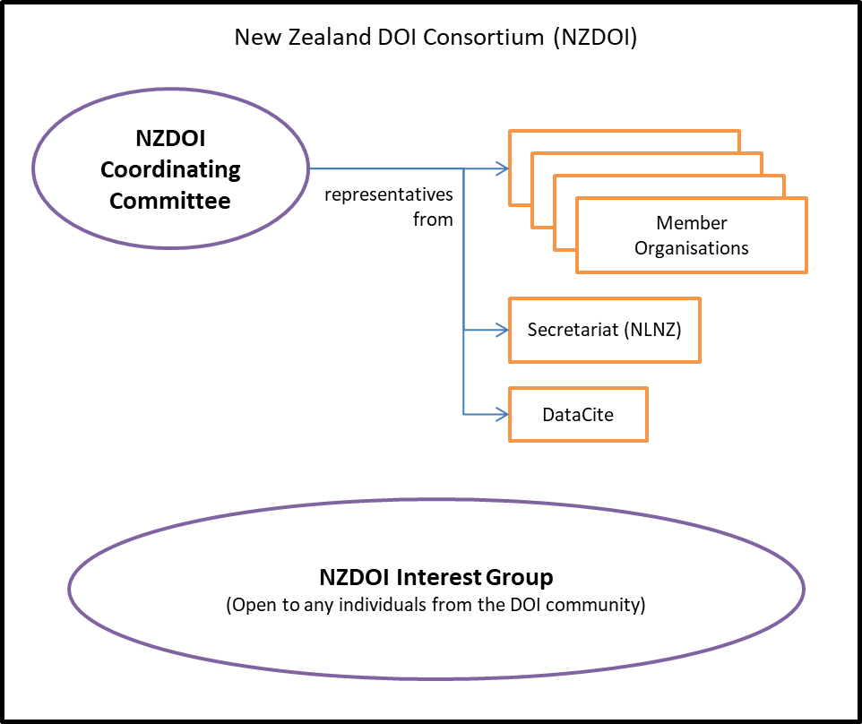
Consortium set-up
Drafted a terms of reference
Background
Purpose
Structure
Membership
Notes:
The first thing we did to set up the Consortium is to get a group of organizations together in the same room to review a draft Terms of Reference I put together for our Consortium. It proved to be a good way to find out where we had consensus & where we didn’t before anything was in place. Here are the main sections of it.
The background has basic information about the consortium – why it was created, the relation to DataCite, the benefits we see.
The purpose outlined 2 roles for the Consortium:
A strategic role (providing pathways for advice and guidance on the direction and activities related to DOI usage in New Zealand and globally)
An operational role (facilitating the creation, management and use of DOIs within the Consortium members’ organisations )
The Structure is shown here. There is a Coordinating Committee to approve processes & change the ToR
The responsibilities of Member organizations is to manage their insts’ DOIs, communicate with their institution’s scholars about DOIs, develop their institution’s policies around DOIs)
The Secretariat, or Consortium lead’s, responsibilities are to be the primary liaison to DataCite, handle all invoices, schedule meetings when needed, first contact for new members)
Interest group – Community of practice open to any interested individuals
It was designed in advance to accommodate growth in the NZ DOI community
Membership section described the eligibility requirements & responsibilities (which are light – need to sign an agreement, agree to pay annual fees and join the interest group

Slide 7
Consortium set-up questions
Structure
Do we need an Interest group in addition to the Coordinating Committee?
Coordinating Committee membership
Process for adding new members (mid-year, pro-rated fees)
Ongoing communication & support
What to use for ongoing communication (Loomio, google group, email, etc.)
Support for member institutions – educational & training resources, promotional activities
Notes:
One of the questions we discussed was around the structure of the Consortium. It was pretty clear from the beginning of our discussions that our members wanted to have as lightweight a structure as was possible. Everyone involved had a lot of other responsibilities and wanted to minimize the time and effort required.
We wondered if it was overkill to have an Interest Group in addition to the Coordinating Committee for the Consortium. We decided to have an Interest Group because it was a way to include individuals & organizations who have a vested interest in open data and research but aren’t necessarily minting DOIs.
We talked to DataCite about the logistics of adding members mid-year and that seemed straightforward so are members are happy to allow that.
We also discussed on-going communication and support. We initially set up a forum in Loomio but ended up migrating it to a Google group.
The question of how to provide support for our member institutions came up but has not yet been addressed, other to note that there is still a need for it.

Slide 8
Consortium lead’s role during changes
(Late 2019) New DataCite member model – changed the Fabrica interface
Learn about the changes to Fabrica
Prepare instructions for members to setup account in test system
Communicate changes to members, help with any problems
Liaise with DataCite staff to migrate members’ accounts
(Early 2020) Funding model change for DataCite membership
Compared the proposed models & analysed the effect on each member
Gave feedback to DataCite on behalf of the Consortium
Prepared individual documents for each member showing the effect of the change
Communicated change to each member
Notes:
Over the last year or so there were a couple changes introduced by DataCite – a new member model that better supports Consortia, and more recently a change to the funding model that will take effect next year.
In both cases, as the Consortium lead, the Library had the task of learning about the changes and communicating them to our members. DataCite staff helped with this by educating us about the changes and preparing informational material, but it did take some time and effort to help our members understand the changes.

Slide 9
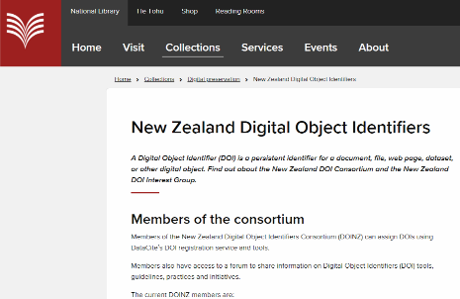
Outreach material
Webpage on NLNZ website
Templates for onboarding new members
Need more of this!
Slides for presentations on the value of joining the Consortium
For example, table showing DataCite Consortium member fees vs DataCite direct member fees
Notes:
To promote the Consortium and to help with member onboarding, the Library has created minimal outreach material.
We have a public Webpage on our website that lists the current Consortium members, explains how to become a member and who to contact.
We’ve created some communication templates for potential new members with Introductory material about the Consortium, the Consortium agreement, and the Process for becoming a member
We definitely need more of this – most of our outreach currently is in response to queries – someone hears about it and wants to know more
One of my goals for the next few months is to create outreach material that doesn’t assume someone already knows the value & purpose of DOIs
I’d like to have this outreach material to send out to all prospective organizations for our Consortium or to leave at Conferences
And lastly I’ve created some slides to use in Presentations about the Consortium
I’ve tried to create slides that show the value of joining the Consortium, for example a table showing how much a member saves by joining through our DataCite Consortium vs as a direct member.

Slide 10
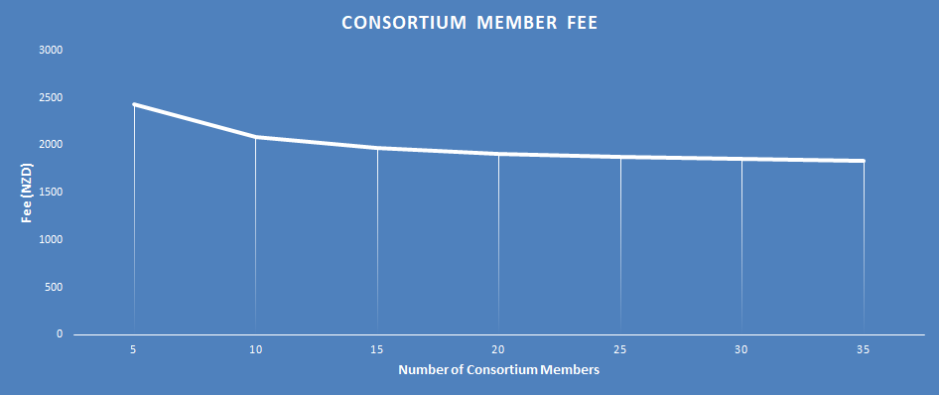

Outreach material
Notes:
Here’s another example I have used in presentations to talk about the financial advantage of the Consortium. This was based on the previous billing model.
It shows that as the number of members in our Consortium increases, the fees for each Consortium member will go down, because there are more member organizations to split the costs.
This is also incentive for our member organisations to help bring new members on.
I need to find another way to communicate this with the new billing model. In the new model the cost will vary depending on the number of DOIs minted, but for most of our members the cost for each is a lot less with the new model.

Slide 11
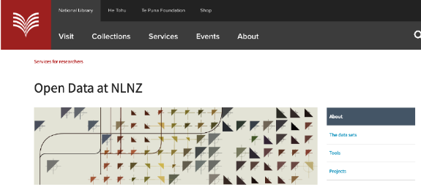
NLNZ’s role
Consortium member? – Mint & manage DOIs for the NLNZ’s open datasets
Advocate for GLAM institutions adopting and using DOIs for our open datasets?
Notes:
I mentioned earlier the Library’s Consortium lead role being based on the Library as a service provider and to provide leadership on preservation & long-term accessibility.
Here are some potential additional roles for the Library within our NZ DataCite consortium.
One potential role is as a member of the Consortium, to mint and manage DOIs for the Library’s growing set of open datasets. The National Library of New Zealand, like other similar institutions around the world is adapting to support emerging forms of research such as the digital humanities and other forms of computational research. The Library has some open datasets available to researchers, downloadable from our website, or available on demand by researchers. Some of this data is collection items that have been packaged up for analysis, other datasets are derivative or are metadata datasets. It may be that we decide to provide DOIs for them to facilitate discovery and citations.
Following on from that, there could be a role for us to encourage more GLAM institutions to use DOIs for their open datasets.

Slide 12



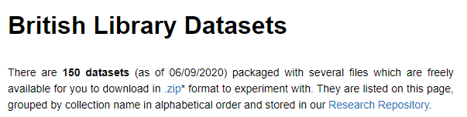
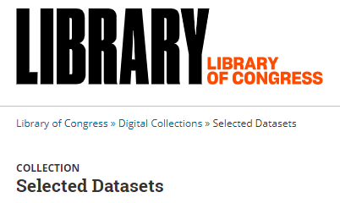

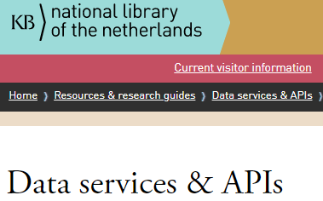
GLAM datasets
Notes:
Especially in the last few years, there has been growing interest and activity within GLAM institutions to provide their collections or derivatives as data for researchers to consume. Some of this data is available for download, but DOIs (or other types of PIDs) are not necessarily provided yet. So I mention that as a potential growth area for DOI advocacy and adoption.

Slide 13
Some guidance for consortium leads
Drafting a Terms of Reference with some of your potential member organizations is a good way to start off with an agreed understanding and to identify potential issues
Finding the right amount of structure is an artform
We went with a lightweight governance / resource structure in NZ, but find it hard to support some activities (outreach, advocacy, education)
DataCite will help you lead your consortium through changes
But these changes do require some time/effort to liaise with your members
Never too soon to develop a plan for growing the Consortium
Next step – develop targeted material for different audiences in NZ (NLNZ, GLAM, research organizations)
Notes:
In summary, based on our experience in NZ setting up a DataCite consortium, here is what we have learned.
I don’t know if its common with the other DataCite consortia but we found that drafting a Terms of Reference for ourselves was a good way to discuss how the Consortium will work. Having the founding organizations discuss it got us to a fairly quick agreement on the logistics.
Finding the right amount of structure for your Consortium is an artform. In the exploratory report on a NZ consortium I mentioned earlier it had recommended more FTE and a resulting higher cost than we ended up going with. There’s some advantages to keeping it light but we are still light in some areas of outreach, advocacy and education.
We found that DataCite will provide the Consortium leads with the help needed to get us through any changes, but we do need to recognize that they will take some of our effort & time, so plan for that if possible.
Lastly even if you’re in the Consortium set up phase, its never too soon to plan for growing your Consortium. Some steps to consider are identifying all the key organizations that are likely to need DOI services and to identify other organizations and networks that can assist with the outreach. In our Consortium one of our members is particularly good at outreach my plan is to see if I can supply that member with outreach material.

Slide 14
Thanks for listening
Andrea.Goethals@dia.govt.nz

