Slide 1
Link Checking
Open Hours March 2019

Slide 2
What is link checking?
Automated - Frequent page scraping of landing pages associated to DOI’s - We check 1000 random samples a day.
Crawler, API, Fabrica - A combination of a crawler to check and exposing this information within our API and Fabrica for members to make further decisions on.
A tool - To help ensure persistence and quality of the DOI ecosystem.
More info: https://support.datacite.org/docs/link-checker
Notes:
We check 1000 random samples a day.
The crawler is an open source application that works in many ways similar to web search engines, but focused on looking for specific information relevant to DOI’s or more generally persistent identifiers. This is then what collects the data and we then provide and expose that via our API and Fabrica.

Slide 3
Why is it important?
In general ensuring the quality of the DOI ecosystem.
Helps ensure URL’s are up to date i.e. making sure DOI’s are persistent.
Helps guide quality of landing pages so third parties who also visit the landing pages get the right information e.g. Google Dataset Search
Helps our members see problems earlier in systems. e.g. potential server issues, multiple redirects, dns timeouts, etc.
Notes:
This is all around ensuring the quality of the DOI ecosystem
And this means making sure URLs are kept up to date, so the landing ages are accurate,
that there are landing pages which is our general guidance for DOI’s,
And then which then we look for the relative quality of a landing page.
This is all in turn ensuring the longevity of DOI’s and ensuring our members can potentially see problems within their own systems.
A final point is the topic of course how third parties use our data e.g. like Google which can cather information from schema.org embedded in landing pages.

Slide 4
How it works
Scan/ Extract Data
Store
Am I allowed to check?
API
Crawler
Landing Page
Notes:
Crawler checks
We’re polite
We gather data
We store it
And we expose it

Slide 5
What we’re looking for
HTTP Responses i.e. 200, 404, 500
HTTP Redirects taken.
Metadata information i.e. schema.org, dublin core, citation
Basic body checks - Looking for DOI anywhere in text content.
Download latency of page (geographically dependant)
Potential errors i.e. DNS Timeouts, server rejections, unexpected errors
Notes:
This is a collection of what we’re currently gathering, this is all listed in our documentation too. Some of this is more important than others and that is why we only expose some of this information directly in Fabrica to provide a summary.

Slide 6
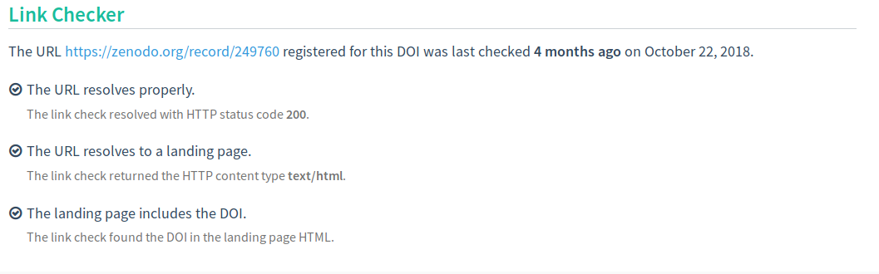
Example (Fabrica)
10.5281/zenodo.249760
Notes:
This shows the summary we provide

Slide 7
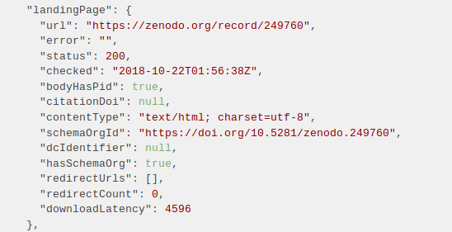
Example (API)
https://api.datacite.org/dois/10.5281/zenodo.249760
Notes:
The raw extra data from an authenticated request

Slide 8
Statistics (Everyone loves numbers)
Checked so far - 356,538 Dois
Return a good response (200) - 307,115 Dois
Not found (404) - 4,008 Dois
Have schema.org metadata - 25,441 Dois
Is a html landing page - 297,246 Dois
Notes:
Some general statistics

Slide 9
Where do we go next?
We have ideas, but what are your thoughts

