Slide 1
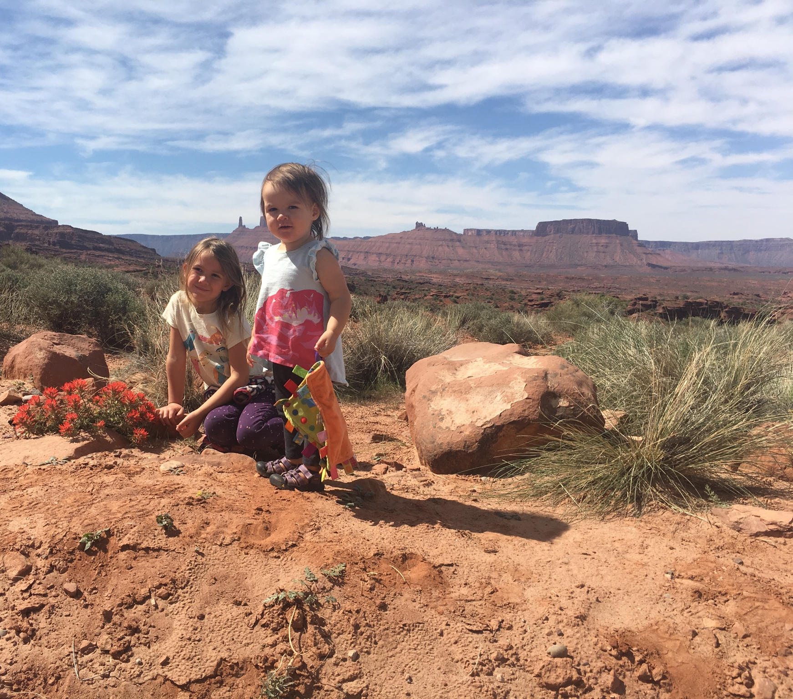
Measuring Metadata Completeness
Ted Habermann, Metadata Game Changers
Measurement is the first step that leads to control and eventually to improvement. If you can’t measure something, you can’t understand it. If you can’t understand it, …, you can’t improve it.
- H. James Harrington

Slide 2
Metadata 2020: Lifecycle
A community of metadata experts
and a model for incentivizing metadata across the entire life cycle.
Incentives for Improving Metadata Quality
1
2
Metadata
Recommendation and Element Mappings
Metadata Assessment
Communities
Create
?
Dialect(s)
Implementation Mapping Between
Representations
Metadata
Communication with Researchers & Repositories
Recommendation(s)
Conceptual Mapping Between
Recommendations

Slide 3
FAIR Recommendation
: Spirals
FAIR Findable Support
Date Submitted
Keyword Value URI
Keyword Vocabulary URI
Funder Identifier
Funder Identifier Type
Award Number
Award URI
Award Title
TIME
FAIR Findable Essential
Date Created
Keyword
Keyword Vocabulary
Funder Project Identifier
Resource Author Affiliation
Abstract
Project Funder
Temporal Extent
Spatial Extent
Resource Type
Resource Author Type
Resource Identifier Type
Resource Author Identifier
Resource Author Identifier Type
Resource Author Affiliation Identifier
Resource Author Affiliation Identifier Type
Resource Author Affiliation Identifier Scheme URI
DataCite Mandatory
Resource URL
Resource Title
Resource Author
Resource Identifier
Resource Type General
Resource Publication Date
Resource Publisher
FAIR AIR Essential
Distribution Contact
RightsHolder
Rights
Rights URI
Resource Size
Resource Format
Resource Contact
Methods
CitedBy
DescribedBy
DocumentedBy
HasMetadata
ReferencedBy
ReviewedBy
SourceOf
SupplementTo
HasPart
FAIR AIR Support
Resource Contact Identifier
Resource Contact Identifier Scheme
Resource Contact Identifier Scheme URI
Distribution Contact Identifier
Distribution Contact Identifier Scheme
Distribution Contact Identifier Scheme URI
Rights Holder Identifier Scheme
Rights Holder Identifier Scheme URI
Rights Holder Identifier
Rights URI
Developed as part of the MetaDIG Project 2015-18, with Matt Jones and Peter Slaughter at NCEAS, Dryad, CDL, LTER, EDI

Slide 4
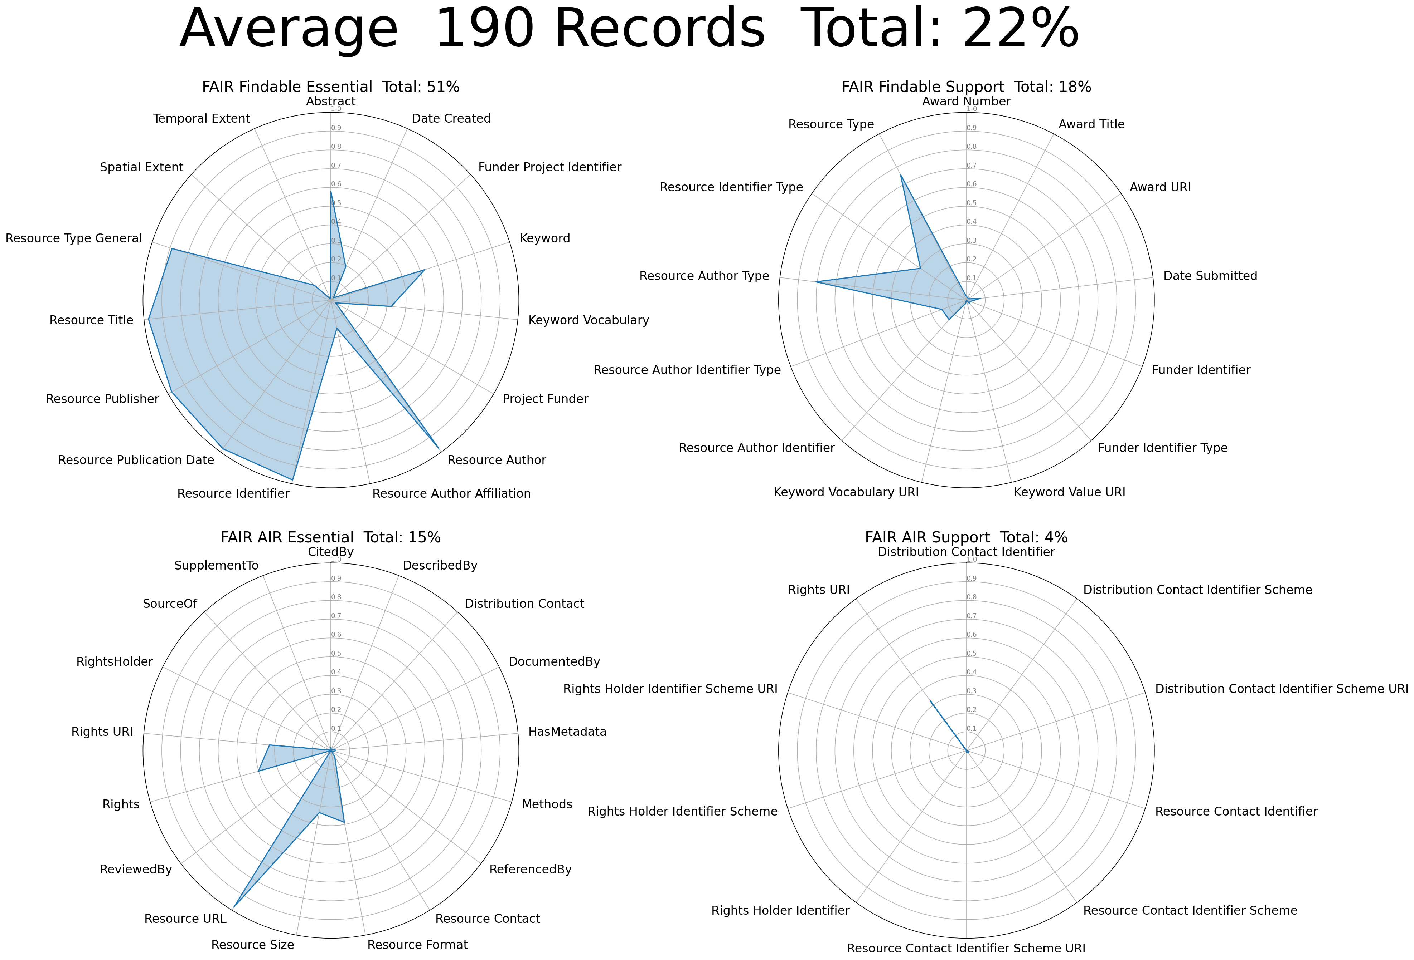
Visualizinging FAIRness
FAIR Findable Essential
Date Created
Keyword
Keyword Vocabulary
Funder Project Identifier
Resource Author Affiliation
FAIR Findable Support
Date Submitted
Keyword Value URI
Keyword Vocabulary URI
Funder Identifier
Funder Identifier Type
Award Number
Award URI
Award Title
Measure % Complete for all recommended fields.
Show results in one Figure.
Resource Type
Resource Author Type
Resource Identifier Type
Resource Author Identifier
Resource Author Identifier Type
Resource Author Affiliation Identifier
Resource Author Affiliation Identifier Type
Resource Author Affiliation Identifier Scheme URI
Abstract
Project Funder
Temporal Extent
Spatial Extent
Elements
~50%
Mandatory fields ~100%
DataCite Mandatory
Resource URL
Resource Title
Resource Author
Resource Identifier
Resource Type General
Resource Publication Date
Resource Publisher
FAIR AIR Essential
Distribution Contact
RightsHolder
Rights
Rights URI
Resource Size
Resource Format
Resource Contact
Methods
CitedBy
DescribedBy
DocumentedBy
HasMetadata
ReferencedBy
ReviewedBy
SourceOf
SupplementTo
HasPart
FAIR AIR Support
Resource Contact Identifier
Resource Contact Identifier Scheme
Resource Contact Identifier Scheme URI
Distribution Contact Identifier
Distribution Contact Identifier Scheme
Distribution Contact Identifier Scheme URI
Rights Holder Identifier Scheme
Rights Holder Identifier Scheme URI
Rights Holder Identifier
Rights URI
Time

Slide 5
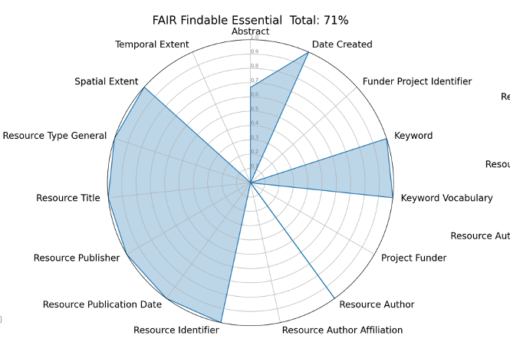
Opportunities:
Completeness Metric
Improvement waiting to happen (gap)
Complete elements at edge of circle
Improvement waiting to happen
(missing element)

Slide 6
Domain Repository Role
Global Research Infrastructure
Minimum metadata required for DOI
DOI
Repository streams a subset of metadata about a dataset (more than sent to DataCite, but not everything)
OAI Feed
Full set of metadata is collected/maintained within a system (e.g. Dublin Core)
Local Repository (IR)
Hidden “data-level” metadata
and documentation (unstructured)
Description of the data captured within files to support reuse (e.g. readme files)
Metadata Content

Slide 7
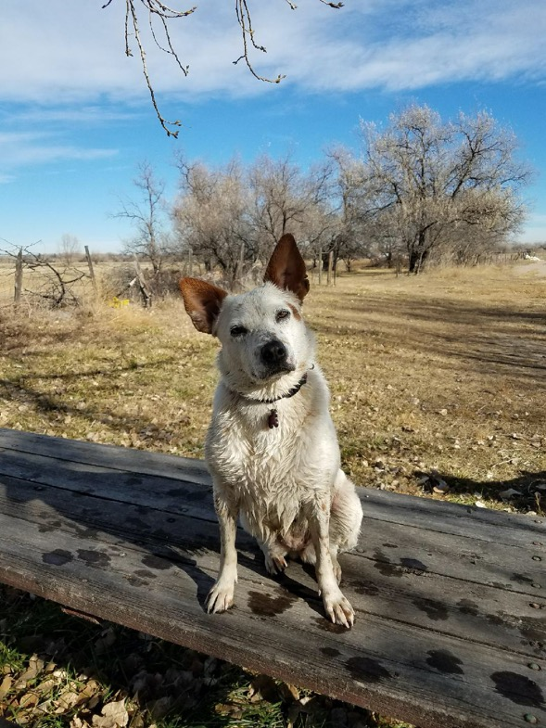

Questions?
Work with us on:
Repository and Journal Connectivity
Metadata evaluation and improvement (FAIR metadata)
Community building strategy
International Metadata Standards (ISO, DataCite, schema.org)
Workshop design and facilitation
Community conventions / profiles
Leadership coaching
Repository Certification (Core Trust Seal)
ted@metadatagamechangers.com
erin@metadatagamechangers.com

