Slide 1
Our Roadmap Process
Open Hours, March 2020

Slide 2
2020 Strategic Priorities

Slide 3

Our overarching theme for 2020 is
making our services and operations
streamlined, shipshape, and watertight.

Slide 4
2020 Strategic Priorities
This year, we have 4 strategic priorities:
Formalising the new business model
Optimising internal operations, systems, and processes
Consolidation of services and infrastructure
Member-driven product development
We’re tying everything we do to at least one of these strategic priorities.

Slide 5
Our Roadmapping Process

Slide 6
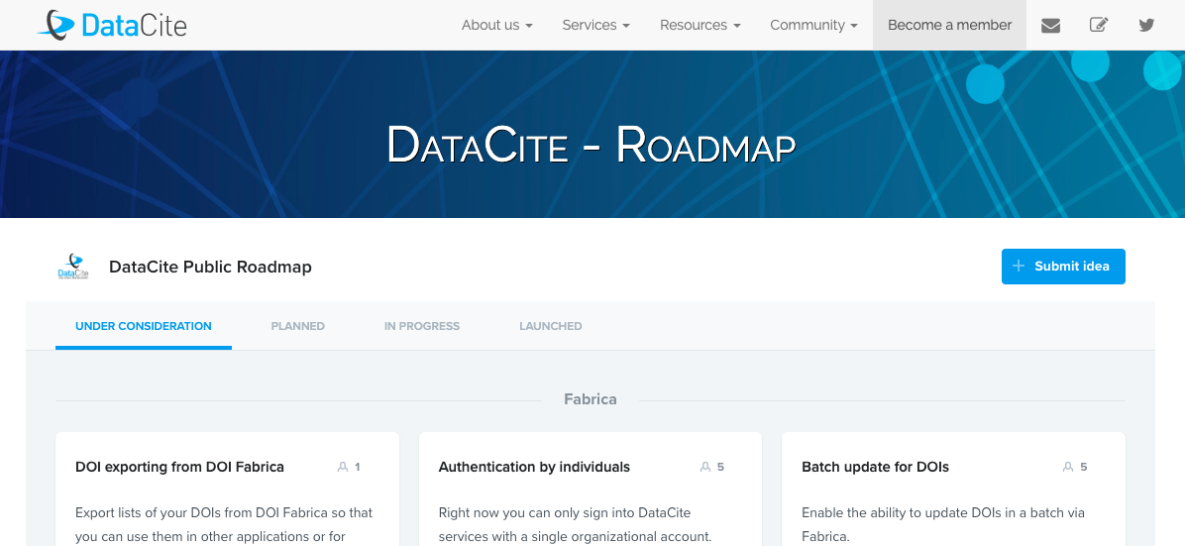
Step 1: Your Contributions
Send us your feedback!
Vote or leave a suggestion on our roadmap portal: https://datacite.org/roadmap.html
Send a message to support: support@datacite.org

Slide 7
Things to know about the roadmap portal
Your comments and suggestions aren’t public, so you can say whatever you want.
The portal will ask you for an email address. We’ll use this to follow up with you if we need to clarify your suggestion.
We put things on the roadmap portal that are small project-sized chunks of work. We continue to do maintenance and bug fixes at the same time.

Slide 8
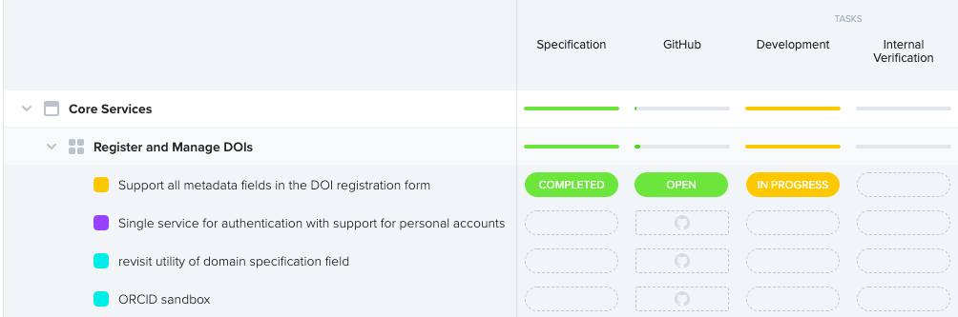
Step 2: We triage the requests
All feature requests go into one central list.
We regularly review the list and see which features should be prioritized.

Slide 9
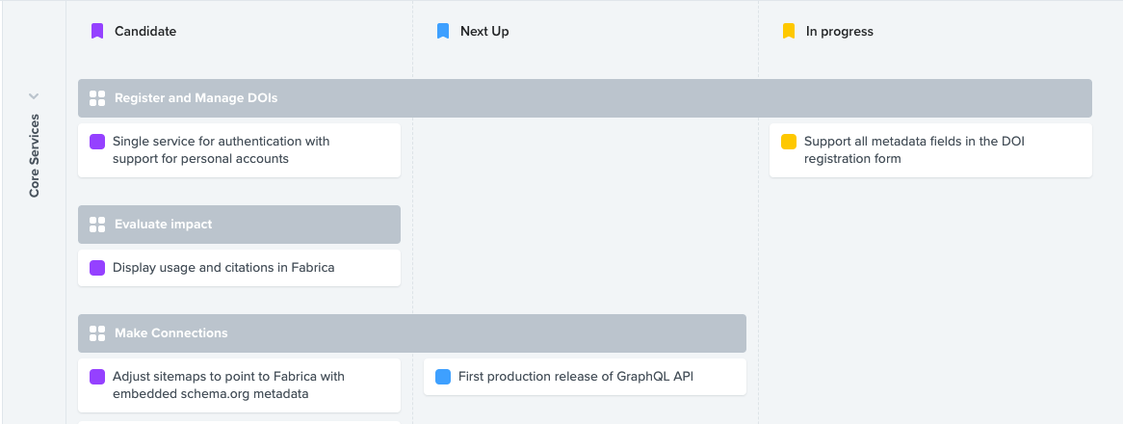
Step 3: Move through the development process
Features that are chosen to be developed then move through our development process.
Features are fleshed out as they go to more specifically identify what needs to be built.

Slide 10
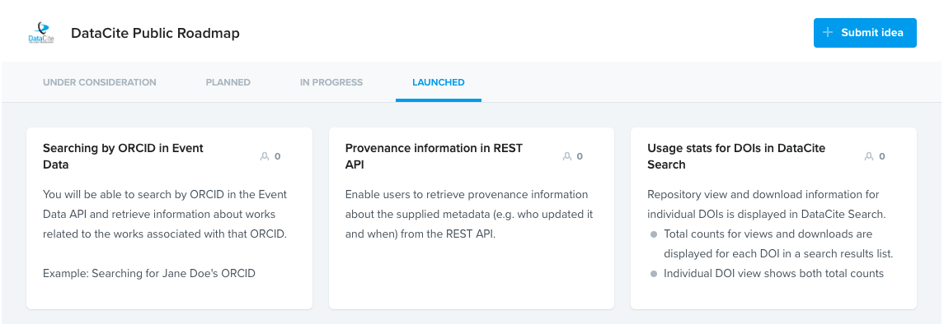
Step 4: Share with you
As features move from ideas to something we’re developing, we’ll update the roadmap portal.
Feel free to leave us feedback at any step of the process. It helps us to adjust course.

Slide 11
Your Feedback

