Slide 1


Welcome
DataCite Open Hours
Bringing the DataCite community together to learn, discuss, and share ideas

Slide 2
Remember...
Please mute while presenters are speaking
Please raise your hand if you would like to ask a question
You can also use the chat box to ask us questions
Suggestions and feedback on the session is always welcome, contact support@datacite.org
Mute
Chat
Raise Hand
X

Slide 3
Open Hours: April 2020
What will we be sharing
updating contact information in Fabrica (Mary)
consortia transfers (Mary)
member meeting in October (Mary)
voting at the business meeting (Matt)
business meeting materials (all)

Slide 4
Updating contact information in Fabrica
We are planning to use the contact information stored in Fabrica to create targeted mailing lists to make sure the right information gets to the right people. We will also use the voting contacts from Fabrica for voting during the General Assembly.
This means the contact information in your Fabrica accounts must be added and kept up to date.

Slide 5
How to update contact information in Fabrica
Log into your member account, consortium account or consortium organization account
Click “Update Organization”
Add “voting contact” (members and consortium lead only)
Add contact information including “service contact” and “technical contact” (all)
Scroll down and add the “billing contact” (members and consortium lead only)

Slide 6
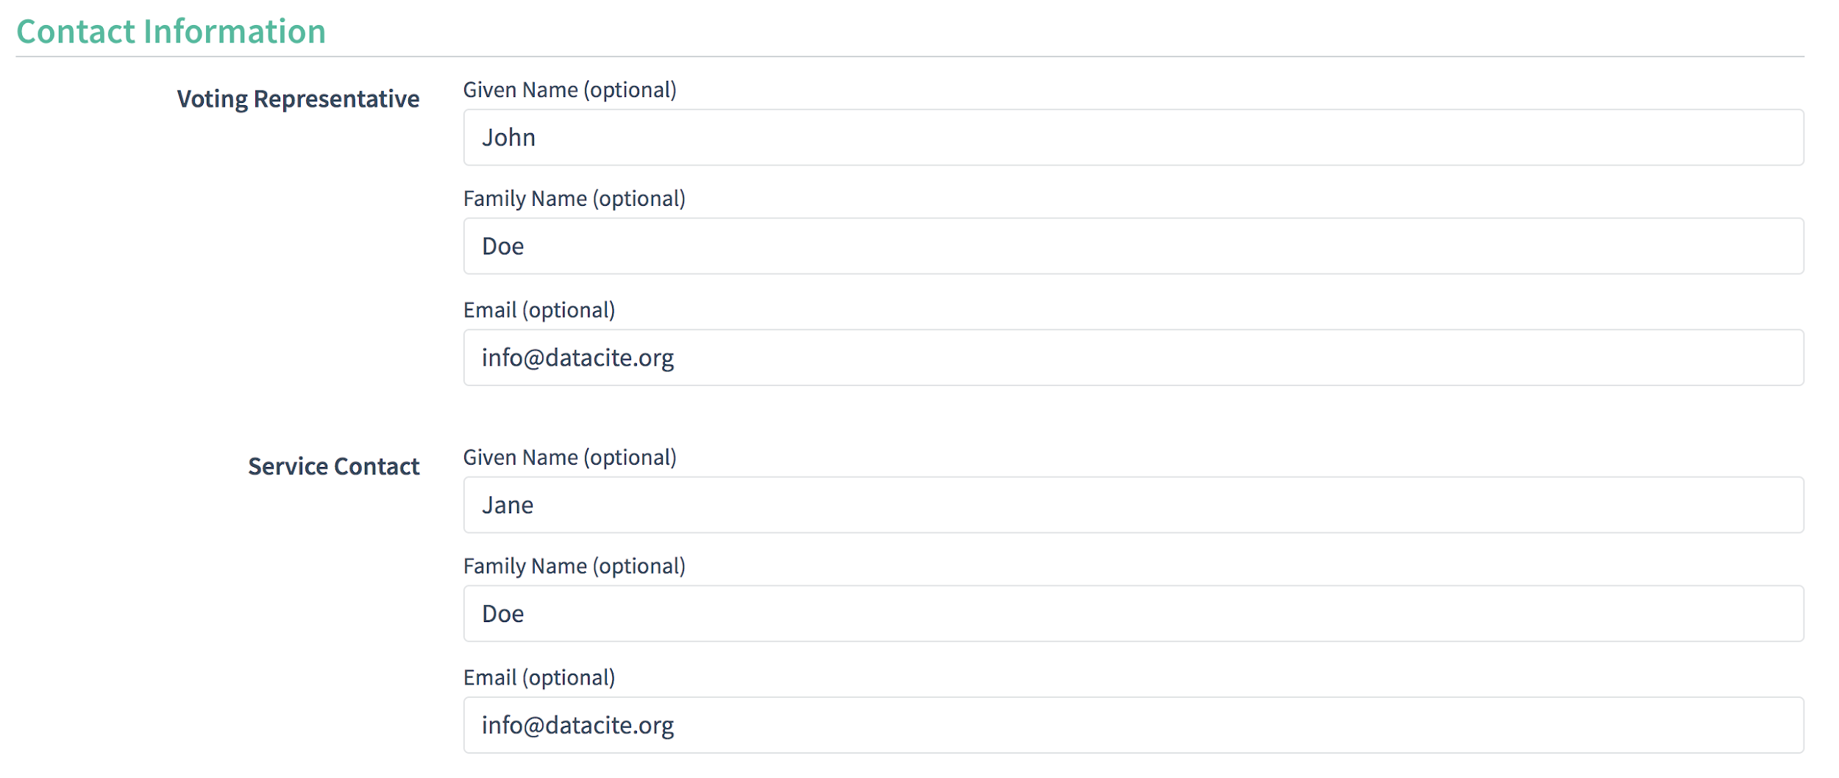
How to update contact information in Fabrica

Slide 7
Consortia
At the end of 2019 we began the process of transferring consortia to the new 3 tiered structure. There are now 6 consortia that are integrated into this structure 😀 :
University College Dublin
Orbis Cascade Alliance
Virtual Library of Virginia
DOI Service Austria (TU Wien)
National Library of New Zealand
DataCite Canada Consortium

Slide 8
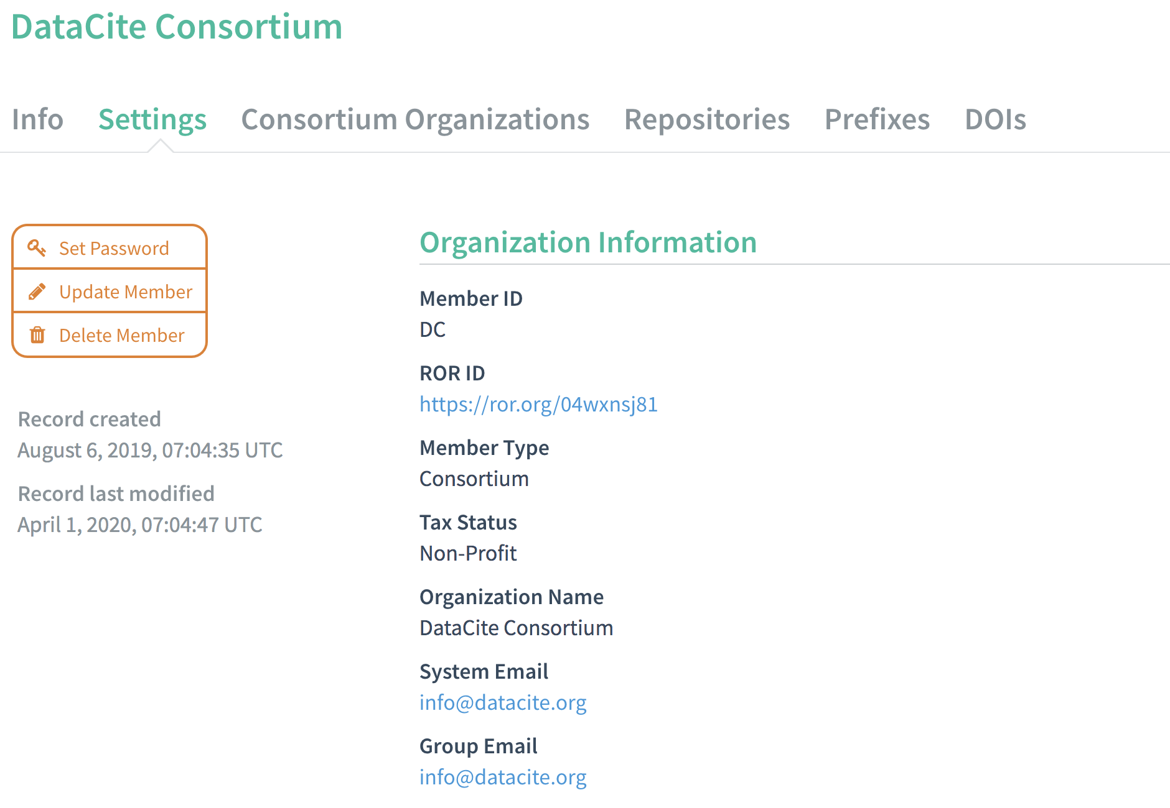
What does that mean?
These consortia now have 1 consortium lead account
with permission to create and manage consortium organizations and their repositories and prefixes

Slide 9
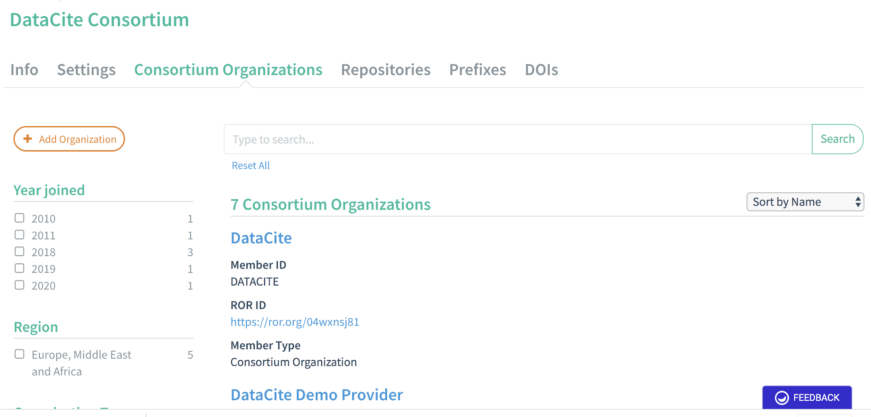
With X number of consortium organization accounts
with permission to create and manage their repositories and prefixes

Slide 10
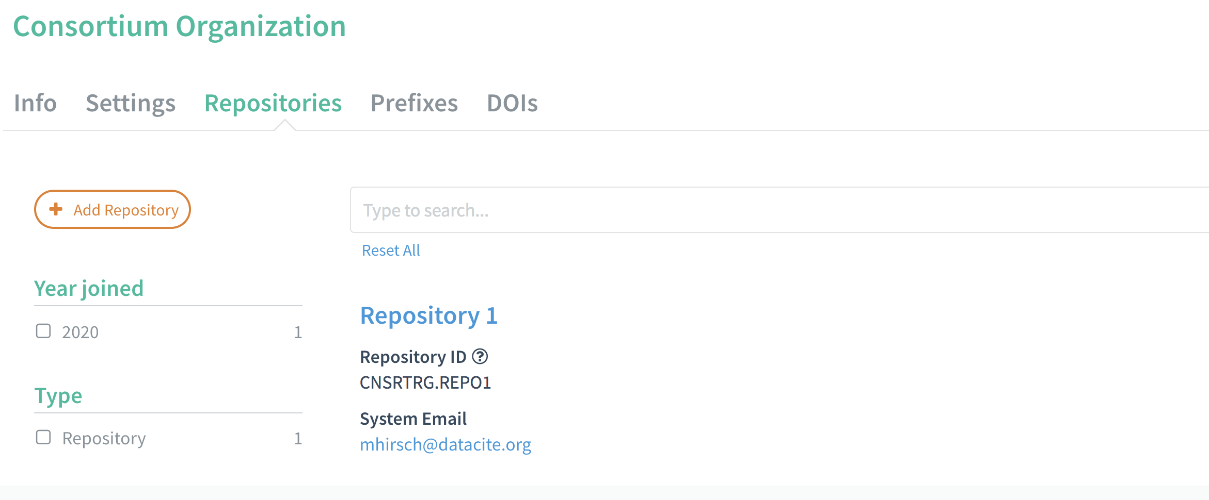
Each consortium organization has 1 or more repositories
with permission to create and manage DOIs and metadata

Slide 11
What’s next?
For all new consortia, the transition to the new Fabrica structure should be completed by the end of 2020. You will need to:
Contact us when your consortium is ready to start the process
Set up your consortium accounts in the Fabrica test environment
We will replicate the structure in the Fabrica production environment
We will guide you through the process. Don’t hesitate to contact us if you have any questions at support@datacite.org.

Slide 12
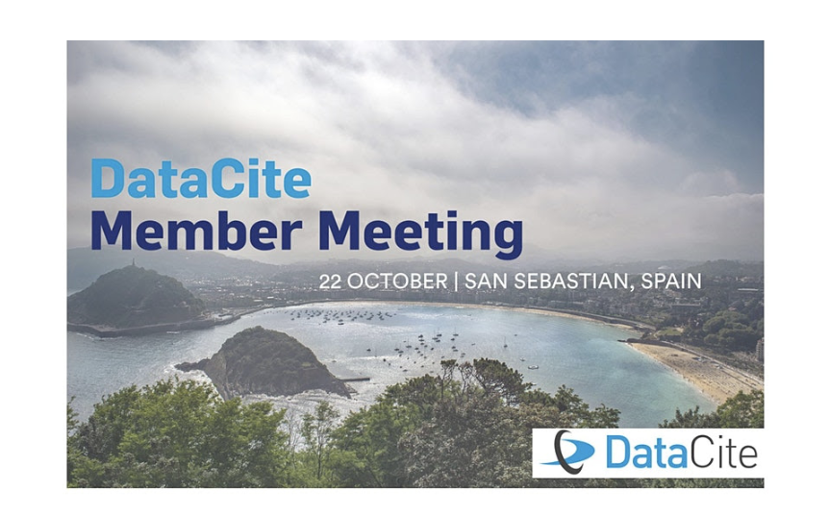
Member Meeting 2020 - Update
Notes:
What kinds of sessions would be of most interest to you?

