Slide 1
Automated Evaluation of LLM based systems
Ing. Marek Matiáš
Ing. Alexandr Vendl
Ing. Ondřej Finke
Dataclair.AI, O2 Czech Republic
2024

Slide 2
What to expect?
Notes:
PH

Slide 3
Expected takeaways from the workshop
RAG: Whys and Hows
Issues commonly encountered when developing RAG for a real usecase
How to build an evaluation system that allows efficient optimization that will overcome the common problems
Notes:
PH

Slide 4
Timeline of the workshop
Introducing RAG methodology
Discussing benefits and limitations
Practical session: Setting up the RAG in google colab about elections around the world
How to evaluate accuracy of the whole RAG system
What kind of metrics can be used
Practical session: improving RAG with manual evaluation
How to automate the evaluation
Introducing the automation process
Practical session: training your own automated agent
Practical session: optimize the RAG -> leaderboards and prizes ☺
Notes:
PH

Slide 5
1. Retrieval-Augmented Generation (RAG)
Notes:
PH

Slide 6
How to overcome knowledge limitation of pretrained models?
 | Pros | Cons
Finetuning | Low inference cost Knowledge discovery | High initial cost Further data updates
RAG | Explainability Privacy (access roles can be implemented) Low initial cost | High inference cost
Notes:
PH

Slide 7
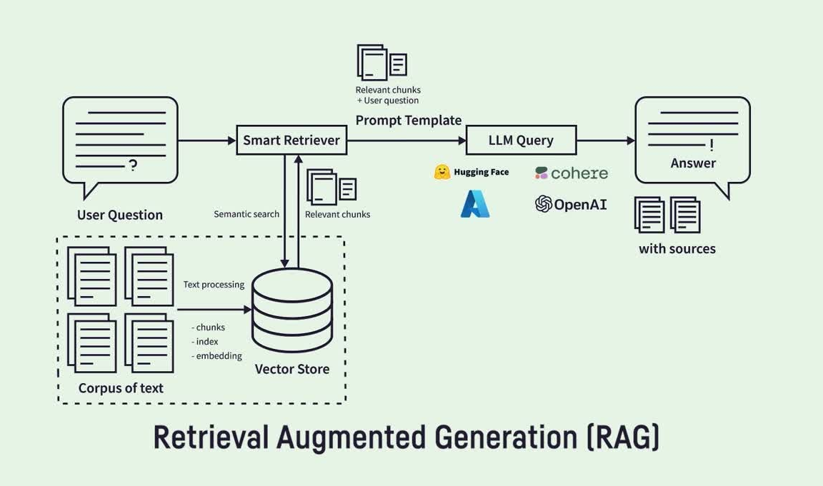
What is RAG?
Notes:
PH

Slide 8
Possible RAG architectures
Incorporating a chatbot -> user can pose additional questions
Combining types of retrievers: vector, BM25 lexical search, Azure Semantic reranker
Reformulating user question into multiple queries
Increasing effectiveness by caching / optimizing the number of documents going into the LLM
Notes:
PH

Slide 9





RAG productionalization
Formulate answer (LLM)
Transform question (LLM)
Knowledge (search)
What is the price?
User management
Caching
Load balancing
Formulate answer (LLM)
Automatic test
Get
Unify
Should update?
GUI, UX, integration, others
Notes:
PH

Slide 10
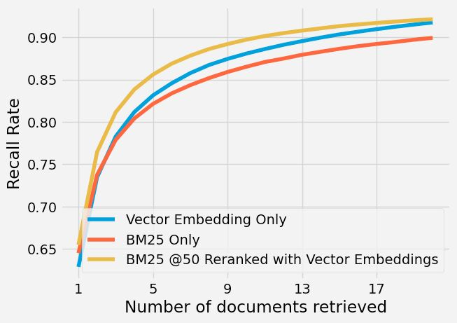
Limitations of RAG methodology
Each call to LLM is expensive:
The more documents we serve the model, the higher the accuracy but also the cost.
Inherently bad at answering general questions that require the combination of many documents:
e.g.: “What countries had elections in 2023?”
The input data has to be well structured:
Ideally in short paragraphs with all the relevant context.
Notes:
PH

Slide 11
Practical session: Hands on experience with RAG
https://tinyurl.com/dataclair-mlprague
Notes:
PH

Slide 12
2. Why evaluation accuracy is crucial
Notes:
PH

Slide 13
It is difficult to optimize LLM systems
Imagine optimizing simple linear regression with just a few predictors by hand
Changing parameters
Computing predictions for test observations and reviewing correctness one by one
Thinking how to change parameters
Repeat
RAG system is much more complex and looking for right composition and correct parameters of each part is very difficult
Evaluating this system by hand is time consuming and frustrating
Notes:
PH

Slide 14
What is necessary for proper evaluation
Validation dataset
Dimensions
Question
Ground truth answers
Source metadata
Question categories
…
Observations
Questions representing actual usage (majority)
Questions simulating non-standard usage
Notes:
Observations
Questions representing actual usage (majority)
proportional representation according to which sources users need more and less
Questions simulating non-standard usage
vague, misleading, questions not answerable from sources, jail-breaks, ...

Slide 15
What is necessary for proper evaluation
Metrics
Basic metrics
Can be done by hand
Correctness
Source accuracy
Advanced metrics
Infeasible to do by hand (but you can use libraries such as Ragas)
Context Recall
Context Precision
Faithfulness
Context Relevancy, ...
Notes:
Metrics
Basic metrics
Can be done by hand
Correctness
domain expert compares answers to ground truth
Citation accuracy
domain expert lists sources that should be used to answer the question
Advanced metrics
Can only be calculated automatically (using libraries such as Ragas)
Useful for evaluation of different parts of the system one by one
Context recall
GT sentences attributable to context / Number of sentences in GT
Faithfulness
Answer claims attributable to context / Number of claims in Answer
Context Precision, Context Relevancy, ...

Slide 16
Practical session: Optimization with manual eval

Slide 17
3. Automating RAG evaluation

Slide 18
Benchmark: Expert human labels
Process:
1
Use previously created Test set
2
Answer the questions using RAG
3
Let domain expert label RAG answers
Correct X Incorrect (ideally just those 2 to keep it simple)
4
Use this data to create evaluation system that evaluates similarly as the domain expert

Slide 19
Creating evaluation pipeline
Training custom model
Expert
LLM
Classes
Test set
RAG
Train data
Classifier
Classes
We can either prompt LLM to evaluate RAG answer to Ground truth
or
Create classifier based on various metrics (citation accuracy, etc.) and LLM inputs

Slide 20
Creating evaluation pipeline
Creating evaluation pipeline
Other custom metrics (citations, etc.)
Custom model
Classes
Test set
Evaluated test set
Out of the box solution (Ragas)
Various metrics

Slide 21
When to trigger
Evaluation pipeline is useful not only for RAG optimization, but also for monitoring
When to evaluate the model:
During development
Creating new version of knowledgebase
Merging new changes to production
Regularly for reporting purposes

Slide 22
Practical session: Automating evaluation

Slide 23
3. Automating RAG evaluation

Slide 24






Possible optimization of RAG system
Document processing
not part of today's workshop
Retriever method
Number of documents going into prompt
Temperature
System prompt
Multiple-queries
not part of today's workshop
Embedding model
not part of today's workshop

Slide 25
Practical session: RAG optimization with automated evaluation

Slide 26


Dataclair is looking for the missing piece.
SW Engineer
Junior AI Engineer
Data Scientist
Turn bold ideas into algorithms and change the world for the better.

