Slide 1

Basic Education and Society
Leo Yi & Christopher Bloome
DATA 607 Final Project
May 4, 2020

Slide 2
Data from Gapminder
Explanatory Variables
Literacy Rate of Adults
Primary School Completion Rate
Primary School Expenditure Rate (% of GDP)
Response Variables
Murders per 100,000 people
Suicides per 100,000 people
Vaccination Rates
Inequality Index (Gini coefficient)

Slide 3
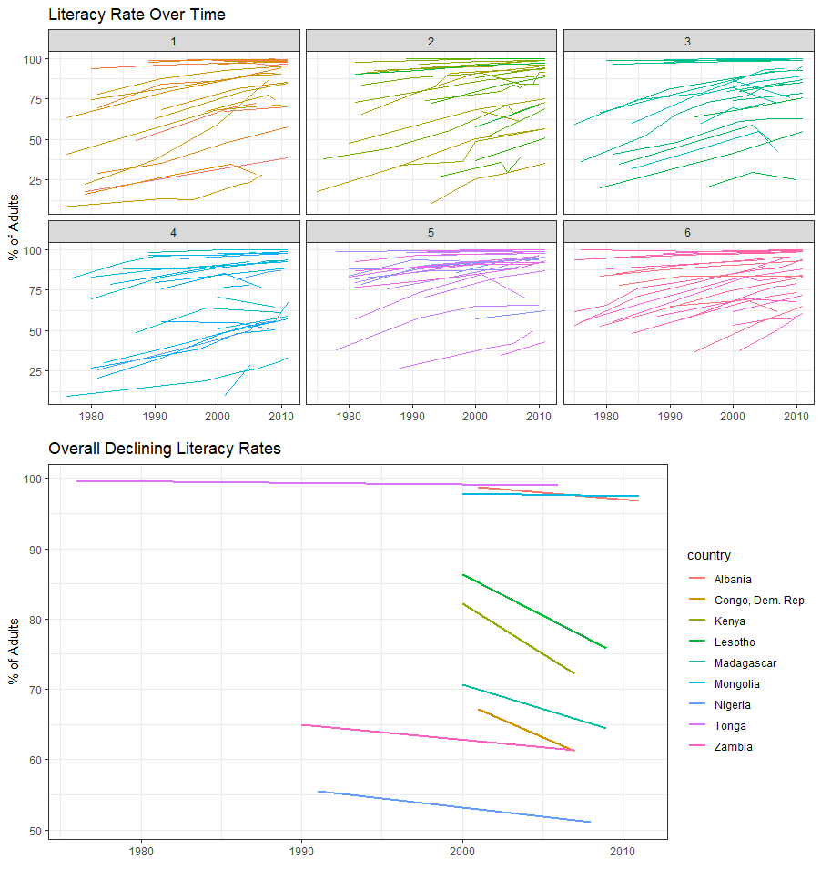
Literacy Rate
Most countries observed advanced over time
A handful of countries declined during the observation period
Most of these countries were in Africa

Slide 4
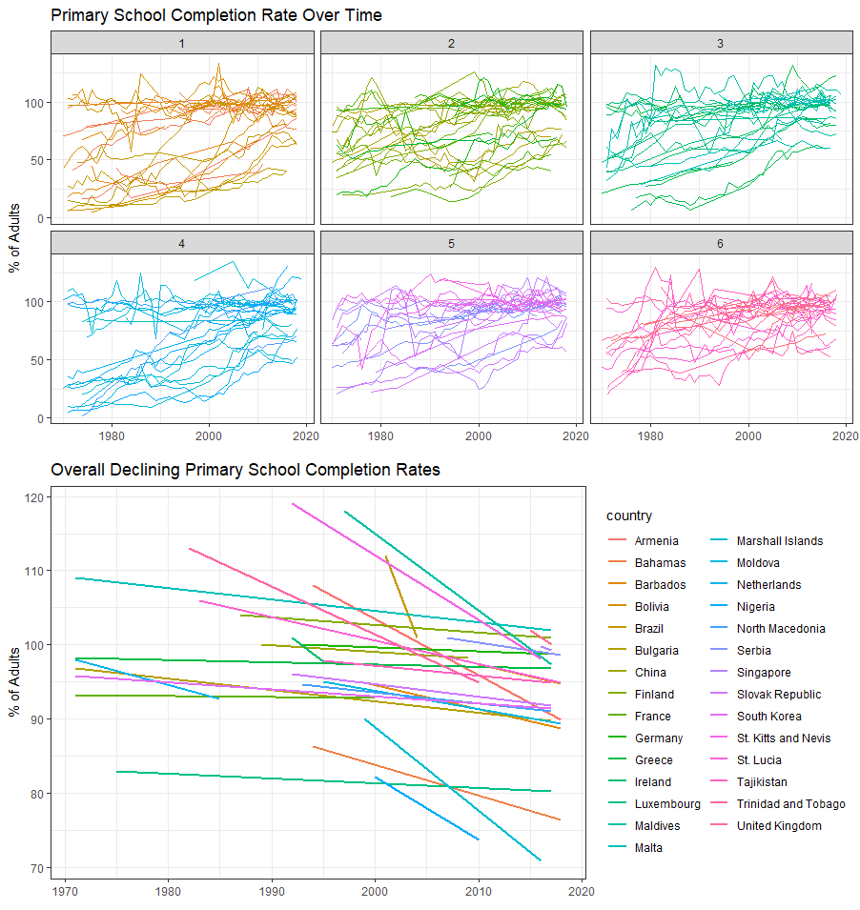
Primary School Completion Rate
Higher variability of data points
General improvement over time
Plenty of countries that have declined over time

Slide 5
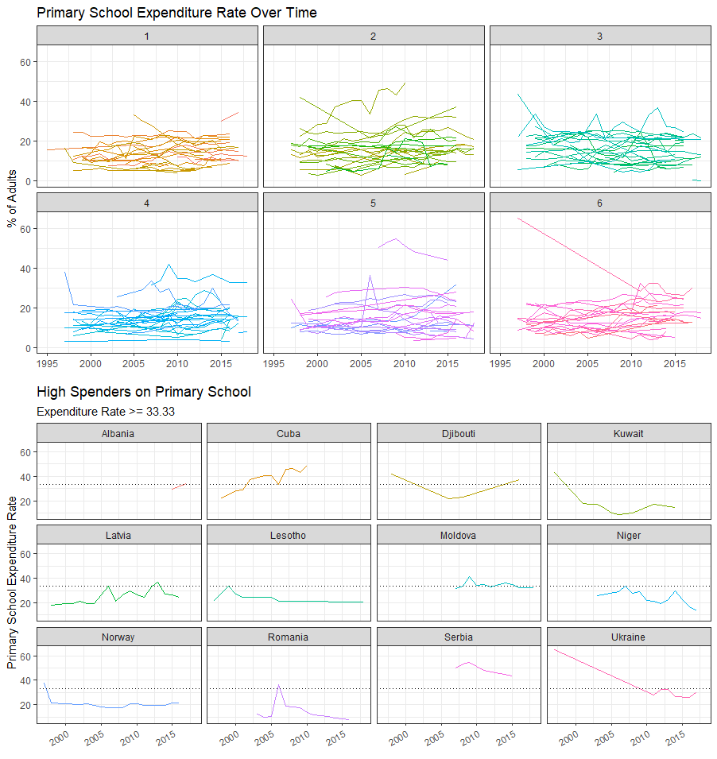
Primary School Expenditure Rate
Most countries expenditure rate steady over time
Some countries spent more than 1/3 of GDP per capita on primary school education

Slide 6
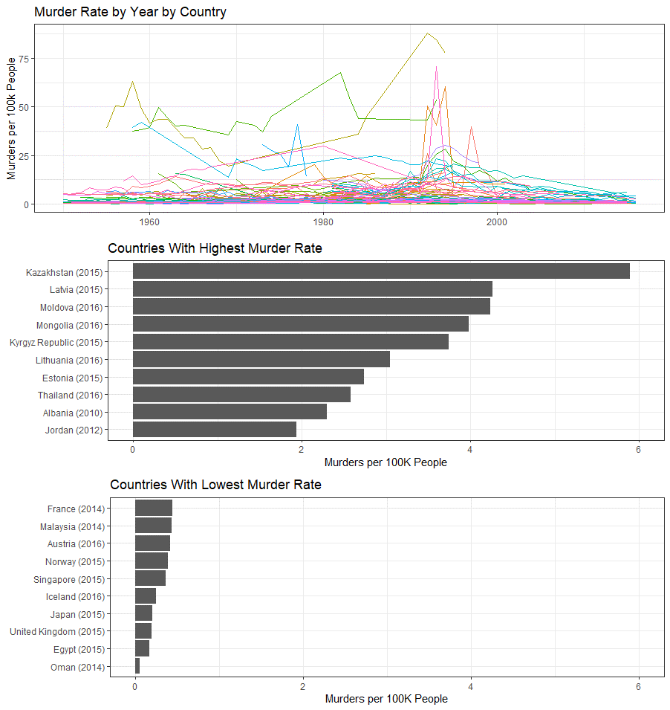
Murder Rate
Most Countries had relatively few murders per 100K people
Looking at the latest data point for each country, we ranked the murder rates

Slide 7
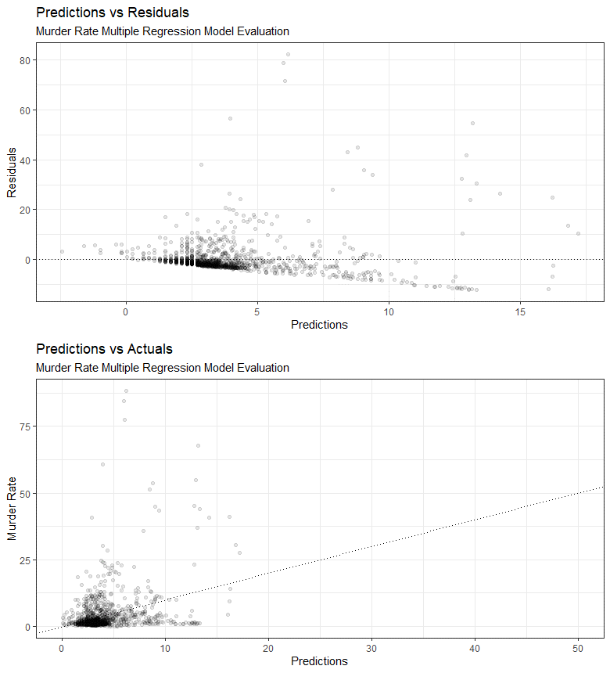
Murder Rate, Linear Regression
1,228 country year observations
Explanatory Vars
Primary School Completion Rate
Correlation = -.33
R squared = .1063

Slide 8
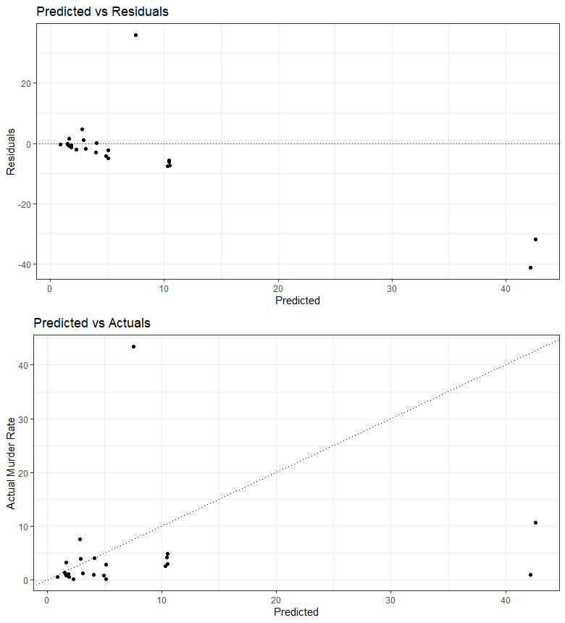
Murder Rate, Random Forest
76 country year observations
70% training
Explanatory Variables
Literacy Rate
Primary School Completion Rate
R squared = .0649

Slide 9
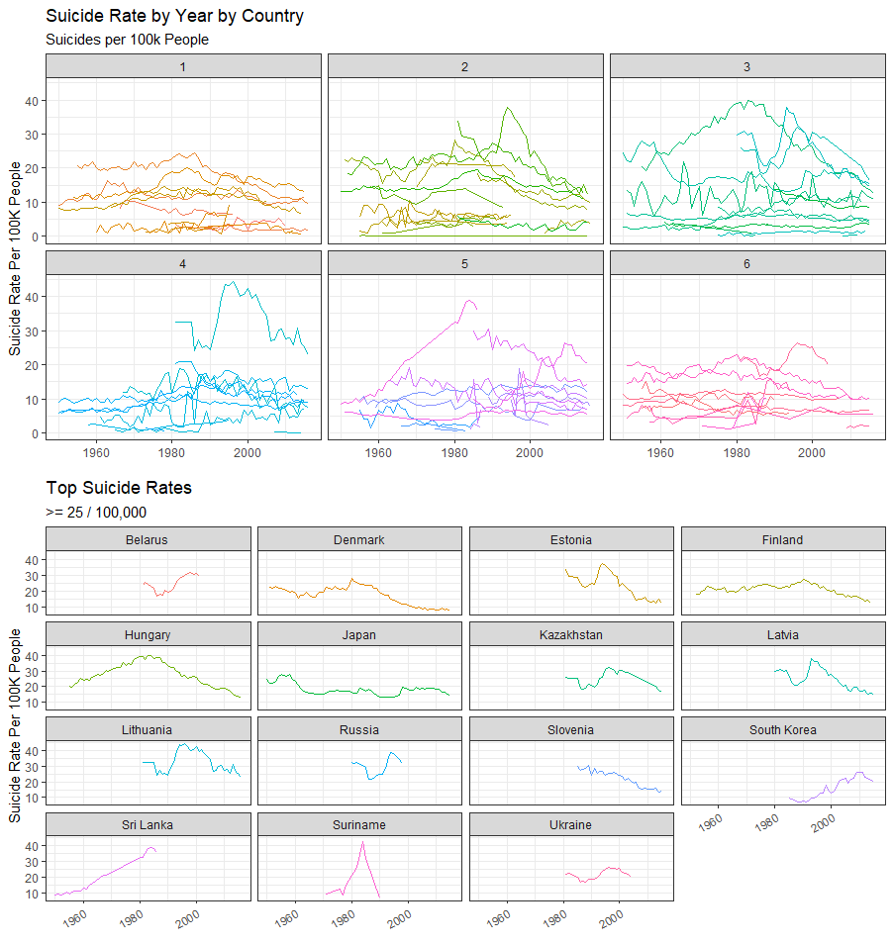
Suicide Rate
Most countries have low rates, others have spikes at different times
We set a level of 25 / 100k suicides at any given year to see which countries had the most suicides

Slide 10
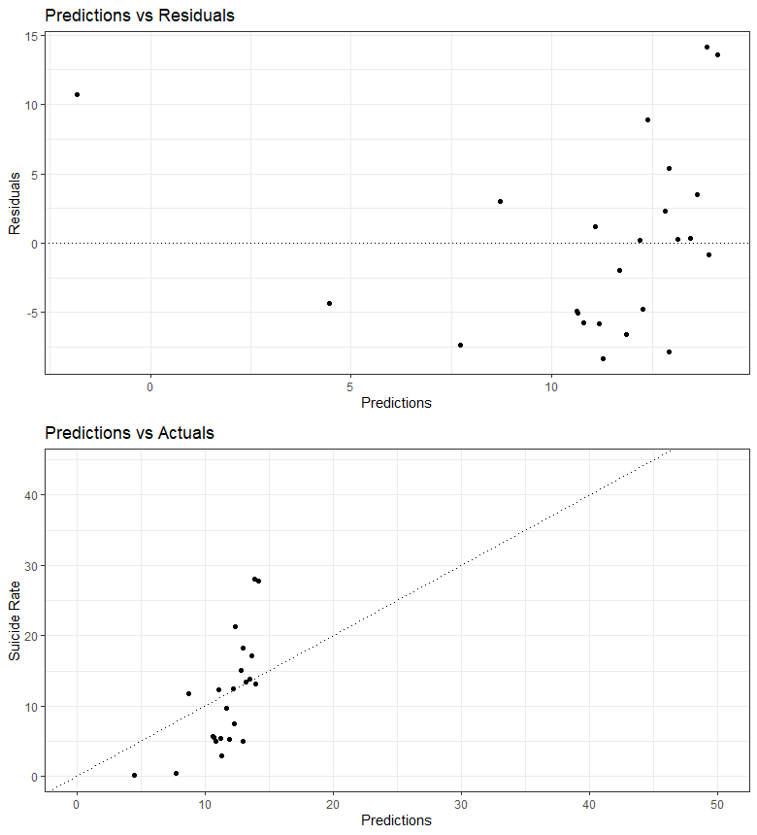
Suicide Rate, Multiple Regression
77 country year observations
Explanatory Vars
Literacy Rate
Primary School Completion Rate
R squared = 0.2171

Slide 11
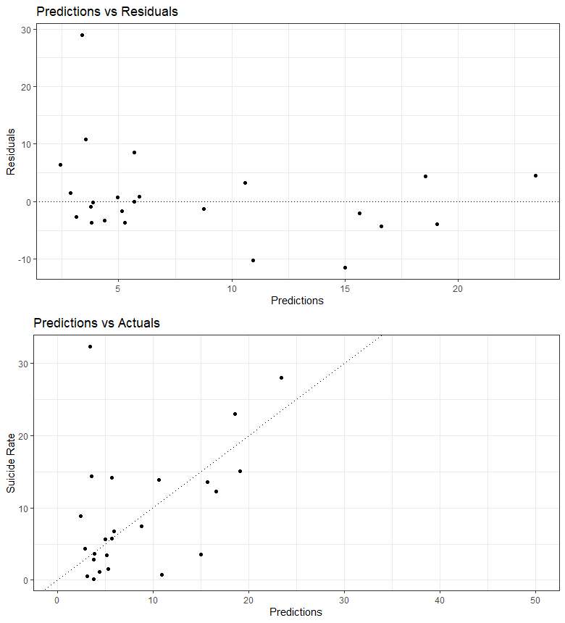
Suicide Rate, Random Forest
77 country year observations
70% training
Explanatory Vars
Literacy Rate
Primary School Completion Rate
R squared = 0.2287

Slide 12
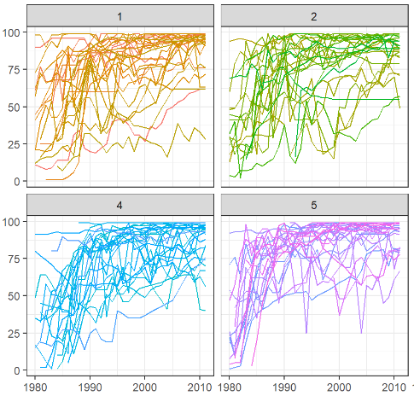
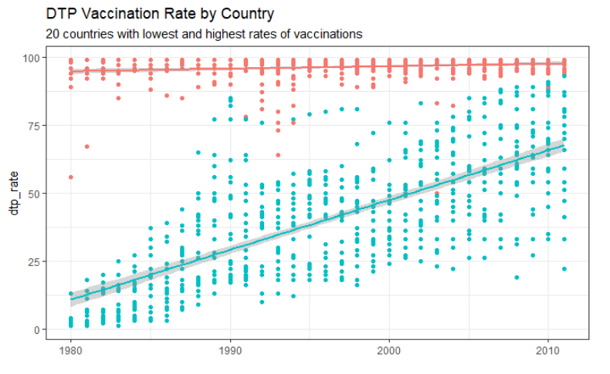
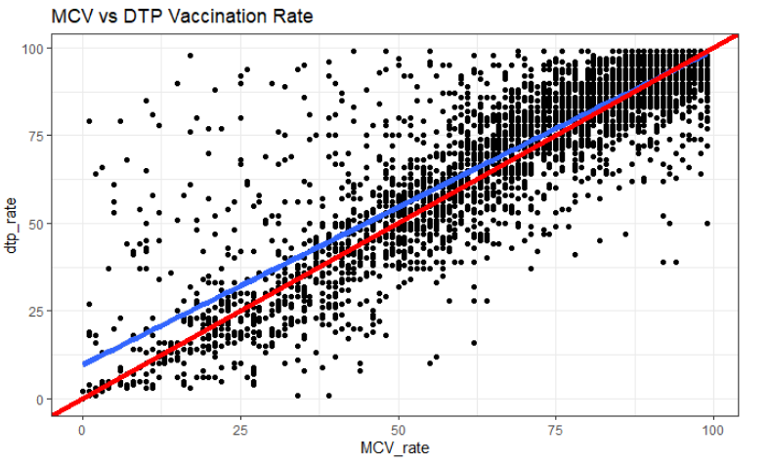
Vaccination Rate
Limited Scope to:
DTP (Diphtheria, tetanus, and pertussis)
MCV (Measles)
Both statistics measure percentage of 1-year-olds who have received all doses.
Nearly collinear (R-Squared = .8)
Improvement across all countries – significant divide between high and lower averaged countries

Slide 13
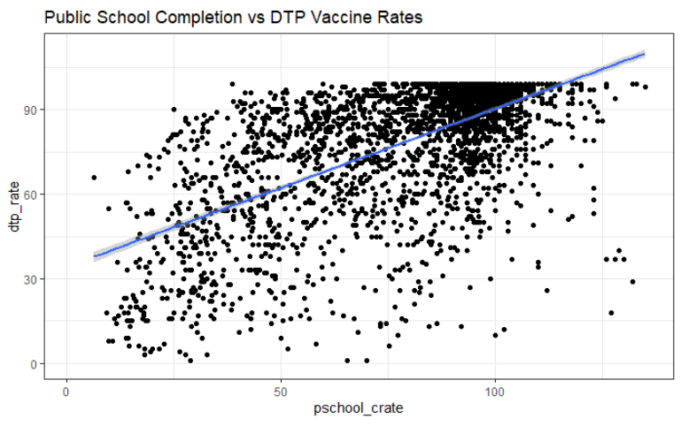
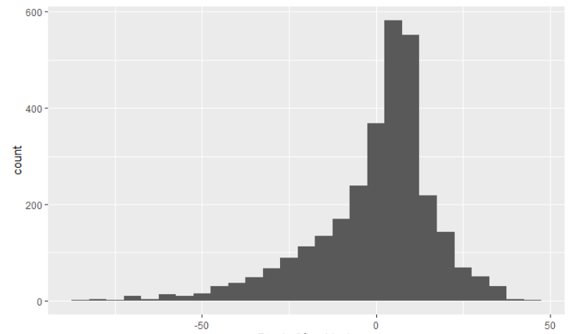
DTP Vaccination Rate, Linear Regression
2989 country year observations
Explanatory Variable: Public School Completion Rate
R -Squared: .40
Normally distributed residuals

Slide 14
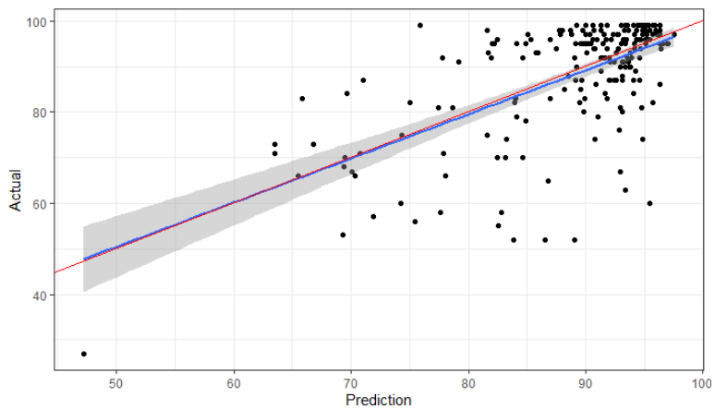
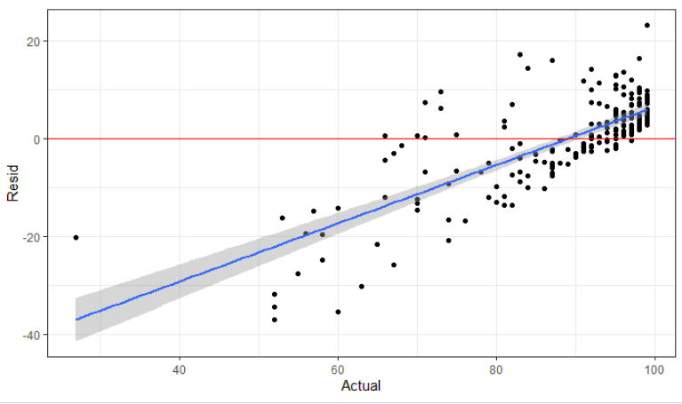
MCV Vaccination Rate, Random Forest
Observations:
Training set: 597
Testing set: 199
Explanatory Variables
Public school completion
Public school expenditure
R-Squared .348
Fails condition of constant variability

Slide 15
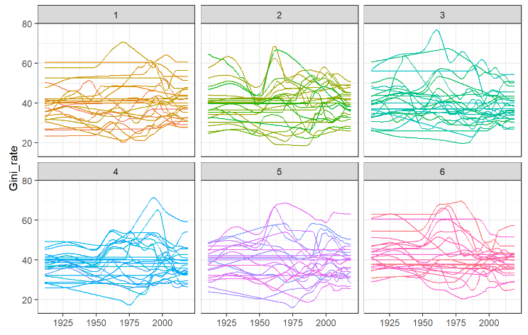
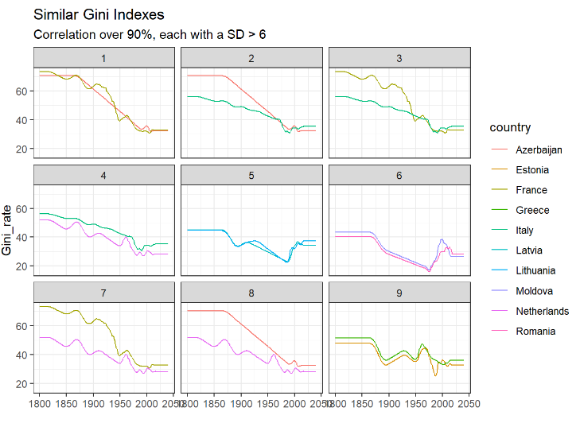
Gini Coefficient
Measure of inequality: higher number implies greater inequality.
Questionable data quality – many countries had consistent value over sample.

Slide 16
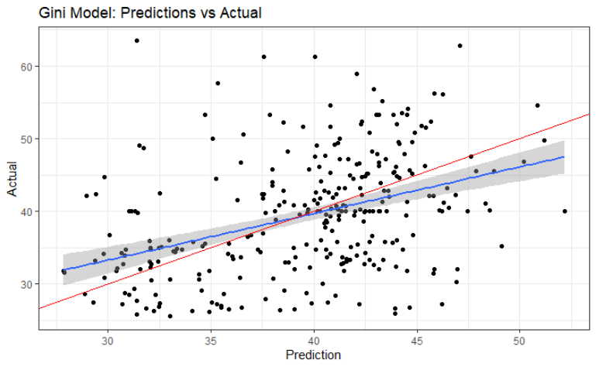
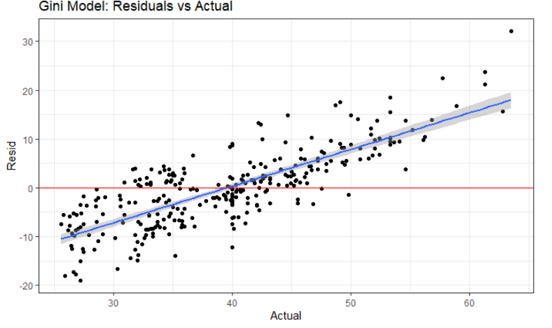
Gini Coefficient, Random Forest
Observations:
Training set: 894
Testing set: 297
Explanatory variables:
Public School Completion
Public School Expenditure
R-Squared: .21
Significantly higher than found in Linear Models

Slide 17
Conclusions
Murder and Suicide:
Expectations: Negative Correlation
Result: Unclear, data does not reflect negative correlation. Likely too much noise in randomness of these isolated events
Vaccination:
Expectations: Positive Correlation
Result: Data reflected positive correlation. Likely to be attributed to rise in rules around mandatory education and vaccination.
Gini Coefficient:
Expectations: negative correlation
Result: Weak positive correlation. Data varied wildly in some countries, was questionably static in others.

