Slide 1


LOGIC-BASED AI FOR NATURAL LANGUAGE
Hugolin Bergier
Datacraft*
11 juillet 2022

Slide 2
LOGIC-BASED AI FOR NLP
Logic-based AI for NLP at the crossroad of:
Logic Programming (Prolog)
Machine Learning (ILP)
Symbolic Logic (Classical and Non-classical logic)
Natural Language Processing (describing and reasoning)
Logic Programming
Machine Learning
Logic-based AI for NLP
Symbolic Logic
Natural Language processing

Slide 3
LOGIC PROGRAMMING
A brief history of Logic Programming
Aristotle’s De Interpretatione (340 B.C.)
Frege’s Grundgesetze (1893)
Gödel’s Incompleteness Theorems (1931)
Robinson’s Resolution Principle (1965)
Prolog (1972)
Logic Programming
Logic-based AI for NLP

Slide 4
LOGIC PROGRAMMING
Deductive inference
Rules + Facts => (new) inferred Facts
Rules + Facts
Theory
Prolog program
Logic database
Example of Rule:
‘All men are mortal’
In Prolog: mortal(X) :- man(X).
Examples of Fact:
‘Socrates is a man’
In Prolog: man(socrates).
Example of inferred fact:
‘Socrates is mortal’
In Prolog: ?- mortal(socrates) true.
Theory
Logic Programming
Rules
Facts
Deductive reasoning
Inferred
Facts

Slide 5

LOGIC PROGRAMMING
Deductive inference
Rules + Facts => (new) inferred Facts
Rules + Facts
Theory
Prolog program
Logic database
Example of Rule:
‘All men are mortal’
In Prolog: mortal(X) :- man(X).
Examples of Fact:
‘Socrates is a man’
In Prolog: man(socrates).
Example of inferred fact:
‘Socrates is mortal’
In Prolog: ?- mortal(socrates) true.

Slide 6
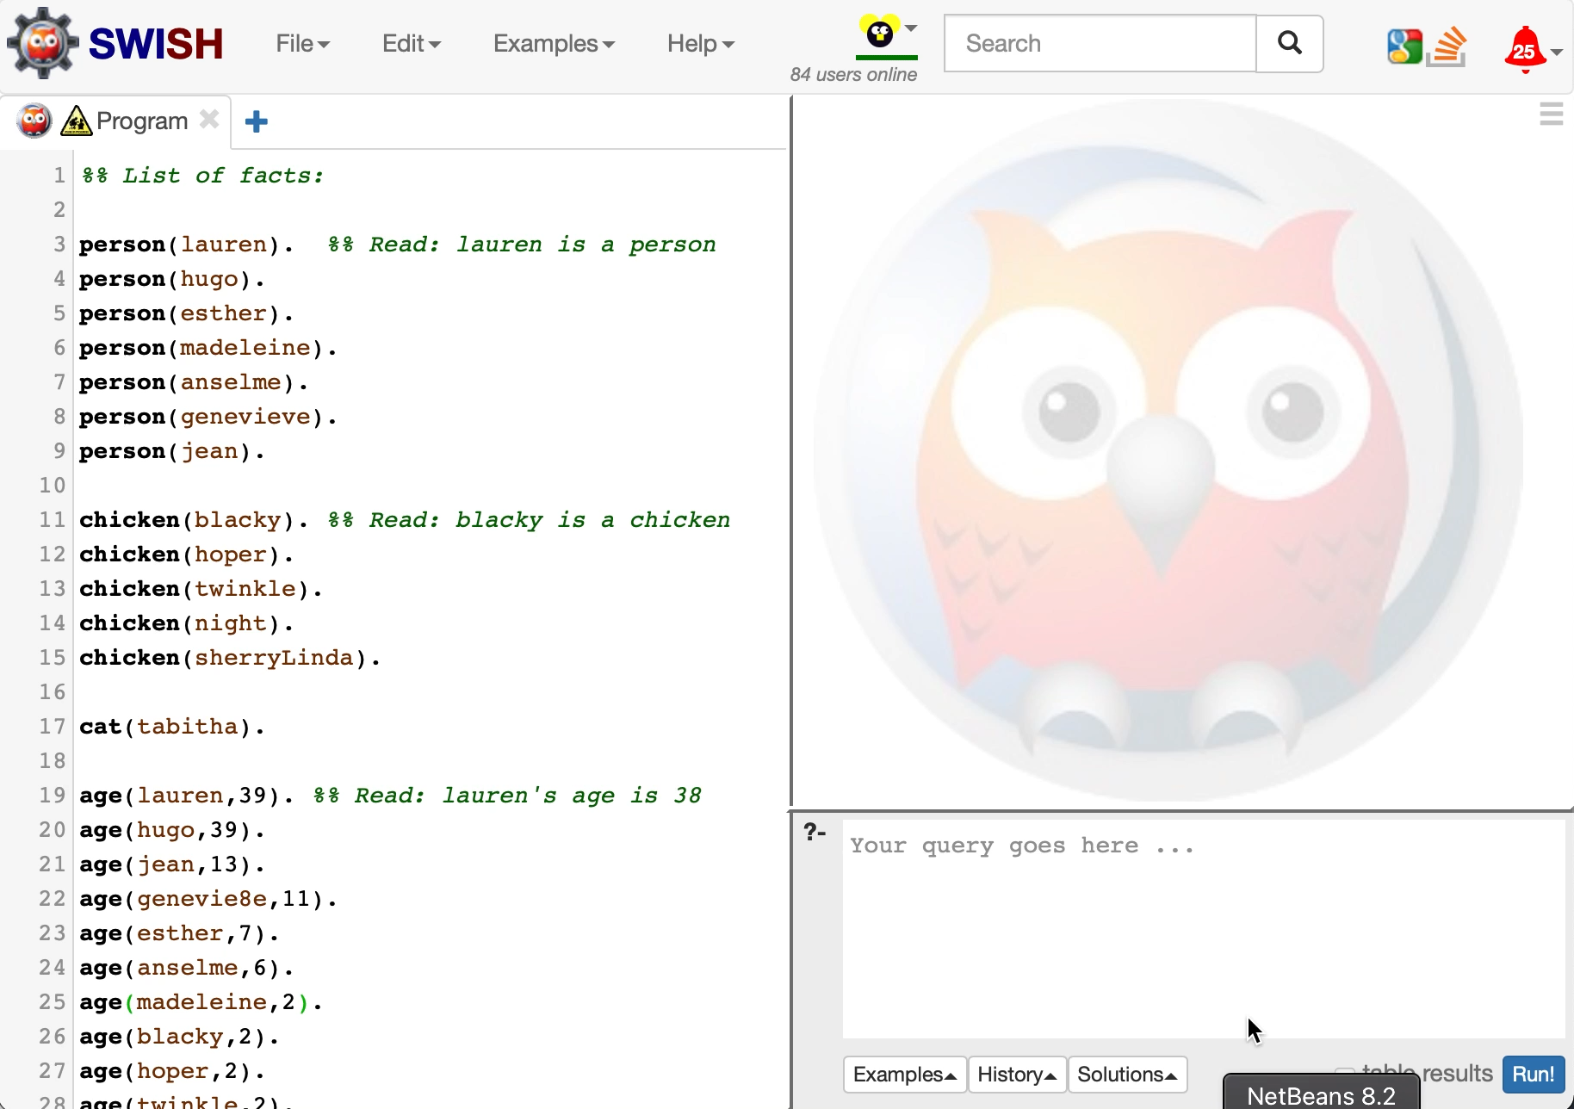
LOGIC PROGRAMMING HANDS ON
Exercise 1: taxonomy
Facts
Jena is a canary
Pigo is a fish
Rules
Birds lay eggs
Fish lay eggs
Canaries are birds
Query
Is Pigo a fish?
Does Jena lay eggs?
What are all the egg layers?
Exercise 2: genealogy
Facts
male/1 ; female/1 ; parent/2
Rules
father/2 ; mother/2 ; brother/2 ; sister/2 ; uncle/2 ; aunt/2 ; grandfather/2 ; grandmother/2 ; cousin/2
Exercise 3: pets
Download pets_missingRule.pl and write the rule illogical_owner/2

Slide 7
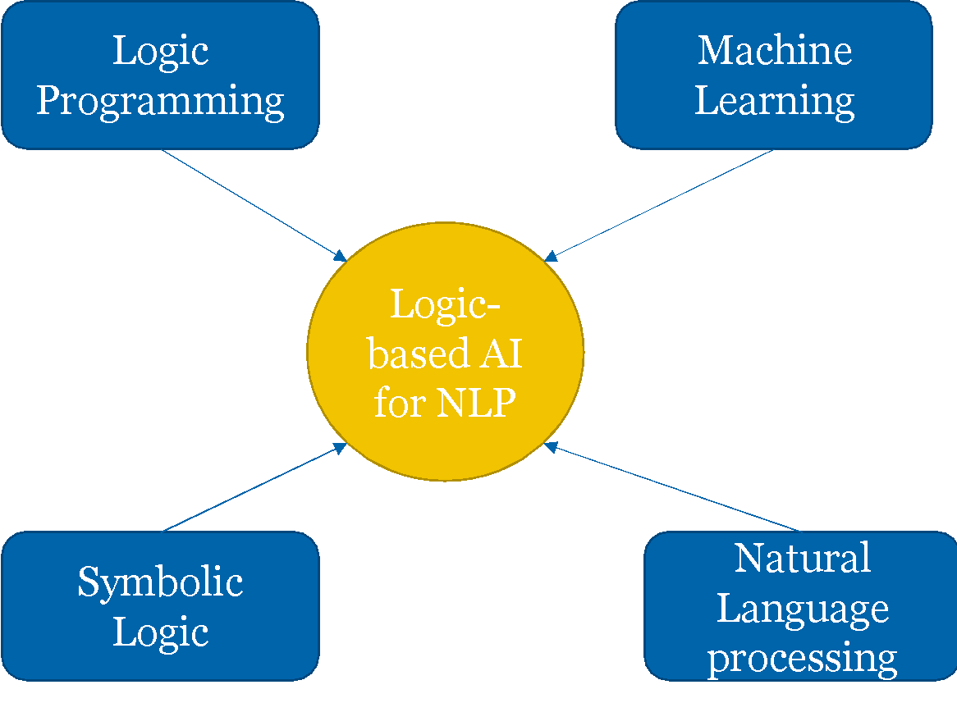
LOGIC PROGRAMMING AND ML
Logic programming has some limited learning capabilities
Inferred facts are learned over the knowledge base and can be persisted into memory (assertion)
But it is not learning in the sense of machine learning
Prolog is purely deductive while ML is inductive
Prolog starts with highly structured data and concepts while ML starts from raw empirical data
No positive / negative examples to learn from
Where does ML fit into the logic programming picture? 3 possible answers:
ML and logic programming are radically different and incompatible approaches of AI.
ML and logic programming are complementary approaches of AI in the order of abstraction from raw unstructured data to conceptualized knowledge.
ML exists in the logic paradigm if we, instead of deducing facts from rules, we induce rules from facts.
Theory
Rules
Facts
Deductive reasoning
Inferred
Facts

Slide 8
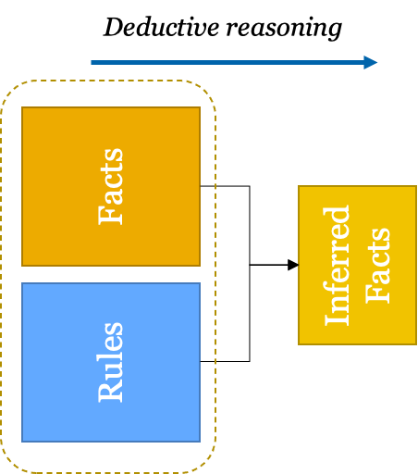
LOGIC PROGRAMMING AND ML TWO COMPLEMENTARY METHODS
Where does ML fit into the logic programming picture? 3 possible answers:
ML and logic programming are radically different and incompatible approaches of AI.
ML and logic programming are complementary approaches of AI in the order of abstraction from raw unstructured data to conceptualized knowledge.
ML exists in the logic paradigm if we, instead of deducing facts from rules, we induce rules from facts.
Unstructured data
Machine Learning

Slide 9
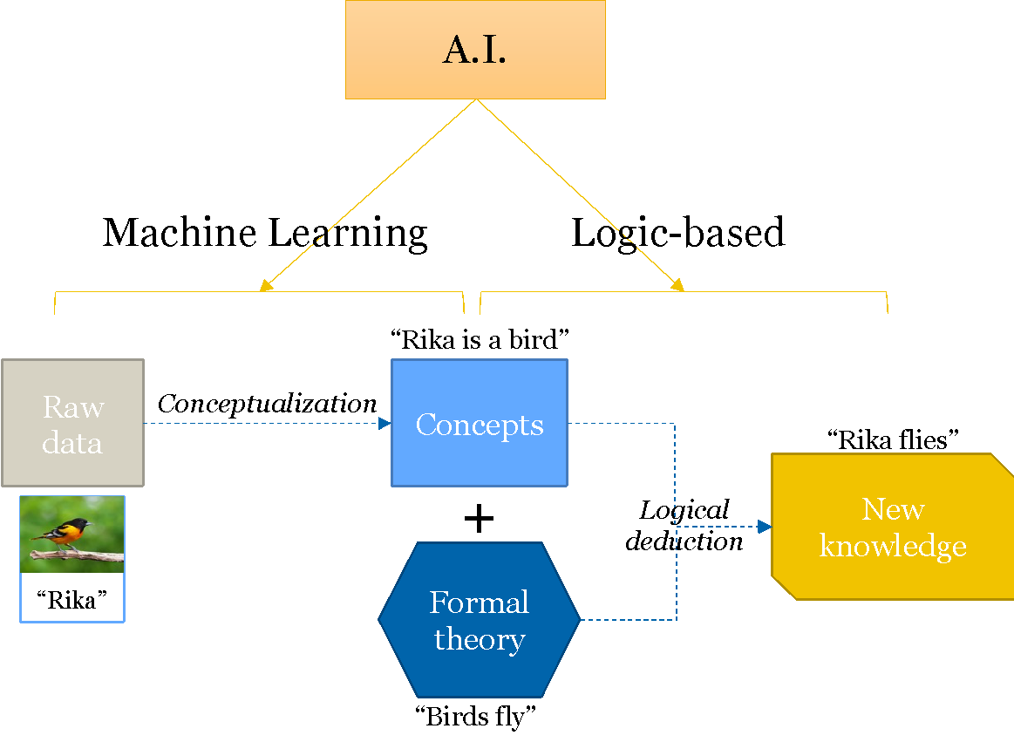
LOGIC PROGRAMMING AND ML TWO COMPLEMENTARY METHODS
Where does ML fit into the logic programming picture? 3 possible answers:
ML and logic programming are radically different and incompatible approaches of AI.
ML and logic programming are complementary approaches of AI in the order of abstraction from raw unstructured data to conceptualized knowledge.
ML exists in the logic paradigm if we, instead of deducing facts from rules, we induce rules from facts.

Slide 10
LOGIC PROGRAMMING AND ML INDUCTIVE LOGIC PROGRAMMING
Where does ML fit into the logic programming picture? 3 possible answers:
ML and logic programming are radically different and incompatible approaches of AI.
ML and logic programming are complementary approaches of AI in the order of abstraction from raw unstructured data to conceptualized knowledge.
ML exists in the logic paradigm if we, instead of deducing facts from rules, we induce rules from facts.
Positive example
Logical
induction

Slide 11
LOGIC PROGRAMMING AND ML INDUCTIVE LOGIC PROGRAMMING
Where does ML fit into the logic programming picture? 3 possible answers:
ML and logic programming are radically different and incompatible approaches of AI.
ML and logic programming are complementary approaches of AI in the order of abstraction from raw unstructured data to conceptualized knowledge.
ML exists in the logic paradigm if we, instead of deducing facts from rules, we induce rules from facts.
Theory
Rules
Facts
Example:
Background knowledge:
bird(jena).
bird(rita).
mammal(nala).
Positive examples:
layEggs(jena).
layEggs(rita).
Negative example;
layEggs(nala).
Induced rule:
layEggs(X) :- bird(X).
Inductive reasoning
Deductive reasoning
Examples
(+ / -)
+
Facts
Background Knowledge

Slide 12
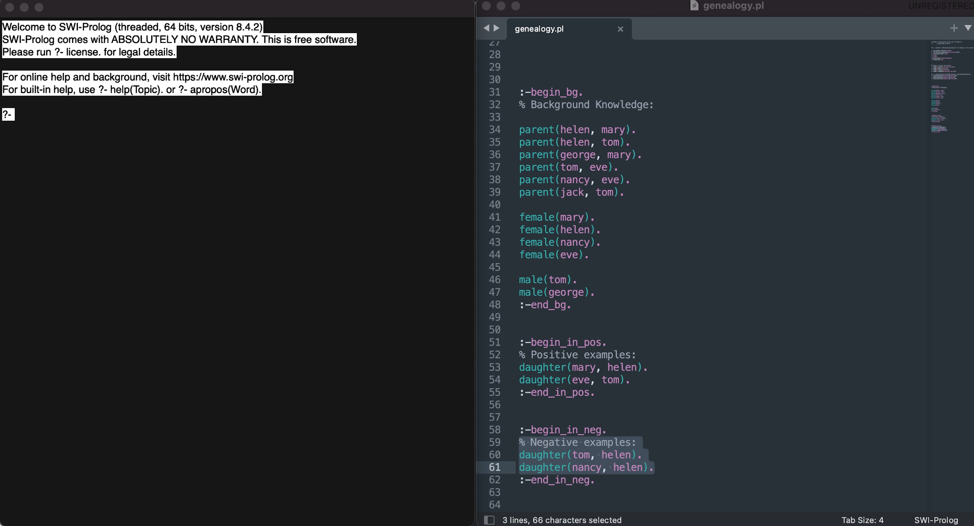
LOGIC PROGRAMMING AND ML INDUCTIVE LOGIC PROGRAMMING
Background knowledge:
parent(helen, mary).
parent(helen, tom).
parent(george, mary).
parent(tom, eve).
parent(nancy, eve).
parent(jack, tom).
female(mary).
female(helen).
female(nancy).
female(eve).
male(tom).
male(george).
Positive examples:
daughter(mary, helen).
daughter(eve, tom).
Negative examples:
daughter(tom, helen).
daughter(nancy, helen).
Induced rule
daughter(A,B) :- parent(B,A), female(A).

Slide 13
LOGIC PROGRAMMING AND ML INDUCTIVE LOGIC PROGRAMMING
Exercise 1: aleph
Download the aleph folder
Uncomment and fix the filepath on line 5
Open SWI and consult the file ‘genealogy.pl’: consult(’YourFilePathHere.pl’).
Execute the induction: induce(’YourFilePathHere.pl’).
Exercise 2: son
Induce the rule for son using the following examples:
Positive examples:
son(tom, helen).
son(tom, jack).
Negative examples:
son(george, helen).
son(eve, tom).
Exercise 3: birds
Operate the induction on ‘birds.pl’
Add two ostriches rita and mila who can’t fly
Operate a new induction – what do you notice?

Slide 14
LOGIC PROGRAMMING AND ML INDUCTIVE LOGIC PROGRAMMING
Exercise 3: birds
Operate the induction on ‘birds.pl’
Add two ostriches rita and mila who can’t fly
Operate a new induction – what do you notice?
Using Generalized Closed-World Specialization to handle exceptions:
?- rdhyp.
|: fly(X).
?- sphyp.
?- show(gcws).
[optional] add the exception rules to the current theory and test with new facts:
addgcws.
assert(hawk(dodo)).
bird(dodo).
fly(dodo).
assert(ostrich(emma)).
bird(emma).
fly(emma).
What do you notice?

Slide 15
LOGIC PROGRAMMING AND MACHINE LEARNING
Theory
Rules
Facts
Inductive reasoning
Deductive reasoning
Examples
(+ / -)
+
Facts
Background Knowledge

Slide 16
LOGIC PROGRAMMING AND NATURAL LANGUAGE
Logic programming (Prolog in particular) is based on classical logic
Classical logic is the main paradigm to formalize propositions and reasoning over them:
Unary Predicate / Arg ≡ Verb / Subject
Ex: “Rita flies”
Binary Predicte / Args ≡ Verb / Subject / Object
Ex: “John likes July”
Logical connectors: and, or, implies
But there are limits
Is predicate logic a good paradigm? What are its limits when it comes to natural language?
Can we faithfully express ordinary language reasoning in Prolog?
Where does the NLP requirement breaks? Facts? Rules?
Think of an automatic extraction of facts and rules from emails, speeches or conversations: where do we risk to see a discrepancy in the model? Is it in the facts? In the rules?

Slide 17
CLASSICAL LOGIC AND THE UNIVERSAL QUANTIFIER
The classical universal quantifier
Purely extensional
Acts on the variable instead of the predicate
No room for atypical objects
No expression of relations between concepts
They don’t fit the actual meaning of generic statements
“Birds fly”
“Pear trees blossom in may”
“Alsaciens are beer drinkers”
Such statements are perfectly valid and can be reasoned upon
Indeed, if you ask someone to represent a bird, he will represent one that flies. So the generic statement is perfectly valid
But if we express them as universally quantified, they generate an inconsistency: ∀x (bird(x) => fly(X)) ; bird(rita) ∧ ¬fly(rita) |= fly(rita) ∧ ¬fly(rita). □
How can we reconcile the natural language reasoning with logic programming?
One solution: Intensional Logic
Universal quantification in classical logic:
∀x (bird(x) => fly(X))
∀x (man(x) => mortal(X))

Slide 18
WHAT IS INTENSIONAL LOGIC?
Ess(Being-bird)
Intension of the concept bird
Essence of the concept bird
The intensional approach assumes the existence of a network of intension (meaning) behind any concept.
We introduce the notion of essence of a concept.
Being-animal
Int(Being-bird)
flying
Laying-eggs
Concept
Being-bird
Typical Object
τ(Being-bird)
δ(Being-ostrich)
δ(Being-canary)
determination
Exp(Being-bird)
canary
ostrich
δ(Being-white)
δ(Being-black)
δ(Being-yellow)
Extension of the concept dog = {Charley, Snoopy, Snowy,…}

Slide 19
WHAT IS INTENSIONAL LOGIC?
Ess(Being-bird)
Intension of the concept bird
Essence of the concept bird
The intensional approach assumes the existence of a network of intension (meaning) behind any concept.
We introduce the notion of essence of a concept.
Flying is not part of the essence of the concept of bird.
Therefore it is acceptable for an object of the expansion to inherit it and another one not to
Being-animal
Int(Being-bird)
flying
Laying-eggs
X
Concept
Being-bird
Typical Object
τ(Being-bird)
δ(Being-ostrich)
δ(Being-canary)
determination
Exp(Being-bird)
canary
ostrich
δ(Being-white)
δ(Being-black)
δ(Being-yellow)
Extension of the concept dog = {Charley, Snoopy, Snowy,…}

Slide 20
WHAT IS INTENSIONAL LOGIC?
Ess(Being-bird)
Intension of the concept bird
Essence of the concept bird
The intensional approach assumes the existence of a network of intension (meaning) behind any concept.
We introduce the notion of essence of a concept.
Flying is not part of the essence of the concept of bird.
Therefore it is acceptable for an object of the expansion to inherit it and another one not to
But all the objects of the expansion inherit the concept of laying eggs
Being-animal
Int(Being-bird)
flying
Laying-eggs
Concept
Being-bird
Typical Object
τ(Being-bird)
δ(Being-ostrich)
δ(Being-canary)
determination
Exp(Being-bird)
canary
ostrich
δ(Being-white)
δ(Being-black)
δ(Being-yellow)
Extension of the concept dog = {Charley, Snoopy, Snowy,…}

Slide 21
AN INTENSIONAL APPROACH ON LOGIC PROGRAMMING
We could include into the Aleph ILP algorithm the intension / essence distinction in order to better fit the natural reasoning
But it would still be a classical (FOPL) framework including:
Universal quantification
Extensional logic
Focusing on the subject/predicate/truth-value.
Instead, we could completely redesign the logic programming into a functional paradigm
More suited for a theory of intension and determination
Demo in Haskell

