Slide 1
INFO6210 Database Management and Database Design
Final Project

Slide 2
Retail Game-Store Management
Shashank Sharad Jain (001880628)

Slide 3

The video game industry is a multi-billion-dollar industry in the United States. There are thousands of companies developing and publishing games in various states throughout the country. Every month hundreds of games are launched across multiple platforms; hence the video game library is ever increasing. It is essential for a store which deals with video games and its related products to have a robust, well-constructed database so as to function properly. Thus, the presented database system is a complete normalized system which deals with sales and delivery of games, consoles and personal computers specially made for gaming purposes.

Slide 4
ER Diagram

Slide 5
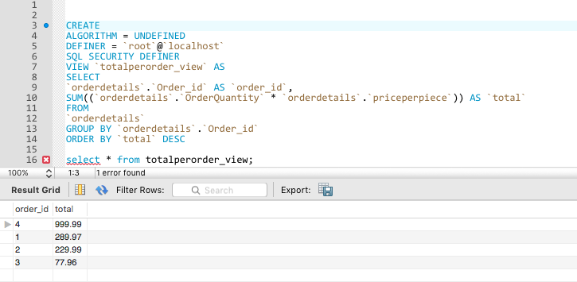
View 1: To see Total bill per order per customer.

Slide 6
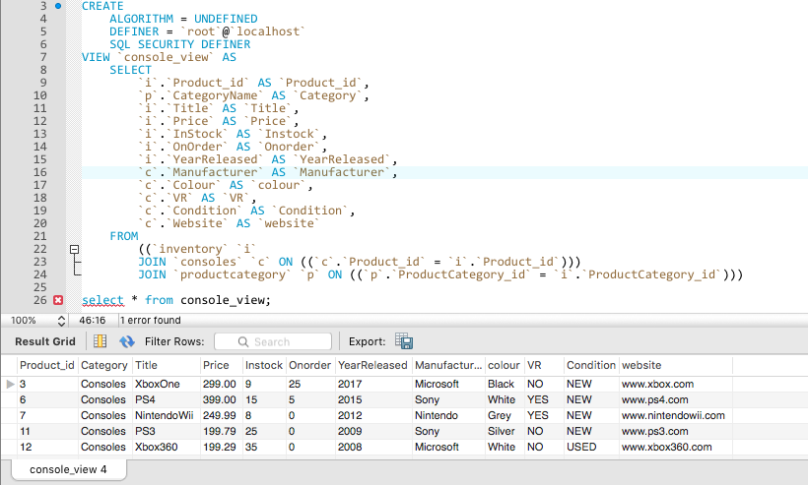
View 2: To see all the available details for Consoles only.

Slide 7
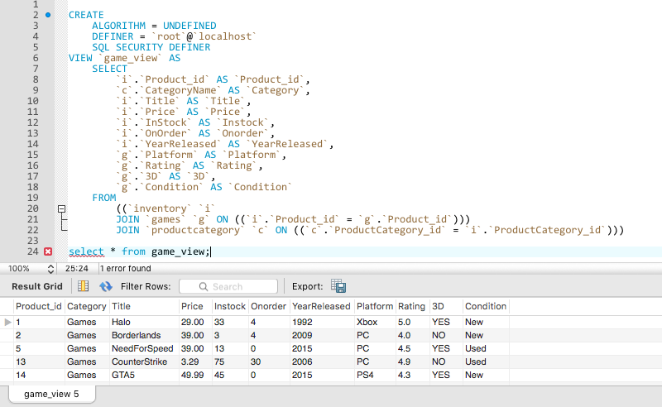
View 3: To see all the available details for games only.

Slide 8
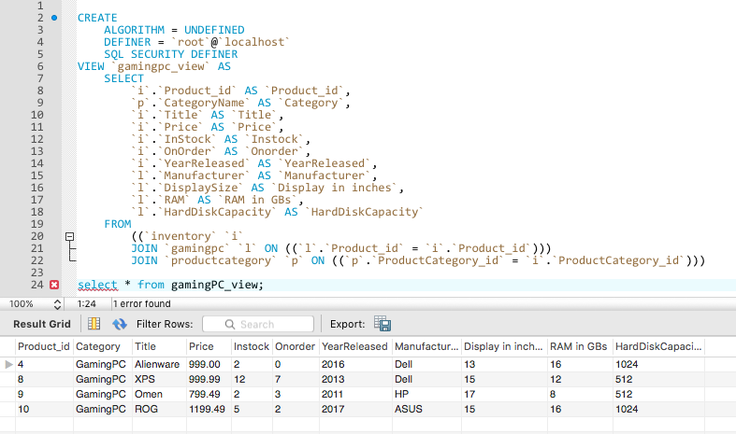
View 4: To see all the available details for gamingPCs only.

Slide 9
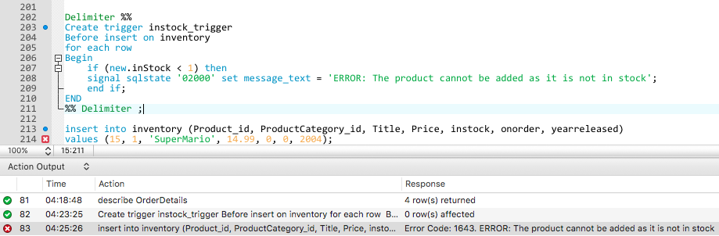
Trigger: Used a type of a validator.

Slide 10
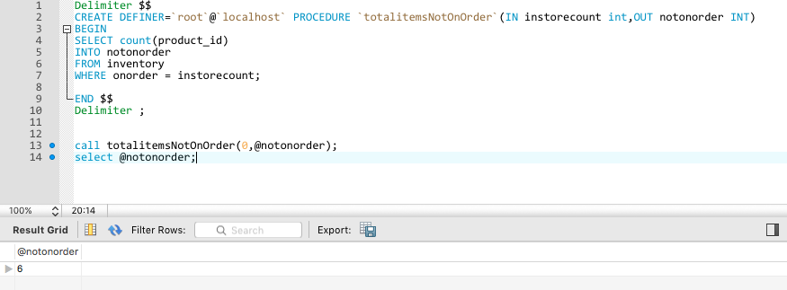
Stored Procedure 1: Used to see all the items that are out of stock.

Slide 11
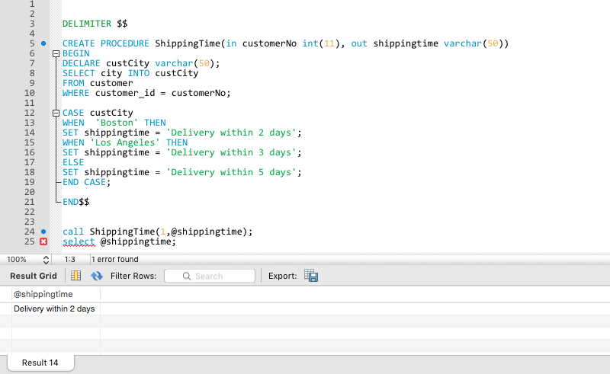
Stored Procedure 2: To check delivery time based on customer’s location.

Slide 12
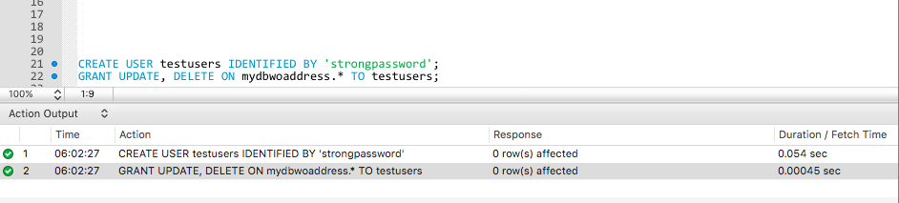
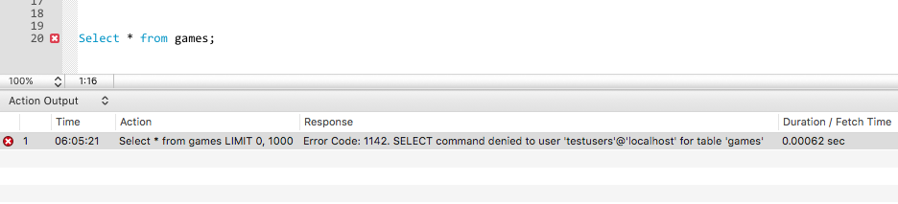
User Access: Created a user to test grants and privileges.

Slide 13
Thank you!

