Slide 1

BAYESIAN
Truong Nguyen Duy Khang
Nguyen Duc Huy
Nguyen Truong
Posterior $=\frac{likelihood ∗ prior}{evidence}$

Slide 2
Bayesian and Frequentist
Naive Bayes Classifier
Markov chain Monte Carlo
Metropolis-Hasting
Gibbs sampling
Demo
Bayesian components
Conjugate distribution
Maximum Likelihood and Posterior

Slide 3
Bayesian and Frequentist
Naive Bayes Classifier
Markov chain Monte Carlo
Metropolis-Hasting
Gibbs sampling
Demo
Bayesian components
Conjugate distribution
Maximum Likelihood and Posterior

Slide 4

Bayesian and frequentist
Two possible outcomes:
Head (H)
Tail (T)
Frequentist:
50% head and 50% tail
Bayesian:
50% is just a subjective measurement of uncertainty

Slide 5
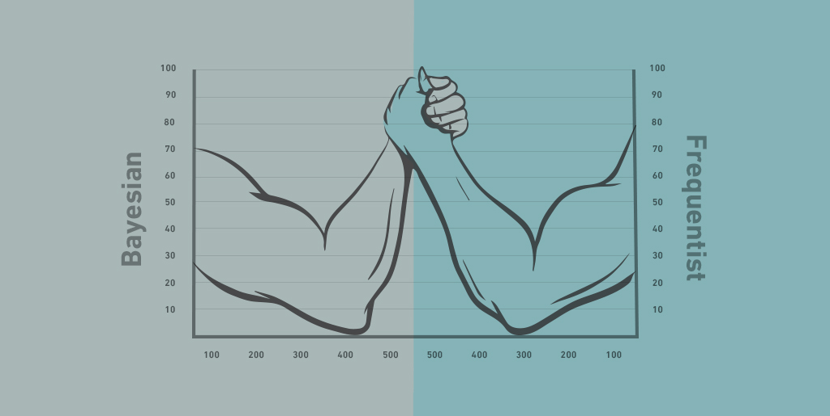
Bayesian and frequentist
SportStatist.com
Bayesian:
Prior distribution
Frequentist:
Significance level, p-value

Slide 6

Bayesian and frequentist
Sunghae Jun - Frequentist and Bayesian Learning Approaches to Artificial Intelligence

Slide 7


Bayesian components
$$p\left(θ | x\right)= \frac{p(x|θ) p(θ)}{p(x)}$$
Posterior $=\frac{likelihood ∗ prior}{evidence}$

Slide 8
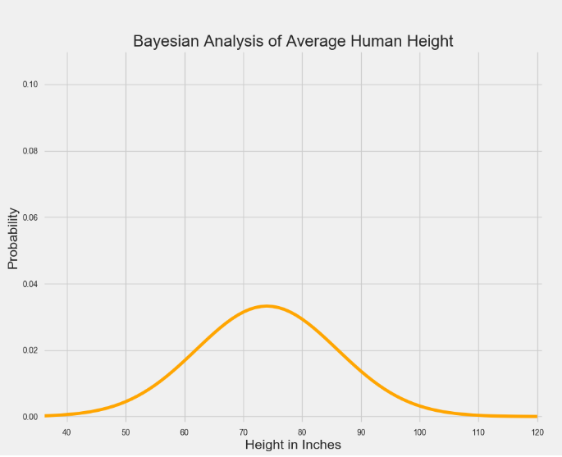
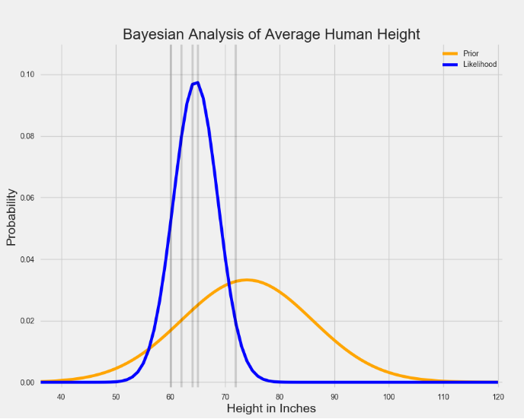
Bayesian components
Ben Shaver
Ben Shaver
Most likely average adult height is 73 inches
Observed data show 64 inches

Slide 9
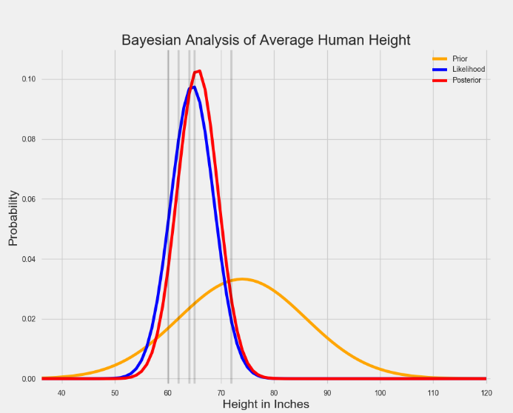
Bayesian components
Prior distribution is shorter and more spread out → Less sure of belief about true value
Likelihood summarizes data within narrow range → More sure guess about true value
Prior and likelihood combined → convinced by data with weak prior
If prior and likelihood distribution weren’t so well-behaved
Ben Shaver

Slide 10
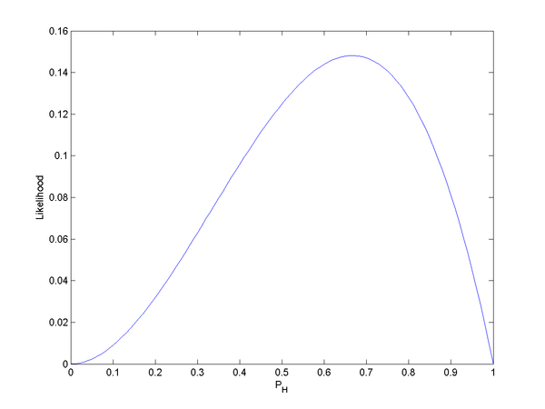

Maximum likelihood
Likelihood Function:
L(θ:D) = P(D|θ) = $\prod_{m}{P(x[m]|\text{θ})}$ (Product Function)
L(θ:D) = P(D|θ) = $\sum_{m}{ln⁡(P\left(x\left[m\right] | \text{θ}\right))}$ (Sum Function)
Maximum Likelihood Estimation:
Choose parameters that maximize the likelihood function
Most commonly used estimators in statistics
Notes:
Θ là xác suất thành công của một sự kiện
m là số mẫu xảy ra

Slide 11

Maximum likelihood
Probability density of observing a single data point x, that is generated from a Gaussian distribution is given by:
P(x; μ,σ) = $\frac{1}{\text{σ}\text{∗}\text{sqrt}\text{(2}π)}∗exp⁡(−\frac{{(x−\text{μ})}^{2}}{2{\text{σ}}^{2}}$)
Find Maxima of this function by differentiation.
Take ln for easier differentiation
(ln(P(x; μ,σ)) dμ = $\frac{1}{{\text{σ}}^{2}}(\sum_{m}{x}$ – mμ) → Do the same with $\text{σ}$
Notes:
Θ là xác suất thành công xảy ra của một sự kiện
m là số mẫu xảy ra
X là giá trị các mẫu

Slide 12

Maximum A posterior
Model form of Bayes’ Theorem:
P(A|B) = $\frac{\text{P}\text{(}\text{B}\text{|}\text{A}\text{)}\text{xP}\text{(}\text{A}\text{)}}{P(B)}$
Let event A as θ, represent for μ and σ, θ = {μ,σ}
Let event B as data collection {x1, x2, x3, ...}
Notes:
P(theta):
P(data):
Nếu chỉ quan tâm đến điểm ngưỡng mà phân bố đạt đến, k phải quan tâm đến phân bố đó có được chuẩn hóa hay không
Alpha: Tỉ lệ với

Slide 13


Maximum A posterior
Model form of Bayes’ Theorem:
→ P(θ|data) = $\frac{\text{P}\text{(}\text{data}\text{|}\text{θ}\text{)}\text{xP}\text{(}\text{θ}\text{)}}{P(data)}$
P(θ|data): posterior distribution
$\text{P}\text{(}\text{data}\text{|}\text{θ}\text{)}$: likelihood distribution
$\text{P}\text{(}\text{θ}\text{)}$: prior distribution
P(data): Evidence
→ P(θ|data) α $\text{P}\text{(}\text{data}\text{|}\text{θ}\text{)}\text{xP}\text{(}\text{θ}\text{)}$
Notes:
P(theta):
P(data):
Nếu chỉ quan tâm đến điểm ngưỡng mà phân bố đạt đến, k phải quan tâm đến phân bố đó có được chuẩn hóa hay không
Alpha: Tỉ lệ với

Slide 14
Maximum A posterior
Different from Maximum Likelihood:
Posterior has the P(θ)
Weighted with some weight coming from the prior
MAP will be equal to ML if we assigned equal weight everywhere, eg: uniform distribution
ML is a special case of MAP
Notes:
P(theta):
P(data):
Nếu chỉ quan tâm đến điểm ngưỡng mà phân bố đạt đến, k phải quan tâm đến phân bố đó có được chuẩn hóa hay không
Alpha: Tỉ lệ với

Slide 15
Maximum A posterior
Maximum Posterior can be calculated by:
Conjugate priors
Derivatives → Conjugate gradient
Monte Carlo Method
…
Notes:
P(theta):
P(data):
Nếu chỉ quan tâm đến điểm ngưỡng mà phân bố đạt đến, k phải quan tâm đến phân bố đó có được chuẩn hóa hay không
Alpha: Tỉ lệ với

Slide 16
Conjugate distribution
Posterior P(θ|data) in the same probability distribution family as prior P(θ) → Conjugate distribution
Prior P(θ) is called conjugate prior for likelihood function
Notes:
P(theta):
P(data):
Nếu chỉ quan tâm đến điểm ngưỡng mà phân bố đạt đến, k phải quan tâm đến phân bố đó có được chuẩn hóa hay không
Alpha: Tỉ lệ với

Slide 17
Conjugate distribution
Common types of Conjugate distribution for likelihood’s discrete distribution:
Beta distribution → Conjugate prior for binomial, Bernoulli, Geometric distribution
Normal distribution → self-conjugate
Gamma distribution → Poisson
Dirichlet distribution → Categorical, Multinomial
…
Notes:
(Likelihood function is binomial, prior is beta → posterior is beta)

Slide 18
Conjugate distribution
Common types of Conjugate distribution for likelihood’s continuous distribution:
Gamma distribution → Exponential,Gamma
Normal distribution → self-conjugate, log-normal
Wishart distribution → Multivariate normal
…
Notes:
(Likelihood function is binomial, prior is beta → posterior is beta)

Slide 19
Bayesian and Frequentist
Naive Bayes Classifier
Markov chain Monte Carlo
Metropolis-Hasting
Gibbs sampling
Demo
Bayesian components
Conjugate distribution
Maximum Likelihood and Posterior

Slide 20


Naive bayes claSsifier
Classification problem:
C different classes, find the label of each data point x $∈$ $R^{d}$
Solve: find the label $→$ find p(c|x)
Optimization: ]
c = argmax p(c|x)
c $∈${1,…,C)

Slide 21


Naive bayes claSsifier
Bayesian rule:
$P\left(y | x\right)= \frac{P(x|y) P(y)}{P(x)}$
Apply Bayesian rule to convert into:
$$p\left(c | x\right)= \frac{p(x|c) p(c)}{p(x)}$$
for c = 1, 2,...,C

Slide 22
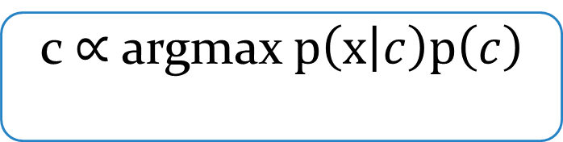

Naive bayes claSsifier
Problem:
c = argmax p(c|x) = argmax $\frac{p(x|c) p(c)}{p(x)}$
p(x) independent with c $→$
c
c
c $∝$ argmax $p\left(x | c\right)p\left(c\right)$
c

Slide 23

Naive bayes claSsifier
p(c) : probability to any point falls into class c
Maximum likelihood estimation (MLE)
p(c) $=\frac{\text{number} \text{of} \text{points} \text{of} \text{class} \text{c}}{\text{number} \text{of} \text{points} \text{in} \text{the} \text{training} \text{set}}$

Slide 24

Naive bayes clasSifier
$p(x|c)$ : distribution of data point in class c
Assume: features of random variable x are independent (Naive)
p(x|c) = p($x_{1}$, $x_{2}$,…, $x_{d}$|c) = $\prod_{i=1}^{d}{p(}x_{1}$|c)
= p($x_{1}$|c) * p($x_{2}$|c) * … * p($x_{d}$|c)

Slide 25

Naive bayes clasSifier
New data point:
c = argmax p(c) $\prod_{i=1}^{d}{p(}x_{i}$|c)
$c_{0}$ = log c
= argmax {log[p(c)] + $\sum_{i=1}^{d}{log⁡[p\left(x_{i}\text{|}\text{c}\right)]}$}
c

Slide 26
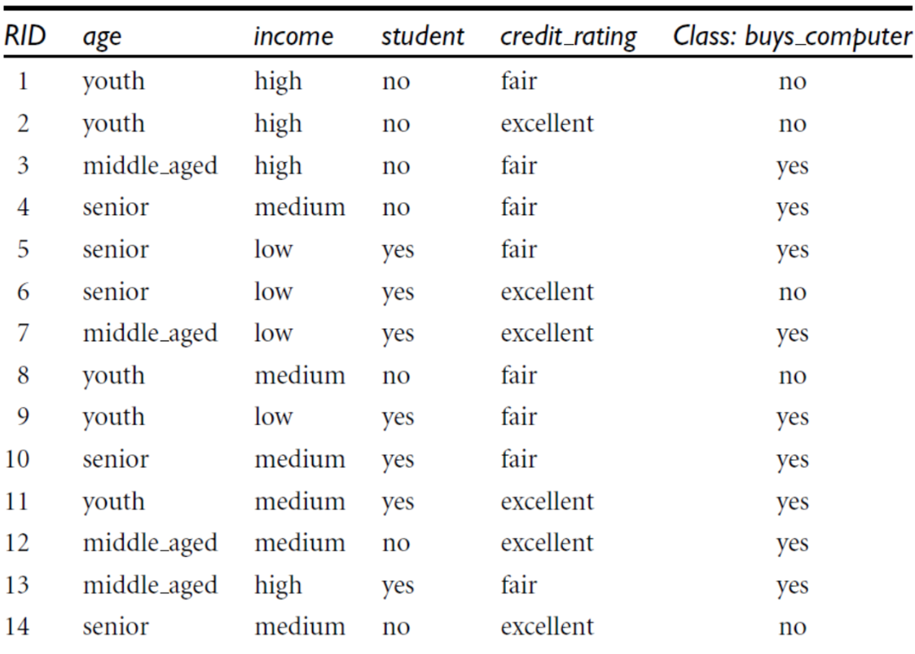
Naive bayes clasSifier
Example: Electronics customer database

Slide 27
Naive bayes clasSifier
Classify data:
X = (age = youth, income = medium,
student = yes, credit_rating = fair)
2 classes: “yes” and “no”
We maximize: p(C|X)
p(buys_computer = yes | age = youth, income = medium,
student = yes, credit_rate = fair)
p(buys_computer = no | age = youth, income = medium,
student = yes, credit_rate = fair)

Slide 28

Naive bayes claSsifier
p (buys_computer = yes) = 9/14 = 0.643 - p (C) -
p (buys_computer = no) = 5/14 = 0.357
p (age = youth | buy_computer = yes) = 2/9 = 0.222 - p ($x_{i}$|c) -
p (age = youth | buy_computer = no) = 3/5 = 0.6
p (income = medium | buy_computer = yes) = 4/9 = 0.444
p (income = medium | buy_computer = no) = 2/5 = 0.4
p (student = yes | buy_computer = yes) = 6/9 = 0.667
p (student = yes | buy_computer = no) = 1/5 = 0.2
p (credit_rating = fair | buy_computer = yes) = 6/9 = 0.667
p (credit_rating = fair | buy_computer = no) = 1/5 = 0.4

Slide 29
Naive bayes clasSifier
Example: Electronics customer database

Slide 30

Naive bayes claSsifier
p (X | buys_computer = yes) = P (age = youth | buy_computer = yes) x
P (income = medium | buy_computer = yes) x
P (student = yes | buy_computer = yes) x
P (credit_rating = fair | buy_computer = yes) x
= 0.222 x 0.444 x 0.667 x 0.667 = 0.044
p (X | buys_computer = no) = 0.6 x 0.4 x 0.2 x 0.4 = 0.019
p (X | buys_computer = yes) x p (buys_computer = yes) = 0.044 x 0643 = 0.028
p (X | buys_computer = no) x p (buys_computer = no) = 0.019 x 0.357 = 0.007
$→$ X $∈$class “Yes”

Slide 31
Naive bayes clasSifier
Another bayes problem:
Classify data:
X = (age = 35, income = medium,
student = no, credit_rating = fair) ?
Age | Income | Student | Credit-rating | Buys-computer
24 | High | No | Fair | No
32 | High | No | Fair | Yes
47 | Low | Yes | Excellent | No
44 | Medium | Yes | Fair | Yes
39 | High | Yes | Fair | Yes
21 | Medium | No | Fair | No
48 | Medium | No | Excellent | No

Slide 32
Naive bayes clasSifier
Zero probability handle
Laplacian correction
Distribution: - Gaussian naïve Bayes
- Multinomial naïve Bayes
- Bernoulli Naïve Bayes

Slide 33
Naive bayes clasSifier
Laplacian correction
Suppose a dataset with 1000 tuples, income = low (0), income = medium (990), income = high (10).
Use Laplacian correction (or Laplacian estimator)
Adding 1 to each case:
p (income = low) = 1/1003
p (income = medium) = 991/1003
p (income = high) = 11/1003

Slide 34

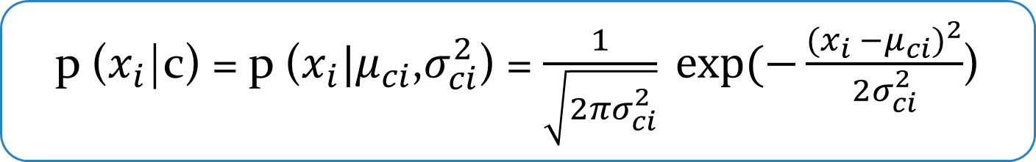
Naive bayes clasSifier
Gaussian naïve Bayes
With any dimension i, X follows a distribution of expectation $μ_{ci}$ and variance $σ_{ci}^{2}:$
($θ=\{μ_{ci}\text{,}σ_{ci}^{2}\}$ is determined by MLE based on data points of training set of each class C)
p ($x_{i}$|c) = p ($x_{i}|μ_{ci}$,$σ_{ci}^{2}$) = $\frac{1}{\sqrt{2πσ_{ci}^{2}}} exp⁡(−\frac{{(x_{i} −μ_{ci})}^{2}}{2σ_{ci}^{2}}$)

Slide 35

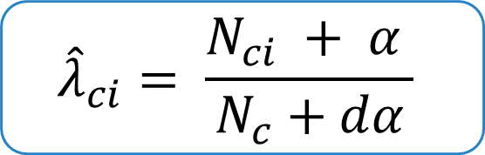
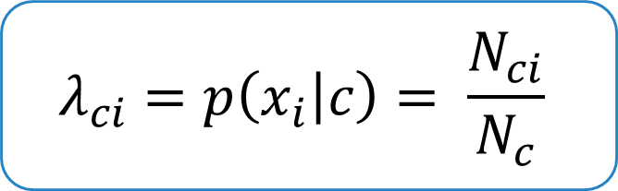
Naive bayes clasSifier
Multinomial naïve Bayes
Using for documents classify. p ($x_{i}$|c) proportional to frequency of i-th word appearing in the document of class c
With zero probability:
$$λ_{ci}=p\left(x_{i} | c\right)= \frac{N_{ci}}{N_{c}}$$
$${\hat{λ}}_{ci}= \frac{N_{ci} + α }{N_{c}+dα}$$

Slide 36
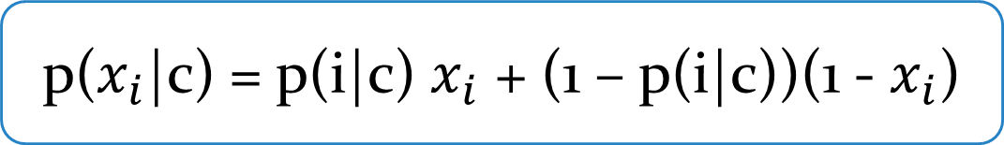
Naive bayes clasSifier
Bernoulli naïve Bayes
Using for data with value is binary: 0 or 1.
Ex: with document, we care about if a word exists or not
p(i|c): probability of the i-th word appearing in documents of class c
p($x_{i}$|c) = p(i|c) $x_{i}$ + (1 – p(i|c))(1 - $x_{i}$)

Slide 37

Naive bayes clasSifier
Example: Text classify
V = {hanoi, pho, chaolong, buncha, omai, banhgio, Saigon, hutiu, banhbo}
2 classes: p(B) = $\frac{3}{4}$, p(N) = $\frac{1}{4}$
 | Text | Content | Class
Training set | d1 | hanoi pho chaolong hanoi | B
 | d2 | hanoi buncha pho omai | B
 | d3 | pho banhgio omai | B
 | d4 | saigon hutiu banhbo pho | N
Test | d5 | hanoi hanoi buncha hutiu | ?

Slide 38
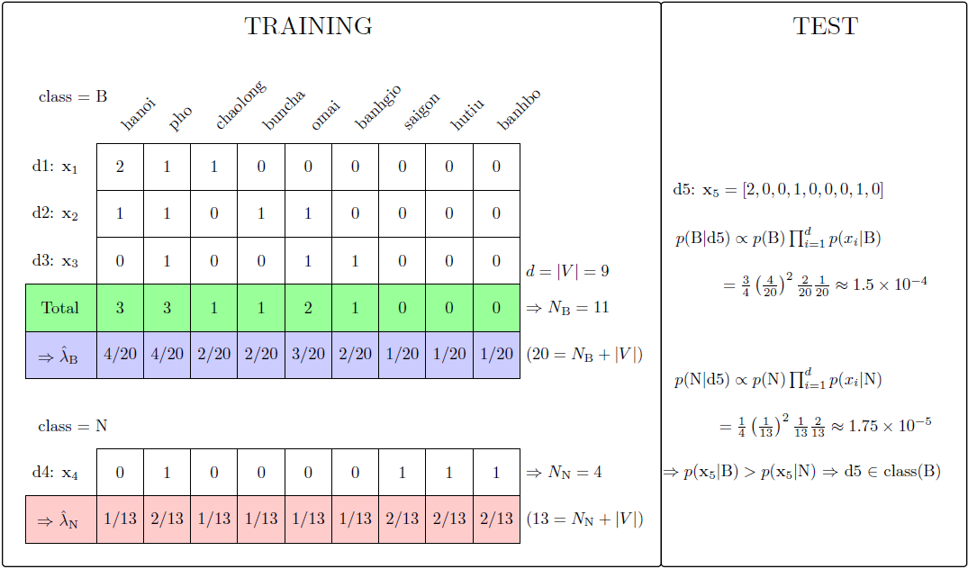

Slide 39
Naive bayes clasSifier
Naïve Bayes classifiers (NBC) is often used in document classify
Fast to training and testing (due to independent assume)
NBC can operate with continuous feature vector (Gaussian distribution) or discrete feature vector (Multinomial or Bernoulli distribution)
Zero probability handling

Slide 40
Bayesian and Frequentist
Naive Bayes Classifier
Markov chain Monte Carlo
Metropolis-Hasting
Gibbs sampling
Demo
Bayesian components
Conjugate distribution
Maximum Likelihood and Posterior

Slide 41
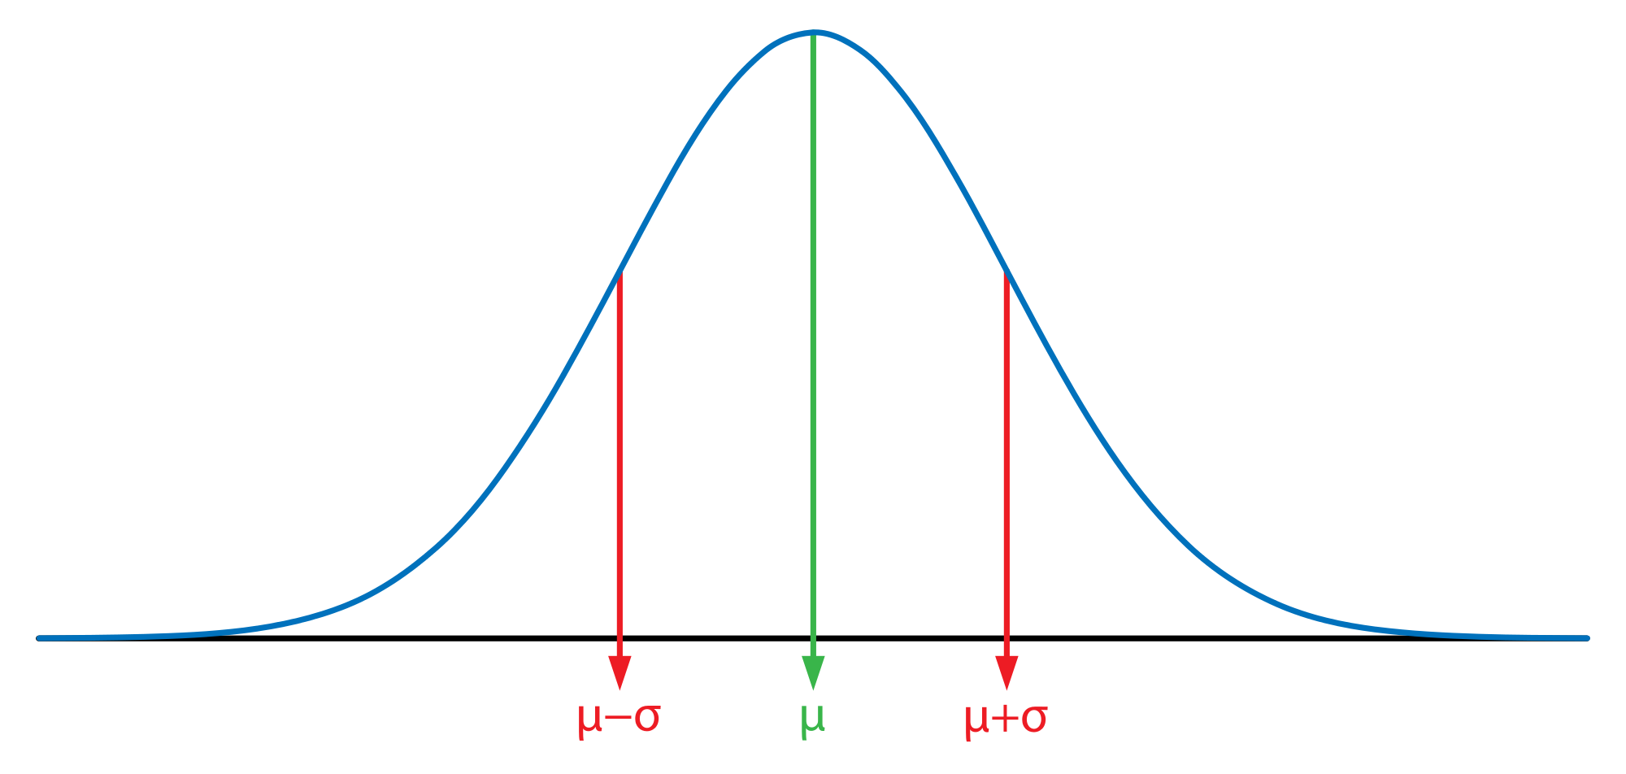
Markov chain monte carlo
“MCMC methods are used to approximate the posterior distribution of a parameter of interest by random sampling in a probabilistic space” ¹

Slide 42
Markov chain monte carlo
Ben Shaver
Ben Shaver
Most likely average adult height is 73 inches
Observed data show 64 inches

Slide 43
Markov chain monte carlo
Prior distribution is shorter and more spread out → Less sure of belief about true value
Likelihood summarizes data within narrow range → More sure guess about true value
Prior and likelihood combined → convinced by data with weak prior
If prior and likelihood distribution weren’t so well-behaved
Ben Shaver

Slide 44
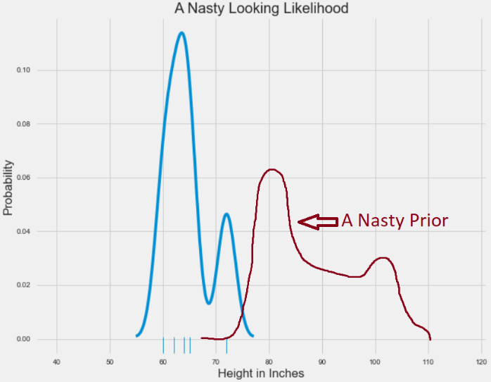
Markov chain monte carlo
Likelihood distribution was represented with two peaks
Wacky prior distribution
Impossible to solve for analytically → Enter MCMC method
MCMC allows to estimate shape of a posterior distribution in case we can’t compute it directly
Ben Shaver

Slide 45
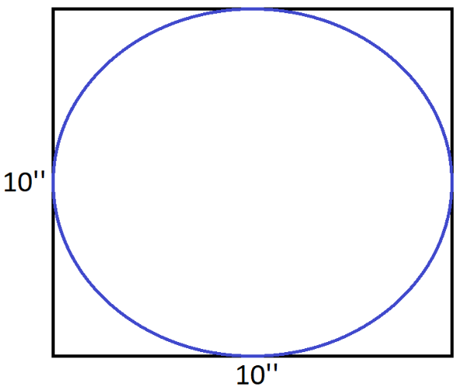
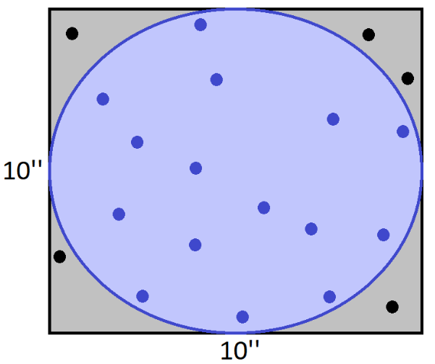
Markov chain monte carlo
Ben Shaver
Ben Shaver
S_{circle} = 3.14 * 5² = 78.5
S_{circle} = 15/20 * 100 = 75

Slide 46
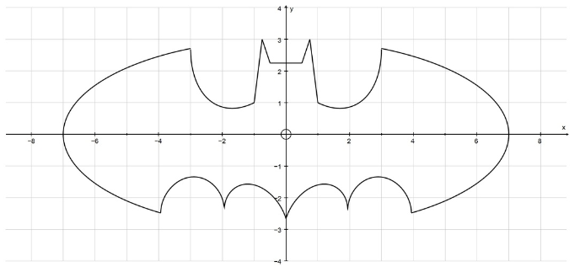
Markov chain monte carlo
Drop points randomly inside a rectangle containing Batman shape → Area
Model very complicated processes
Ben Shaver

Slide 47
Markov chain monte carlo
Sequence of random variables X₁, X₂, …, X_{n}, probability of the entire sequence:
p(X₁, X₂, …, X_{n}) = p(X₁).p(X₂|X₁).p(X₃|X₂, X₁)….p(X_{n}|X_{n-1}, X_{n-2}, …, X₂, X₁) (1)
Markov property: The future is independent of the past given present
p(X_{t+1}|X_{t}, X_{t-1}, …, X₂, X₁) = p(X_{t+1}|X_{t})
(1) → p(X₁, X₂, …, X_{n}) = p(X₁).p(X₂|X₁).p(X₃|X₂).p(X₄|X₃). ….p(X_{n}|X_{n-1})

Slide 48
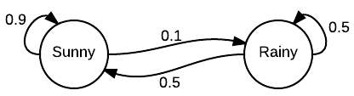
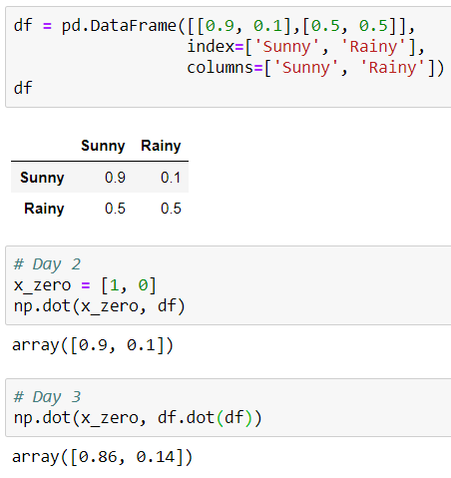
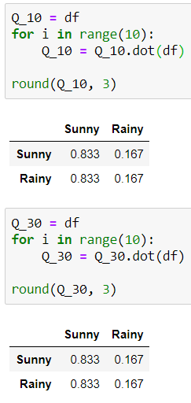
Markov chain monte carlo
Weather on day 1 is know to be sunny, probability vector:
x⁽⁰⁾ = [1, 0]
Weather on day 2 can be predicted by:
x⁽¹⁾ = x⁽⁰⁾P
Weather on day 3 can be predicted by:
x⁽²⁾ = x⁽¹⁾P = x⁽⁰⁾P²
General rule:
x^{(n)} = x⁽⁰⁾P
Stationary distribution

Slide 49
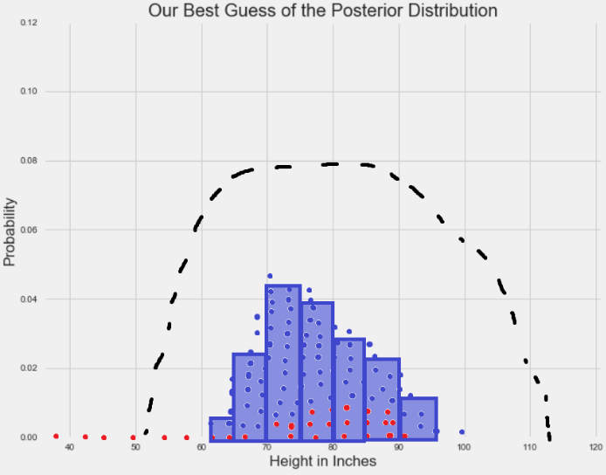
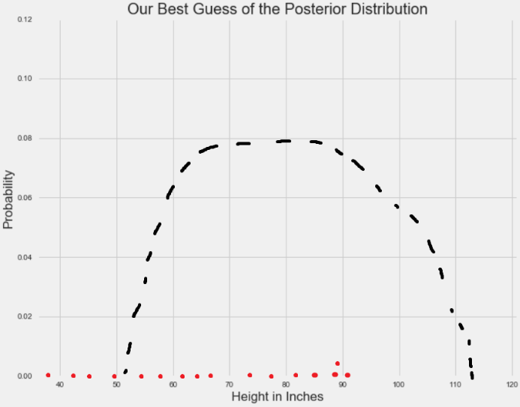
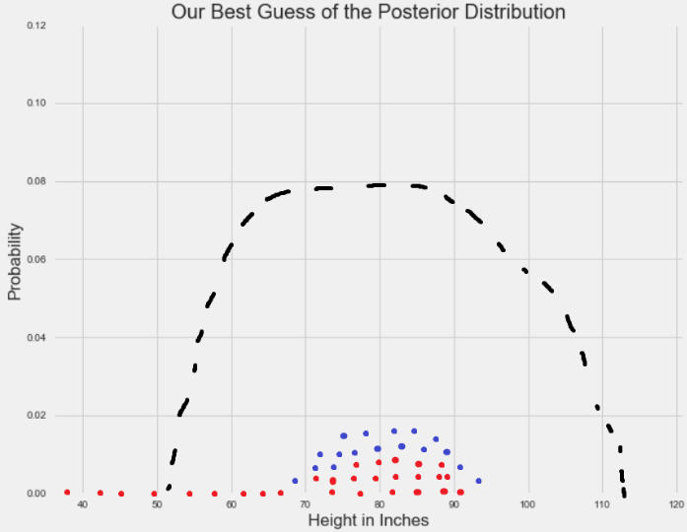
Markov chain monte carlo
Overall distribution is approximately equal to the stationary distribution
To simulate a complicated posterior distribution → Set up and run Markov chain whose stationary distribution is the posterior distribution.
Samples can be used as a Monte Carlo sample from stationary distribution (posterior distribution)
Ben Shaver

Slide 50
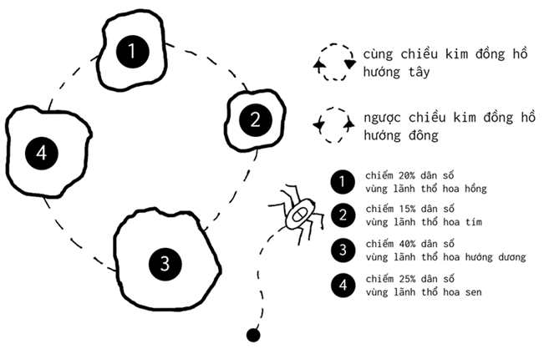
Metropolis - hasting
Each week visit a territory of the kingdom, travel each region to understand the kingdom's situation.
Ensure fairness between each territory. Where more population is visited, small regions are less likely to be visited.
The schedule must always be random, not fixed ... so it is an interesting monarch, and perhaps so, to ensure safety.
A random schedule, but approximates the distribution we want, is there any simple way to solve this problem?
ThetaLog.com

Slide 51
Metropolis - hasting
The future depends on the intensions:
Stay in current location
Move to west
Move to east
If the destination is larger than the current location, it seems that we should go to a new location.
In contrast, we decide to move with a probability p_{move} = p_{proposed}/p_{current}
What if continuous destination?
ThetaLog.com

Slide 52

Metropolis - hasting
p is the distribution to be sampled with the probability density function p(x)
At each step, we will consider making plans from current state x to the next state x’ with the probability q(x’|x) when knowing state before x, with q is called proposed distribution
If q(x’|x) is a symmetric distribution satisfy q(x’|x) = q(x|x’)
r = min{1, $\frac{p(x′)}{p(x)}$}
If q(x’|x) is not a symmetric distribution → Hasting correlation:
r = min(1, α)
α $=\frac{p(x′)/q(x^{′}|x)}{p(x)/q(x|x′)}$ = $\frac{p(x′)q(x|x′)}{p(x)q(x′|x)}$
Notes:
Phép chuẩn hóa đơn giản này để đảm bảo “công bằng” giữa việc dịch chuyển từ trạng thái x sang x′x hay từ x′sang x,
tránh việc thiên vị cho một số trạng thái dù phân bố dự định có sao đi chăng nữa.

Slide 53
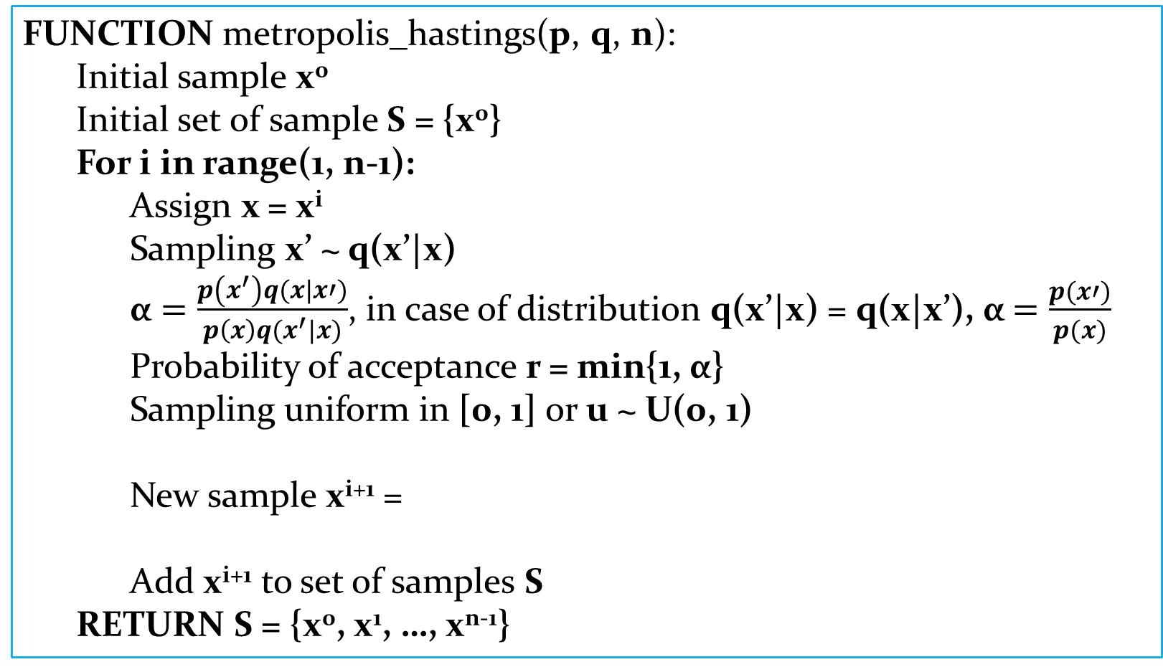
Metropolis - hasting
FUNCTION metropolis_hastings(p, q, n):
Initial sample x⁰
Initial set of sample S = {x⁰}
For i in range(1, n-1):
Assign x = x^{i}
Sampling x’ ~ q(x’|x)
α $=\frac{p\left(x^{′}\right)q(x|x′)}{p\left(x\right)q(x^{′}|x)}$, in case of distribution q(x’|x) = q(x|x’), α $=\frac{p(x′)}{p(x)}$
Probability of acceptance r = min{1, α}
Sampling uniform in [0, 1] or u ~ U(0, 1)
New sample x^{i+1} =
Add x^{i+1} to set of samples S
RETURN S = {x⁰, x¹, …, x^{n-1}}
x‘ if u < r
x if u ≥ r

Slide 54
GIBBS Sampling
FUNCTION gibbs_sampling(p, q, n):
Initial sample x⁰ = (x₁⁰, …, x_{d}⁰)
Initial set of sample S = {x⁰}
For i in range(0, n-2): // Take sample x^{i+1}
Current state x = x^{i} = (x₁^{i}, …, x_{d}^{i})
For j in range(1, d+1): // Take a sample with size d
Sampling x_{j}^{i+1} ~ p(x_{j}|x_{-j}) with x_{-j} is set of current x except x_{j}
Update x_{j}^{i+1} to x or x_{j} ← x_{j}^{i+1}
We have x^{i+1} = (x₁^{i+1}, …, x_{d}^{i+1})
Add x^{i+1} to set of samples S
RETURN S = {x⁰, x¹, …, x^{n-1}}

Slide 55
DEMO

Slide 56
Q & A

