Slide 1
2013/14 NCAA Div-I Basketball
Source: www.sports-reference.com/cbb
Acquisition: Scraped via BeautifulSoup

Slide 2
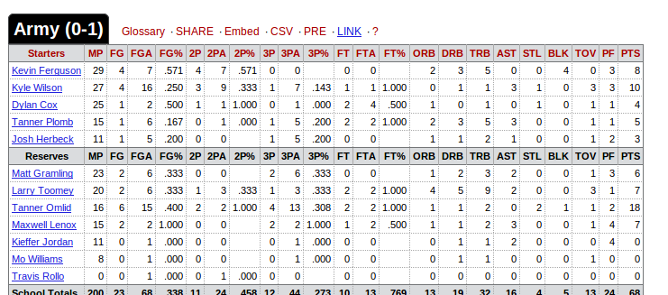
Sample Data Format and Categories

Slide 3
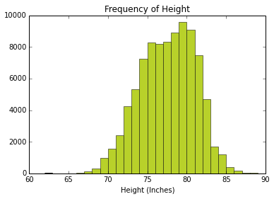

Slide 4
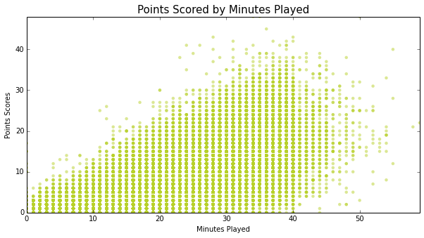

Slide 5
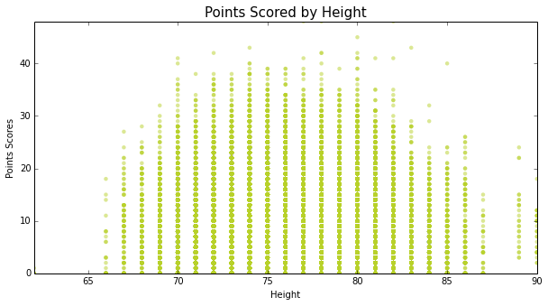

Slide 6
