Slide 1
NCAA Div. 1
Men's Basketball 2013/14

Slide 2

Acquisition:
Data from Sports-Reference.com/cbb (S-R) with a BeautifulSoup scraper that I wrote for Project 1, pulling data from multiple pages to populate three CSV files: Teams-Conferences, Rosters, and Box Scores.

Slide 3
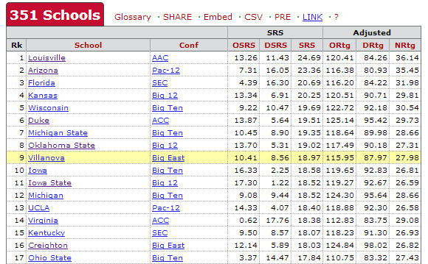
Teams and Conference Affiliations.

Slide 4
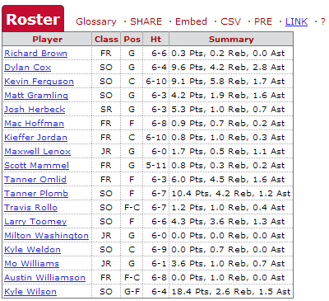
Teams' Rosters

Slide 5
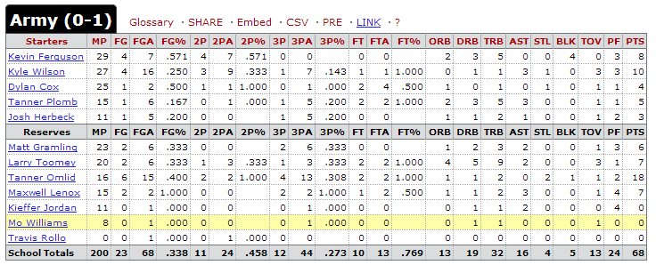
Box Score Data
Player-level box score data for every game in the 2013/14 regular season (save 1/18) including standard box score stats:

Slide 6
Cleaning
Renamed some columns in each of the DataFrames to something more meaningful.
S-R had a number of box score records for players named " Team" and "Team Team". Removed from the dataset.
NaN records were abound in the box scores; it seems S-R is not always consistent about how it reflects a zero value, sometimes being "0" and other times with whitespace.
After verifying that the missing values for % features were, in fact, zero - and finding one case where the blank cell was an error - I replaced all NaN values with zero.
Under positions, two players had "W" (Wing) , which I re-classified as "G-F" (Guard-Forward) to match the rest of the records.
I transformed the Position and Class features each into a series of Boolean features.
  Later, I would group the Classes to create one feature, "UpperClass", that indicated whether a player was a Jr, Sr or grad student.
Finally, I added a feature, "Major", that classified each player as being on either a Major or Mid-Major team based on their conference affiliation. (Major = ['aac', 'acc', 'atlantic-10', 'big-12', 'big-east', 'big-ten', 'cusa', 'mwc', 'pac-12', 'sec'])

Slide 7
Explore
41% of player-game records belong to Major Conference players.
Plotted and looked at means for each feature for Major and Mid-Major datasets, looking for areas of difference.
There were small skews on various categories but, for the most part, they were relatively similar.

Slide 8
Major | MP | C | G | F | SR | FR | SO | GR | JR | FG | FGA | FG%
FALSE | 19.717 | 0.092 | 0.554 | 0.425 | 0.268 | 0.221 | 0.226 | 0.006 | 0.279 | 2.392 | 5.382 | 0.371
TRUE | 20.046 | 0.096 | 0.527 | 0.436 | 0.233 | 0.255 | 0.252 | 0.008 | 0.253 | 2.461 | 5.519 | 0.374
Major | 2P | 2PA | 2P% | 3P | 3PA | 3P% | FT | FTA | FT% | ORB | DRB | TRB
FALSE | 1.766 | 3.586 | 0.376 | 0.626 | 1.796 | 0.173 | 1.540 | 2.192 | 0.372 | 0.896 | 2.157 | 3.053
TRUE | 1.850 | 3.753 | 0.381 | 0.610 | 1.767 | 0.168 | 1.583 | 2.280 | 0.378 | 0.971 | 2.293 | 3.264
Major | AST | STL | BLK | TOV | PF | PTS | Ht | UpperClass
FALSE | 1.229 | 0.601 | 0.342 | 1.187 | 1.894 | 6.945 | 76.728 | 0.553
TRUE | 1.298 | 0.611 | 0.406 | 1.152 | 1.842 | 7.110 | 77.572 | 0.493

Slide 9
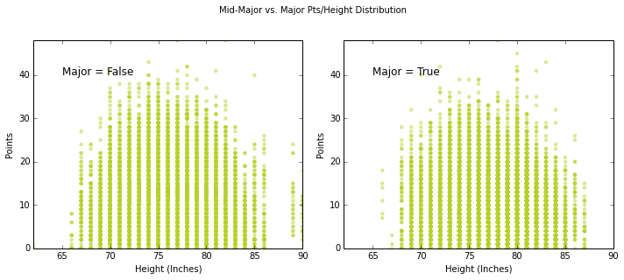

Slide 10
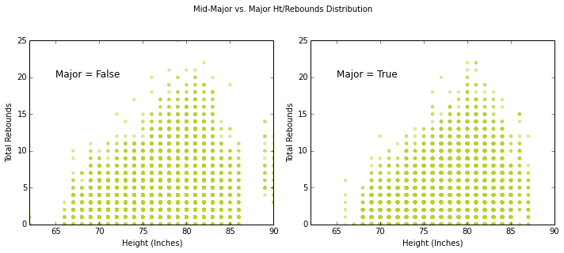

Slide 11
Fine Tuning
Filtered out records where players were in game for < 10 Minutes.
Transformed stats to “per 40 Min” to measure efficiency rather than playing time.
Changed depth of DT and min_leave_samples
Changed K in KNN
Tried a range of train-test splits from 25 to 33.

Slide 12
Choosing A Classifier
Ruled out Linear Regression - Not looking for continuous value in prediction.
Candidates:
  KNN
  Naive Bayes
  Decision Tree/Random Forest
  Logistic Regression

Slide 13
KNN
Expectation:
  Could be useful but might be too much overlap in all the categories.
Results:
  Great Training Set; Sub-avg Test Set.

Slide 14
Naive Bayes
Expectation:
  Tons of data; great "prior" knowledge. This should work out well.
Results:
  Did not work out well. Consistently just below the other classifiers.
  Using UpperClass alone actually increased the accuracy, so it appears adding in the other categories just muddied the waters, creating false positives.

Slide 15
DT/RF
Expectation:
  A lot of diversity among both classifications and good for addressing outliers so I expected good results and a lot of waiting.
Results:
  This was consistently one of the most accurate classifiers, and had the best AUC by a sizable margin.
  Curiously, the AUC for RF was worse than for DT in the training set but much better in the test set.

Slide 16
Logistic
Expectation:
  Did not expect much since there didn't appear to be linear relationship between any individual stats and Major/Mid-Major classification.
Results:
  Along with DT/RF was consistently the most accurate in both training and test accuracy.
  Had much lower cost to run than DT/RF.
  The AUC, though, was much worse than DT/RF.

Slide 17
Preferred Classifier
Decision Trees/Random Forests

Slide 18
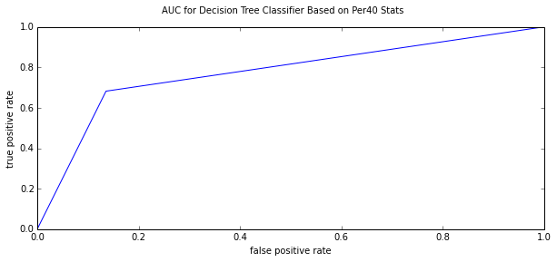
Decision Trees - Training
Training: 78.9%
Training Mean score: 0.585 (+/-0.000)

Slide 19
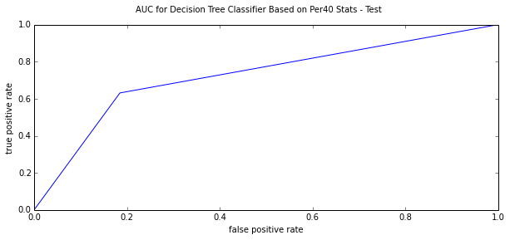
Decision Trees - Test
Test: 57.9%
Test Mean score: 0.579 (+/-0.000)

Slide 20
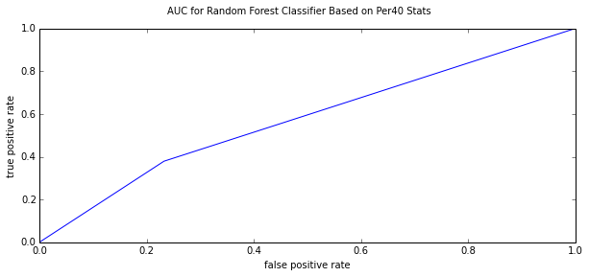
Random Forest - Training
Training Mean score: 0.612 (+/-0.000)

Slide 21
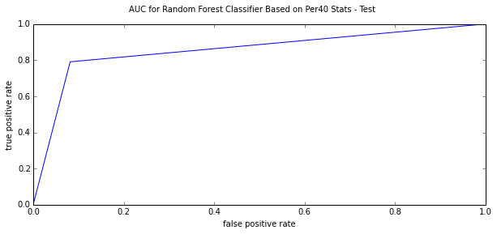
Random Forest - Test
Test Mean score: 0.606 (+/-0.000)

Slide 22
Takeaways
Maybe there's not that much of a difference between players' performance at Mid-Majors and Majors
Maybe playing against like-talented players allows stats to overlap due to lack of context?
Might need to use strength of schedule adjustments or filter only for games against Major Conference opponents?

