Slide 1
Project 01 – GADS
Diamonds

Slide 2
Collect data on the quality and cost of diamonds
About 50k diamonds
Collected data:
Carat
Cut
Clarity
Color
Cost
Size Measurements
Clean the Data
This primarily focused on converting the various qualities into a numeric value
An overall score was also calculated

Slide 3
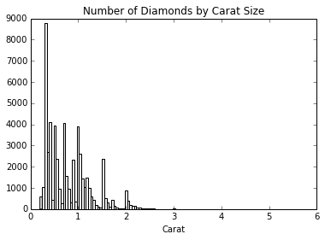
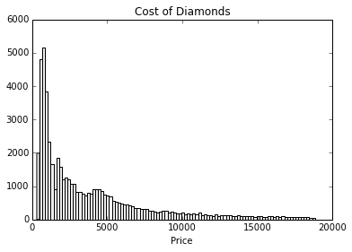
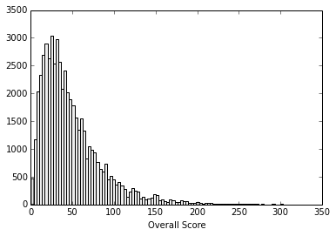
Histograms

Slide 4
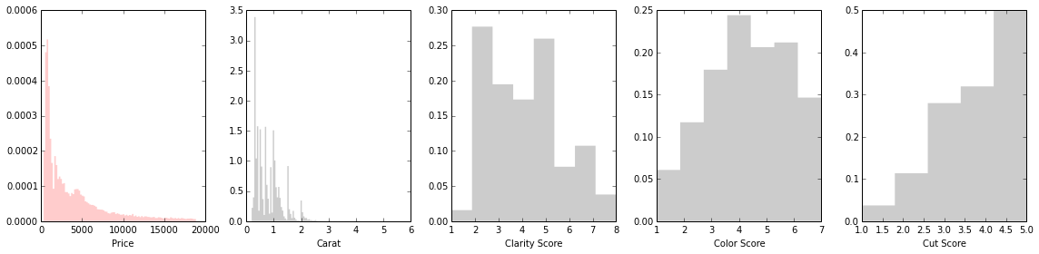

Slide 5
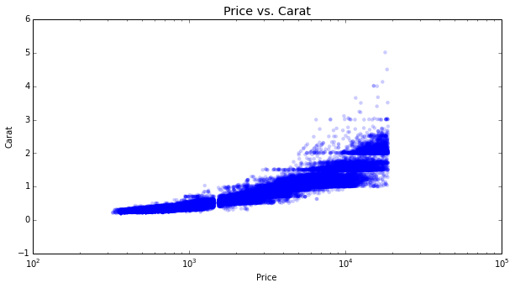
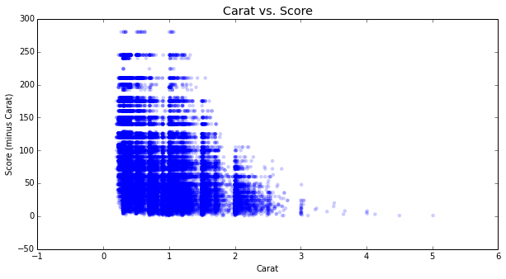
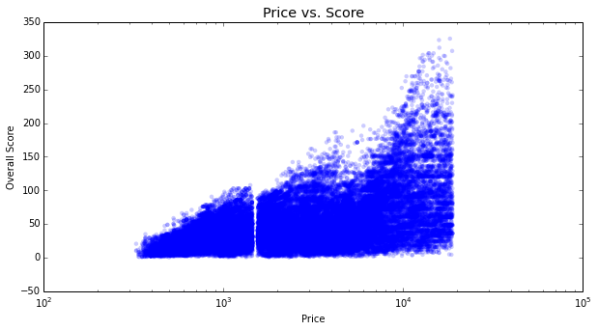
Scatter Plots

