Slide 1
AI IN BUSINESS
1 / 13
AI use cases at SMEs
Week 5.
AI in Business · week 5
Notes:
Session of Monday 5 October. AIBS theme: AI use cases at SMEs. AEL: one way to keep knowledge, built live from an empty folder.

Slide 2
AIBS
2 / 13
Two handbook pages, one argument
PAGE 1 · KNOWLEDGE GAPS
What does the firm not know yet?
PAGE 2 · USE CASES
What could AI do for it?
The use case answers a gap.
AI in Business · week 5
Notes:
AIBS segment. Two pages this week: week 4's theme (SME knowledge gaps) and week 5's (AI use cases). They are one argument: page 1 finds the gap, page 2 picks a use case that answers it. Both follow the chapter template and its four criteria. The full brief is on the week page under the assignments.
Fieldwork is behind across the cohort: several interview guides are not final yet. Keep the tone positive. The point of this segment is that no team waits on a firm to start writing.

Slide 3
AIBS · PLAN A
3 / 13
Your interview is the best source for both pages
GREEN LIGHT
Plan the visit. Ask about both themes.
NOT YET
Finish your guide. Start plan B alongside it.
AI in Business · week 5
Notes:
Plan A. Two groups in the room. Teams with a green light: plan the visit this week, and check the guide asks about both themes (what the firm knows and lacks; what it uses, tried or dropped). Teams without one: finish the guide first. The green light and signed consent still come before any contact. They start plan B alongside, so the pages move while they wait.

Slide 4
AIBS · PLAN B
4 / 13
No firm yet? Get as close to one as you can
Someone close to the firm → owners in public → surveys of SMEs → documented cases
Plan B, step by step
AI in Business · week 5
Notes:
Plan B, in order of closeness to the firm. Step 1 (another SME in the sector, a sector association, a regional development agency, an innovation hub, an advisor) is still field research: green light and consent apply. Step 2: owners in public (trade press, podcasts, webinars). Step 3: surveys of SMEs (Eurostat, CBS, the OECD report from the demo), which say what is common and not what this firm does. Step 4: documented cases; recall the week 2 rule that a vendor's story shows a product exists, not that it works.

Slide 5
IN CLASS · THREE ECONOMIES
5 / 13
What economy are the US, China and Europe building with AI?
CHINA
Team 5 · 6 · 8
UNITED STATES
Team 1 · 2 · 4
EUROPE
Team 3 · 7
Start from your own sector.
AI in Business · week 5
Notes:
In-class assignment, about 60 minutes; what does not get finished becomes homework (photo of cards and postcard in the Teams channel before 12 October). The big question is open on purpose: strategies, whether this is what we want, alignment, who benefits. The aim is that students take part in that discussion, starting from their own sector. Split: China 5, 6, 8; US 1, 2, 4; Europe 3, 7. The industry teams (1, 5, 6, 7) are spread over all three regions, so the wall can compare the same sector across regions.

Slide 6
IN CLASS · THREE ECONOMIES
6 / 13
Four steps, sixty minutes
15 MIN
Hunt for front-runners
15 MIN
Read your use cases
10 MIN
A postcard from 2035
20 MIN
Three regions, one wall
The steps, in full
AI in Business · week 5
Notes:
Walk through the four steps quickly; the full text is on the week page. Keep time visible. If the session runs short, stop after step 2 or 3 and move the rest to homework; the wall then opens the 12 October session.

Slide 7
IN CLASS · THREE ECONOMIES
7 / 13
Five questions for every front-runner
What does it do? Whose AI is it? Who gains, who pays? What does it need from the country? What economy does it show?
AI in Business · week 5
Notes:
The five card questions. Questions 2 to 4 carry the geopolitics: whose model and data, who gains and who pays, and what the state provides or steers. Remind them that front-runner stories mostly come from the company, a vendor or a government: appraise them as in week 2.

Slide 8
TAKEAWAY
8 / 13
Is that the economy we want? And for whom?
AI in Business · week 5
Notes:
Takeaway, at the wall. Let the room answer before the lecturers do. Push on three points: one sentence per region on what it is building; who is left out; and whether Europe is behind or on a route of its own, and what that route means for their SME. Connect to Draghi from week 1, and to CBI guiding questions 3a and 3b. Ask them to write one line in the portfolio on what surprised them.

Slide 9
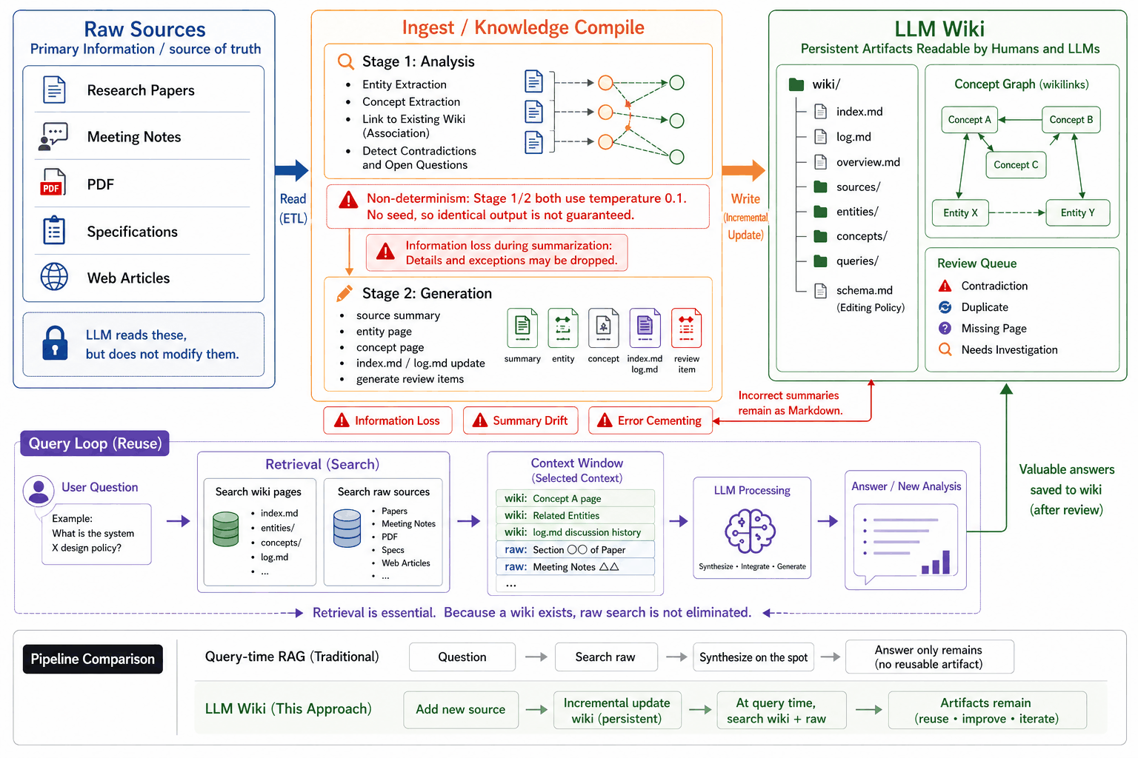
Diagram: SmartScope, LLM Wiki Architecture, 2026.
Notes:
The diagram fills the slide; tell it left to right, then bottom.
• Start at the bottom row, the comparison. Query-time RAG: question, search raw, synthesise on the spot, and only the answer remains. That is what most teams built in week 4: it works, and it forgets. Karpathy: the LLM "is rediscovering knowledge from scratch on every question". The wiki row ends differently: artifacts remain, and are reused and improved.
• Raw sources, top left. The source of truth. The model reads them and never modifies them.
• Ingest, the orange box. Two stages: analysis (entities, concepts, links to what is already in the wiki, contradictions and open questions), then generation (the source summary, entity and concept pages, index and log). This is the step the demo shows.
• The red boxes are the honest part. The same source ingested twice will not give identical pages. A summary drops details. A wrong summary stays as markdown and gets built on: error cementing. This is why the template pauses before writing, checks every quotation against the raw file, and keeps a log.
• LLM wiki, top right. Plain markdown files a person can read. The review queue (contradictions, duplicates, missing pages) is what the lint reports.
• Query loop, the purple row. A question searches the wiki pages and, where needed, the raw sources, fills the context window, and a good answer is saved back to the wiki. Retrieval does not disappear; it gets a better index.
Where the template differs from the diagram: `syntheses/` instead of `queries/`, `AGENTS.md` instead of `schema.md`, no `overview.md`. And "meeting notes" as a raw source is fine for a company, never for our field research: no interview material in the wiki.
All six assistants the students use read `AGENTS.md`; `CLAUDE.md` and `GEMINI.md` in the template point to it. Week 3's visualisation (one question, four ways) is the reminder that this is one of four options.

Slide 10
LIVE DEMO
10 / 13
Three sources, three formats, one empty wiki
• Article. OECD Cogito blog, 2025.
• Video. Asian Productivity Organization, 64 minutes.
• Report. OECD survey, 2026, 36 pages.
AI in Business · week 5
Notes:
The demo. Leave this card up and switch to the terminal and Obsidian.
Before class (the day before). Create the demo repository from the template, install the helpers, and acquire and ingest the video and the report. They are too long to run live: in the dry run on 30 September (headless, no pause) the video took 10½ minutes and the report 17. Commit after each. The article stays in `raw/` un-ingested, or is fetched live.
Acquire, one command per format (show at least the article live; the other two take seconds):
• Article: `python3 tools/fetch_article.py https://oecdcogito.blog/2025/09/16/agentic-ai-for-small-business-growth/` — about 1,800 words, word for word.
• Video: `python3 tools/fetch_youtube.py https://www.youtube.com/watch?v=51lXx4wBuHE` — captions only; 64 minutes, about 7,600 words of automatic captions.
• Report: save the PDF in raw/reports/, then `markitdown raw/reports/oecd-empowering-smes-in-the-age-of-ai.pdf > raw/reports/oecd-empowering-smes-in-the-age-of-ai.md` — 36 pages, about 13,000 words, four seconds. The PDF itself is not committed (.gitignore).
Live: the article. `/ingest raw/articles/agentic-ai-for-small-business-growth.md — added by Witek`. Let the pause happen and read the takeaways aloud before saying go. On an empty wiki it took just under five minutes; on top of the report and the video expect longer, so budget ten with the pause and talk. Because the survey is already in, the disagreement appears live.
Four things to show:
1. The pause: the place to catch a misreading before it lands on ten pages.
2. The source page's caveats. In the dry run it found that the author heads PayPal's government relations, that PayPal is a partner of the survey the article cites, that the "72%" figure links back to the article itself, and that the two business owners are invented examples.
3. The disagreement. In the dry run it landed on the `agentic-ai` concept page under Debates: the article writes in the present tense about agents that reorder stock and negotiate with suppliers; the OECD survey counts 3.6% of AI users running agentic AI, in a sample it says is not representative and skews to the digitally mature. The page says what the disagreement turns on (partly tense, partly being found by other people's agents versus running your own) and the page's confidence dropped to 0.65.
4. Query and lint. Ask: *Which AI uses pay off first for a small manufacturer, according to the wiki?* Show the citations, then the query entry in the log with the pages it read. Then `/lint`, and dwell on the quote check: every quotation on a wiki page is compared with the raw file, so an invented quotation fails. These are the two habits the knowledge architecture criteria said would come back in week 5.
Fallback. The dry-run wiki, all three sources ingested and lint clean (52 pages), is on the lecturer's laptop outside the repositories. Open it in Obsidian if the network or the model fails.

Slide 11
YOURS TO TAKE
11 / 13
Your team’s copy takes ten minutes
datadrivendecisions/llm-wiki-template
Never interview material.
AI in Business · week 5
Notes:
Teams make their copy now if they did not before the session; the README has the steps. Walk the room: the usual problems are Python on Windows (`python`, not `python3`) and a venv that is not activated. Each team ingests one published source of its own and reads the source page back. Never interview material, private repository or not: what the assistant reads goes to a model service.
Nobody has to switch. A folder with a naming rule, traced end to end, is still a good answer. What the wiki costs: every source is read when it arrives, whether anyone asks or not; a misreading lands on several pages at once; past a few hundred pages the index is not enough and you need search. A team that adopts it writes a decision-log entry and versions its knowledge architecture.

Slide 12
HOMEWORK
12 / 13
Before 12 October: two pages, the evaluation, your decision log
The assignment is here.
AI in Business · week 5
Notes:
Two handbook pages and the first evaluation are due at the start of the session on 12 October; it is the last session and the last feedback moment, and teams may keep improving the two pages afterwards. The first evaluation is held against the PRD's own criteria, and the decision log travels with it. The lookup record and the quotation check are what let a team explain a wrong sentence on its page instead of guessing.

Slide 13
OUR RULEBOOK
13 / 13
The rules we keep, week by week
RULE 1
Before taking a break, always set AI to work.
RULE 2
Do something weird.
RULE 3
Learning above results.
RULE 4
Technology is not the barrier.
RULE 5
Never make someone else’s problem yours.
AI in Business · week 5
Notes:
The rulebook grows by one rule a week. Rules 1 to 3 came from weeks 1 to 3; rule 4 from week 4, "Technology is not the barrier". Rule 5, "Never make someone else's problem yours", was written together in this session, on the whiteboard above the four kinds of knowns and unknowns.

