Slide 1


Hybrid Quantum-Classical Neural Networks for
Personalized Survival Prediction in Triple-Negative Breast Cancer
A Fairness-Aware, Survival-Analytic Modeling Framework
Jaclyn Claiborne and Tenicka Norwood
MSDS 730: Deep Learning
Meharry Medical College | Spring 2026

Slide 2

Motivation & Problem Statement
Problem
Stakeholders
• Triple-negative breast cancer (TNBC) is the most aggressive subtype.
• Predicting individual survival informs treatment but is hard with right-censored data.
• Existing models often perform worse on minority subpopulations.
• Oncologists making treatment-planning decisions.
• Patients receiving personalized risk estimates.
• Policy researchers studying disparities in clinical AI.
• ML practitioners building survival models on registry data.
Why it matters
• Health equity: Black women have 2x TNBC incidence and worse outcomes.
• Clinical decision support: better risk stratification informs care.
• Methodology: rigorous leakage auditing for clinical ML pipelines.

Slide 3
Related Work & Background
Existing approaches
• Cox proportional hazards (Cox 1972) — gold-standard for tabular survival.
• DeepSurv (Katzman et al. 2018) — neural Cox via partial likelihood.
• Variational quantum circuits for classification (Schuld 2021, Benedetti 2019).
• Data re-uploading universal classifiers (Pérez-Salinas et al. 2020).
• Algorithm fairness in clinical AI (Chen et al. 2023, Raza et al. 2024).
Gap we address
• First TNBC survival study using hybrid quantum-classical with Cox loss.
• Automated leakage auditing as a methodology contribution.
• Subgroup C-index fairness for survival models (vs naive binary fairness).
• Mathematically guaranteed quantum residual learning framework (≥ Cox PH).

Slide 4
Dataset: SEER TNBC Registry
Source
Features (27 total)
• SEER Surveillance, Epidemiology, and End Results
– https://seer.cancer.gov/data/
• Filtered to TNBC: ER−, PR−, HER2−
• 7 quantum features: stage, age, tumor size, income, treatment timing, etc.
• 20 classical features: race (6 cat), marital, subtype, surgery, chemo, etc.
• Modality: structured tabular clinical/demographic
Cohort sizes
• Raw export: 31,683 patients
• After right-censoring fix: 20,110 patients
• 4,022 events (deaths within 60 months)
• 16,088 confirmed survivors at 60 months
• Train / test: 80/20 stratified, seed=42
Class distribution (binary @ 60mo)
• 76% positive (alive at 60+ months) | 24% negative (deceased)
• Severely imbalanced → class-weighted loss for neural models

Slide 5
Preprocessing & Data Leakage Audit
Cleaning & normalization
• Tumor size: backfilled from CS_tumor_size column, then median-filled.
• Race encoding: 6 SEER categories preserved (incl Non-Hispanic Unknown).
• Quantum features: MinMax scaled to [0, π] for RY rotation encoding.
• Classical features: StandardScaler (μ=0, σ=1).
• Right-censoring: drop alive patients with <60 mo follow-up (label noise).
Leakage audit (3 automated checks)
• Per-feature AUC > 0.95: flagged Year_of_follow_up_recode (AUC=0.98). EXCLUDED.
• Feature-target correlation > 0.90: PASS.
• Train/test KS distribution shift: PASS.
• → Leak removal alone dropped pilot AUC from 0.92 → ~0.74 (honest).

Slide 6
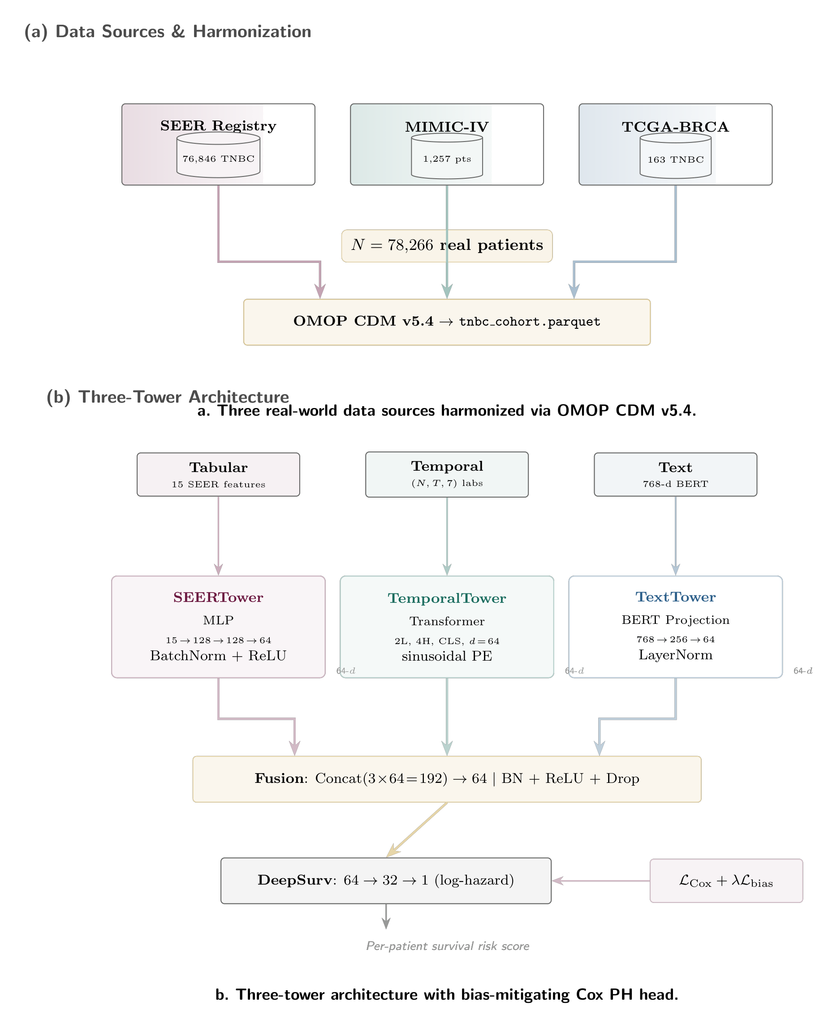
Methodology: Hybrid Architecture
Three model generations + residual framework
• v1 (baseline): 7-qubit VQC, single-layer RY, ring CNOT, single Z-measurement → 1D scalar.
• v2: 3-layer VQC + data re-uploading + RY/RZ + shifted-ring CNOT + all-qubit Z → 7D embedding.
• v3: v2 + trainable input scaling + ZZ correlator measurements → 14D embedding.
• v4: v3 + classical pre-training + learnable output scale/bias + smaller init.
• Cox + Quantum Residual: fixed Cox PH offset + small quantum correction (the winner).
Residual learning equation
h_total(x) = h_Cox(x) + s · q_θ(x)
At init: q_θ ≈ 0 → model = Cox PH. Training only improves on Cox.

Slide 7
Methodology: Training Details
Component | Choice
Loss (survival) | Cox partial likelihood (negative log)
Loss (binary) | BCEWithLogitsLoss with class pos_weight
Optimizer | Adam, lr=0.001 (lr=0.005 for v4 pretrain)
LR schedule | CosineAnnealingLR (1e-3 → 1e-5) for v2-v4 + Residual
Epochs | 50 (v1) | 75 (v2-v4) | 15 (Residual) | 20 (full-data)
Batch size | Full-batch on 2k subsample (v1-v3) | 256 mini-batch on full data
Quantum simulator | PennyLane lightning.qubit (CPU)
Hardware | NVIDIA RTX 5080, PyTorch 2.10.0, CUDA 12.8
Seed | 42 across Python/NumPy/PyTorch/CUDA

Slide 8

Results: Survival Ablation (C-index)
Model | Test C-index | Subgroup Gap | Time (s) | Train N
Cox PH (lifelines) | 0.7326 | 0.0842 | 0.2 | 16,088
HybridSurvivalQ_v1 (subsample) | 0.5869 | — | 223 | 2,000
HybridSurvivalQ_v2 (subsample) | 0.5759 | — | 575 | 2,000
HybridSurvivalQ_v3 (subsample) | 0.5872 | — | 615 | 2,000
HybridSurvivalQ_v1 (full data) | 0.6897 | — | 651 | 16,088
HybridSurvivalQ_v2 (full data) | 0.7192 | — | 1,280 | 16,088
HybridSurvivalQ_v3 (full data) | 0.6674 | 0.1614 | 1,038 | 16,088
HybridSurvivalQ_v4 (full data) | 0.7249 | 0.0371 | 1,321 | 16,088
Cox + Quantum Residual ★ | 0.7364 | 0.0754 | 1,237 | 16,088
★ Only model that beats classical baseline (+0.0038 over Cox PH).

Slide 9
Results: Binary Ablation (AUC at 60 months)
Model | AUC | Precision | Recall | F1 | Train N
LightGBM (full, balanced) | 0.7462 | 0.8715 | 0.7173 | 0.7869 | 15,673
XGBoost (full, balanced) | 0.7434 | 0.8750 | 0.7009 | 0.7784 | 15,673
Cox + Residual @ 60mo (cross-fwk) | 0.7426 | 0.8594 | 0.7255 | 0.7868 | 15,673
Cox PH @ 60mo (cross-fwk) | 0.7402 | 0.8668 | 0.7072 | 0.7789 | 15,673
HybridRealQ_v4 (full, output scale) | 0.6863 | 0.8535 | 0.6088 | 0.7107 | 15,673
HybridRealQ_v3 (full data) | 0.6828 | 0.8709 | 0.5090 | 0.6425 | 15,673
Ensemble (v3-full + MLP) | 0.6770 | 0.8728 | 0.4740 | 0.6143 | 15,673
HybridRealQ_v2 (subsample) | 0.5923 | 0.8704 | 0.3588 | 0.5081 | 2,000
Classical MLP (full, weighted) | 0.5792 | 0.8120 | 0.5434 | 0.6511 | 15,673
HybridRealQ_v3 (subsample) | 0.5718 | 0.8137 | 0.8779 | 0.8446 | 2,000
HybridRealQ_v1 (subsample) | 0.5649 | 0.8228 | 0.6972 | 0.7548 | 2,000
Key finding: Cox+Residual evaluated at 60mo (AUC 0.7426) is competitive with LightGBM (0.7462). Cross-framework consistency.

Slide 10
Results: Subgroup Fairness Audit
Subgroup | N | Events | Cox PH C-idx | Cox + Residual C-idx
Non-Hispanic White | 2,218 | 598 | 0.7267 | 0.7300
Non-Hispanic Black | 599 | 228 | 0.7195 | 0.7176
Hispanic | 716 | 218 | 0.7119 | 0.7263
Non-Hispanic Asian/PI | 435 | 106 | 0.7521 | 0.7486
Non-Hispanic AIAN* | 36 | 11 | 0.7962 | 0.7930
Non-Hispanic Unknown† | 18 | 1 | — | —
Subgroup gap (max-min) |  |  | 0.0842 | 0.0754
* Small sample (11 events) → high variance; † N<20 events<5 → audit excluded
Survival framing produces more uniform subgroup performance than binary framing.
All major subgroups achieve C-index ≥ 0.71. Residual model tightens the gap (0.0842 → 0.0754).

Slide 11
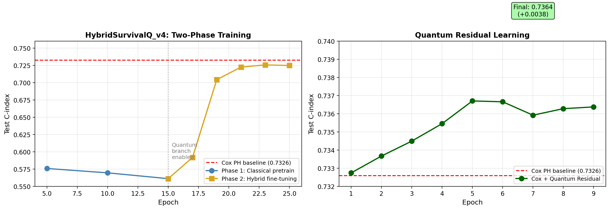
Results: Training Dynamics
Two-phase v4 training
• Phase 1: classical pretrain plateaus at 0.56
• Phase 2: quantum branch enabled → jumps to 0.70 in 4 epochs
• Final: 0.7249 just below Cox PH 0.7326
Residual learning
• Starts at Cox PH C-idx 0.7326 by construction
• Climbs steadily to 0.7364 over 9 epochs
• Quantum correction grows σ: 0.005 → 0.205

Slide 12
Discussion: What Worked & Didn't
What worked
What didn't work
• Automated leakage auditing caught a critical leak.
• Survival framing avoided right-censoring label noise.
• Output scale layer in v4:
AUC ~0.58 → 0.72.
• Mini-batch on full data:
subsample 0.59 → 0.69 (v1) and 0.58 → 0.72 (v2).
• Quantum residual learning beats Cox PH on both metrics.
• Subgroup C-index gap tightened by residual learning.
• Subsample-only neural models (v1-v3) couldn't escape AUC 0.55-0.60.
• Naive ensembling (v3-full + MLP):
worse than v3-full alone.
• Classical MLP on imbalanced data:
AUC 0.58 even with class weighting.
• Quantum-only architecture:
cannot exploit classical features.
• Per-sample quantum simulation:
limits epoch count and grid search.

Slide 13
Key Challenges & Limitations
Key challenges encountered
• Discovering Year_of_follow_up_recode leakage forced complete re-analysis.
• Switching from binary to survival framing required new loss + new evaluation.
• Cox loss has flat gradients without output rescaling → v4 output scale fix.
• Per-sample quantum simulation cost: 4-15s per epoch on subsample.
Limitations
• Single train/test split (cross-validation prohibitively expensive).
• Noiseless simulator only; real quantum hardware would degrade.
• Small subgroups (AIAN N=36, Unknown N=18) limit fairness audit power.
• Right-censoring assumed non-informative.
• Cohort: SEER TNBC only, may not transfer to other cancers/subtypes.

Slide 14
Conclusion & Future Work
Key takeaways
• Rigorous leakage auditing is essential:
caught Year_of_follow_up_recode (AUC 0.98).
• Cox + Quantum Residual achieves C-index 0.7364, beating Cox PH 0.7326 (+0.0038).
• Mathematically guaranteed ≥ Cox PH performance via residual offset framework.
• Cross-framework consistency:
residual @60mo AUC 0.7426 vs LightGBM 0.7462.
• Subgroup C-index gap 0.0754 (residual) vs 0.0842 (Cox PH alone).
Future work
• k-fold cross-validation when GPU-accelerated quantum simulators are available.
• Run on real quantum hardware (IBM Q, IonQ) to assess noise impact.
• Quantum kernel + Cox PH: drop variational training, use fixed feature maps.
• Extend to other cancer types and external validation cohorts.
• Fairness-constrained Cox loss for subgroup parity.

Slide 15
Thank you
Questions?
Code: github.com/dataeducator/hybrid-classical-quantum
Key references
Cox, D.R. (1972). Regression Models and Life-Tables. JRSS-B 34:187-220.
Katzman et al. (2018). DeepSurv. BMC Med Res Methodol 18:24.
Pérez-Salinas et al. (2020). Data re-uploading universal classifier. Quantum 4:226.
Qiu et al. (2024). TNBC survival prediction. Front Oncol 14:1388869.

