Slide 1
CAPSTONE PROJECT
Presenter – Sunita Thapa

Slide 2
INTRODUCTION
GOAL :
The goal of this project is to create data pipelines for the health care insurance company that will enable the company to make appropriate business strategies to enhance their revenue by analysing customers behaviours and send offers and royalties to customers respectively.
TOPICS:
Data Preprocessing
Implementation & Testing
Deployment
ENVIRONMENT USED:
AWS S3
AWS Redshift
AWS Glue
Databricks
Pyspark
Jira
GitHub

Slide 3
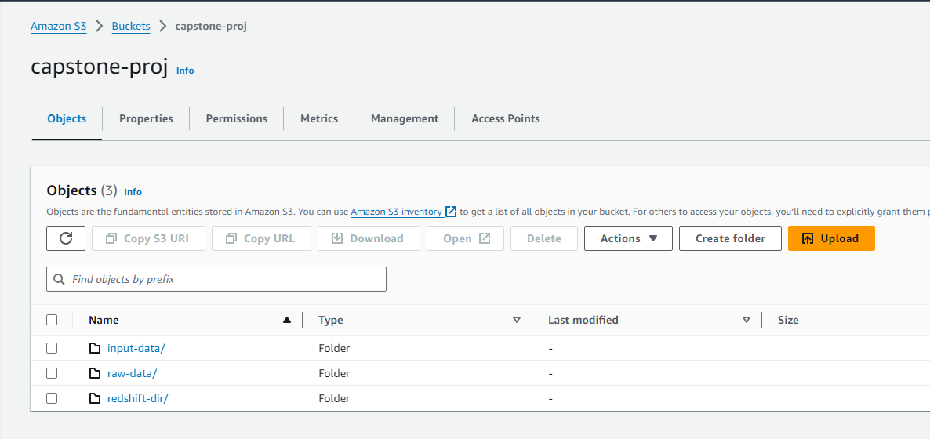
DATA PREPROCESSING
DATASET CREATION :
Upload the provided (raw) data into AWS S3

Slide 4
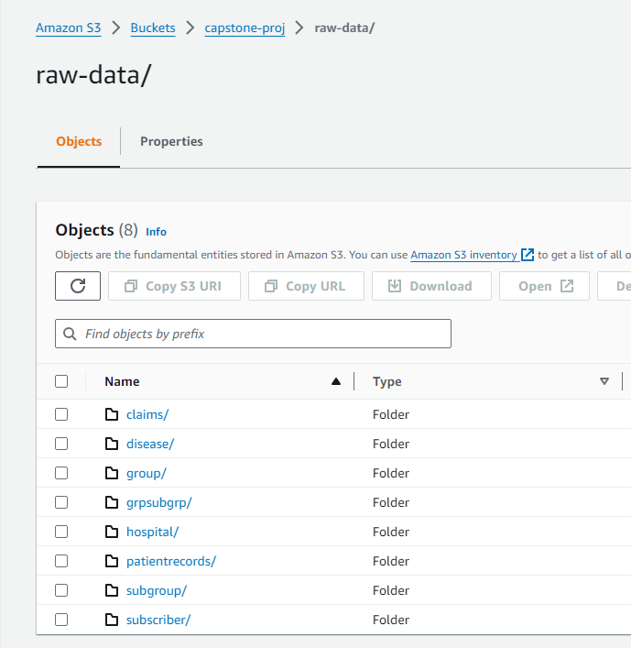
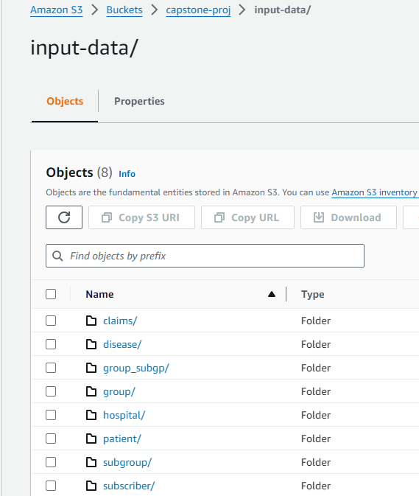
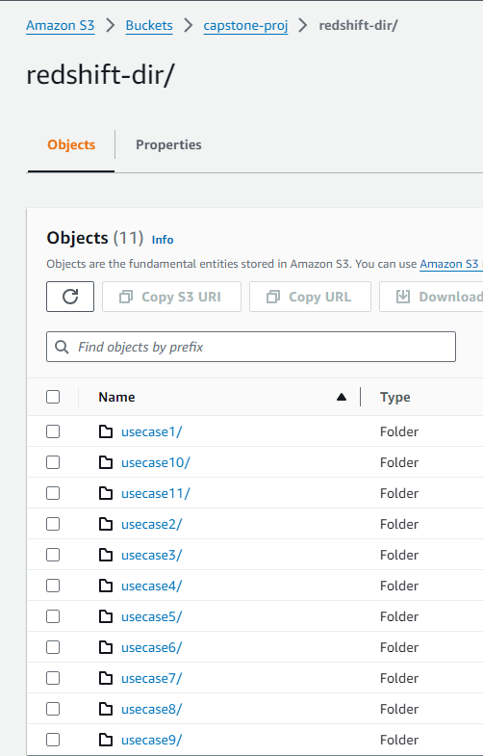
UPLOAD RAW DATA INTO S3 contd..

Slide 5
DATA CLEANING
Incorrect or corrupted data
Duplicate data
Mislabled data
Null Values:
String -> NA
Integer -> 0
Dates -> 19000101
Used Databricks and Pyspark for development

Slide 6
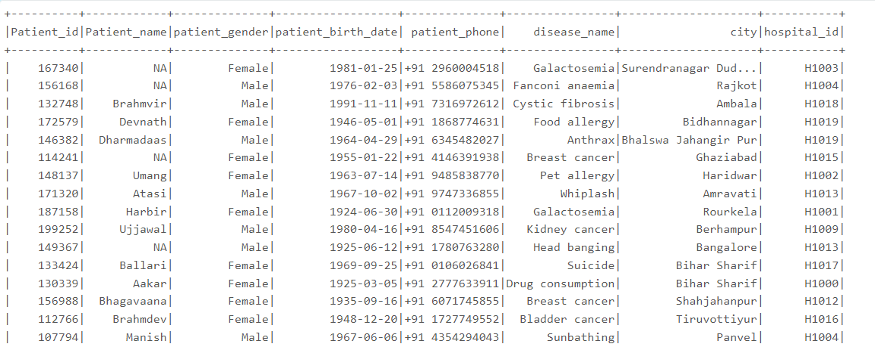
Examples 1:
Output =>

Slide 7
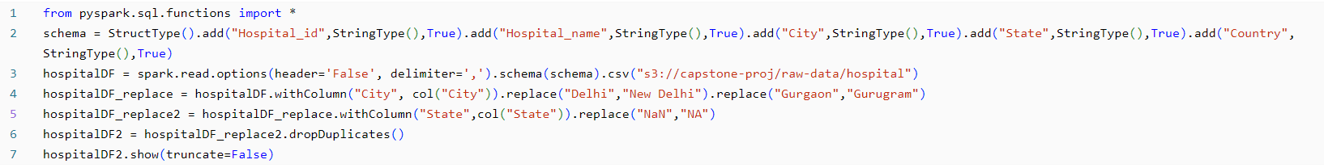
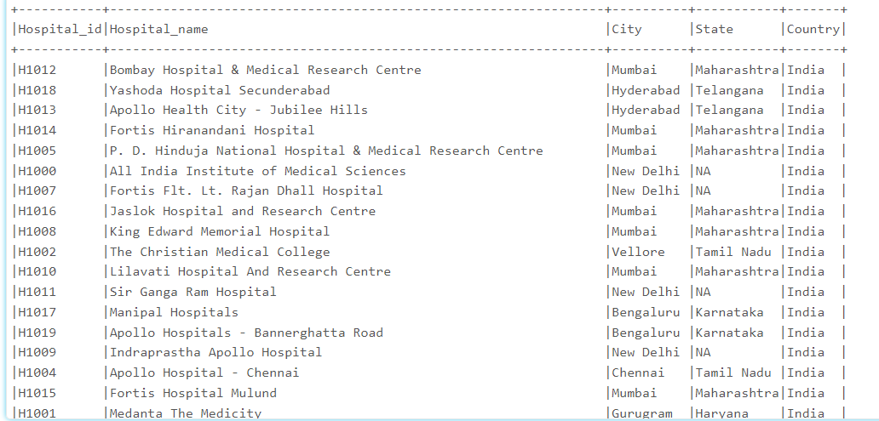
Example 2:
Output =>

Slide 8
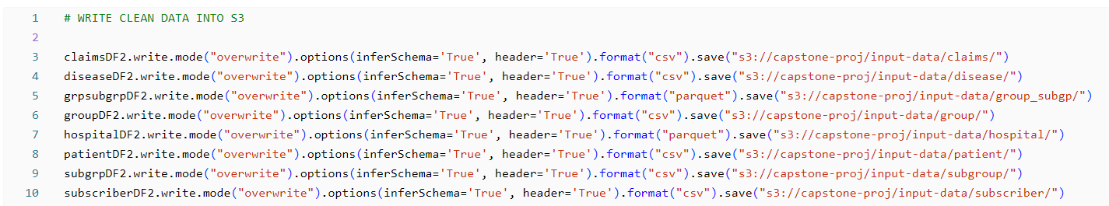
UPLOAD CLEAN DATA BACK INTO S3
Upload cleaned data into S3
Created a crawler and executed it to create Glue Tables on the cleaned data
Used Athena to check the table data for any inconsistencies or inaccurate formatting

Slide 9
IMPEMENTATION & TESTING
Used Databricks and Pyspark for development
Connect Databricks to S3
Read from AWS S3 input/ folder (cleaned data) and created dataframe for each table to be used for our use cases.
Create DataFrame for each use cases (11)

Slide 10
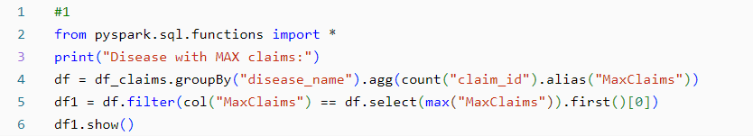
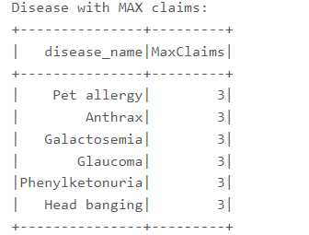
Usecase 1 : Which disease has a maximum number of claims.
Table used: CLAIMS
Methods Used: groupBy(), count(), filter(), max()
Output ->

Slide 11
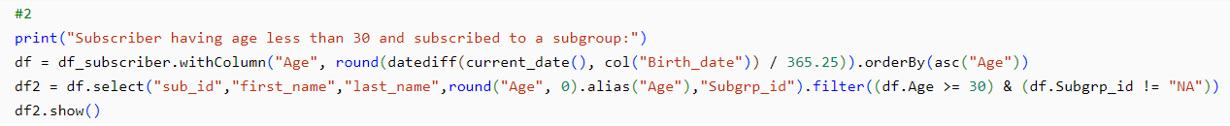
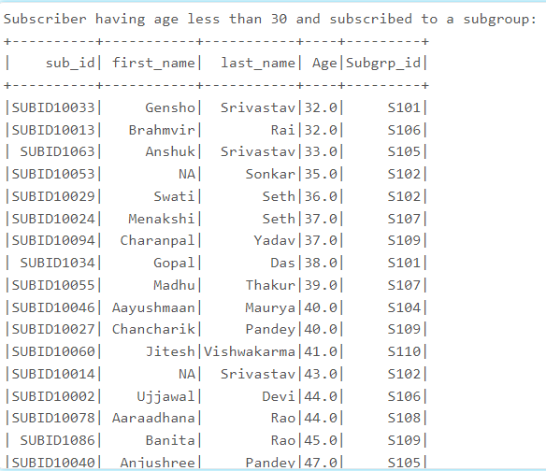
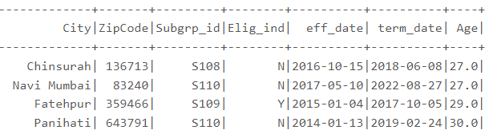


Usecase 2 : Find those Subscribers having age less than 30 and they subscribe any subgroup
Table used: SUBSCRIBER
Methods Used: withColumn(), groupBy(), datediff(), filter(), round(), current_date(), orderBy()
Output ->

Slide 12
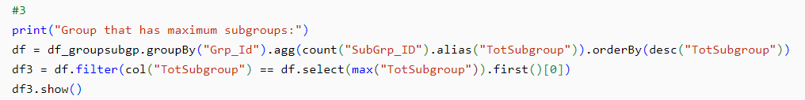
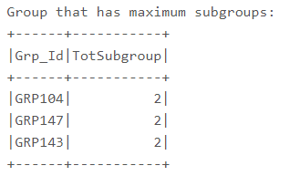
Usecase 3 : Find out which group has maximum subgroups.
Table used: GROUPSUBGROUP
Methods Used: groupBy(), count(), filter(), max()
Output ->

Slide 13
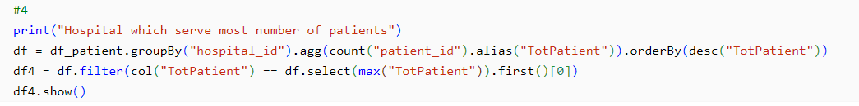
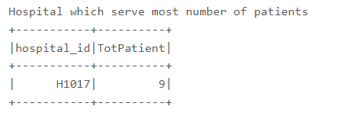
Usecase 4 : Find out hospital which serve most number of patients
Table used: PATIENT
Methods Used: groupBy(), count(), filter(), max(), select()
Output ->

Slide 14
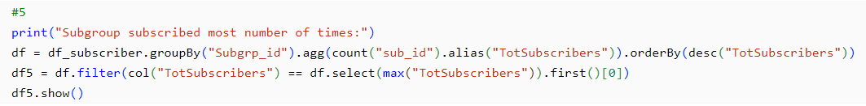
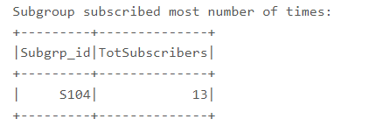
Usecase 5 : Find out which subgroups subscribe most number of times
Table used: SUBSCRIBER
Methods Used: groupBy(), count(), filter(), max(), first()
Output ->

Slide 15
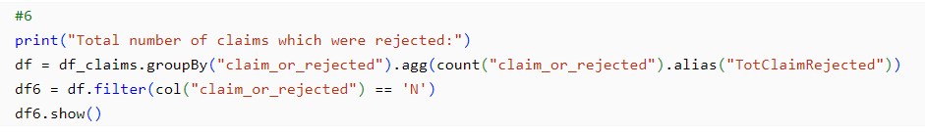
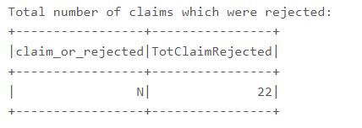
Usecase 6 : Find out total number of claims which were rejected
Table used: CLAIMS
Methods Used: groupBy(), count(), filter(), col()
Output ->

Slide 16
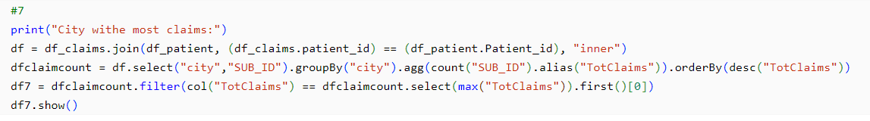
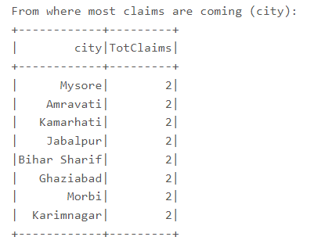
Usecase 7 : From where most claims are coming (city)
Table used: CLAIMS, PATIENT
Methods Used: join(), select(), groupBy(), count(), filter(), max(), orderBy(), first()
Output ->

Slide 17
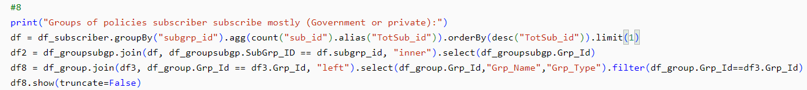

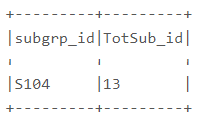
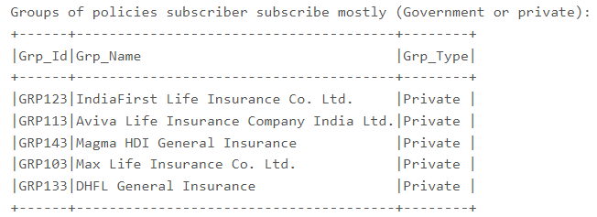
Usecase 8 : Which groups of policies subscriber subscribe mostly Government or private
Table used: SUBSCRIBER, GROUPSUBGROUP, GROUP
Methods Used: groupBy(), count(), orderBy(), Limit(), join(), select(), filter()
Output ->

Slide 18
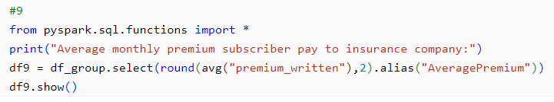
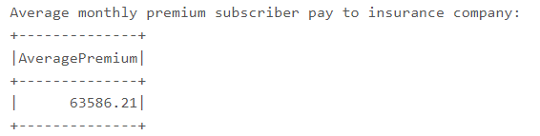
Usecase 9 : Average monthly premium subscriber pay to insurance company
Table used: GROUP
Methods Used: select(), avg()
Output ->

Slide 19
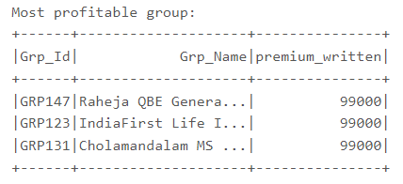
Usecase 10 : Find out Which group is most profitable
Table used: GROUP
Methods Used: select(), filter(), max(), first()
Output ->

Slide 20
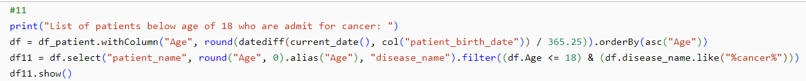
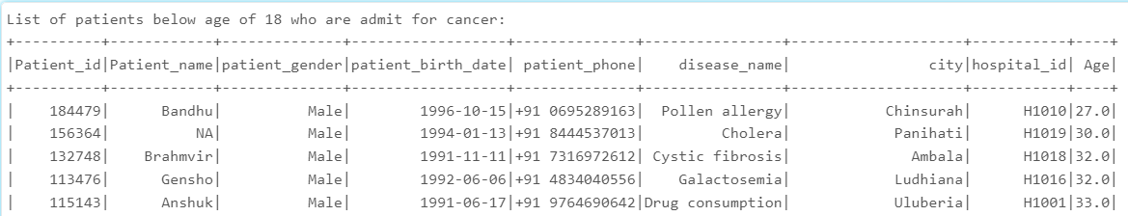
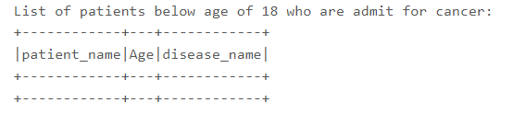

Usecase 11 : List all the patients below age of 18 who are admit for cancer
Table used: PATIENT
Methods Used: withColumn(), round(), current_date(), datediff(), orderBy(), filter()
Output ->

Slide 21
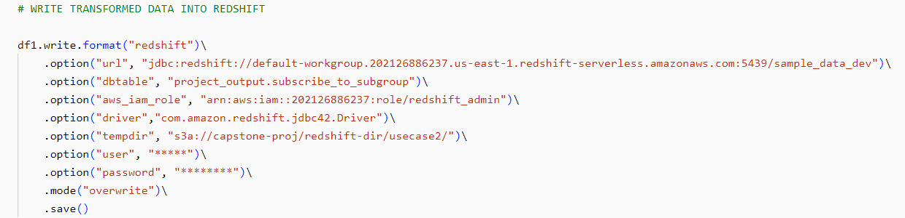
DEPLOYMENT
RESULT CREATION ON REDSHIFT
Move the resultant output tables into Redshift in “Project-Output” schema.

Slide 22
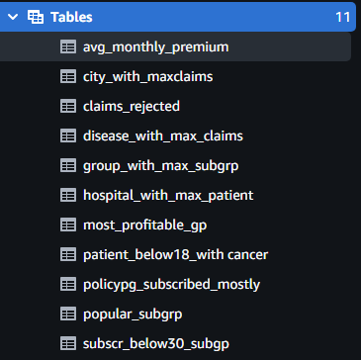
Individual redshift table for each use case output in a redshift schema “Project-Output”

Slide 23
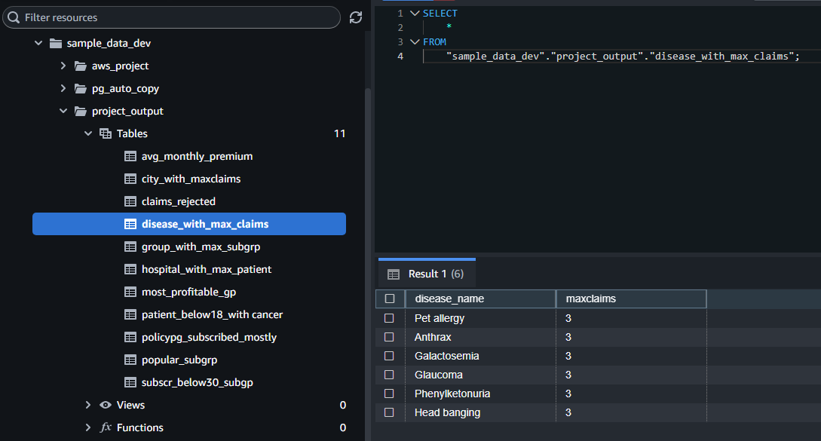
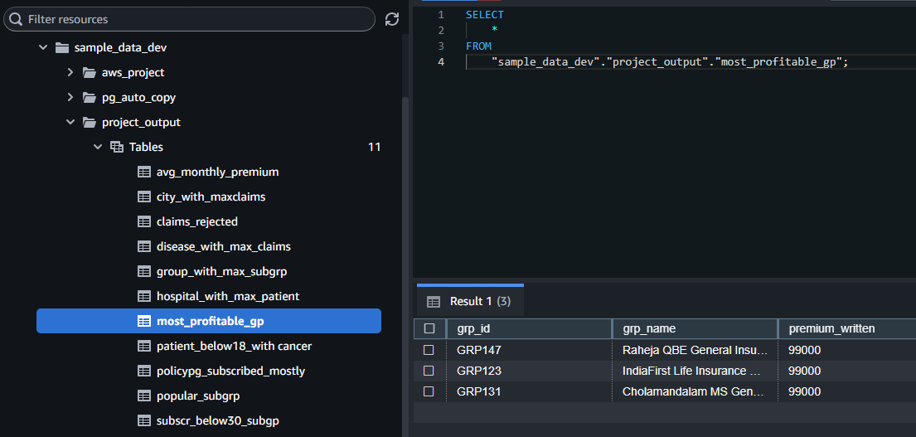
REDSHIFT QUERY EDITOR:
<- Sample Query 1
Sample Query 2 ->

