Slide 1
Data Engineer TA Session
Zhonglin Han

Slide 2
Outlines
How to use AWS to build your clusters
EC2 instance
EMR steps
S3
Introduction of Spark
Why Spark
Key words of Spark
An example of SparkSQL

Slide 3
Amazon Web Service (AWS)
Elastic Compute Cloud (EC2)
Elastic MapReduce (EMR)
Simple Storage Service (S3)
Steps to start the EMR
Example for spark clusters setup

Slide 4
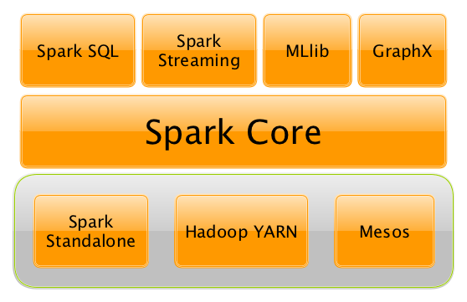
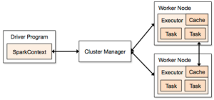
Introduction of Spark
Terminology of Spark
Why Spark & Spark Architecture

Slide 5
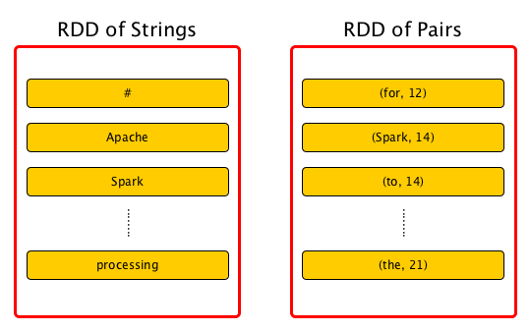
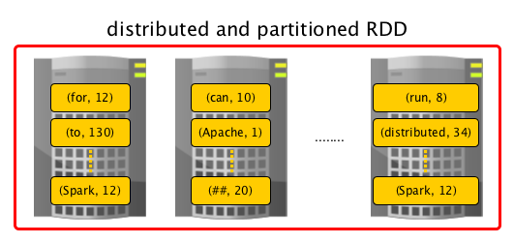
Spark RDD Overview
“Resilient Distributed Datasets (RDDs) are a distributed memory abstraction that lets programmers perform in-memory computations on large clusters in a fault-tolerant manner.” Resilient Distributed Dtasets: A Fault-Tolerant Abstraction for In-Memory Cluster Computing

Slide 6
Operators - Transformations and Actions
Transformations : lazy operations on a RDD that return RDD objects or collections of RDDs, e.g.map, filter, reduceByKey, join, cogroup, randomSplit, etc.
Actions : operations that return values, i.e. any RDD operation that returns a value of any type butRDD[T] is an action. Like : aggregate, collect, count, first

Slide 7
First Example of SparkSQL
Tools : Zeppeline + S3
Or use terminal command line /usr/bin/pyspark

