Slide 1
DataEthics4All
Chloe Feng with Mentor Juliana Shihadeh

Slide 2
Goal of the Project
How it was created
Explanation on the Project
Results
Demo
What I've learned
Overview:

Slide 3
Terminal Towers + Flatiron Building
My Project Goal:
To be able to classify the type of a building from two different classes

Slide 4
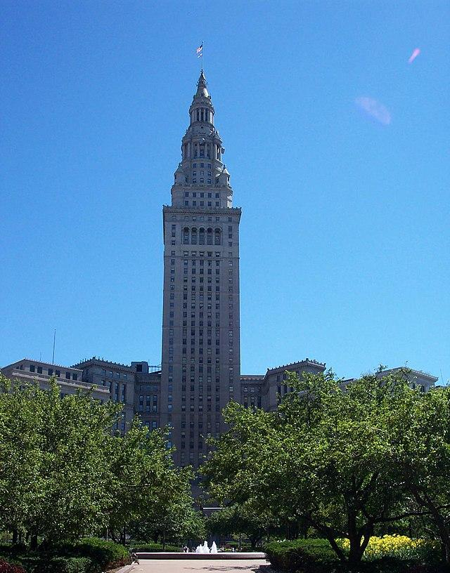
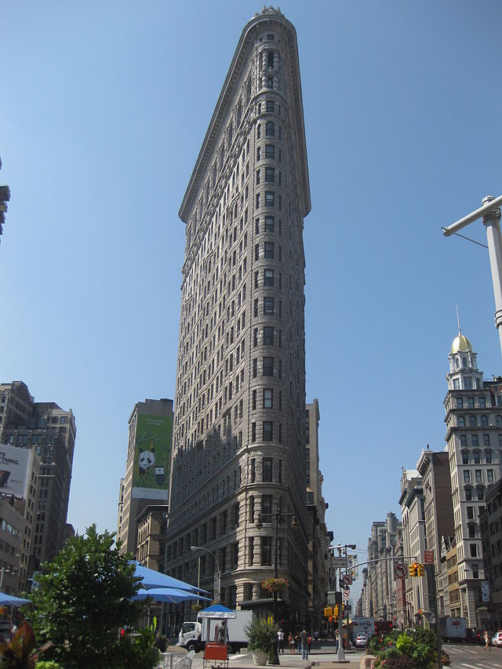
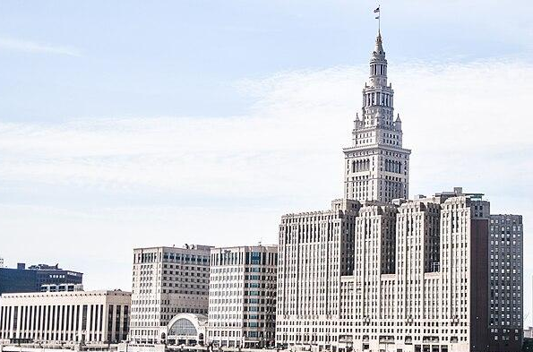
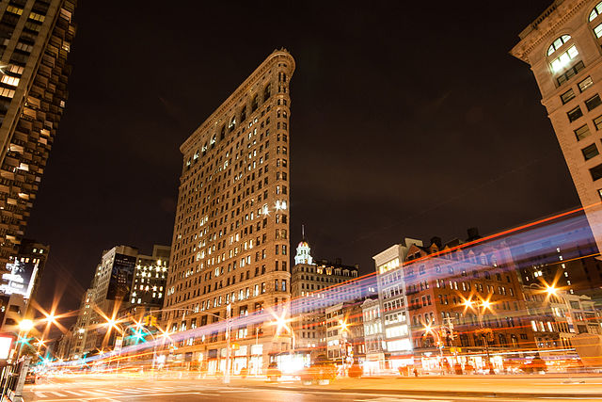
Dataset Overview
Using the Google Landmarks Dataset V2, curated a sub-dataset based on two buildings: Terminal Tower and the Flatiron Building.
Total amount of images
Terminal Towers: 256 images
Flatiron Building: 170 images

Slide 5
My Implementation Method
3. Resizing the data
1. Curating a Dataset
2. Creating Directories
Google Landmarks Dataset V2, Terminal Towers + Flatiron Building
Separated the data into a training set and a testing set
Preprocessing testing sets for both classes in for loops so images are the same size
6. Creating a model
4. Extracting RGB values
5. Reshaping array
Transforming from a 3D array into a 2D array
Trained a k-means model to cluster the data into two groups
Took the RGB values from each image

Slide 6
Evaluation Methodology
The amount of true labels in the training predictions was 272 images with 203 that matched.
The amount of true labels in the testing predictions was 85 images with 62 that matched.

Slide 7
Methodology
Training + Testing accuracy
Checked how many of the predictions matched the actual label of the image.
Accuracy: number of correct images/total images
Analyzing the clusters visually
I graphed the data points to see the shape of the two clusters. When the clusters overlap less it means that k-means is more accurate.

Slide 8
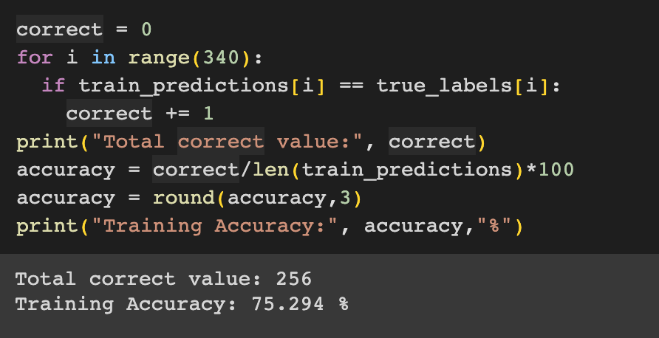
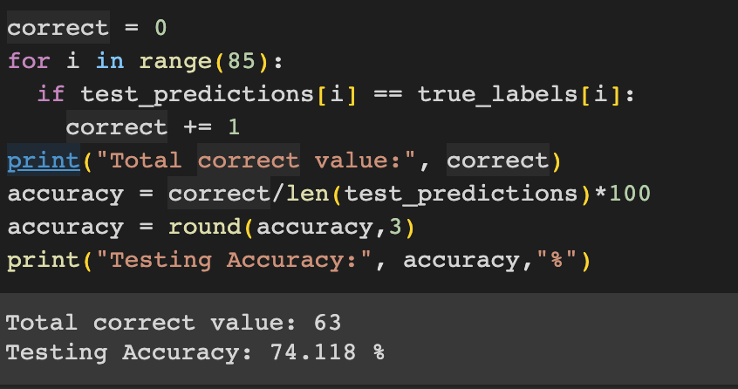
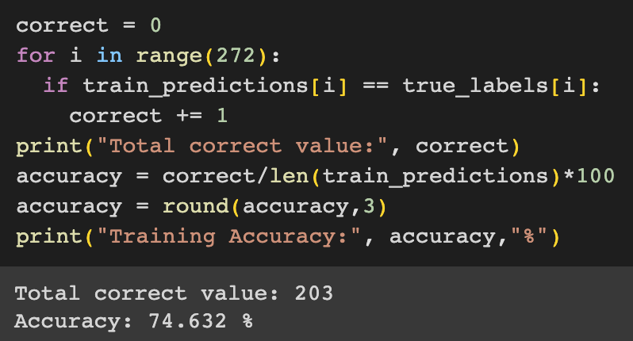
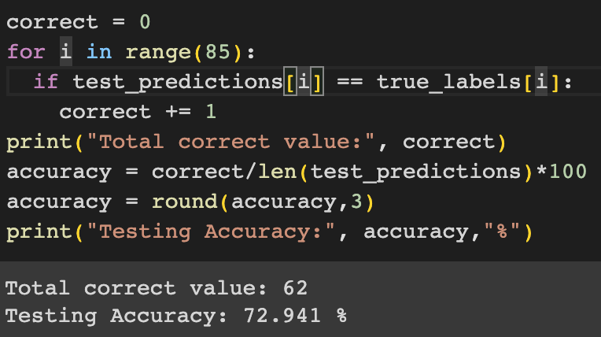
Results
Balanced Dataset = Equal # of Images in Each Class
Unbalanced Dataset = One Class had more images
The unbalanced dataset has a higher accuracy percentage the the balanced as it has more images to train on.
Unbalanced dataset
Balanced dataset
 | Unbalanced | Balanced
Training Accuracy | 75.3% | 74.1%
Testing Accuracy | 74.6% | 72.9%

Slide 9
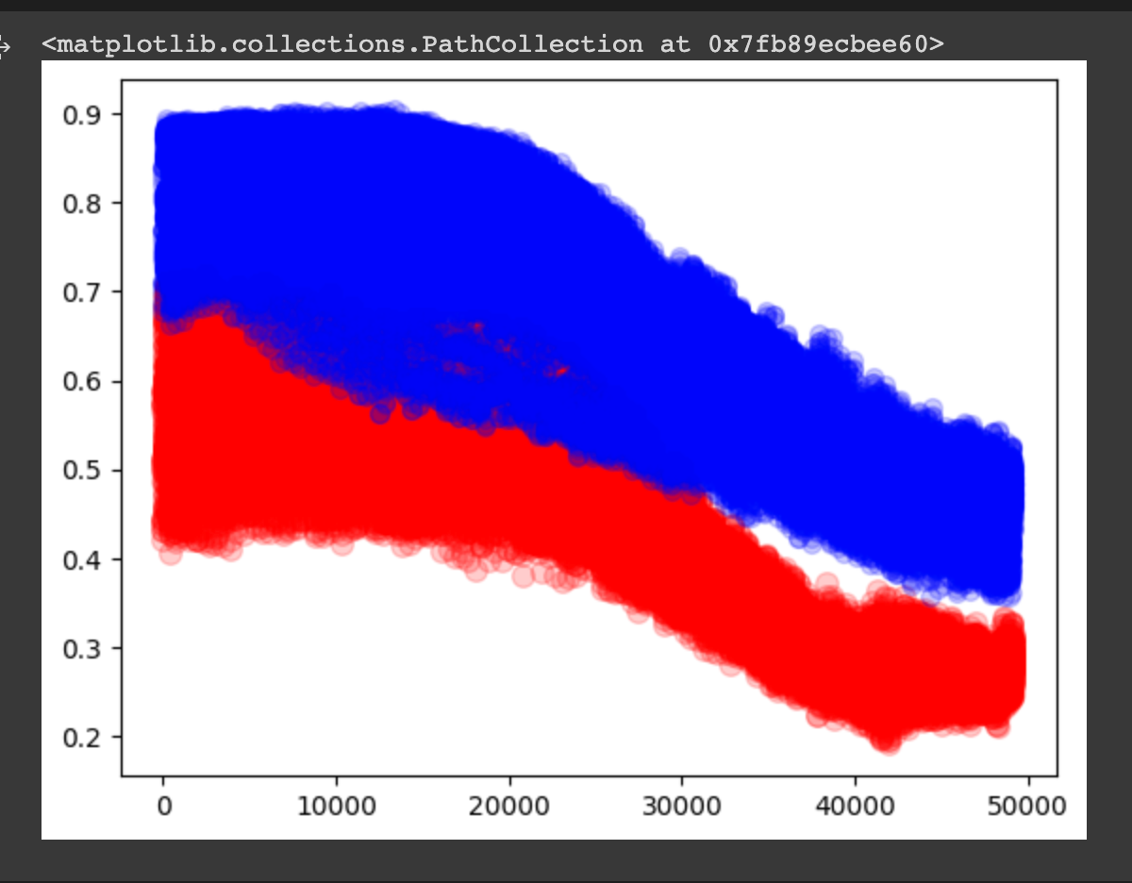
Results
An Example of a Graph of the Clusters
The datapoints partially overlap in the center

Slide 10
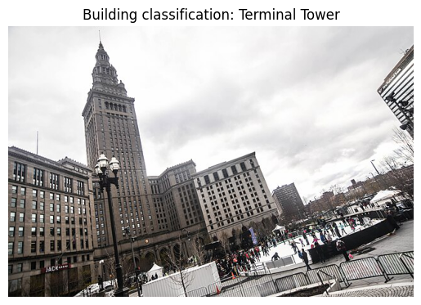
Demo
The model is able to classify whether the image is from Terminal Tower or from Flatiron Building.

Slide 11
My Experience
Challenges:
Learning about the basics of Python and how to effectively use different types of functions
Favorites:
I enjoyed learning about the different applications of AI and also about how to code in Python.

Slide 12
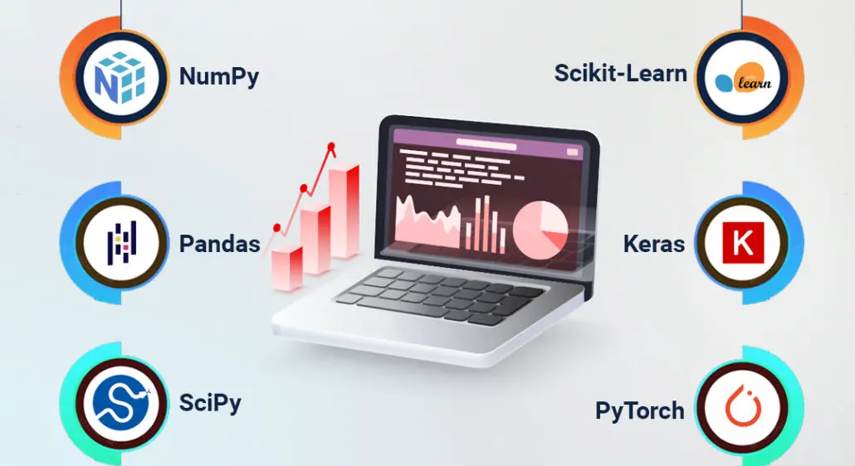
What I've Learned
Understanding the impacts of AI and how it works
Different types of libraries (Machine Learning Libraries)
Experimenting with Python, Jupyter notebook, and Google Collab

Slide 13
Sources:
https://storage.googleapis.com/gld-v2/web/index.html
https://machinelearningmastery.com/save-load-machine-learning-models-python-scikit-learn/
https://www.learndatasci.com/solutions/python-move-file/
https://scikit-learn.org/stable/modules/generated/sklearn.cluster.KMeans.html
https://medium.com/analytics-vidhya/how-to-calculate-rgb-values-for-some-images-in-python-ccf9abcea8f3

Slide 14
Thanks!
-
Please keep this slide for attribution

