Slide 1
CHAMELEON
An AI-driven melody harmonization system based on Conceptual Blending.

Slide 2

01
CONCEPTUAL BLENDING AS A CREATIVE MUSIC SYSTEM
HOW MANY HARMONIES HIDE IN 8 NOTES?
El cant dels ocells

Slide 3




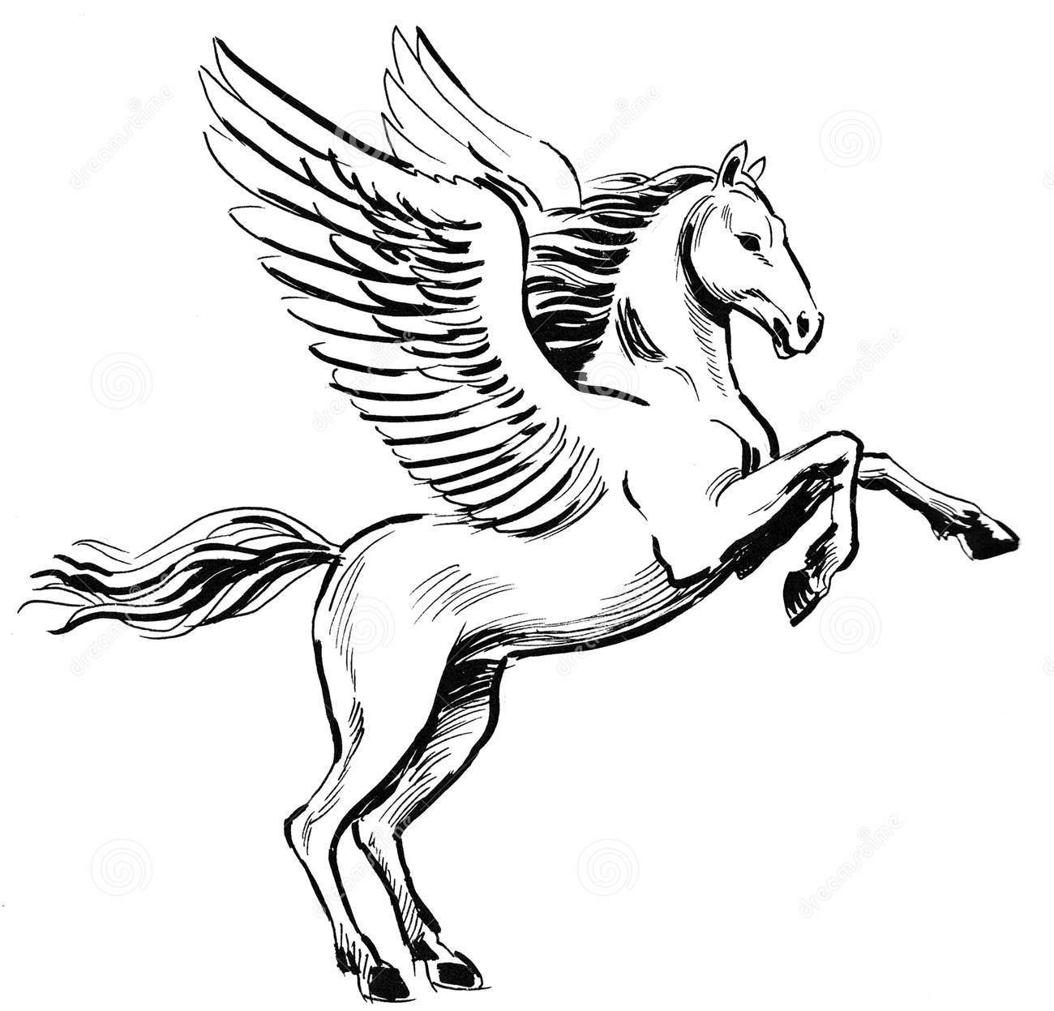

Some Blends
Boat House
Planets Atom
Boathouse
Rutherford’s atomic model
Toothbrush Jacknife
Horse Bird
Human Duck
Folding toothbrush
Pegasus
Donald Duck

Slide 4
CONCEPTUAL BLENDING
https://ccm.web.auth.gr/blendedharmonisations.html

Slide 5
Blending in harmony
CHAMELEON harmonisation assistant

Slide 6
02
Functionality
Under the hood

Slide 7
TRAINING
Modal harmonisation in the Middle Ages (11th – 14th centuries): includes subcategories of the Medieval harmonic styles of Organum and Fauxbourdon.
Modal harmonisation in the Renaissance (15th – 17th centuries): includes modal music from the 16th – 17th centuries along with modal chorales.
Tonal harmonisation (17th – 19th centuries): includes a set of Bach Chorales, the Kostka-Payne corpus (http://theory.esm.rochester.edu/temperley/kp-stats/index.html) and tonal harmonisation sets from the 18th – 19th centuries.
Harmonisation in National Schools (19th – 20th centuries): includes 19th – 20th century harmonisation of folk songs from Norway, Hungary and Greece.
Harmonisation in the 20th century: includes mainly vocal music by Cl. Debussy, P. Hindemith, E. Whitacre, I. Stravinsky, among others. Also, includes 20th-century harmonic concepts extracted from short musical excerpts.
Harmonisation in folk traditions: includes Tango (classical and nuevo styles), Epirus polyphonic songs and Rebetiko songs.
Harmonisation in 20th-century popular music and jazz: includes mainstream jazz, piano pieces by Bill Evans and a collection of songs by The Beatles.
https://ccm.web.auth.gr/datasetdescription.html
CHAMELEON is trained on a vast amount of different harmonic levels (chord transitions, cadences and voice leading) from a data pool with ‘real-world’ representations of historical traditions of music creation.

Slide 8
Statistical learning of harmonies
The harmoniser is based on a statistical learning approach (HMMs) that combines different learning modules:
chord types
chord transitions
cadences
bass line voice leading
The training material comprises many diverse musical idioms, annotated by human experts.

Slide 9

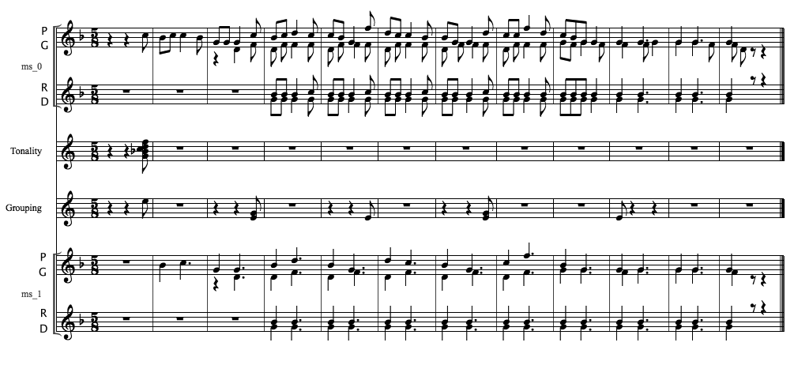
Annotated score example
Tin Ammo Ammo Pigena
Explainable AI

Slide 10
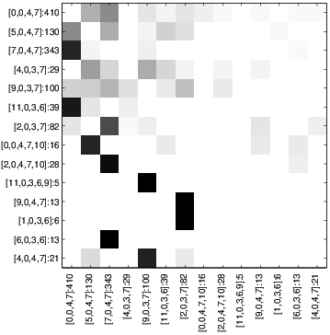
Chord transition spaces
Chord transitions are learned from data
Pitch class based chord system

Slide 11
03
USING CHAMELEON
The fun part

Slide 12
Using Chameleon
Harmonic blending, as performed by CHAMELEON, involves two different processes:
melody-harmony blending, whereby a melody originating from a given musical idiom (with certain implied harmonic qualities) is harmonized based on a harmonic space (chord types, chord transitions, cadences, basic voice-leading) derived via machine learning from a different harmonic idiom.
harmony-harmony blending whereby the harmonic space that is used to harmonize a given melody is, itself, the product of blending between two different harmonic idioms.
In this paper we use both processes, whereby an annotated melody is presented to the system to be harmonized in different single or blended harmonic styles

Slide 13
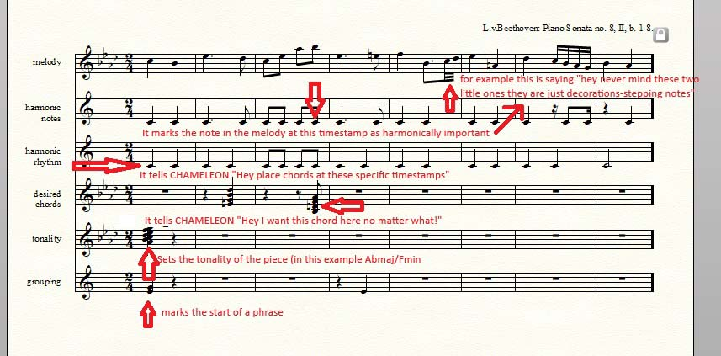
CHAMELEON WORKS BACKWARDS
Start from the cadenzas.
Firstly the model harmonizes the phrase endings.

Slide 14

Polyphonic Epirus song (PE)
Melody of Tin Ammo Ammo Pigena polyphonic song from Epirus harmonised by the cHMM model

Slide 15
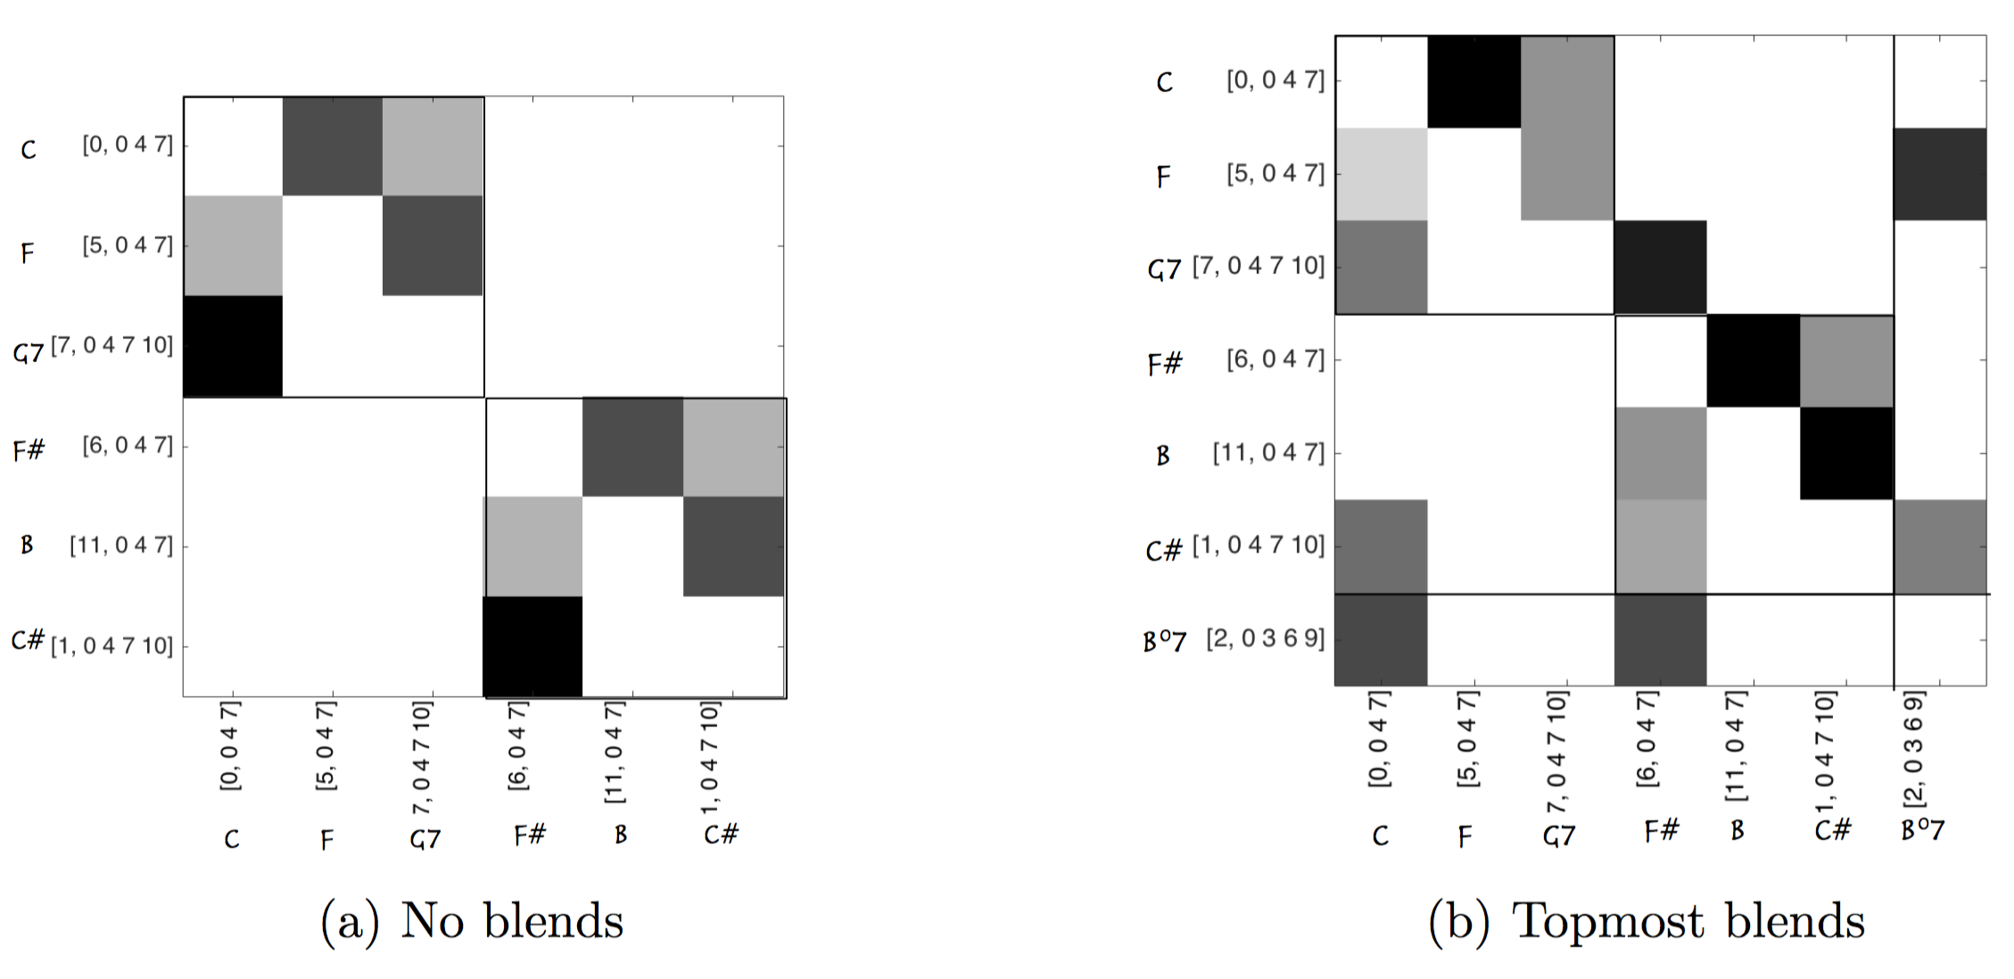
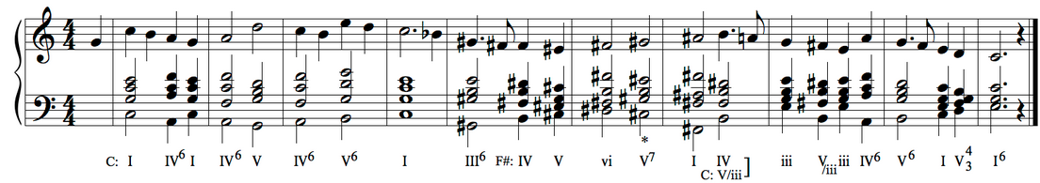

Blending chord transition matrices
User selects two idioms from a list.
System automatically blends the most common transitions
The ‘best’ resulting blends are integrated in a compound matrix.

Slide 16
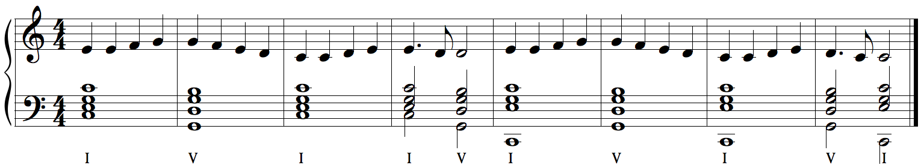

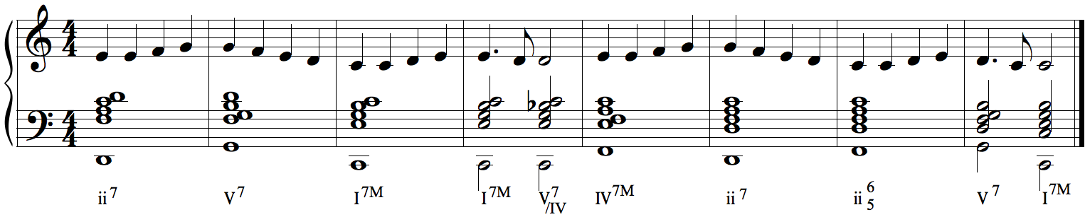
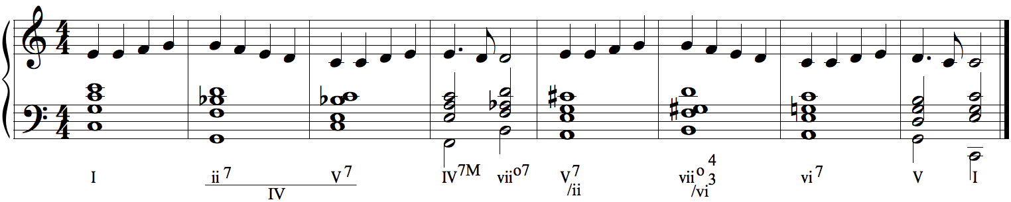
Harmony-Harmony Blending: Harmonization by Blending Harmonic Spaces
L.v. Beethoven's "Ode to joy" with three harmonisations:
BC major (Bach chorale), JA major (Jazz), Blend of BC major/JA major

Slide 17
Discussion
CHAMELEON aids composers at one of the most important stages of composition, the choice of pitch material and the creation of the harmonic background, by providing a computational environment which very rapidly produces a multitude of diverse creative options, thus by broadening their choices.
What defines the quality and originality of the musical result is ultimately each composer's personal touch and inventiveness, as the creative kick provided by CHAMELEON is only the first stage of evolution of the pieces' character, form and design, parameters between which the seven compositions differentiated substantially.
Creative systems such as CHAMELEON may enhance users’ appreciation for and engagement with music creation.

Slide 18
Used in real life
Chameleon has been used by some composers to enchance their work’s creative approach.
https://ccm.web.auth.gr/creativeusecomposers.html
https://www.artificia.pro/chameleons-blendings-premiere

Slide 19
Future Work
Training data expansion (on existing idioms and adding more)
Automating the detection of the harmonic notes, tonality and cadencas
Adding back the blending percentage bar
Better more musical ouput (music 21 issues)
Fix some bugs when the tonality is different from what expected (matlab -> python)

Slide 20
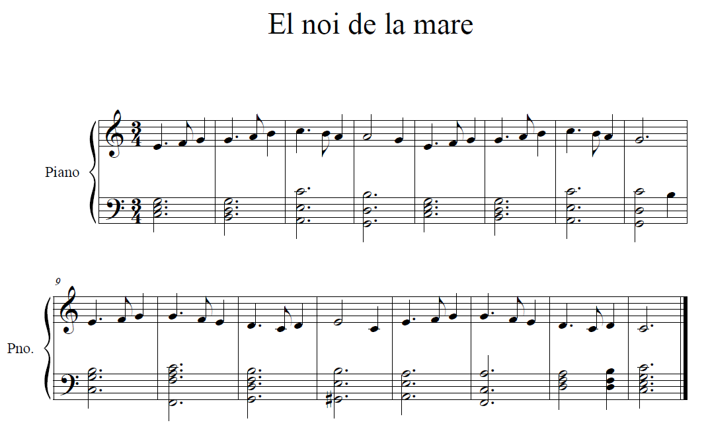

Slide 21
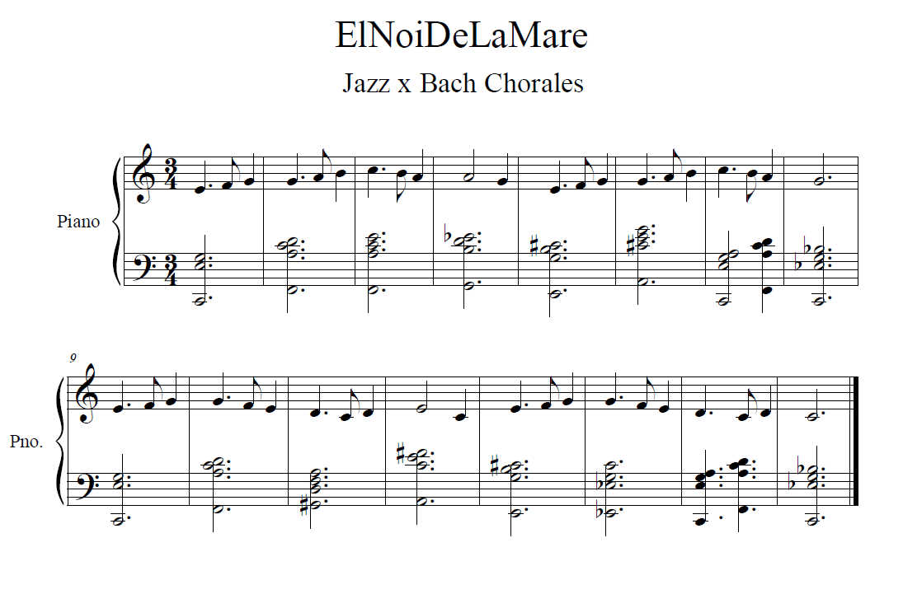
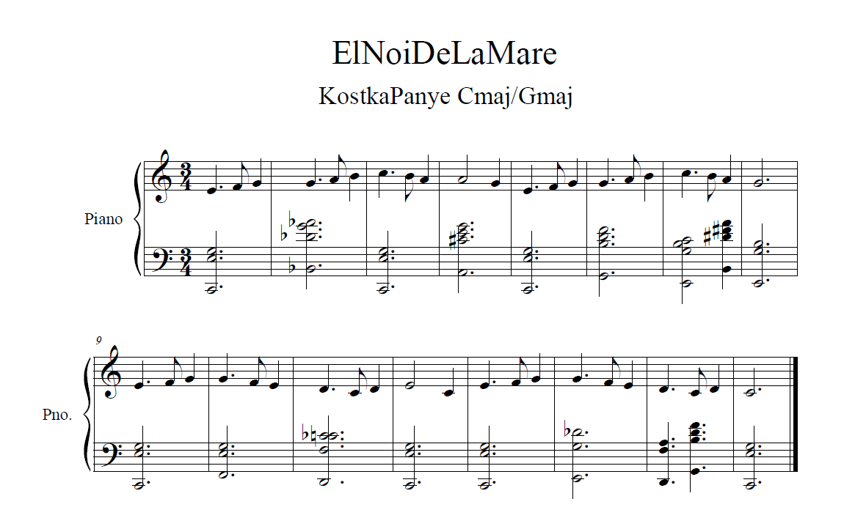

Slide 22
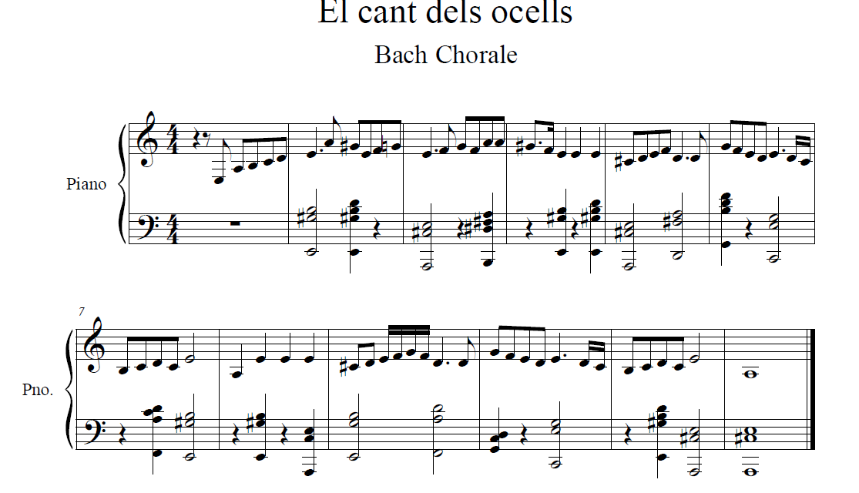

Slide 23
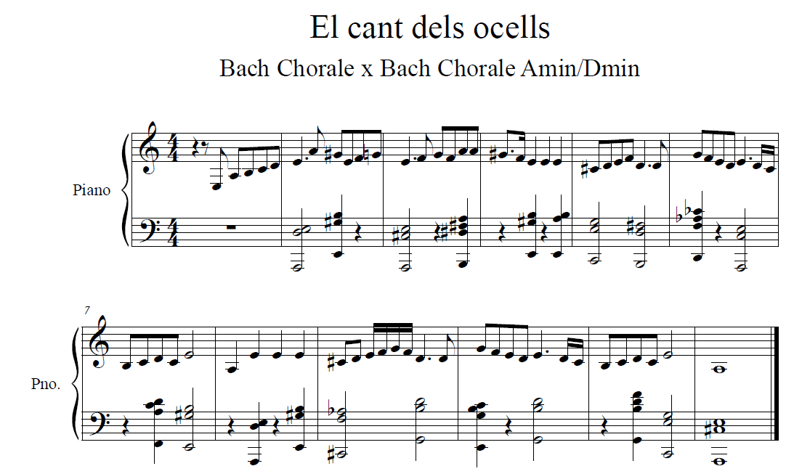
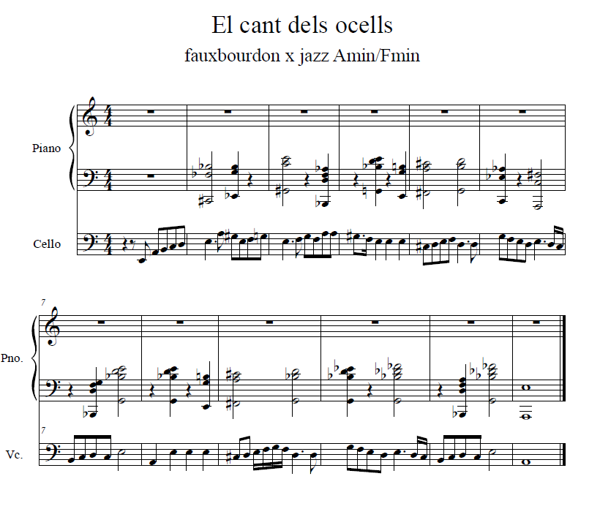

Slide 24
Thank you!
Do you have any questions? Lets try some music together!
christkoutso@gmail.com

