Slide 1
CHAMELEON
An AI-driven melody harmonization system based on Conceptual Blending.

Slide 2
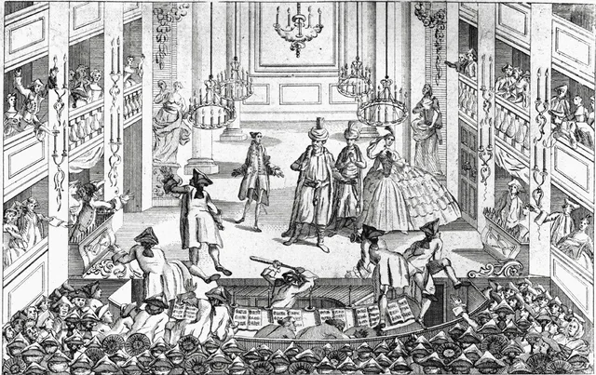
Introduction
Paris, May 29 1913. A packed Théâtre des Champs-Élysées awaits the premiere of Igor Stravinsky’s Rite of Spring.
Thirty seconds in, bassoons snarl in a register no bassoon had dared before; off-kilter accents shatter the graceful ballet expectations.

Slide 3
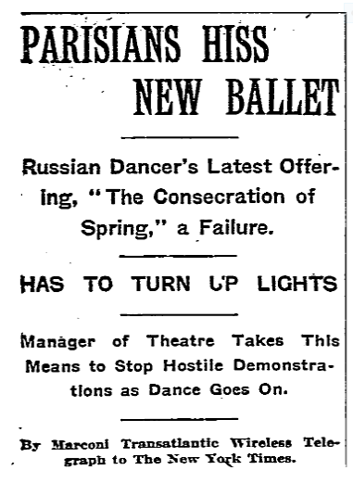
Introduction
Fistfights break out, the police are called, the press writes of a ‘scandalous cacophony’.

Slide 4
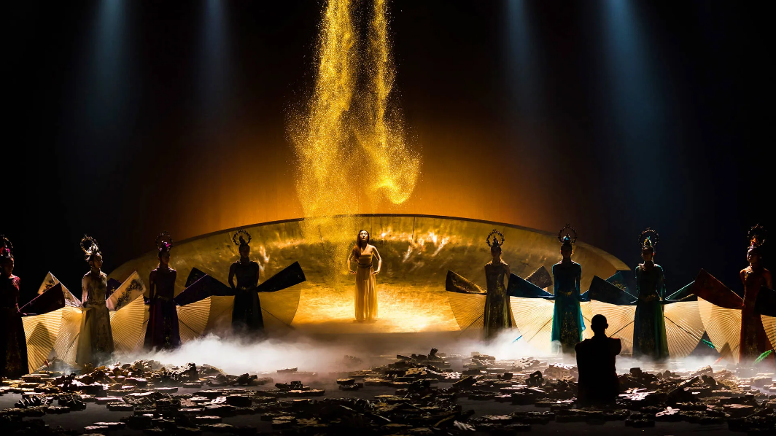
Introduction
Fast-forward a century: the same piece is studied in every harmony class and sells out concert halls
Rite of Spring by Yang Liping in Melbourne Festival. Photo by Yijian Li (2019)

Slide 5

WHAT IS CREATIVITY?
Human creativity is something of a mystery, not to say a paradox.
M.Boden(1990)

Slide 6
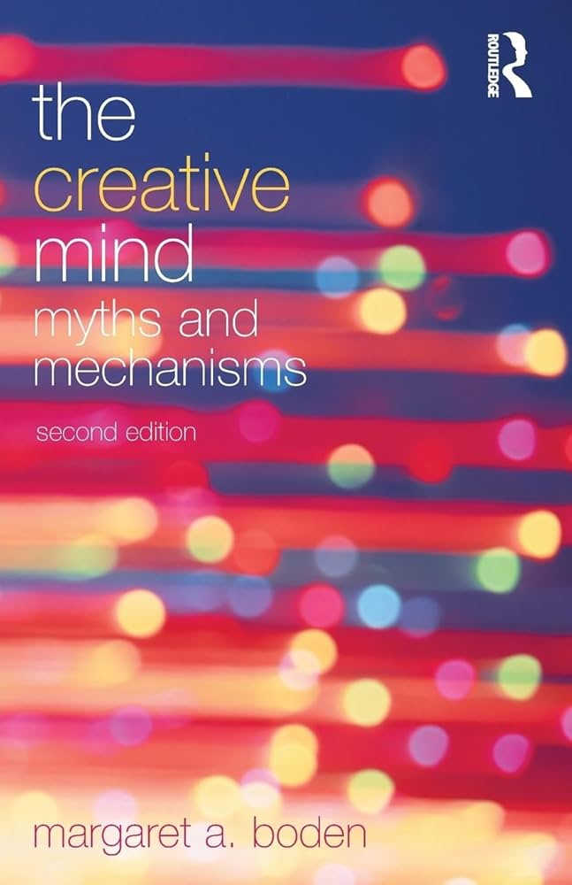
WHAT IS CREATIVITY?
According to M.Boden:
Creativity in general is the generation of
Novel
Valuable ideas
Surprise

Slide 7
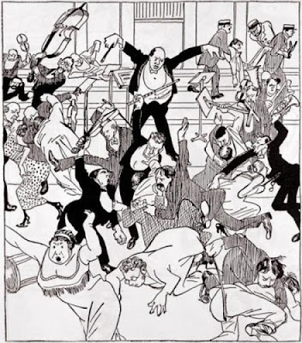
THE RITE OF SPRING
‣ Novel? Primitive rhythms, polytonality, bassoon in the stratosphere—none of it had precedent.
‣ Surprising? The audience literally rioted.
‣ Valuable? It reshaped 20th-century music; today it’s canonical.
That’s creativity in a nutshell: new, unexpected, yet ultimately prized. Our goal with CHAMELEON is humbler but similar—let a computer propose harmonies that make you raise an eyebrow.
AND WHY NOT? START A RIOT!

Slide 8

Can we create creativity?
Even better: Does a computer can?
If we manage to provide any of these:
Novelty (not so easy)
Valuable ideas (more subjective)
Surprise(now we talk)

Slide 9
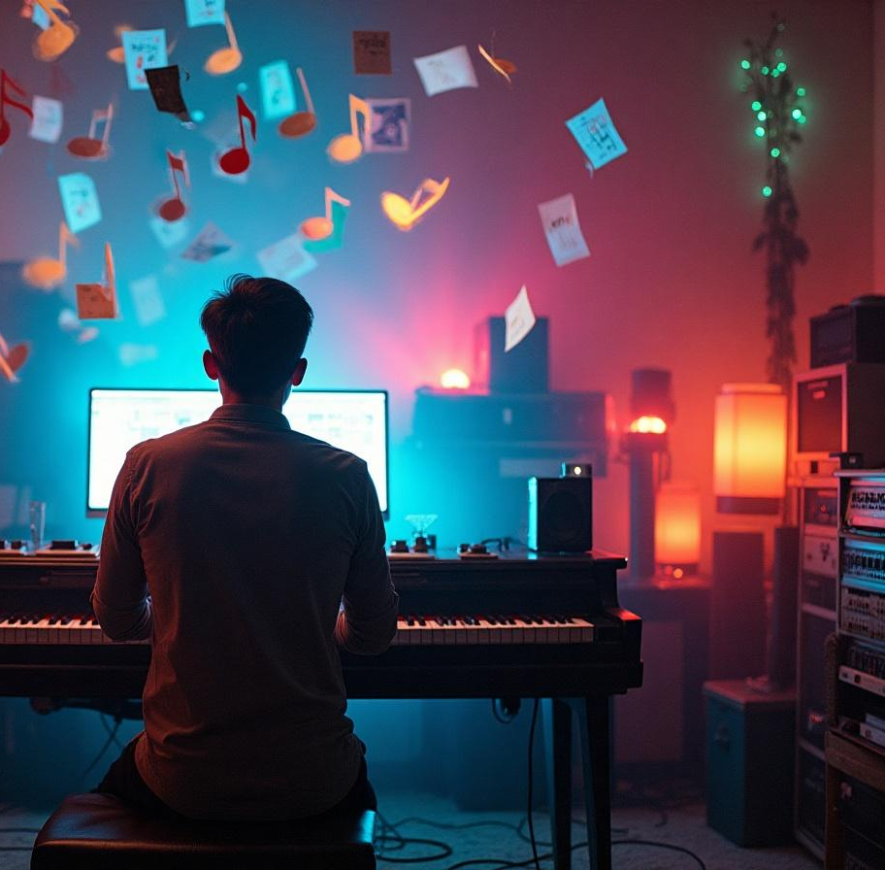
The three roads to: SURPRISE
3 Types of Creativity that lead to the unexpected:
Exploratory (Little surprise) A student harmonising Bach chorales: they stay inside strict voice-leading, yet discover fresh inner-part moves and surprise suspensions.
Transformational (More surprise) Schoenberg’s twelve-tone system drops major/minor keys and treats all 12 pitches as equals.
Combinational (Maximum Surprise) Gershwin’s “Rhapsody in Blue”: classical orchestration collides with hot-club jazz chords.

Slide 10

01
CONCEPTUAL BLENDING AS A CREATIVE MUSIC SYSTEM
HOW MANY HARMONIES HIDE IN 8 NOTES?
El cant dels ocells

Slide 11
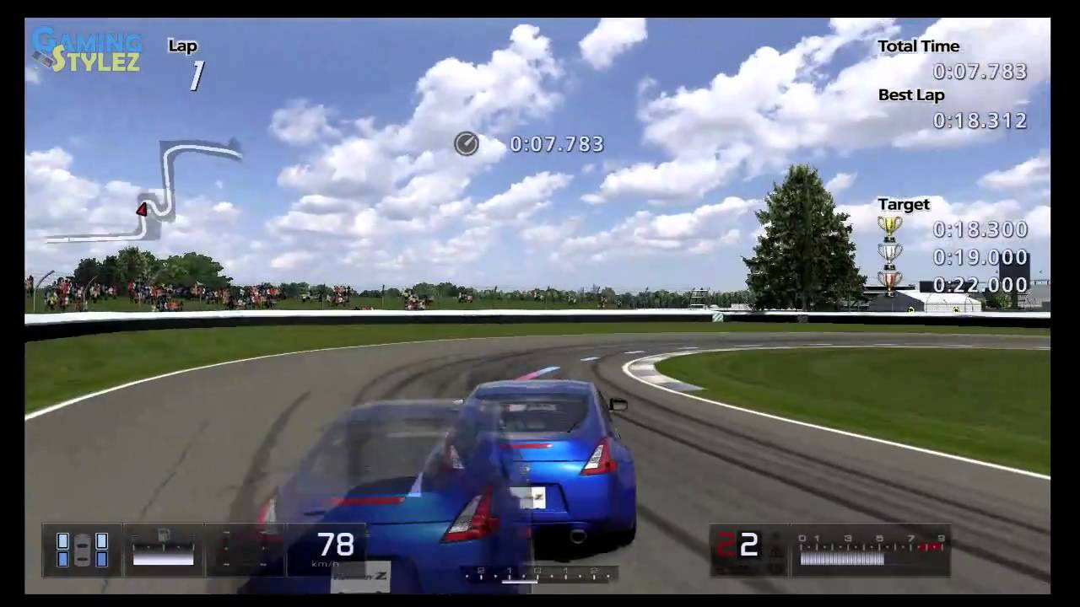
CONCEPTUAL BLENDING
PREVIOUS LAP
CURRENT LAP

Slide 12
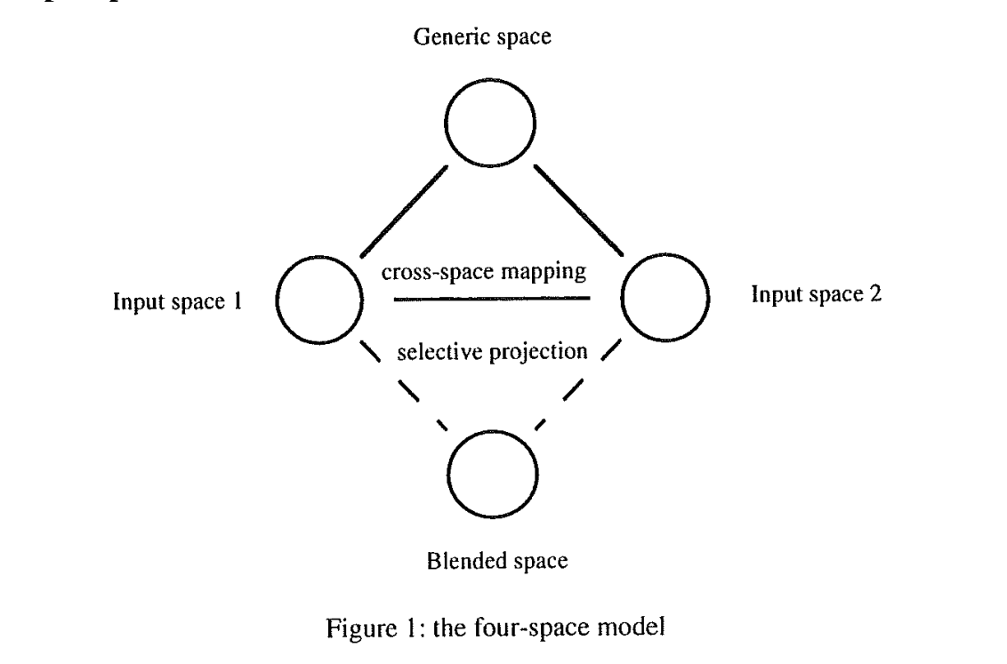
CONCEPTUAL BLENDING
Race track
Previous lap
Current lap
‘ghost’ view
‘Normal’ view
Final output
CONCEPTUAL BLENDING, FORM AND MEANING, Gilles Fauconnier and Mark Turner (2003)

Slide 13
CONCEPTUAL BLENDING
Blending element | Racing-game scene | CHAMELEON harmony
Generic space | The shared racetrack geometry | The given melody & four-part texture
Input space 1 | Recorded lap (ghost car) | Idiom A – e.g., strict Bach-style chorale rules
Input space 2 | Your current live lap | Idiom B – e.g., modern jazz chord–scale practice
Blend | Both cars visible together—every corner shows who’s ahead or behind | A single progression where, say, a G13 ♭9 (jazz colour) resolves with flawless Bach voice-leading

Slide 14
CONCEPTUAL BLENDING
Jazz Idiom
Bach Chorale Idiom

Slide 15
CONCEPTUAL BLENDING
Major key
Minor key

Slide 16
CONCEPTUAL BLENDING
https://ccm.web.auth.gr/blendedharmonisations.html

Slide 17
02
Functionality
Under the hood

Slide 18
TRAINING
Modal harmonisation in the Middle Ages (11th – 14th centuries): includes subcategories of the Medieval harmonic styles of Organum and Fauxbourdon.
Modal harmonisation in the Renaissance (15th – 17th centuries): includes modal music from the 16th – 17th centuries along with modal chorales.
Tonal harmonisation (17th – 19th centuries): includes a set of Bach Chorales, the Kostka-Payne corpus (http://theory.esm.rochester.edu/temperley/kp-stats/index.html) and tonal harmonisation sets from the 18th – 19th centuries.
Harmonisation in National Schools (19th – 20th centuries): includes 19th – 20th century harmonisation of folk songs from Norway, Hungary and Greece.
Harmonisation in the 20th century: includes mainly vocal music by Cl. Debussy, P. Hindemith, E. Whitacre, I. Stravinsky, among others. Also, includes 20th-century harmonic concepts extracted from short musical excerpts.
Harmonisation in folk traditions: includes Tango (classical and nuevo styles), Epirus polyphonic songs and Rebetiko songs.
Harmonisation in 20th-century popular music and jazz: includes mainstream jazz, piano pieces by Bill Evans and a collection of songs by The Beatles.
https://ccm.web.auth.gr/datasetdescription.html
CHAMELEON is trained on a vast amount of different harmonic levels (chord transitions, cadences and voice leading) from a data pool with ‘real-world’ representations of historical traditions of music creation.

Slide 19
EVERYTHING IS RELATIVE
For CHAMELEON all notes in the melody are translated as relations to the root (based on the tonality setting)
e.g. In a Cmaj scale a G not is not a G but a 7(7 semitones from the root) as absolute and a 5 (V) as realative.

Slide 20
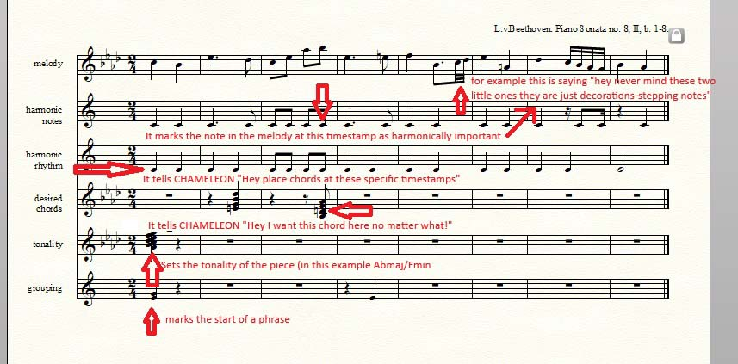
CHAMELEON WORKS BACKWARDS
Start from the cadenzas.
Firstly the model harmonizes the phrase endings.

Slide 21
Integration with music software

Slide 22
Conclusions
In conclusion, CHAMELEON exemplifies the intersection of technology and creativity within music studies. Its innovative approach to melody harmonization not only aids composers but also serves as a valuable educational resource. By leveraging AI algorithms, CHAMELEON enhances the richness of musical composition, making it an indispensable tool in contemporary music making.
In conclusion, CHAMELEON exemplifies the intersection of technology and creativity within music studies. Its innovative approach to melody harmonization not only aids composers but also serves as a valuable educational resource. By leveraging AI algorithms, CHAMELEON enhances the richness of musical composition, making it an indispensable tool in contemporary music making.

Slide 23
Thank you!
Do you have any questions?

