Slide 1
Apache Hadoop Installation
Will|PMC
Email:datafibers@gmail.com
Date: 2017-07-17

Slide 2
Prerequisites
OS installed, such as Ubuntu, CentOS, RedHat, Windows
Java installed by checking "java -version", >= 1.7
SSH installed, sudo apt-get install openssh-server
Hadoop binary – will show the download later
All command is highlighted in this way and run in Ubuntu in this slide.

Slide 3
Hadoop Supported Running Mode
Local (Standalone) Mode - By default, Hadoop is configured to run in a non-distributed mode, as a single Java process. This is useful for debugging and no need to configure.
Pseudo-Distributed Mode - Hadoop can also be run on a single-node in a pseudo-distributed mode where each Hadoop daemon runs in a separate Java process. This tutorial will start the installation steps from this mode.
Fully-Distributed Mode - Hadoop can be run on a multiple-node in a fully-distributed mode where each Hadoop daemon runs in a separate physical node. This tutorial will also cover the installation steps for this mode at the end.
Let’s start from master node configuration

Slide 4
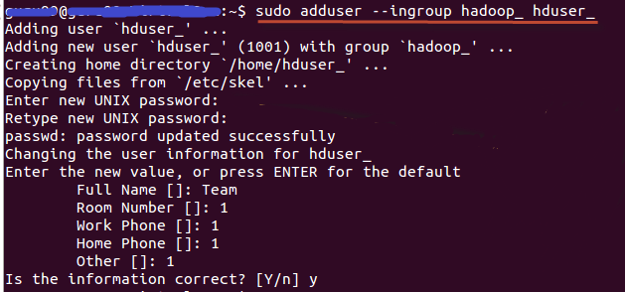
Add A Hadoop System User
Add group - sudo addgroup hadoop_
Add the user to the group - sudo adduser --ingroup hadoop_ hduser_
Note:
if there is an error in later steps, like "hduser is not in the sudoers file. This incident will be reported." Login/switch to root user, then run – sudo adduser hduser_ sudo
Notes:
sudo addgroup hadoop_
sudo adduser --ingroup hadoop_ hduser_
Enter your password , name and other details.
NOTE:
There is a possibility of below mentioned error in this setup and installation process.
"hduser is not in the sudoers file. This incident will be reported."
Hadoop Setup Tutorial - Installation & Configuration
This error can be resolved by
Login as a root user
Hadoop Setup Tutorial - Installation & Configuration
Execute the command
sudo adduser hduser_ sudo
Hadoop Setup Tutorial - Installation & Configuration
Re-login as hduser_

Slide 5
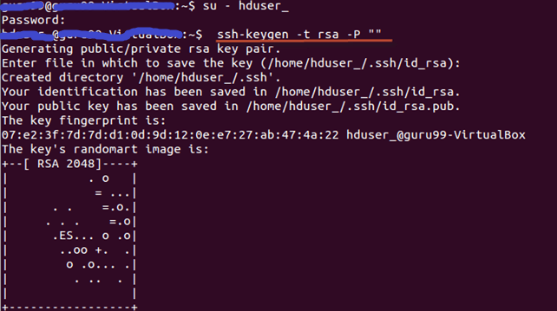
SSH Configuration With No Key Needed
Setup and manage Hadoop requires SSH installed and configured
Create a new key - ssh-keygen -t rsa -P ""
Enable SSH access to local machine using this key –
cat $HOME/.ssh/id_rsa.pub >> $HOME/.ssh/authorized_keys
Notes:
Enable SSH access to local machine using this key.
cat $HOME/.ssh/id_rsa.pub >> $HOME/.ssh/authorized_keys

Slide 6
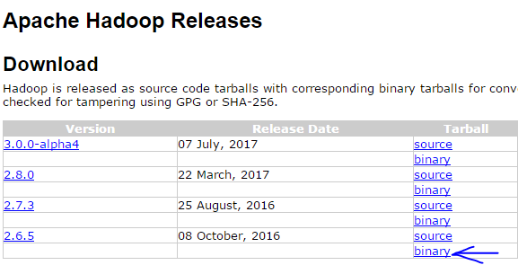
Download Hadoop
Get the binary from https://hadoop.apache.org/releases.html by browser, wget, or curl
Unzip the tar to the proper folder – sudo tar -xvf Hadoop-2.6.0.tar.gz –directory hadoop
Change ownership – sudo chown -R hduser_:hadoop_ hadoop
Add Hadoop to the PATH – vi ~/.bashrc then appending below to the file and save
Make it effective – source ~./bashrc
#Set HADOOP_HOME
export HADOOP_HOME=<Installation Directory of Hadoop>
#Set JAVA_HOME
export JAVA_HOME=<Installation Directory of Java>
# Add bin/ directory of Hadoop to PATH
export PATH=$PATH:$HADOOP_HOME/bin

Slide 7
Configure Hadoop Environment (Optional)
Set JAVA_HOME inside file $HADOOP_HOME/etc/hadoop/hadoop-env.sh
vi ${HADOOP_HOME}/etc/hadoop/hadoop-env.sh
Update below in the file (This is optional if you already have ${JAVA_HOME} available in the user profile.
# The java implementation to use
export JAVA=${JAVA_HOME}
# The java implementation to use
export JAVA=/home/hduser/Downloads/jdk1.8.0_05

Slide 8
Configure Hadoop HDFS: core-site.xml
Set hadoop.tmp.dir and fs.default.name inside file $HADOOP_HOME/etc/hadoop/core-site.xml
vi ${HADOOP_HOME}/etc/hadoop/core-site.xml, then adding below lines
Create above temp folder if it is not there
Note, master is the hostname for the namenode
<property>
<name>hadoop.tmp.dir</name>
<value>/app/hadoop/tmp</value>
<description>Parent directory for other temporary directories.</description>
</property>
<property>
<name>fs.defaultFS </name>
<value>hdfs://master:9000</value>
<description>The name of the default file system. </description>
</property>

Slide 9
Configure Hadoop HDFS: hdfs-site.xml (optional)
Set dfs.replication inside file $HADOOP_HOME/etc/hadoop/hdfs-site.xml
vi ${HADOOP_HOME}/etc/hadoop/hdfs-site.xml, then adding below lines
Note, default hadoop replication is 3
<configuration>
<property>
<name>dfs.replication</name>
<value>2</value>
</property>
</configuration>

Slide 10
Configure Hadoop Engine: mapred-site.xml
Create the configuration file - sudo cp $HADOOP_HOME/etc/hadoop/mapred-site.xml.template $HADOOP_HOME/etc/hadoop/mapred-site.xm
Edit the file by adding below.
<configuration>
<property>
<name>mapreduce.framework.name</name>
<value>yarn</value>
</property>
</configuration>

Slide 11
Configure Hadoop Engine: yarn-site.xml
Create the configuration file - sudo cp $HADOOP_HOME/etc/hadoop/yarn-site.xml.template $HADOOP_HOME/etc/hadoop/yarn-site.xm
Edit the file by adding below.
<configuration>
<property>
<name>yarn.nodemanager.aux-services</name>
<value>mapreduce_shuffle</value>
</property>
<property>
<name>yarn.nodemanager.aux-services.mapreduce.shuffle.class</name>
<value>org.apache.hadoop.mapred.ShuffleHandler</value>
</property>
<property>
<name>yarn.resourcemanager.resource-tracker.address</name>
<value>master:8025</value>
</property>
<property>
<name>yarn.resourcemanager.scheduler.address</name>
<value>master:8030</value>
</property>
<property>
<name>yarn.resourcemanager.address</name>
<value>master:8040</value>
</property>
</configuration>

Slide 12
Steps left for the Clustering Configuration – Master Node
Edit configuration file slaves (located in HADOOP_HOME/etc/hadoop/slaves) and add following entries of slave hostname:
slave01
slave02
Edit hosts file and add below entries of master and slaves - sudo vi /etc/hosts
MASTER-IP master
SLAVE01-IP slave01
SLAVE02-IP slave02

Slide 13

Steps left for the Clustering Configuration – Slaves Node
Copy the content of .ssh/id_rsa.pub (of master) and append to .ssh/authorized_keys (of all the slaves) so that you can ssh to all of the slave nodes without ssh password
Add entries in hosts file for all slaves nodes (see previous slide)
Copy all configured files from master to all the slave nodes
tar czf hadoop.tar.gz hadoop // zip all configured hadoop files in the master node
scp hadoop.tar.gz slave01:~ // scp the file from master node to all salve nodes
scp hadoop.tar.gz slave02:~ // scp the file from master node to all salve nodes
tar xzf hadoop.tar.gz –directory hadoop // scp the file from master node to all salve nodes
Then, DONE!!
Notes:
tar czf hadoop.tar.gz hadoop
scp hadoop.tar.gz slave01:~
scp hadoop.tar.gz slave02:~
tar xzf hadoop.tar.gz

Slide 14
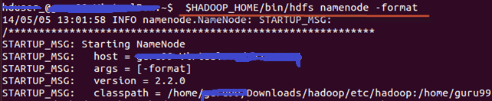
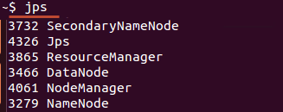
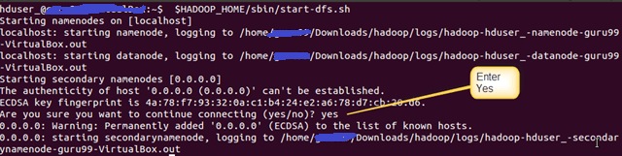

Start Hadoop Cluster
Note
Format namenode – hdfs namenode -format
Start hdfs service – start-dfs.sh
Start yarn service – start-yarn.sh
“jps” can be used to verify the service running.
//
Notes:
tar czf hadoop.tar.gz hadoop
scp hadoop.tar.gz slave01:~
scp hadoop.tar.gz slave02:~
tar xzf hadoop.tar.gz

Slide 15
Stop Hadoop Cluster
Stop yarn service – stop-yarn.sh
Stop hdfs service – stop-dfs.sh
Side notes – common web interface
Daemon | Web Interface | Notes
NameNode | http://nn_host:port/ | Default HTTP port is 50070.
ResourceManager | http://rm_host:port/ | Default HTTP port is 8088.
MapReduce JobHistory Server | http://jhs_host:port/ | Default HTTP port is 19888.

Slide 16
Further Reading
Ambari – GUI to install Hadoop (HDP) https://hortonworks.com/hadoop-tutorial/introducing-apache-ambari-deploying-managing-apache-hadoop/
Cloudera Manager – GUI to install Hadoop (CDH) https://weidongzhou.wordpress.com/2015/09/17/install-cloudera-hadoop-cluster-using-cloudera-manager/
AWS install Hadoop - http://sparkera.ca/2014/04/05/Install-CDH-In-AWS/

Slide 17
Thank You
Come and Join Us

