Slide 1
Apache Hadoop Installation
Will|PMC
Email:datafibers@gmail.com
Date: 2017-07-17

Slide 2
Prerequisites
OS installed, such as Ubuntu, CentOS, RedHat, Windows
Java installed by checking "java -version", >= 1.7
SSH installed, sudo apt-get install openssh-server
Hadoop binary – will show the download later
All command is highlighted in this way in this slide

Slide 3
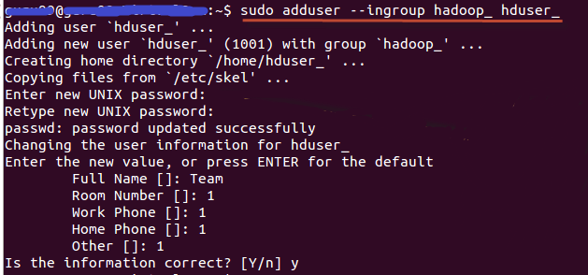
Add A Hadoop System User
Add group - sudo addgroup hadoop_
Add the user to the group - sudo adduser --ingroup hadoop_ hduser_
Note:
if there is an error in later steps, like "hduser is not in the sudoers file. This incident will be reported." Login/switch to root user, then run – sudo adduser hduser_ sudo
Notes:
sudo addgroup hadoop_
sudo adduser --ingroup hadoop_ hduser_
Enter your password , name and other details.
NOTE:
There is a possibility of below mentioned error in this setup and installation process.
"hduser is not in the sudoers file. This incident will be reported."
Hadoop Setup Tutorial - Installation & Configuration
This error can be resolved by
Login as a root user
Hadoop Setup Tutorial - Installation & Configuration
Execute the command
sudo adduser hduser_ sudo
Hadoop Setup Tutorial - Installation & Configuration
Re-login as hduser_

Slide 4
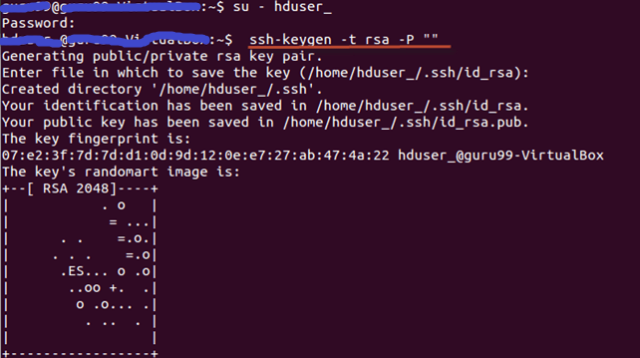
SSH Configuration With No Key Needed
Setup and manage Hadoop requires SSH installed and configured
Create a new key - ssh-keygen -t rsa -P ""
Enable SSH access to local machine using this key –
cat $HOME/.ssh/id_rsa.pub >> $HOME/.ssh/authorized_keys
Notes:
Enable SSH access to local machine using this key.
cat $HOME/.ssh/id_rsa.pub >> $HOME/.ssh/authorized_keys

Slide 5
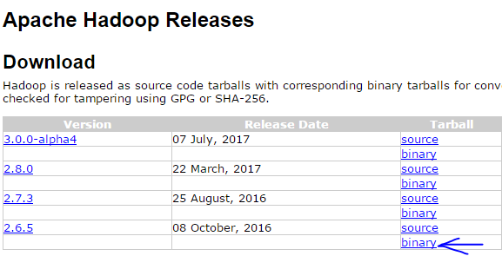
Download Hadoop
Get the binary from https://hadoop.apache.org/releases.html by browser, wget, or curl
Unzip the tar to the proper folder – sudo tar -xvf Hadoop-2.6.0.tar.gz --directory Hadoop
Change ownership – sudo chown -R hduser_:hadoop_ hadoop
Add Hadoop to the PATH – vi ~/.bashrc then appending below to the file and save
Make it effective – source ~./bashrc
#Set HADOOP_HOME
export HADOOP_HOME=<Installation Directory of Hadoop>
#Set JAVA_HOME
export JAVA_HOME=<Installation Directory of Java>
# Add bin/ directory of Hadoop to PATH
export PATH=$PATH:$HADOOP_HOME/bin

Slide 6
Hadoop Supported Running Mode
Local (Standalone) Mode - By default, Hadoop is configured to run in a non-distributed mode, as a single Java process. This is useful for debugging and no need to configure.
Pseudo-Distributed Mode - Hadoop can also be run on a single-node in a pseudo-distributed mode where each Hadoop daemon runs in a separate Java process. This tutorial will start the installation steps from this mode.
Fully-Distributed Mode - Hadoop can be run on a multiple-node in a fully-distributed mode where each Hadoop daemon runs in a separate physical node. This tutorial will also cover the installation steps for this mode at the end.

Slide 7
Configure Hadoop Environment (Optional)
Set JAVA_HOME inside file $HADOOP_HOME/etc/hadoop/hadoop-env.sh
vi ${HADOOP_HOME}/etc/hadoop/hadoop-env.sh
Update below in the file (This is optional if you already have ${JAVA_HOME} available in the user profile.
# The java implementation to use
export JAVA=${JAVA_HOME}
# The java implementation to use
export JAVA=/home/hduser/Downloads/jdk1.8.0_05

Slide 8
Configure Hadoop HDFS: core-site.xml
Set hadoop.tmp.dir and fs.default.name inside file $HADOOP_HOME/etc/hadoop/core-site.xml
vi ${HADOOP_HOME}/etc/hadoop/core-site.xml, then adding below lines
Create above temp folder if it is not there
Note, master is the hostname for the namenode
<property>
<name>hadoop.tmp.dir</name>
<value>/app/hadoop/tmp</value>
<description>Parent directory for other temporary directories.</description>
</property>
<property>
<name>fs.defaultFS </name>
<value>hdfs://master:9000</value>
<description>The name of the default file system. </description>
</property>

Slide 9
Configure Hadoop HDFS: hdfs-site.xml (optional)
Set dfs.replication inside file $HADOOP_HOME/etc/hadoop/hdfs-site.xml
vi ${HADOOP_HOME}/etc/hadoop/hdfs-site.xml, then adding below lines
Note, default hadoop replication is 3
<configuration>
<property>
<name>dfs.replication</name>
<value>2</value>
</property>
</configuration>

Slide 10
Configure Hadoop Engine: mapred-site.xml
Create the configuration file - sudo cp $HADOOP_HOME/etc/hadoop/mapred-site.xml.template $HADOOP_HOME/etc/hadoop/mapred-site.xm
Edit the file by adding below.
Note, job tracker information can be override or set as well
<configuration>
<property>
<name>mapreduce.framework.name</name>
<value>yarn</value>
</property>
</configuration>

Slide 11
Configure Hadoop Engine: yarn-site.xml
Create the configuration file - sudo cp $HADOOP_HOME/etc/hadoop/yarn-site.xml.template $HADOOP_HOME/etc/hadoop/yarn-site.xm
Edit the file by adding below.
<configuration>
<property>
<name>yarn.nodemanager.aux-services</name>
<value>mapreduce_shuffle</value>
</property>
<property>
<name>yarn.nodemanager.aux-services.mapreduce.shuffle.class</name>
<value>org.apache.hadoop.mapred.ShuffleHandler</value>
</property>
<property>
<name>yarn.resourcemanager.resource-tracker.address</name>
<value>master:8025</value>
</property>
<property>
<name>yarn.resourcemanager.scheduler.address</name>
<value>master:8030</value>
</property>
<property>
<name>yarn.resourcemanager.address</name>
<value>master:8040</value>
</property>
</configuration>

Slide 12
Steps left for the Clustering Configuration – Master Node
Copy the content of .ssh/id_rsa.pub (of master) and append to .ssh/authorized_keys (of all the slaves as well as master) so that you can ssh to slave nodes without ssh password
Edit configuration file slaves (located in HADOOP_HOME/etc/hadoop) and add following entries of slave hostname:
slave01
slave02
Edit hosts file and add below entries of master and slaves - sudo nano /etc/hosts
MASTER-IP master
SLAVE01-IP slave01
SLAVE02-IP slave02

Slide 13

Steps left for the Clustering Configuration – Slaves Node
Add entries in hosts file for all slaves nodes (see previous slide)
Copy all configured files from master to all the slave nodes
tar czf hadoop.tar.gz hadoop // zip all configured hadoop files in the master node
scp hadoop.tar.gz slave01:~ // scp the file from master node to all salve nodes
scp hadoop.tar.gz slave02:~ // scp the file from master node to all salve nodes
tar xzf hadoop.tar.gz –directory hadoop // scp the file from master node to all salve nodes
Then, DONE!!
Notes:
tar czf hadoop.tar.gz hadoop
scp hadoop.tar.gz slave01:~
scp hadoop.tar.gz slave02:~
tar xzf hadoop.tar.gz

Slide 14
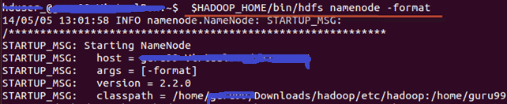
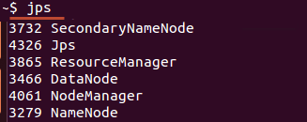
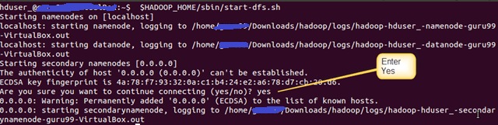

Start Hadoop Cluster
Format namenode – hdfs namenode -format
Start hdfs service – start-dfs.sh
Start yarn service – start-yarn.sh
“jps” can be used to verify the service running.
//
Notes:
tar czf hadoop.tar.gz hadoop
scp hadoop.tar.gz slave01:~
scp hadoop.tar.gz slave02:~
tar xzf hadoop.tar.gz

Slide 15
Stop Hadoop Cluster
Stop yarn service – stop-yarn.sh
Stop hdfs service – stop-dfs.sh
Side notes – common web interface
Daemon | Web Interface | Notes
NameNode | http://nn_host:port/ | Default HTTP port is 50070.
ResourceManager | http://rm_host:port/ | Default HTTP port is 8088.
MapReduce JobHistory Server | http://jhs_host:port/ | Default HTTP port is 19888.

Slide 16
Further Reading
Ambari – GUI to install Hadoop (HDP) https://hortonworks.com/hadoop-tutorial/introducing-apache-ambari-deploying-managing-apache-hadoop/
Cloudera Manager – GUI to install Hadoop (CDH) https://weidongzhou.wordpress.com/2015/09/17/install-cloudera-hadoop-cluster-using-cloudera-manager/
AWS install Hadoop - http://sparkera.ca/2014/04/05/Install-CDH-In-AWS/

Slide 17
Thank You
Come and Join Us

